Slide 1
What Does the Design of a CAR T-cell Therapy Say About Its Efficacy and Toxicity Profile?
Adam D. Cohen, MD
Associate Professor, Medicine
Director, Myeloma Immunotherapy
University of Pennsylvania
Philadelphia, PA

Slide 2
Disclaimer
The views and opinions expressed in this educational activity are those of the faculty and do not necessarily represent the views of TotalCME, Inc., the CME providers, or the companies providing educational grants. This presentation is not intended to define an exclusive course of patient management; the participant should use their clinical judgment, knowledge, experience, and diagnostic skills in applying or adopting for professional use any of the information provided herein. Any procedures, medications, or other courses of diagnosis or treatment discussed or suggested in this activity should not be used by clinicians without evaluation of their patient's conditions and possible contraindications or dangers in use, review of any applicable manufacturer’s product information, and comparison with recommendations of other authorities. Links to other sites may be provided as additional sources of information.

Slide 3
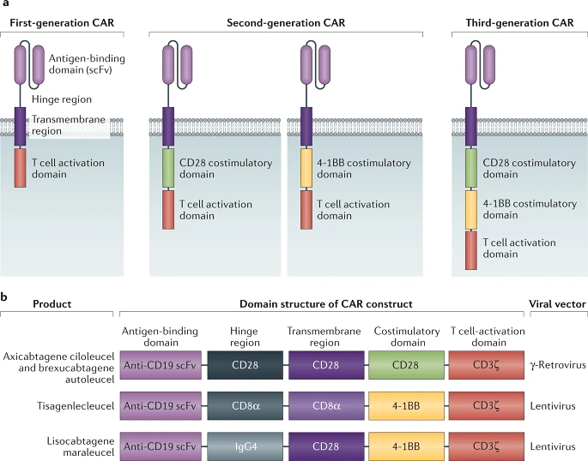
Components of a CAR T-cell Product
Source of T-cells
CAR construct
  Binding domain, hinge/transmembrane region, co-stimulatory domain, signaling domain
Manufacturing method
Transduction method
Lymphodepletion
Dose

Slide 4
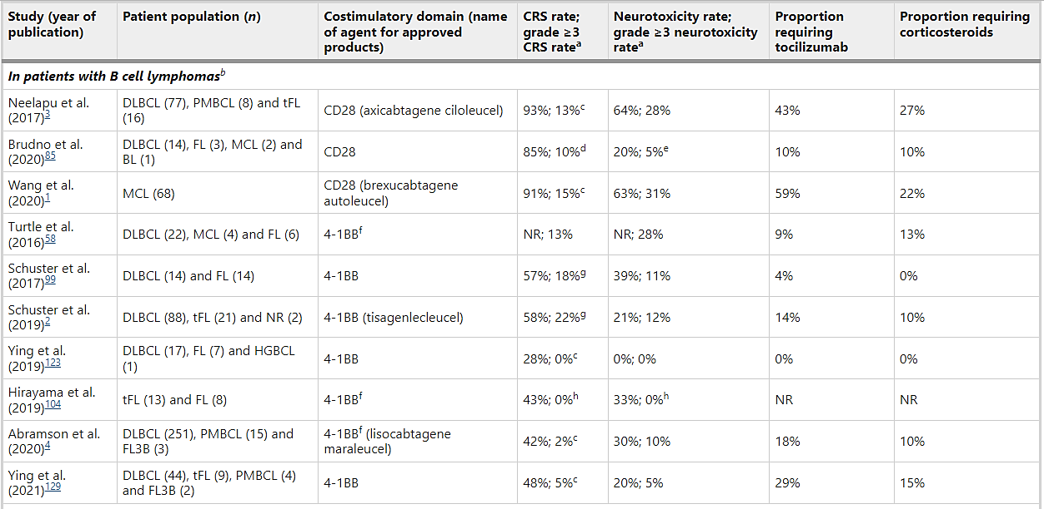
Costimulatory Domains: CD28 vs 4-1BB

Slide 5
Costimulatory Domains: CD28 vs 4-1BB

Slide 6
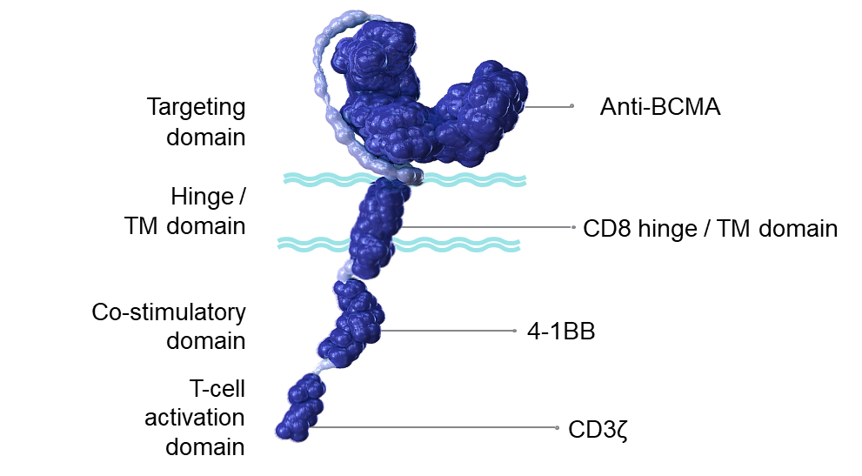
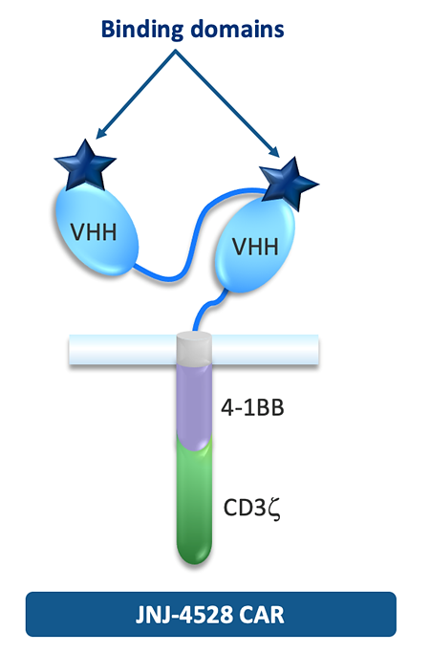
BCMA CAR T-cells: Binding Domains
idecabtagene vicleucel
(ide-cel)
ciltacabtagene autoleucel
(cilta-cel)

Slide 7
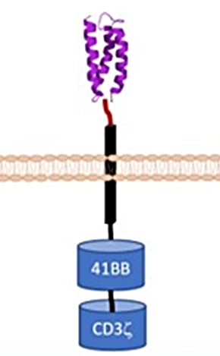
BCMA CAR T-cells: Binding Domains
idecabtagene vicleucel
(ide-cel)
ciltacabtagene autoleucel
(cilta-cel)
CAR T-ddBCMA
D-Domain
(8kDa)

Slide 8
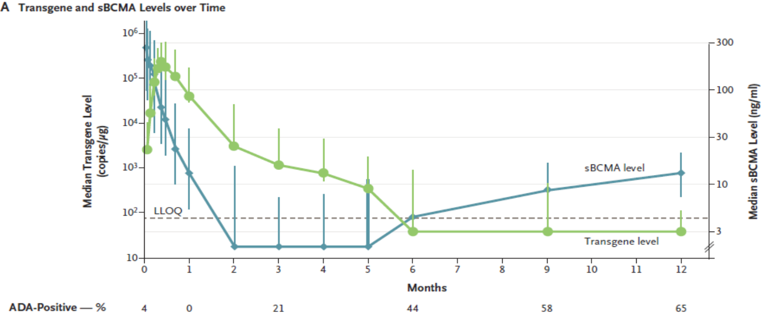
BCMA CAR T-cells: Binding Domains
Both ide-cel and cilta-cel are immunogenic
  Limits persistence → unclear if impacts efficacy
  Await ongoing studies with fully human and synthetic binding domains
ide-cel
cilta-cel

Slide 9
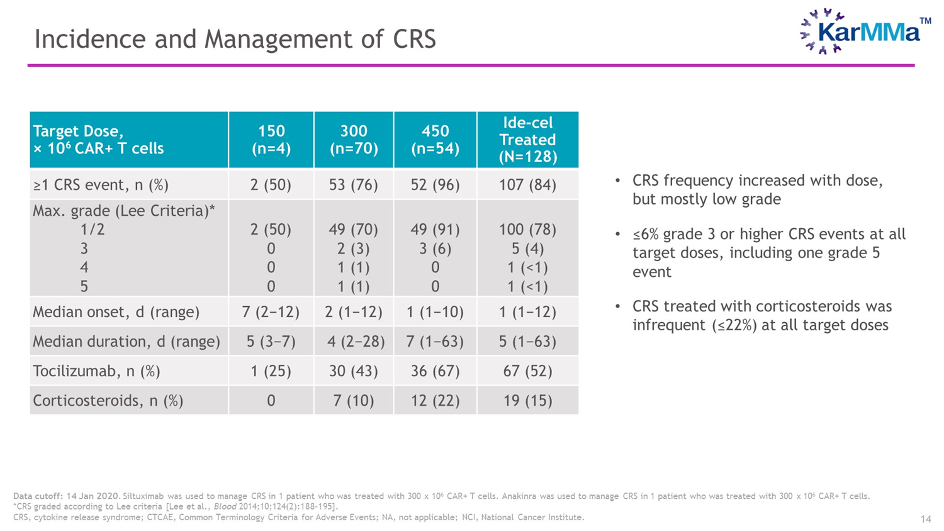
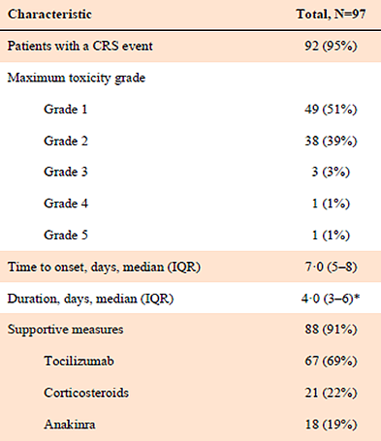
BCMA CAR T-cell Toxicities: Cytokine Release Syndrome
ide-cel
cilta-cel

Slide 10
BCMA CAR T-cell Toxicities: Cytokine Release Syndrome
ide-cel
cilta-cel

Slide 11
BCMA CAR T-cell Toxicities: Cytokine Release Syndrome
ide-cel
cilta-cel

Slide 12
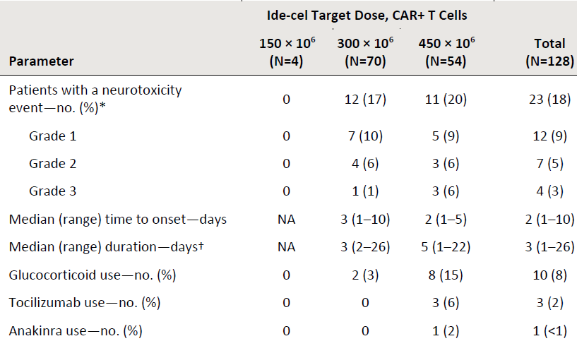
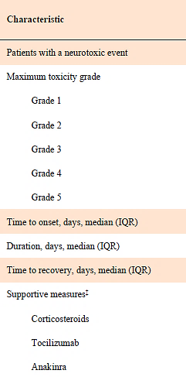
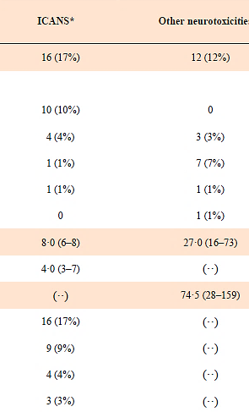
BCMA CAR T-cell Toxicities: Neurotoxicity
ide-cel
cilta-cel

Slide 13
BCMA CAR T-cell Toxicities: Neurotoxicity
ide-cel
cilta-cel

Slide 14
BCMA CAR T-cell Toxicities: Neurotoxicity
ide-cel
cilta-cel
Any neurotox = 21% (n = 20)
Gr 3-5 = 9% (n = 9)

Slide 15
CAR T-cell Product Design: Take Home Points
Multiple variables distinguish each CAR T cell product
Co-stimulatory domains (CD28 vs 4-1BB) may impact toxicity rates with CD19 directed CAR Ts in lymphoma
BCMA CAR T cells in myeloma
  Both approved products use 4-1BB domains
  Different binding domains and manufacturing techniques
    Unclear impact on efficacy and toxicity
  Lower dose of cilta-cel vs ide-cel may explain different timing of CRS onset
    Median Day 7 (cilta-cel) vs Day 1 (ide-cel)

