Slide 1
Muscarinic Cholinergic M1/M4 Stimulation: What Is the Role of Muscarinic Agents for the Treatment of Schizophrenia?
Jonathan M. Meyer, MD
Voluntary Clinical Professor, Department of Psychiatry
University of California San Diego
La Jolla, CA

Slide 2
Disclaimer
The views and opinions expressed in this educational activity are those of the faculty and do not necessarily represent the views of TotalCME, Inc., the CME providers, or the companies providing educational grants. This presentation is not intended to define an exclusive course of patient management; the participant should use their clinical judgment, knowledge, experience, and diagnostic skills in applying or adopting for professional use any of the information provided herein. Any procedures, medications, or other courses of diagnosis or treatment discussed or suggested in this activity should not be used by clinicians without evaluation of their patient's conditions and possible contraindications or dangers in use, review of any applicable manufacturer’s product information, and comparison with recommendations of other authorities. Links to other sites may be provided as additional sources of information.

Slide 3



Resource Information
About This Resource
These slides are one component of a continuing education program available online at MedEd On The Go titled Schizophrenia: A Promising Treatment Era Dawns
Program Learning Objectives:
Explain how the limitations associated with conventional treatments for SCZ have resulted in excessive burdens for patients and their caregivers, which contribute to poor outcomes
Outline the safety and efficacy profiles, limitations, and barriers associated with using conventional dopamine-centric antipsychotics approved for the treatment of SCZ
Describe the latest advances in SCZ research related to the cellular and molecular pathways underlying SCZ
Differentiate between emerging TAAR1 agonists versus muscarinic and serotonergic-based therapies in terms of the pharmacodynamics as well as efficacy and safety data from clinical trials
MedEd On The Go®
www.mededonthego.com
This content or portions thereof may not be published, posted online or used in presentations without permission.
This content can be saved for personal use (non-commercial use only) with credit given to the resource authors.
To contact us regarding inaccuracies, omissions or permissions please email us at support@MedEdOTG.com

Slide 4
A Crack in the Postsynaptic Dopamine Edifice:
The Unexpected Human Findings from LY246708
1992: A novel compound LY246708 is synthesized by Eli Lilly and characterized initially as a selective M₁ agonist (M₄ and M₅ cloned receptors not yet being available). The intent was to develop a procognitive agent for dementia of the Alzheimer type. It had no D₂ binding
1997: Results of a large study (n=343) of patients with mild to moderate Alzheimer disease published
  Method: Patients randomized in a double-blind manner to LY246708 (now called xanomeline) 75 mg/d, 150 mg/d or 225 mg/d or placebo and followed up to 6 months
  Cognitive results: Patients in the high-dose arm (225 mg/d) had superior endpoint scores on the ADAS-Cog versus placebo (P <0.05)
  Behavioral results: Significant dose-dependent reductions in vocal outbursts, suspiciousness, delusions, agitation, and hallucinations
  Tolerability: 52% D/C due to dose-dependent AEs, mostly gastrointestinal. Syncope seen in 12.6% in high-dose group
ADAS-Cog, Alzheimer's Disease Assessment Scale-Cognitive Subscale; AE, adverse event; D/C, discontinue; D2, dopamine receptor, type 2; GI, gastrointestinal.
Bodick NC, et al. Arch Neurol. 1997;54(4):465-473; Bymaster FP, et al. J Pharmacol Exp Ther. 1994;269(1):282-289; Sauerberg P, et al. J Med Chem. 1992;35(12):2274-2283; Shannon HE, et al. J Pharmacol Exp Ther. 1994;269(1):271-281.

Slide 5
Xanomeline In Vitro Binding and Functional Activity
Receptor binding is nonselective; functional effects are much more selective with much higher intrinsic activity
at M₁/M₄ receptors
(red arrows)
Receptor | Affinity Ki (nM) * | PI/cAMP EC₅₀ nM (% E_{max}) **
M₁ | 6.5 | 355 (80%) [PI]
M₂ | 8 | 2500 (46%) [cAMP]
M₃ | 7.1 | 1235 (22%) [PI]
M₄ | 29 | 125 (96%) [cAMP]
M₅ | 9 | 7500 (59%) [PI]
*Bonifazi A, et al. J Med Chem. 2014;57(4):9065-9077; **Bymaster F, et al. Drug Dev Res. 1997;40(2):158-170.
cAMP, cyclic AMP production; EC5, concentration that produces 50% of the maximal effect; Emax, maximal efficacy; PI, phosphoinositol turnover.

Slide 6

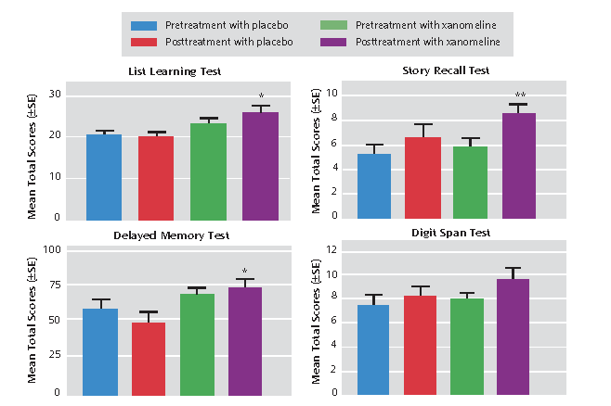
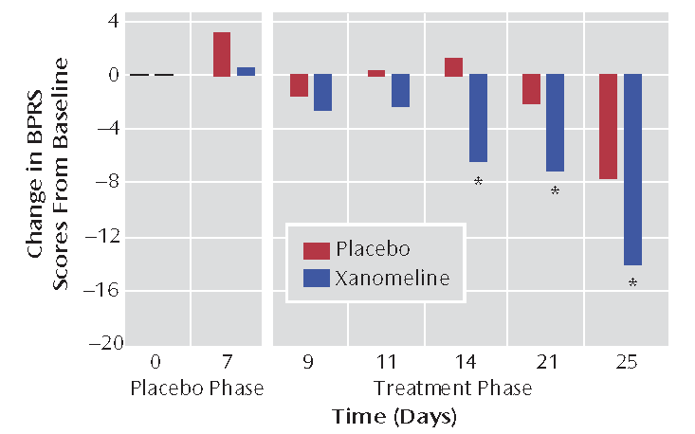
2008 Pilot Study: Xanomeline Versus Placebo
Method: Double-blind, placebo-controlled, 4-week inpatient trial of xanomeline
Dosing: Xanomeline started at 25 mg TID, increased every 2 days by 75 mg/d to 75 mg TID (if tolerated)
Subjects: Adults with an acute exacerbation of schizophrenia or schizoaffective disorder, PANSS >60 with at least one positive item ≥4 or 2 items ≥3
Completion: 8/10 xanomeline; 7/10 placebo. All dropouts were due to lack of efficacy, none due to Aes
Symptoms: Significant differences over last 2 weeks of the study on BPRS
Cognition: Significant differences on several tests
BPRS, Brief Psychiatric Rating Scale; PANSS, Positive and Negative Syndrome Scale; TID, three times a day.
Shekhar A, et al. Am J Psych. 2008;165(8):1033-1039.

Slide 7
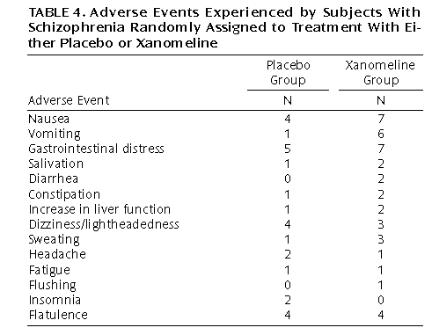
2008 Pilot Study: Xanomeline Versus Placebo
Tolerability comments:
Unlike the Alzheimer study done a decade prior, these patients were much younger, and xanomeline was titrated over 6 days to the target dose of 225 mg/d (dosed as 75 mg TID)
None of the dropouts were due to adverse effects
AEs: The pattern was consistent with known muscarinic M₁ receptor agonist effects. Although nausea was numerically more frequent in the xanomeline group, only 10% of placebo patients experienced emesis versus 60% of xanomeline-treated patients
Shekhar A, et al. Am J Psych. 2008;165(8):1033-1039.

Slide 8
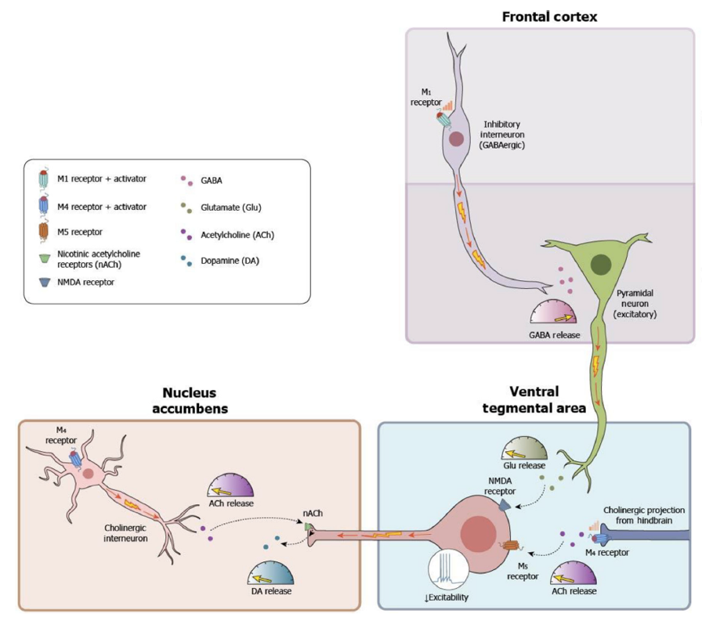
How M₁/M₄ Agonists Control Dopamine Circuits and Modulate Presynaptic VTA Dopamine Release
Concept 1: Local regulation in the striatum
VTA neurons have muscarinic receptors on their cell bodies. These receptors receive ACh input from the midbrain LDT pathway. Cholinergic stimulation of VTA neurons increases DA release
LDT ACh release is modulated by the M₄ autoreceptor. Stimulation of M₄ autoreceptors on the LDT decreases ACh release.
Net effect: Decreased VTA neuron firing and less VTA DA release
Selectivity: The decreased DA outflow from M₄ stimulation occurs selectively in striatal areas related to psychosis, not in motor systems that are controlled more by M₂ autoreceptors
GABA, gamma aminobutyric acid; LDT, laterodorsal tegmental nuclei; NMDA, N-methyl-D-aspartate; VTA, ventral tegmental area.
Paul SM, et al. Am J Psych. 2022;179(9):611-627; Yohn SE, et al. Trends Pharmacol Sci. 2022;43(12):1098-1112.

Slide 9
How M₁/M₄ Agonists Control Dopamine Circuits and Modulate Presynaptic VTA Dopamine Release
Concept 2: Top-down regulation
GABAergic inhibitory interneurons control glutamate release from excitatory PFC pyramidal neurons. These glutamate neurons have downstream projections to the VTA that stimulate DA release
Stimulation of M₁ receptors on GABAergic inhibitory interneurons inhibits pyramidal cell glutamate release
  Net effect: Decreased VTA neuron firing and less VTA DA release but no motor effects
PFC, prefrontal cortex.
Paul SM, et al. Am J Psych. 2022;179(9):611-627; Yohn SE, et al. Trends Pharmacol Sci. 2022;43(12):1098-1112.

Slide 10
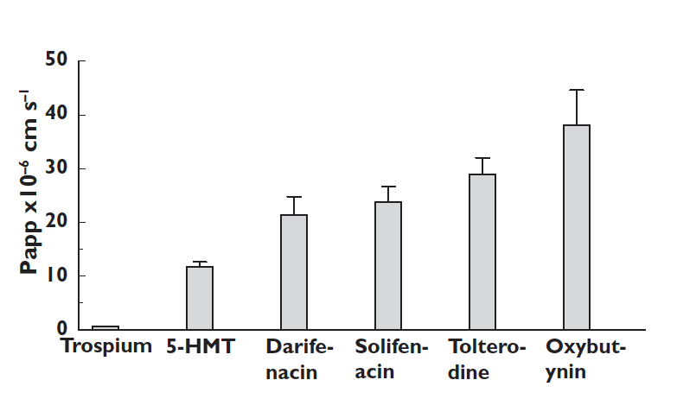
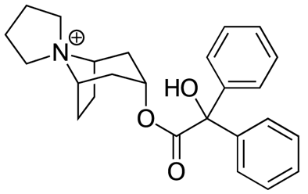
Managing the Peripheral Procholinergic Effects of Xanomeline
Issue: Xanomeline induces peripheral adverse effects, primarily related to M₁ agonism
The answer: Find an anticholinergic with limited CNS penetration to mitigate xanomeline's peripheral effects
The winner: Trospium! Found after screening hundreds of compounds
What is trospium: A nonselective muscarinic antagonist available since 1974 for overactive bladder (approved in 2004 in the US)
Figure:
Trospium is a quaternary ammonium compound. The positively charged ammonium group makes trospium too polar to cross the BBB
Passive diffusion across cloned kidney cells as a model for BBB penetration
5-HMT, 5-hydroxymethyl tolterodine; BBB, blood-brain barrier; CNS, central nervous system.
Callegari E, et al. Br J Clin Pharmacol. 2011;72(2):235–246; Chancellor MB, et al. Drugs Aging. 2012;29(4):259-273; Duong V, et al. Int Urogynecol J. 2021;32(10):2693-2702; Malcher MF, et al. J Urol. 2022;208(4):863-871.

Slide 11
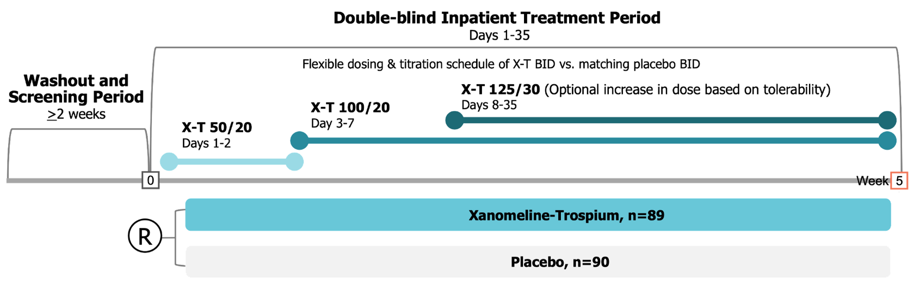
EMERGENT-1 Phase 2 Clinical Trial Design
5-week double-blind, placebo-controlled inpatient trial
Adults ages 18 to 60 with an acute exacerbation of schizophrenia
Mean age 42.5 years, 70% male, 76% racial & ethnic minority groups, mean baseline PANSS 97.1
91% were able to tolerate titration the highest dose of xanomeline-trospium
BID, twice a day; X-T, xanomeline-trospium.
Brannan SK, et al. N Engl J Med. 2021;384(8):717-726.

Slide 12
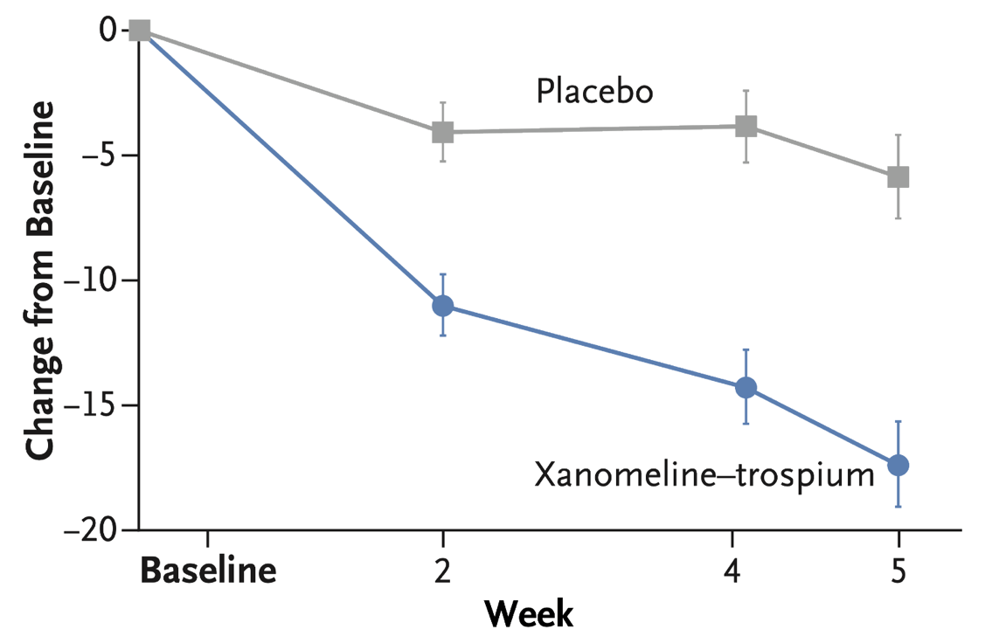
Xanomeline-Trospium Phase 2b Results: PANSS Total Score
X-T: -17.4 ± 1.8 pts
PBO: -5.9 ± 1.7 pts
(P <0.001)
Effect size: 0.75
PBO, placebo.
Brannan SK, et al. N Engl J Med. 2021;384(8):717-726.

Slide 13
Xanomeline-Trospium Phase 2 Tolerability Data
Adverse effects occurring in >2% of X-T and greater than placebo
 | X-T (n=89) | PBO (n=90)
Any AE | 48 (54%) | 39 (43%)
Serious AE | 1 (1%) | 0
Severe AE | 1 (1%) | 1 (1%)
Discontinuations | 18 (20%) | 19 (21%)
AE leading to D/C | 2 (2%) | 2 (2%)
 | X-T | PBO
Constipation | 15 (17%) | 3 (3%)
Nausea | 15 (17%) | 4 (4%)
Dry mouth | 8 (9%) | 1 (1%)
Dyspepsia | 8 (9%) | 4 (4%)
Vomiting | 8 (9%) | 4 (4%)
Headache | 6 (7%) | 5 (6%)
Somnolence | 5 (6%) | 4 (4%)
Akathisia | 3 (3%) | 0
Tachycardia | 3 (3%) | 2 (2%)
Weight Changes
Mean change in weight | 3.3 lb±6.2 | 2.4 lb±7.7
≥7% increase in weight | 2 (2.2%) | 5 (5.6%)
There were no discontinuations due to cholinergic or anticholinergic AEs
Incidence of movement disorders and Q-T_{C} changes similar for X-T versus PBO
Brannan SK, et al. N Engl J Med. 2021;384(8):717-726

Slide 14
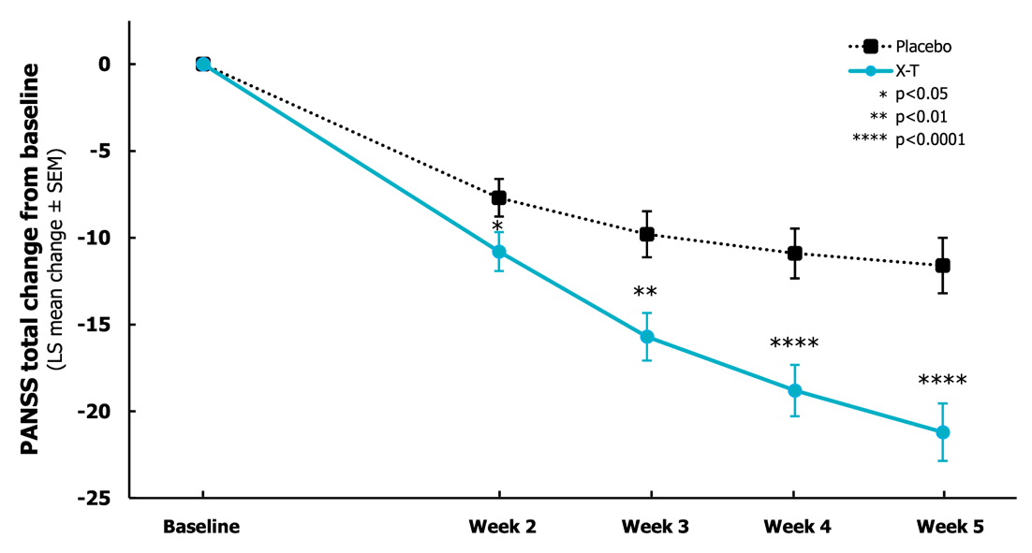
EMERGENT-2 Phase 3 Trial Results: PANSS Total Score
5-week, double-blind, placebo-controlled inpatient trial
Adults aged 18 to 65 with an acute exacerbation of schizophrenia
Mean age 45.6 years, 75% male, 77.4% racial & ethnic minority groups, mean baseline PANSS 98.1
X-T: -21.2 pts
PBO: -11.6 pts
P <0.001
Effect size: 0.61
Overall discontinuation rates:
25% X-T
21% PBO
Discontinuation related to AEs:
7% X-T
6% PBO
Paul S, et al. ACNP Annual Meeting 2022.

Slide 15
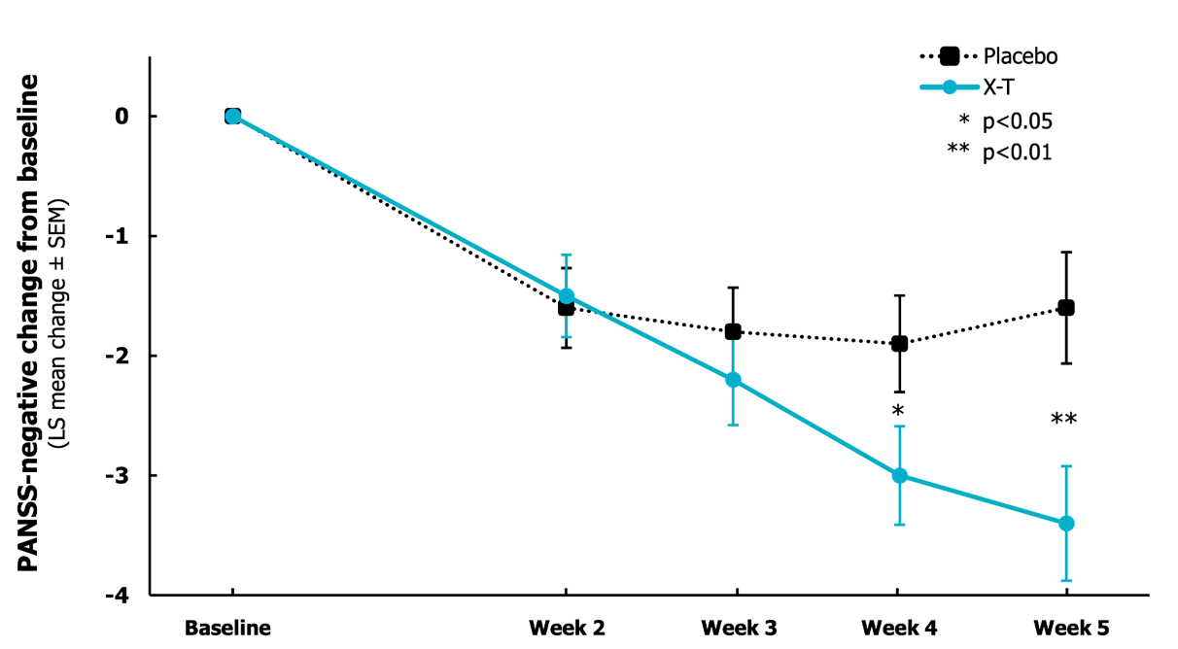
EMERGENT-2 Phase 3 Results: PANSS Negative Symptoms
X-T: -3.4 pts
PBO: -1.6 pts
Difference: -1.8
(P <0.01)
LS, least squares; SEM, standard error of the mean.
Paul S, et al. ACNP Annual Meeting 2022.

Slide 16
Muscarinic Agonism for Psychosis Rediscovered
Agents in development include the following mechanisms:
Positive allosteric modulators of M₁ receptors (VU0486846) or M₁ receptor agonism
Positive allosteric modulators of M₄ receptors (eg, emraclidine) or M₄ receptor agonism (NBI-1117568)
Bertron JL, et al. Bioorg Med Chem Lett. 2018;28(12):2175-2179; clinicaltrials.gov; accessed 02/21/2023; Krystal JH, et al. Lancet. 2022;400(10369):2210-2220; Moran SP, et al. Neuropsychopharmacology. 2018;43(8):1763-1771; Yohn SE, et al. Neuropharmacology. 2018;136(Pt C):438-448.

Slide 17



Looking for more resources
on this topic?
CME/CE in minutes
Congress highlights
Late-breaking data
Quizzes
Webinars
In-person events
Slides & resources
www.MedEdOTG.com

