Slide 1
Not Just Dopamine: An Overview of Neurotransmitters and Circuits Implicated in Schizophrenia
Leslie Citrome, MD, MPH
Clinical Professor of Psychiatry and Behavioral Sciences
New York Medical College
Valhalla, NY

Slide 2
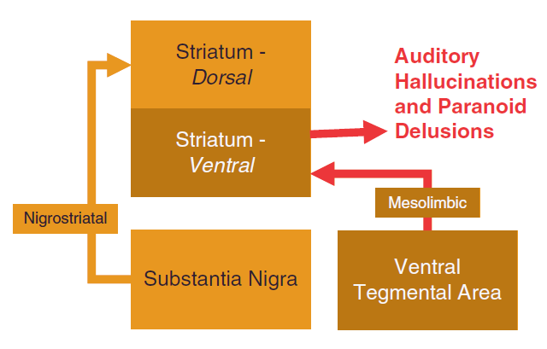
Schizophrenia: The Classical Dopamine Story
For over 50 years, psychosis, particularly auditory hallucinations and paranoid delusions, has been thought to be the result of hyperactivation of the dopaminergic mesolimbic pathway
The mesolimbic pathway projects from the ventral tegmental area (VTA) to the ventral striatum
The dorsal striatum is not thought to be affected by this hyperactivity because it is innervated via the nigrostriatal pathway from the substantia nigra and controls motor movements
Stahl SM. CNS Spectr. 2018;23(3):187-191.

Slide 3
The New Dopamine System, Based on Human Data
Classic Mesolimbic Hyperdopaminergia
New Concept: Integrative Hub Mesostriatal Hyperdopaminergia
Neuroimaging data suggest that dopaminergic activity may be unaltered in the ventral striatum but may instead be overactive in an intermediate part of the striatum called the associative striatum, which receives input from the substantia nigra rather than the VTA
McCutcheon RA, et al. Trends Neurosci. 2019;42(3):205-220; Stahl SM. Stahl's Essential Psychopharmacology: Neuroscientific Basis and Practical Applications. 5th ed. Cambridge University Press; 2021.

Slide 4
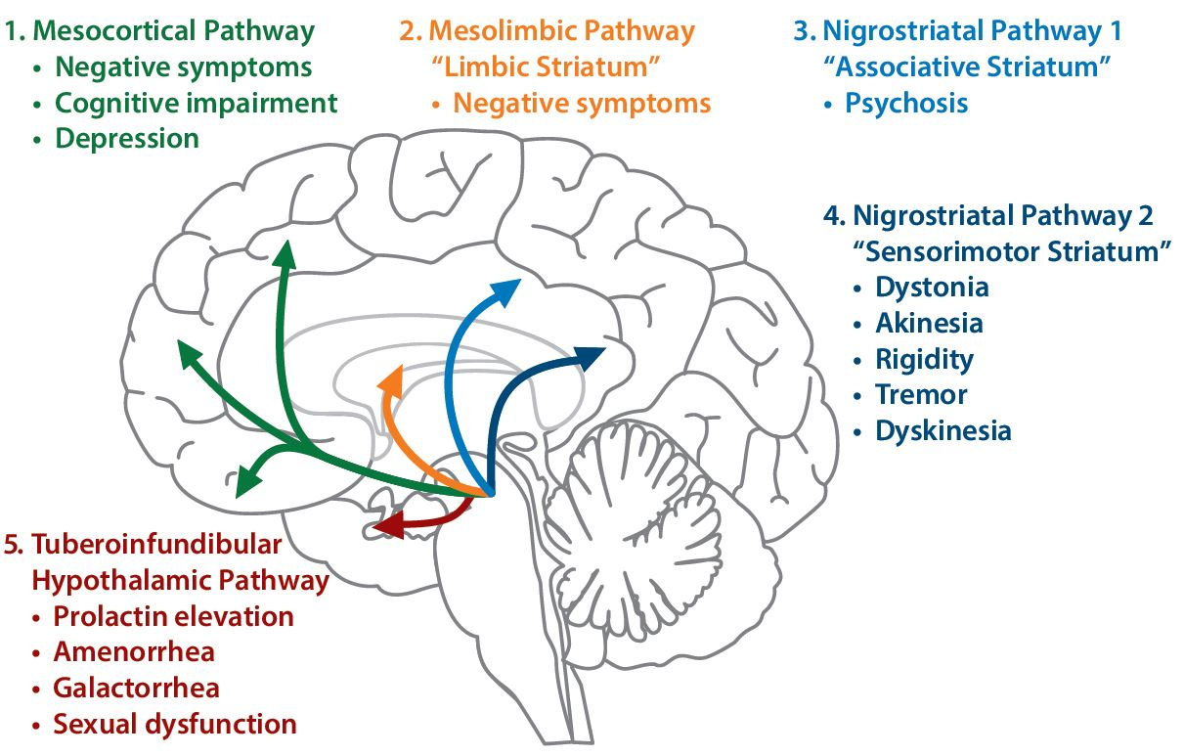
Schizophrenia: The New Dopamine Story
The mesocortical pathway originates from the ventral tegmental area in the midbrain and innervates areas of the frontal cortex
The mesolimbic pathway originates from the ventral tegmental area in the midbrain and innervates the ventral striatum, olfactory tubercle, and parts of the limbic system
The nigrostriatal pathway 1 originates in the substantia nigra and innervates the associative striatum
The nigrostriatal pathway 2 originates in the substantia nigra and innervates the sensorimotor striatum
The tuberoinfundibular hypothalamic pathway projects from the hypothalamus to the anterior pituitary gland
Correll CU, et al. J Clin Psychiatry. 2022;83(1):SU21204IP1.

Slide 5
Collateral Damage by Blocking Postsynaptic Dopamine D₂ Receptors
Postsynaptic dopamine D₂ receptors are also blocked in the dorsal striatum, causing drug-induced extrapyramidal side effects or movement disorders
Subsequent upregulation of these receptors in the dorsal striatum leads to tardive dyskinesia
Postsynaptic dopamine D₂ receptors are also blocked in the hypothalamic-pituitary pathway, causing hyperprolactinemia
Volavka J, Citrome L. Expert Opin Pharmacother. 2009;10(12):1917-1928.

Slide 6
Schizophrenia: What About Glutamate?
Psychosis in schizophrenia may be the result of hypofunctional NMDA receptors on GABA interneurons in the cerebral cortex
This hypofunction may lead to overactivation of downstream glutamate signaling
Overactivation of this pathway may result in turn in excess dopamine, resulting in psychosis
Fun fact: clozapine has glycine transport inhibition properties, potentially rendering a hypofunctioning NMDA receptor more active
The NMDA Receptor Complex
Ca, calcium; GABA, γ-aminobutyric acid; GLY, glycine; Mg, magnesium; NMDA, N-methyl-D-aspartate; PCP, phencyclidine. Javitt DC, et al. Mol Psychiatry. 2005;10(3):275-287; Javitt DC, et al. Primary Psychiatry. 2006;13(10):38-46; Stahl SM. CNS Spectr. 2018;23(3):187-191.

Slide 7
Schizophrenia: All Roads Lead to Dopamine, But Can We Leverage Glutamate and Serotonin?
Can block dopamine receptors directly and treat psychotic symptoms
This is how we believe ALL currently available antipsychotics work
Can modulate the glutamatergic pathway, and hence modulate dopamine
In theory, yes
In reality, NMDA and other glutamate receptor modulators have failed in trials of the treatment of schizophrenia, but efforts remain ongoing for cognition (iclepertin)
Can antagonize serotonin 5HT2A receptors
Almost all SGAs already do this, in combination with at least some D2 receptor antagonism; there is a new SGA, lumateperone, which builds on this
Pimavanserin, a 5HT2A/5HT2C antagonist/inverse agonist, can treat Parkinson disease psychosis, is being studied for dementia-related psychosis, and has been used to augment antipsychotic response in schizophrenia (and its manufacturer is working more on this)
SGA, second-generation antipsychotic.
Kantrowitz JT. CNS Drugs. 2020;34(9):947-959; McCutcheon RA, et al. World Psychiatry. 2020;19(1):15-33.

Slide 8
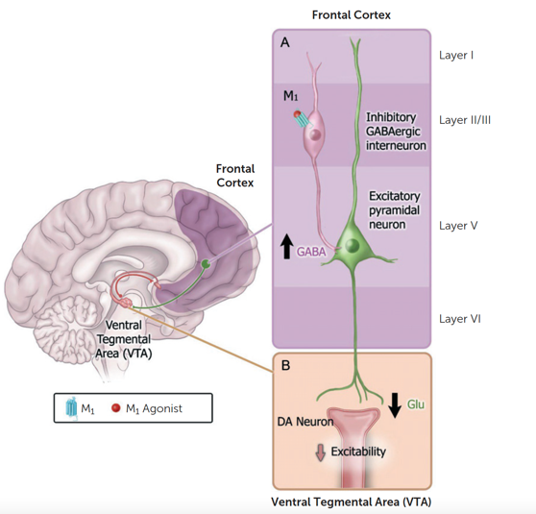
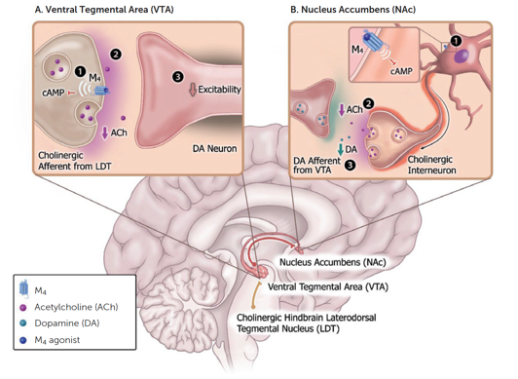
Muscarinic Cholinergic Hypothesis of Schizophrenia
Procholinergic drugs were observed to increase “lucid intervals” in patients with psychosis in the 1950s but were not well tolerated; further development was abandoned, until now
Cholinergic systems directly modulate striatal dopaminergic function in areas associated with positive symptoms of schizophrenia and also regulate descending glutamate pathways that interact with striatal dopamine circuits
Postmortem studies show reductions in M1 and M4 receptor expression in brain regions implicated in schizophrenia. 25% of patients have ≥75% reduction in M1 receptor expression
M1/M4 receptor knockout models replicate the phenotype of schizophrenia in mice, and muscarinic agonists, especially for M4, improve positive and negative symptoms of schizophrenia in mice and humans
M1 Muscarinic Receptors:
“Top-Down” Control
M4 Muscarinic Receptors:
“Bottom-Up” Control
Brannan SK, et al. N Engl J Med. 2021;384(8):717-726; Dean B, et al. Psychiatry Res. 2020;288:112989; Kruse AC, et al. Nat Rev Drug Discov. 2014;13(7):549-560; Matsumoto I, et al. Neurosci Lett. 2005;379(3):164-168; Paul SM, et al. Am J Psychiatry. 2022;179(9):611-627; Pfeiffer CC, et al. Ann N Y Acad Sci. 1957;66(3):753-764.

Slide 9
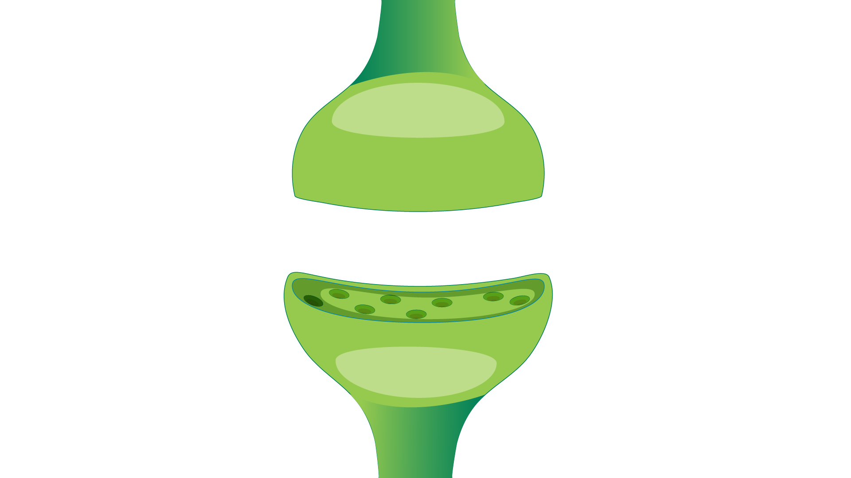


Another Novel Approach: TAAR as Target
Trace amines (TAs)
Endogenous chemical messengers and referred to as ”false neurotransmitters” as they are not released from synaptic vesicles when the neuron fires
Structurally similar to monoamine neurotransmitters, DA, NE, and 5-HT
Expressed at levels at least 100-fold lower than corresponding neurotransmitters
Trace amine-associated receptors (TAARs)
In 2001, TAs were found to selectively activate a family of receptors called TAARs
They are predominantly intracellular receptors that modulate neurotransmission in monoaminergic neurons, but can move to the membrane (and back in)
Most studied is TAAR1
Can interact with D2 receptors presynaptically and postsynaptically to affect DA signaling
(intracellular)
Presynaptic neuron
TAAR1
D2
Bidirectional modulation of signaling
D2
Postsynaptic neuron
TAAR1
(intracellular)
Dedic N, et al. Int J Mol Sci. 2021;22(24):13185; Dodd S, et al. Neurosci Biobehav Rev. 2021;120:537-541; Gainetdinov RR, et al. Pharmacol Rev. 2018;70(3):549-620; Nair PC, et al. Mol Psychiatry. 2022;27(1):88-94.

