Slide 1
Residual Symptoms: Dealing with the Limitations of Existing Treatments
Jonathan M. Meyer, MD Voluntary Clinical Professor - Department of Psychiatry University of California, San Diego La Jolla, CA

Slide 2
Disclaimer
The views and opinions expressed in this educational activity are those of the faculty and do not necessarily represent the views of TotalCME, Inc., the CME providers, or the companies providing educational grants. This presentation is not intended to define an exclusive course of patient management; the participant should use their clinical judgment, knowledge, experience, and diagnostic skills in applying or adopting for professional use any of the information provided herein. Any procedures, medications, or other courses of diagnosis or treatment discussed or suggested in this activity should not be used by clinicians without evaluation of their patient's conditions and possible contraindications or dangers in use, review of any applicable manufacturer’s product information, and comparison with recommendations of other authorities. Links to other sites may be provided as additional sources of information.

Slide 3

Circuit Dysfunction in Schizophrenia: Dopamine D2 Receptor Modulation Has Limited Impact in Many Symptom Areas
Mesocortical/
prefrontal cortex
Associative striatum
Nucleus accumbens
reward circuits
Positive symptoms
Negative
symptoms
Affective
symptoms
Cognitive
symptoms
Aggressive
symptoms
Ventromedial
prefrontal cortex
Dorsolateral
prefrontal cortex
Orbitofrontal cortex
Amygdala
McCutcheon RA, et al. Trends Neurosci. 2019;42(3):205-220; Stahl SM, et al. CNS Spectr. 2014;19(5):449-465.

Slide 4
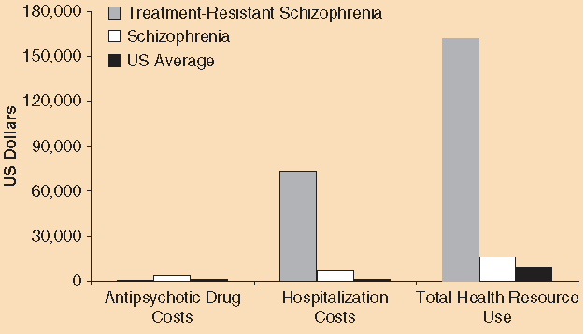
Treatment-Resistant Schizophrenia (TRS) and Glutamate
Prevalence:
Criteria vary in clinical versus research settings, but estimated 25% to 33%.¹ These patients do not adequately respond to D₂ receptor modulation
Economic burden:
Health care associated costs for TRS patients are estimated at 3 to 11 times greater than the annual costs for nonresistant schizophrenia patients^{2,3}
Pharmacotherapy:
Clozapine remains the only medication with compelling evidence for TRS, with response rates ≥40%^{3,4}
Neurobiology:
Cross-sectional neuroimaging studies suggest that poor response to D₂ receptor modulation is associated with relatively normal striatal dopamine synthesis capacity but elevated anterior cingulate cortex (ACC) and striatal glutamate levels^{5,6}
Within 12 weeks of starting clozapine, TRS patients exhibit: a longitudinal reduction in tissue-corrected glutamate concentration (Glu_{corr}) in the caudate (n=23, F=7.61, P=.01) but not the ACC (n=24, F=0.02, P=.59); AND a percentage reduction in caudate Glu_{corr} that positively correlates with percentage improvement in symptoms (n=23, r=.42, P=.04)7
Health-care costs per patient-year for US patients with treatment-resistant schizophrenia, all schizophrenia patients, and the US average (2012 USD).
1. Howes OD, et al. Am J Psychiatry. 2017;174(3):216-229; 2. Kennedy JL, et al. Int Clin Psychopharmacol. 2014;29(2):63-76; 3. Meyer JM, Stahl SM. The Clozapine Handbook. Cambridge University Press; 2019; 4. Wagner E, et al. Schizophr Bull. 2020;46(6):1459-1470; 5. Merritt K, et al. JAMA Psychiatry. 2016;73(7):665-674; 6. Egerton A, et al. Schizophr Bull. 2021;47(2):505-516; 7. McQueen G, et al. Schizophr Bull. 2021;47(3):662-671.

Slide 5
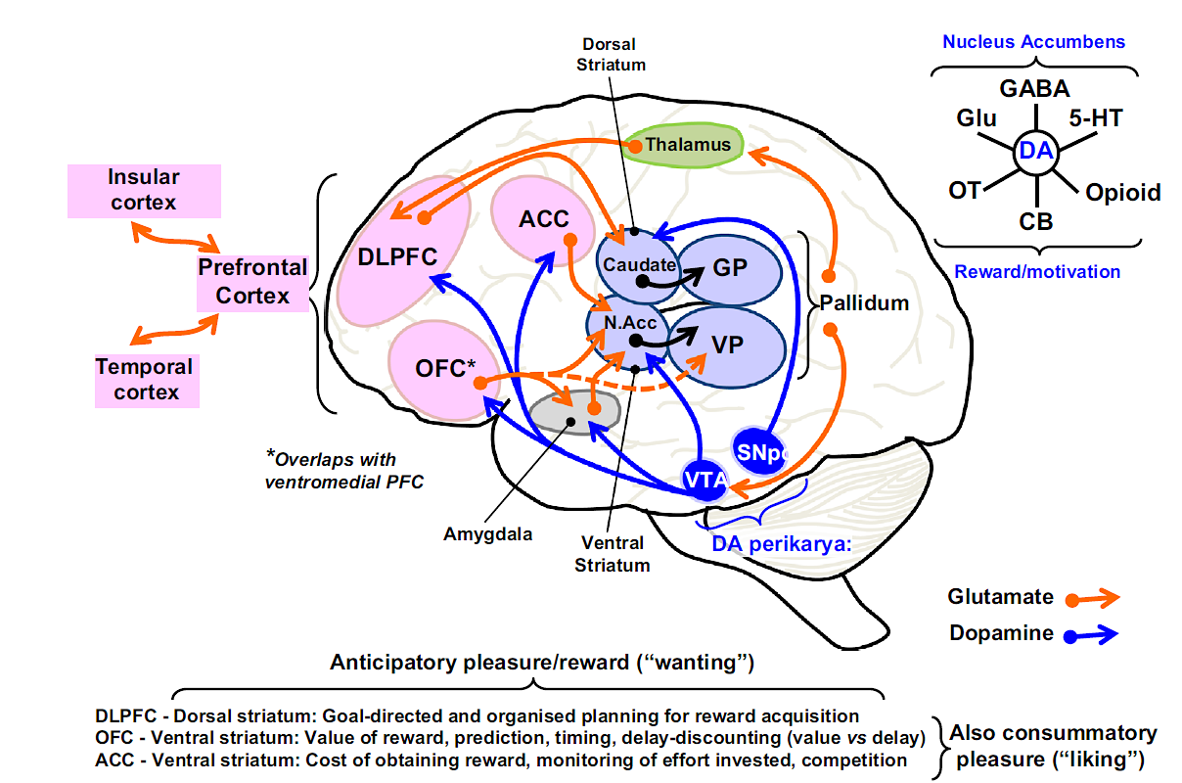
Conceptualization of Negative Symptoms: Decreased Dopamine D1 Receptor PFC Signaling Is a Key Part of the Model
Millan MJ, et al. Eur Neuropsychopharmacol. 2014;24(5):645-692.

Slide 6
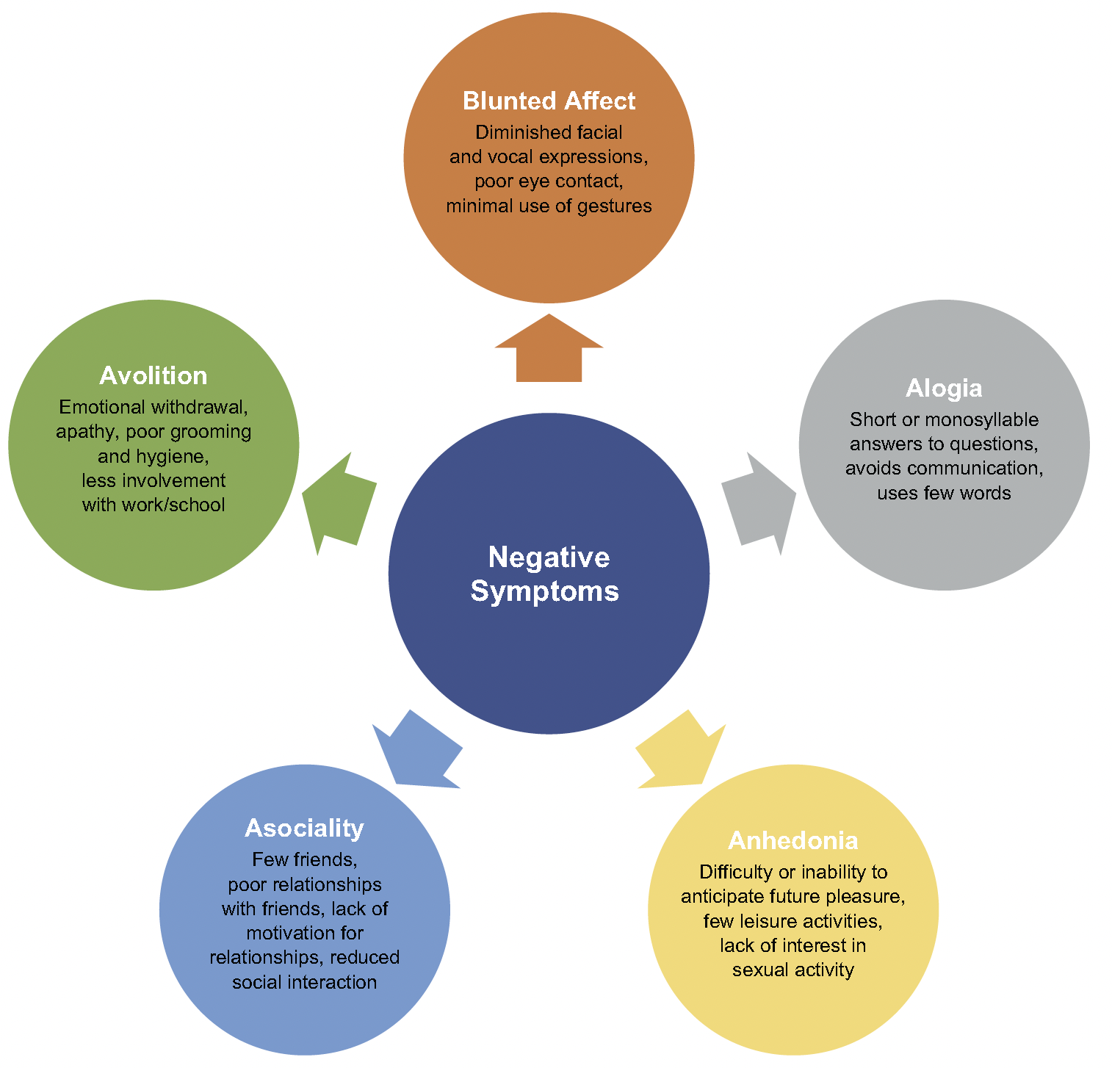
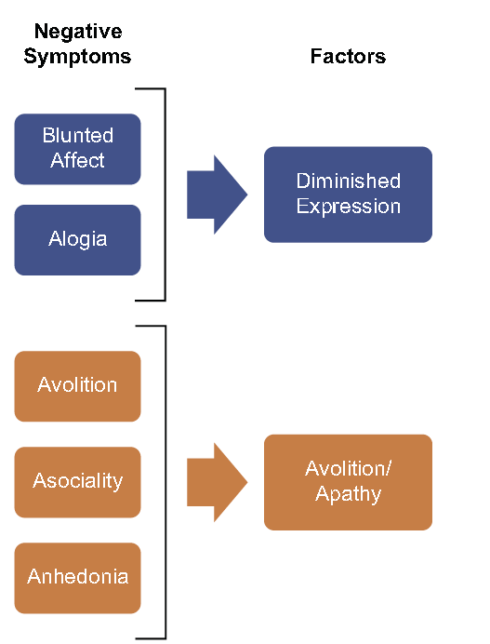
There Are Five Key Domains of Negative Symptoms that Coalesce into Two Factors
Correll CU, et al. Neuropsychiatri Dis Treat. 2020;16:519-534.

Slide 7
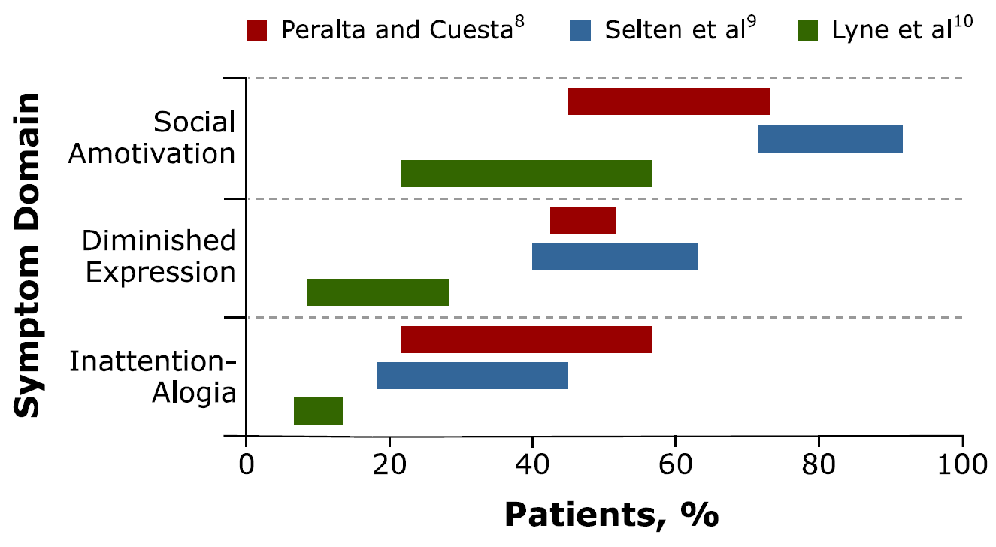
How Common Are the Domains of Negative Symptoms?
Social amotivation is the most prevalent negative symptom
Correll CU. J Clin Psychiatry. 2013;74(2):e04.

Slide 8
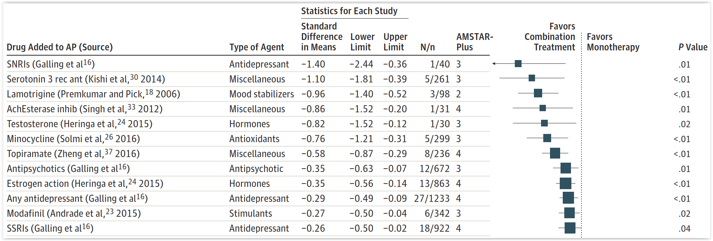
Twelve Adjunctive Treatments to Antipsychotics Beat Placebo for Negative Symptoms
Issues
In an umbrella review of 29 meta-analyses of 42 cotreatments for negative symptoms (trials=381, n=19,833), 12 of 26 meta-analyzed augmentation strategies outperformed placebo (effect sizes= -0.26, -1.40). While the quality of the meta-analysis was high, the quality of the meta-analyzed studies was low. The lower the study quality, the higher the pooled effect sizes. The largest meta-analyzed study did not confirm the pooled results
**
*
*Only augmentation with partial D2 agonist; ** AMSTAR-Plus Content Scale quality scores: 0-9; poorer quality studies=lower P-value Correll CU, et al. JAMA Psychiatry. 2017;74(7):675-684.

Slide 9
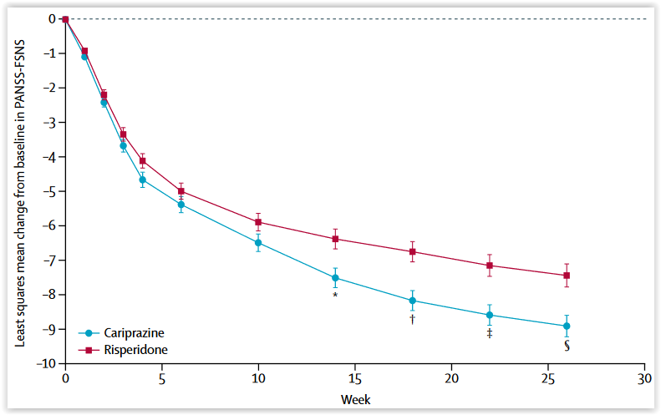
Cariprazine Improves Negative Symptoms Significantly More than Risperidone in Patients with Significant Negative Symptoms and Modest Positive Symptoms
Comment:
Differential improvement in negative symptoms between cariprazine and risperidone was not related to changes in positive symptoms or depression ratings (which were not significantly different at endpoint between the two groups)
There were between-group differences in functional outcomes (eg, self-care, socially useful activities, personal/social relationships)
Demographics:
Mean age: 40 yrs, 57% men, ill 12.5 yrs, and 40% had ≥5 prior relapses
Baseline PANSS-FSNS: 27.6
Response (≥20%↓):
CARIP: 69%
RISP: 58%
NNT=9
(N=227)
(N=229)
P=0092 for the overall treatment eﬀect of cariprazine versus risperidone *P=.0079; †P=.0011; ‡P=.0016; §P=.0022.
FSNS (Factor Score Negative Symptoms): [N1 (blunted affect), N2 (emotional withdrawal), N3 (poor rapport), N4 (passive or apathetic social withdrawal), N6 (lack of spontaneity and flow of conversation), G7 (motor retardation), and G16 (active social avoidance)]
Németh G, et al. Lancet. 2017;389(10074):1103-1113.

Slide 10
Cognitive Dysfunction and Schizophrenia
Significance:
Cognitive dysfunction comprises a significant proportion of the morbidity associated schizophrenia, is present in 80% of patients, and impacts information processing and social and functional domains¹
Onset:
Typically begins before initial manifestation of the first psychotic episode. Premorbid cognitive function is considerably lower in people at risk of developing schizophrenia than matched controls¹
Circuit pathophysiology:
Normal developmental trajectories are disrupted, with increased gray matter loss and aberrant network organization apparent at illness onset¹
Cholinergic systems:
Postmortem studies show reductions in M₁ and M₄ receptor expression in brain regions implicated in schizophrenia. 25% of patients have ≥75% reduction in M₁ receptor expression^{2,3}
Pharmacotherapy:
No proven effective treatment. “There still is a debate if and how any pharmacological treatments could impact on cognitive outcome in schizophrenia, both in specific domains and global performance.”⁴ Cognitive remediation (CR) is a behavioral training-based intervention that aims to improve cognitive processes with the goal of durability and generalization to global functioning. CR is included in the practice guidelines for schizophrenia, but not widely available
1. McCutcheon RA, et al. JAMA Psychiatry. 2020;77(2):201-210; 2. Matsumoto I, et al. Neurosci Lett. 2005;379(3):164-168; 3. Dean B, et al. Psychiatry Res. 2020;288:112989; 4. Harvey PD, et al. Schizophr Res Cogn. 2022;29:100249.

