Slide 1
Illuminating the Etiology and Pathophysiology of Schizophrenia: Neurodevelopmental, Structural, and Neurochemical Abnormalities
Christoph U. Correll, MD
Professor of Psychiatry and Molecular Medicine
Zucker School of Medicine at Hofstra/Northwell
Hempstead, NY

Slide 2
Disclaimer
The views and opinions expressed in this educational activity are those of the faculty and do not necessarily represent the views of TotalCME, Inc., the CME providers, or the companies providing educational grants. This presentation is not intended to define an exclusive course of patient management; the participant should use their clinical judgment, knowledge, experience, and diagnostic skills in applying or adopting for professional use any of the information provided herein. Any procedures, medications, or other courses of diagnosis or treatment discussed or suggested in this activity should not be used by clinicians without evaluation of their patient's conditions and possible contraindications or dangers in use, review of any applicable manufacturer’s product information, and comparison with recommendations of other authorities. Links to other sites may be provided as additional sources of information.

Slide 3
Mortality and Comorbidities

Slide 4

STILL: Unknown Etiology of Schizophrenia

Slide 5
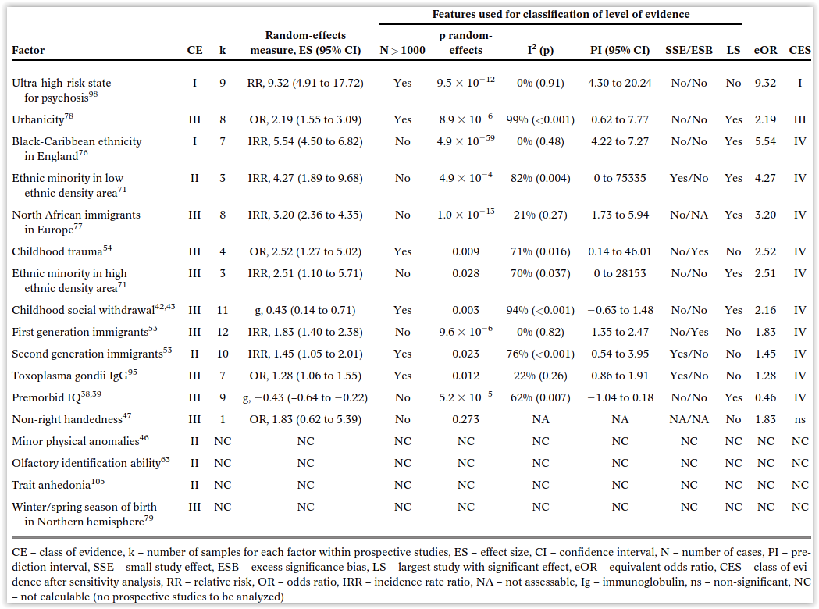
What Causes Psychosis? Results from 55 Meta-analyses, 683 Studies, 170 Risk Factors
PROSPECTIVE STUDIES
In x-sectional analyses only factors with OR/RR >5: Toxocara spp (41.6), chlamydia psit. (29.1), human endog. retrovirus (19.8), DM during pregnancy (10.0), chlamydia pneum (6.0), Parkinsonian sxs in antipsychotic-naïve subjects.

Slide 6
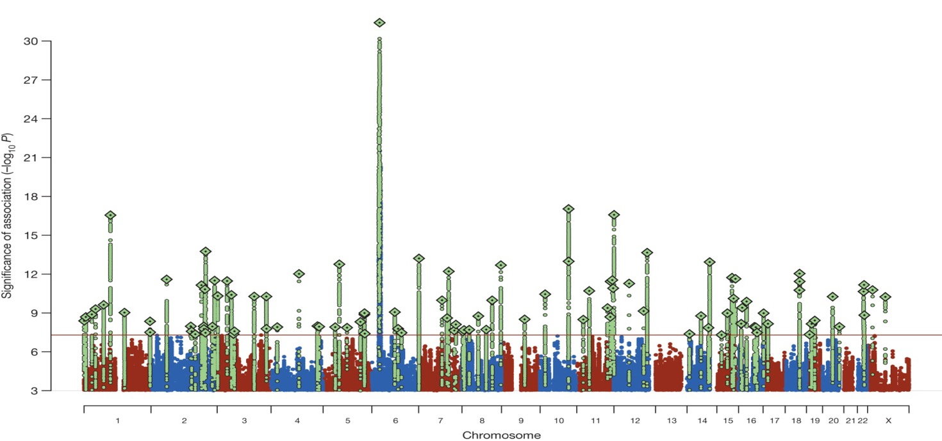
Biological Insights from 108 Schizophrenia-Associated Genetic Loci: Relevance of Information from 100,000 People for One Individual?

Slide 7
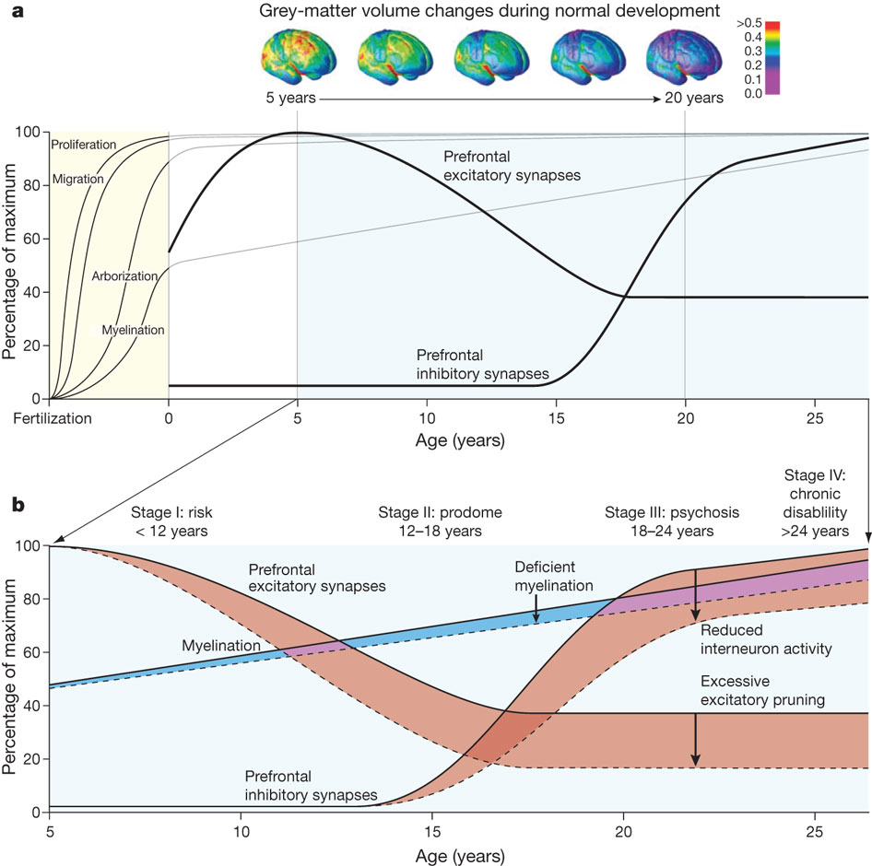
Neurodevelopmental Model of Schizophrenia

Slide 8
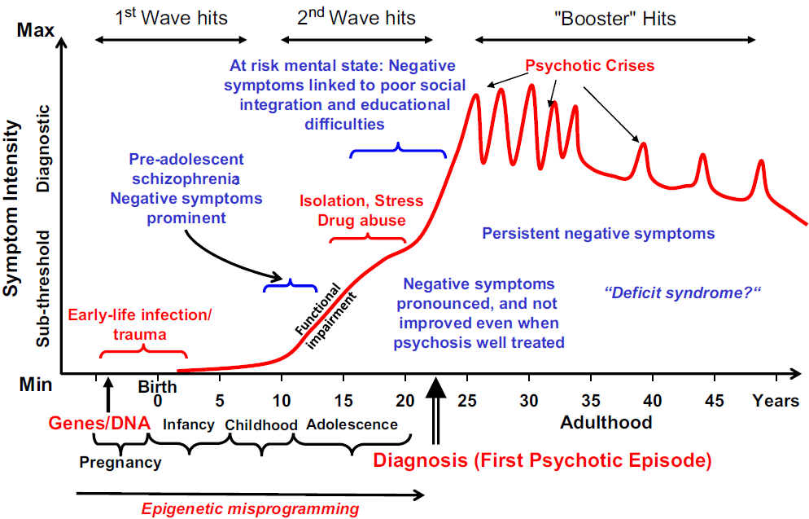
Developmental Model of Schizophrenia

Slide 9
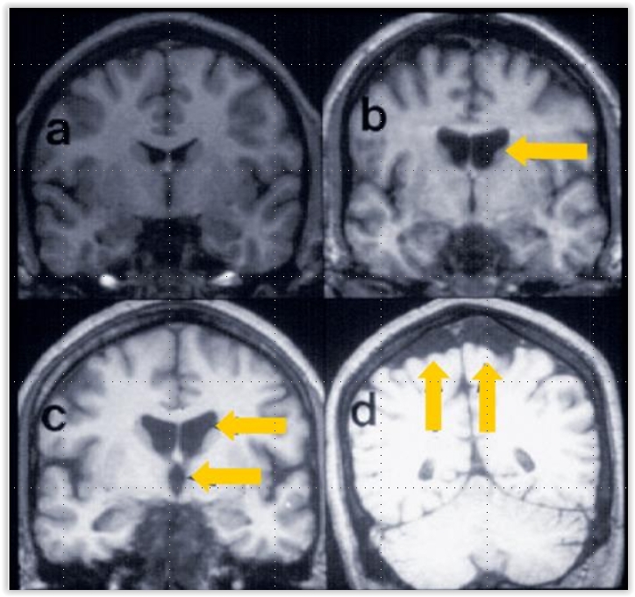
Morphological Findings in Schizophrenia
Normal brain
Enlarged lateral
ventricles
c. Enlarged 3rd and
lateral ventricles
d. Cortical atrophy

Slide 10
Main Characteristics of Cognitive Impairment in Selected Neuropsychiatric Disorders
 | Attention and/or Vigilance | Working Memory | Executive Function | Episodic Memory | Semantic Memory | Visual Memory | Verbal Memory | Fear Extinction | Processing Speed | Procedural Memory | Social Cognition (Theory of Mind) | Language
Major depression | +(+) | ++ | ++ | ++ | + | + | +(+) | 0/+? | ++(+) | + | +(+) | +
Bipolar disorder | ++(+) | ++ | ++ | ++ | + | + | ++ | +? | ++ | 0 | ++ | ++
Schizophrenia | +++^{M} | +++^{M} | +++^{M} | +++ | ++ | +(+) ^{M} | +++^{M} | ++ | ++^{M} | + | +++^{M} | +++
ASD | +++ | + | +++ | ++ | + | + | +(+) | +(+) | ++++ | 0/+ | +++ | +++
ADHD | +++ | ++ | +++ | 0/+ | + | ++ | ++ | + | ++ | + | + | 0/+
OCD | +++(↑) | +(+) | ++ | + | 0/+ | + | 0/+ | ++ | ++ | ++ | + | 0/+
PTSD | +++(↑) | +(+) | +(+) | ++ | + | + | ++(+) | +++ | + | 0 | 0/+ | 0
Panic disorder | +++(↑) | + | 0/+ | + | 0/+ | 0/+ | + | ++ | ++ | 0 | 0 | 0
GAD | + | + | 0 | 0 | + | + | + | + | 0 | 0 | 0/+ | 0
Parkinson’s disease | ++ | ++(+) | ++ | + | 0+ | + | + | 0? | +++ | +++ | +(+) | +(+)
Alzhemier’s disease | +(+) | +(+) | +(+) | +++ | +++ | +++ | ++(+) | 0? | + | + | + | ++

Slide 11
Patients Not Meeting Clinical Neuropsychology Criteria for Impairment May Still Have Cognitive Deficits Relative to Expected Abilities
Cognitive score predicted by maternal education
2
1
Above Expectation
Group
0
Patients (n = 150)
Normal control regression line
-1
Cognitive Composite Score
Controls (n = 50)
-2
-3
98% of patients fail to reach expected levels of cognitive performance
-4
Below Expectation
-5
0
5
10
15
20
Maternal Education (years)*
Notes:
Keefe 2005, p689, Fig 1

Slide 12
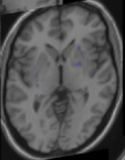
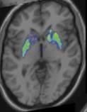
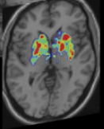
Stress Releases More Dopamine in Schizophrenia than in Healthy Controls
Controls
Prodromal signs
Schizophrenia

Slide 13
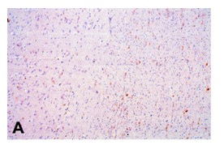
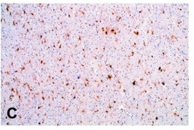
Signs of Inflammation and Activated Microglia in Schizophrenia
Healthy Controls
Schizophrenia

Slide 14
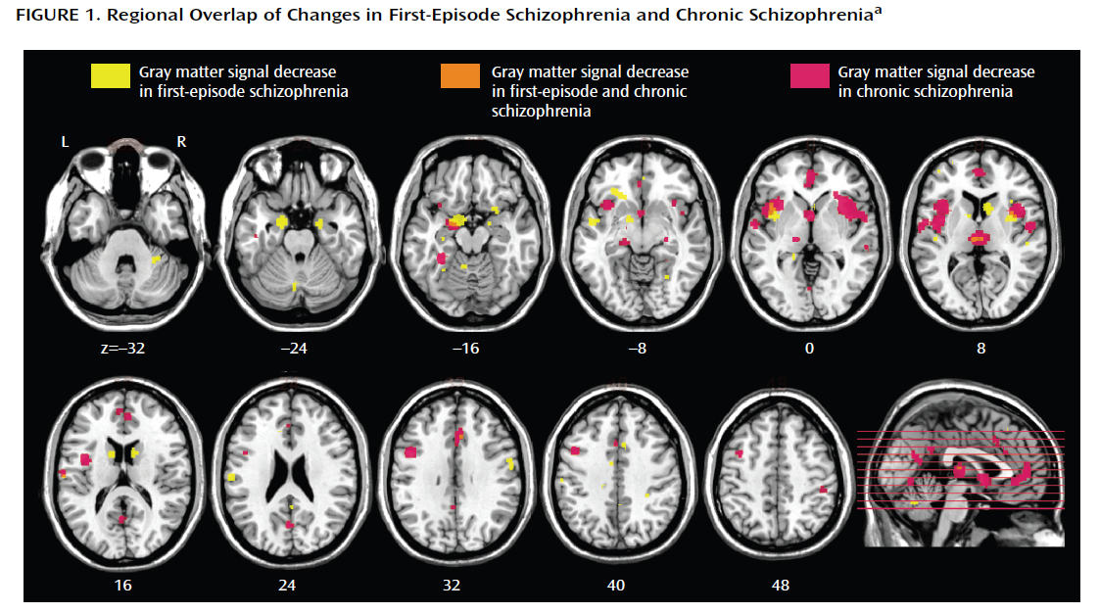
Meta-analysis of 27 Voxel-based Structural MRI Studies of First-episode Schizophrenia Versus Chronic Schizophrenia: Evidence of Gray Matter Loss
When comparing first-episode schizophrenia and chronic schizophrenia, decreases in gray matter volume were detected in first-episode schizophrenia but not in chronic schizophrenia in the caudate head bilaterally; decreases were more widespread in cortical regions in chronic schizophrenia.

Slide 15
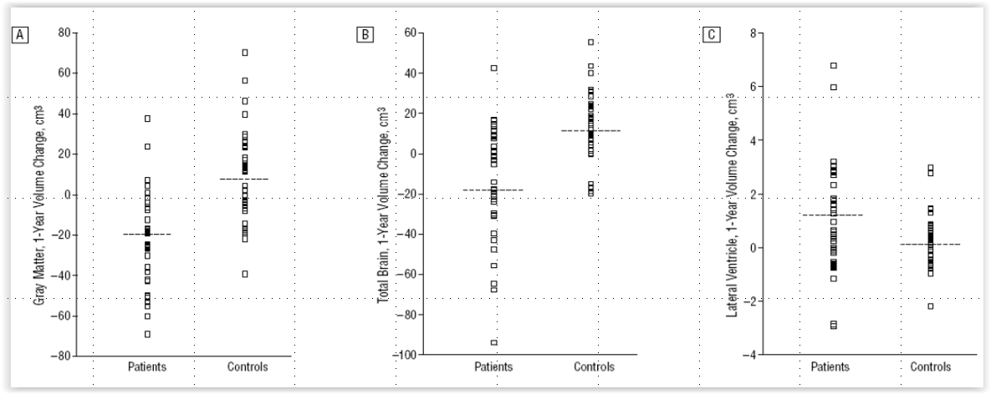
Brain Volume Changes in First-episode Schizophrenia: A 1-year Follow-up Study
A. Gray Matter
B. Total Brain
C. Lateral Ventricles

Slide 16
Acute Ketamine-like Early Illness Stage Resting State Hyperconnectivity Versus Chronic Illness Stage Hypo-connectivity in Schizophrenia

Slide 17
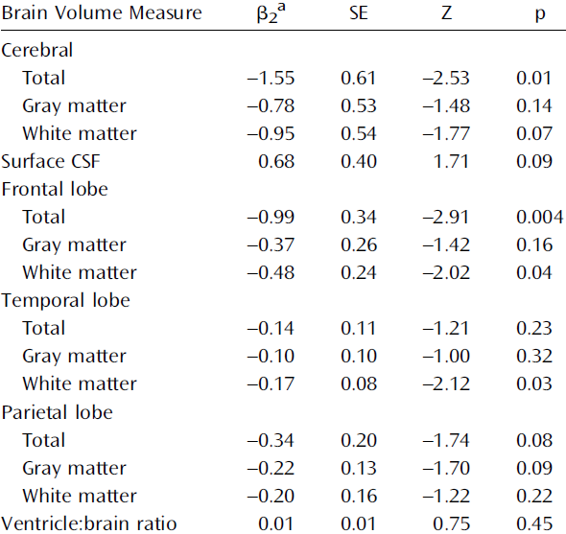
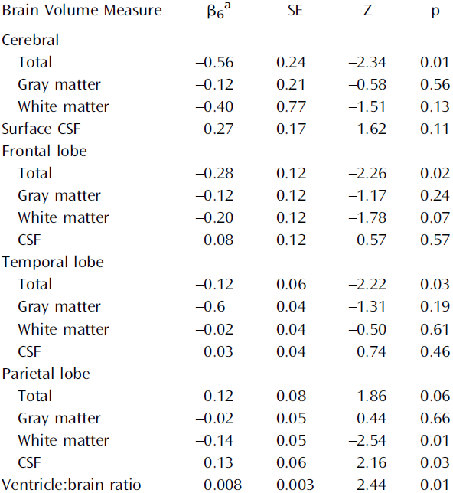
Brain Volume Change in cc (=beta) Per Year of Relapse (A) Is 3 Times Larger than Per Year of 4 mg of HAL Equivalent Treatment (B)
A. Brain Volume Decrease Per Year of Relapse
B. Brain Volume Decrease Per Year of AP Rx
c
c
Notes:
17

Slide 18
Increased Striatal “Presynaptic” Dopamine Measures in Early and Chronic Schizophrenia

Slide 19
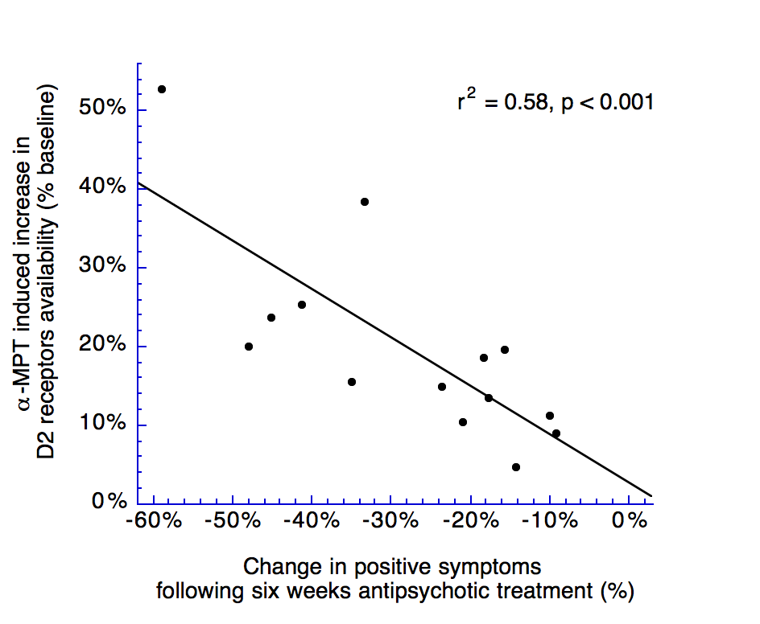
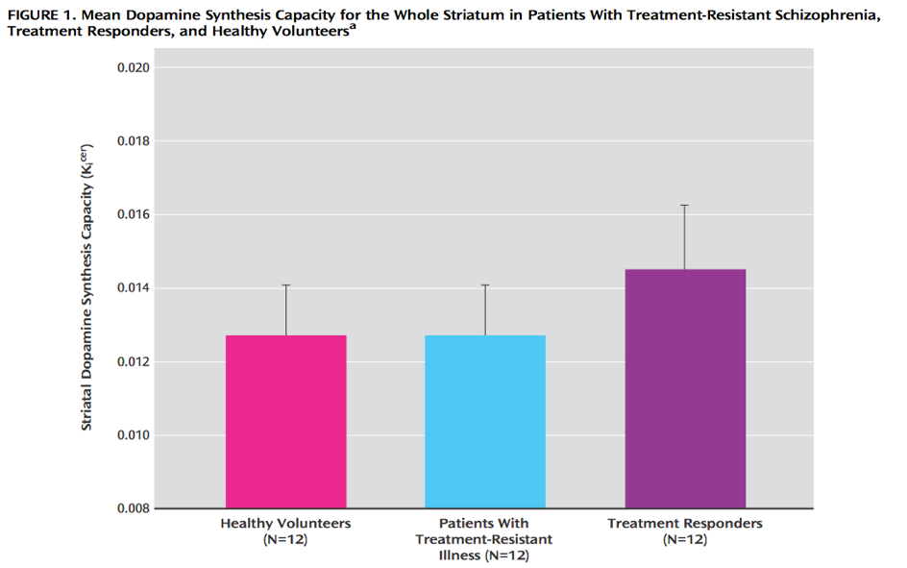
Striatal Hyperdopaminergia Predicts Antipsychotic Treatment Response
e

Slide 20
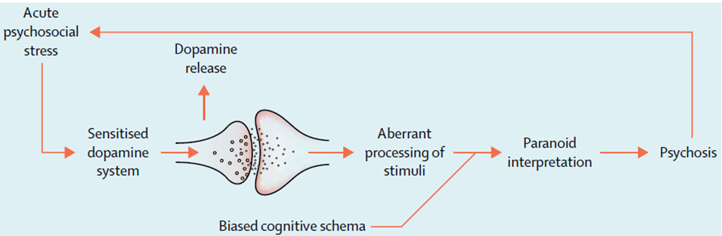
Pathophysiological Model of Psychosis

Slide 21







Interrelated Pathophysiological Domains in Schizophrenia
Gene x environment interaction
Dopamine, GABA, glutamate, acetylcholine, serotonin
Neuronal
dysmetria
Systems
dysmetria
Positive, negative, cognitive, reward, social
Neurodevelopmental, genetic and environmental factors¹⁻⁷
Neurotransmitter dysregulation
Excitation/ inhibition imbalance
Network dysfunction of interconnected neural circuits
Behavioral changes
Genetic and Epigenetic Level
Cell Level
Neuronal Circuit Level
Brain Network Level
Symptom Presentation
Notes:
21

Slide 22
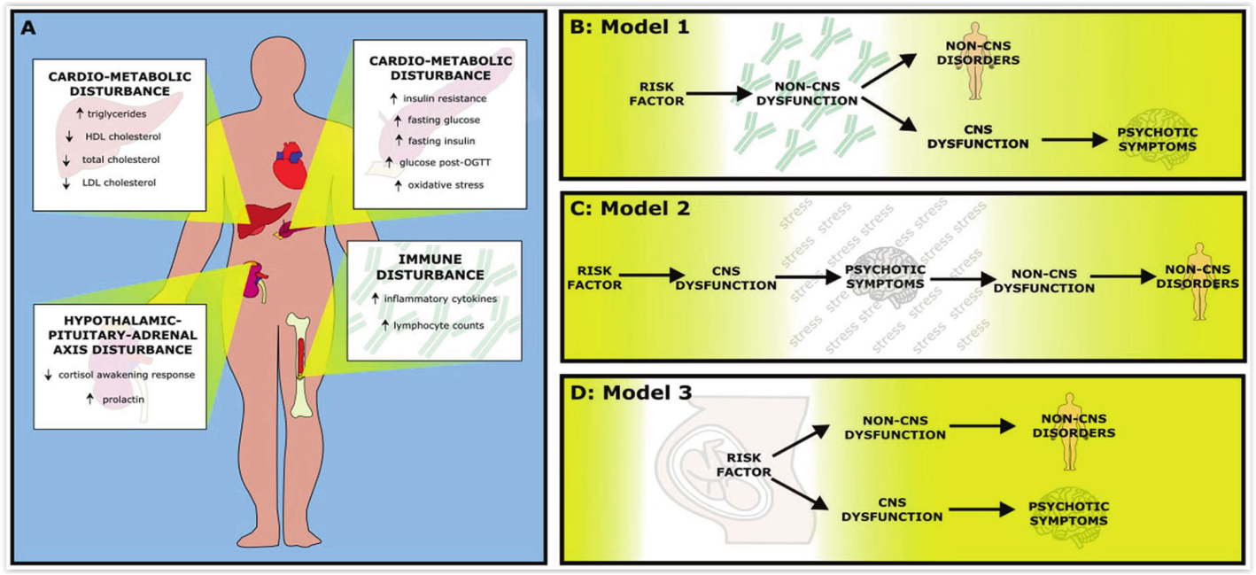
Case-control Studies in First-episode Schizophrenia: Similar Effect Sizes for CNS and Non-CNS Alterations
CNS effect sizes: brain structure: g=0.40; neurophysiology: g=0.80; neurochemistry: g=0.43
Non-CNS effect sizes:
g=0.23
g=0.23
g=1.19
g=0.68
165 case-control studies, n=13,440

Slide 23
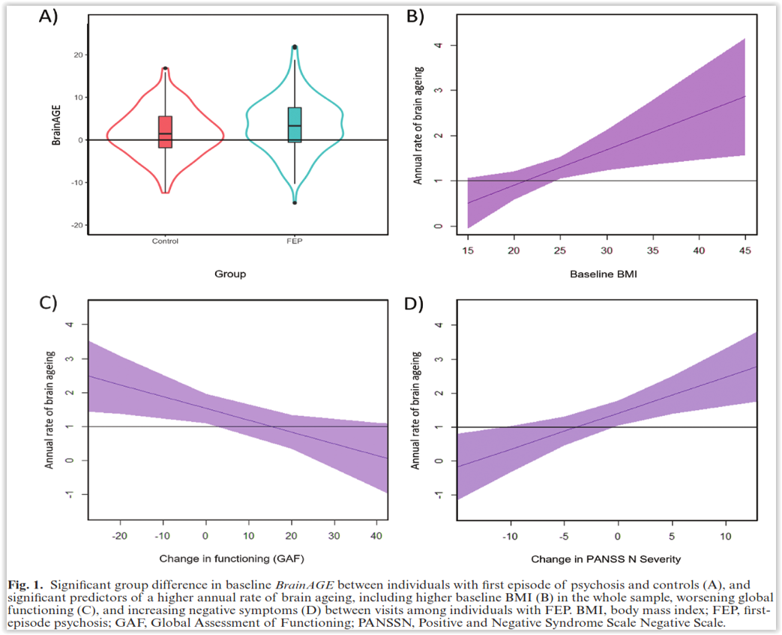
Increased Brain Age is Correlated with Higher BMI, Higher Psychopathology and Lower Functioning
First-episode SCZ: n=183,
Controls: n=155
2 prospective MRI scans on average 1.61 years apart
Machine learning trained on a separate sample of 504 controls to estimate brain age and calculate brain age by subtracting chronological from estimated brain age
For each additional BMI point, the brain aged by 1 additional month per year

Slide 24
Summary
The exact pathophysiology of schizophrenia remains unknown and is highly likely heterogeneous
Data point to both neurodevelopmental and neuroprogressive components
Schizophrenia is associated with central and peripheral multisystem dysfunction, involving structural, neurochemical and cellular abnormalities
Treatments targeting the pathophysiology beyond dopamine blockade are needed to address more expressions of schizophrenia and the likely subtypes

