Slide 1
Unlocking Insights for Underrepresented Patients: The Role of Real-World Evidence in Addressing Limitations of CDK4/6 Inhibitor RCTs
Adam Brufsky, MD, PhD
Professor of Medicine
Co-Director, Comprehensive Breast Cancer Center
University of Pittsburgh Cancer Institute
Pittsburgh, PA

Slide 2



Resource Information
About This Resource
These slides are one component of a continuing education program available online at MedEd On The Go titled RWE Where RCTs Fall Short: Optimizing Frontline Treatment of HR+/HER2- Metastatic Breast Cancer
Program Learning Objectives:
Critically evaluate components of RWE publications to distinguish high-quality from low-quality sources of information
Evaluate RWE of CDK4/6 inhibitors in HR+/HER2- MBC as it relates to clinical trial evidence
Apply RWE to make treatment decisions for patients regarding the choice of CDK4/6 inhibitors in HR+/HER2- MBC
Increase clinician awareness of the patient's perspective on the existence and utility of RWE as it applies to shared decision-making conversations
MedEd On The Go®
www.mededonthego.com
This content or portions thereof may not be published, posted online or used in presentations without permission.
This content can be saved for personal use (non-commercial use only) with credit given to the resource authors.
To contact us regarding inaccuracies, omissions or permissions please email us at support@MedEdOTG.com

Slide 3
Disclaimer
The views and opinions expressed in this educational activity are those of the faculty and do not necessarily represent the views of Total CME, LLC, the CME providers, or the companies providing educational grants. This presentation is not intended to define an exclusive course of patient management; the participant should use their clinical judgment, knowledge, experience, and diagnostic skills in applying or adopting for professional use any of the information provided herein. Any procedures, medications, or other courses of diagnosis or treatment discussed or suggested in this activity should not be used by clinicians without evaluation of their patient's conditions and possible contraindications or dangers in use, review of any applicable manufacturer’s product information, and comparison with recommendations of other authorities. Links to other sites may be provided as additional sources of information.

Slide 4
RWE to Address Populations Not Included in
Clinical Trials
African Americans
Asians
Elderly

Slide 5
P-REALITY X: Palbociclib REAl-world first-LIne comparaTive effectiveness studY eXtended
Objective
To evaluate the effectiveness of first-line PAL + AI, as compared with AI alone, in patients with HR+/HER2– MBC treated in real-world clinical practice in the United States
Method
Retrospective, cohort analysis of electronic health records within the US Flatiron Health Analytic Database
Planned endpoints:
Primary - OS*
Secondary - rwPFS†
  Postmenopausal women and men aged
  ≥18 years with HR+/HER2‒ mBC (N=2888)
  Index date i.e., starting date of the first line mBC treatment (PAL plus AI or AI alone) from 03 February 2015 to 31 March 2020
  Follow-up from index date to death, study end (data cut-off, 30 September 2020), or last visit, whichever occurred first
PAL + AI
n=1324
  Statistical analyses:
Unadjusted analyses were conducted first
sIPTW as the primary analysis was performed to balance baseline demographic and clinical characteristics
1:1 PSM was conducted as a sensitivity analysis
Median survival times and 95% CIs for OS and rwPFS were estimated using the weighted Kaplan-Meier method.
Cox proportional hazards model was used to compute the HR and the corresponding 95% CI
AI
n=1564

Slide 6
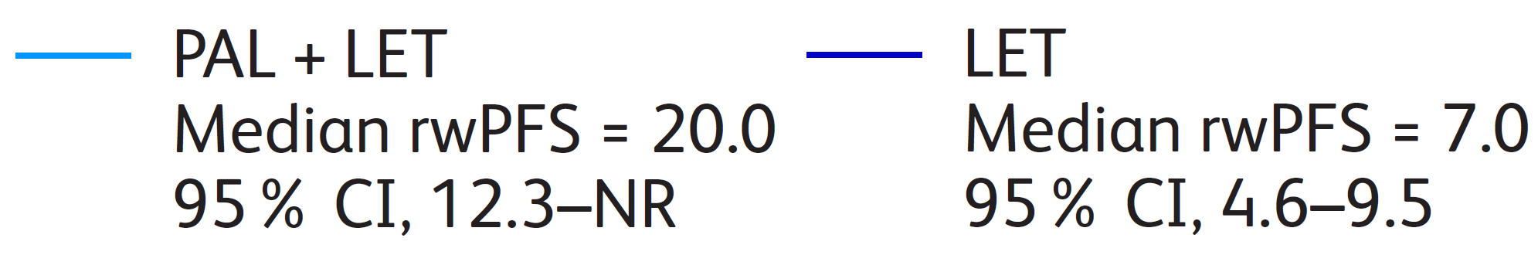
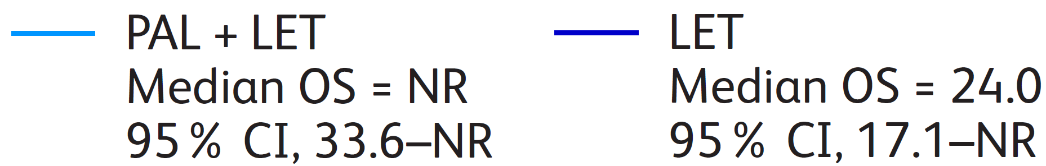
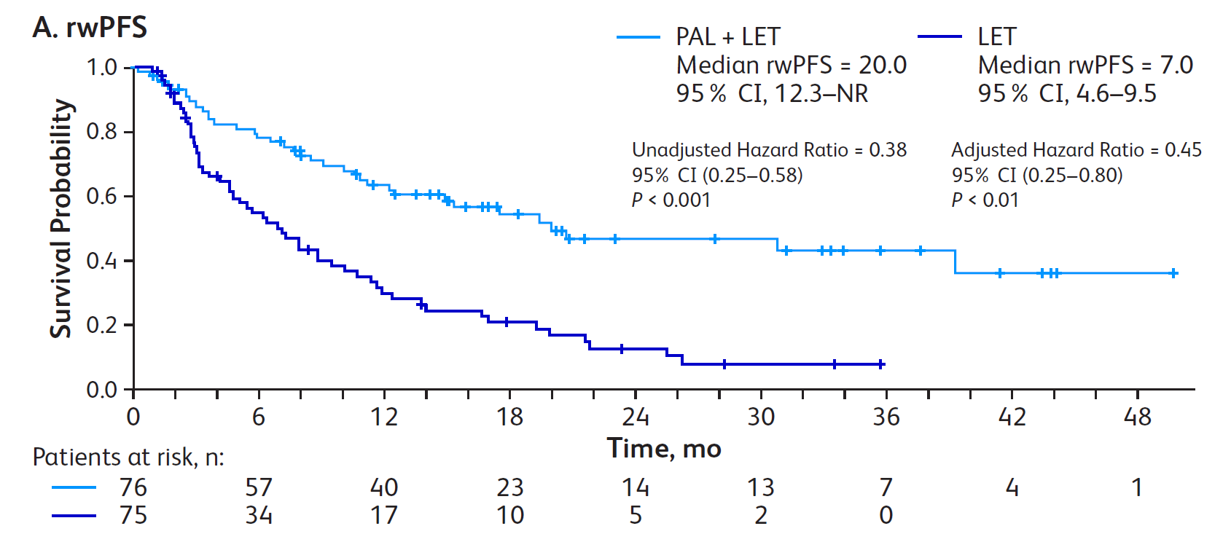
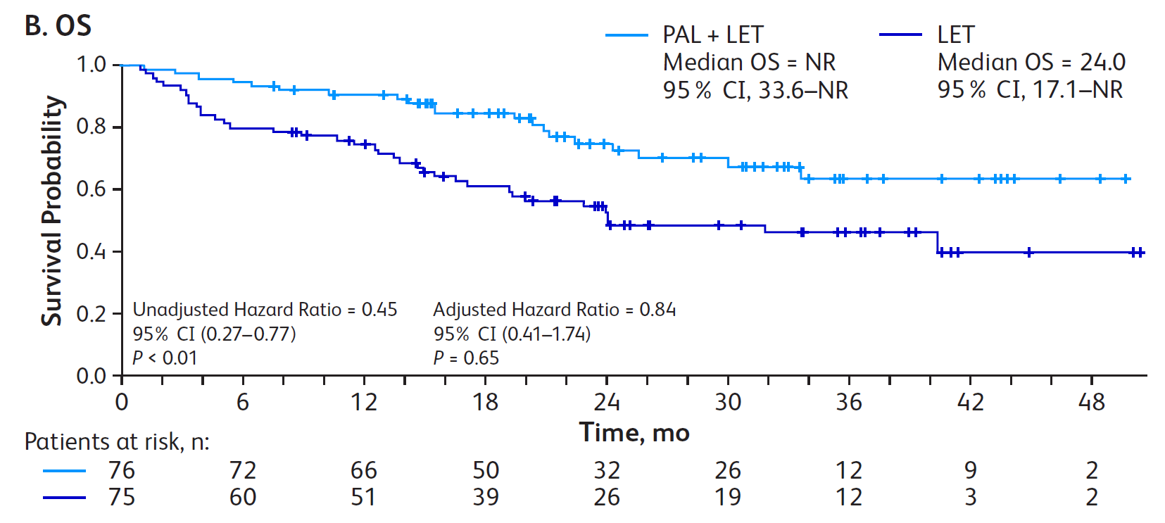
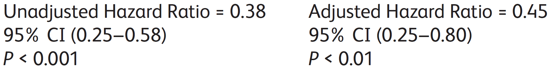
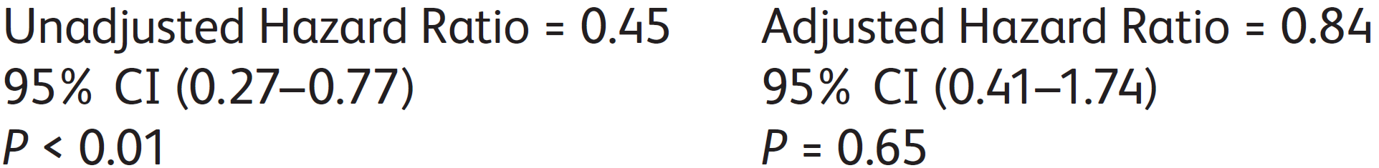
Real-World Studies Reflect Clinical Trial Data for Black and Hispanic Patients, Demonstrating Similar Benefit Profiles with PAL + ET
Real-world comparative effectiveness study: Hispanic and African American patients (FLATIRON database)
151 Hispanic and African American women with HR+/HER2- mBC; 24.5% were Hispanic and 75.5% were African American
rwPFS in Hispanic (n=37) and African American (n=114) patients*
OS in Hispanic (n=37) and African American (n=114) patients*
rwPFS Probability
OS Probability
Outcome, % | PAL+LET (n=76) | LET (n=75)
rwPFS rate
at 6 months | 78.0 | 52.9
at 12 months | 61.6 | 29.4
at 20 months | 49.0 | 16.3
Outcome, % | PAL+LET (n=76) | LET (n=75)
OS rate
at 12 months | 89.3 | 73.0
at 24 months | 72.6 | 48.7
In Hispanic and African American patients, PAL+LET prolonged median rwPFS and OS compared with LET alone

Slide 7
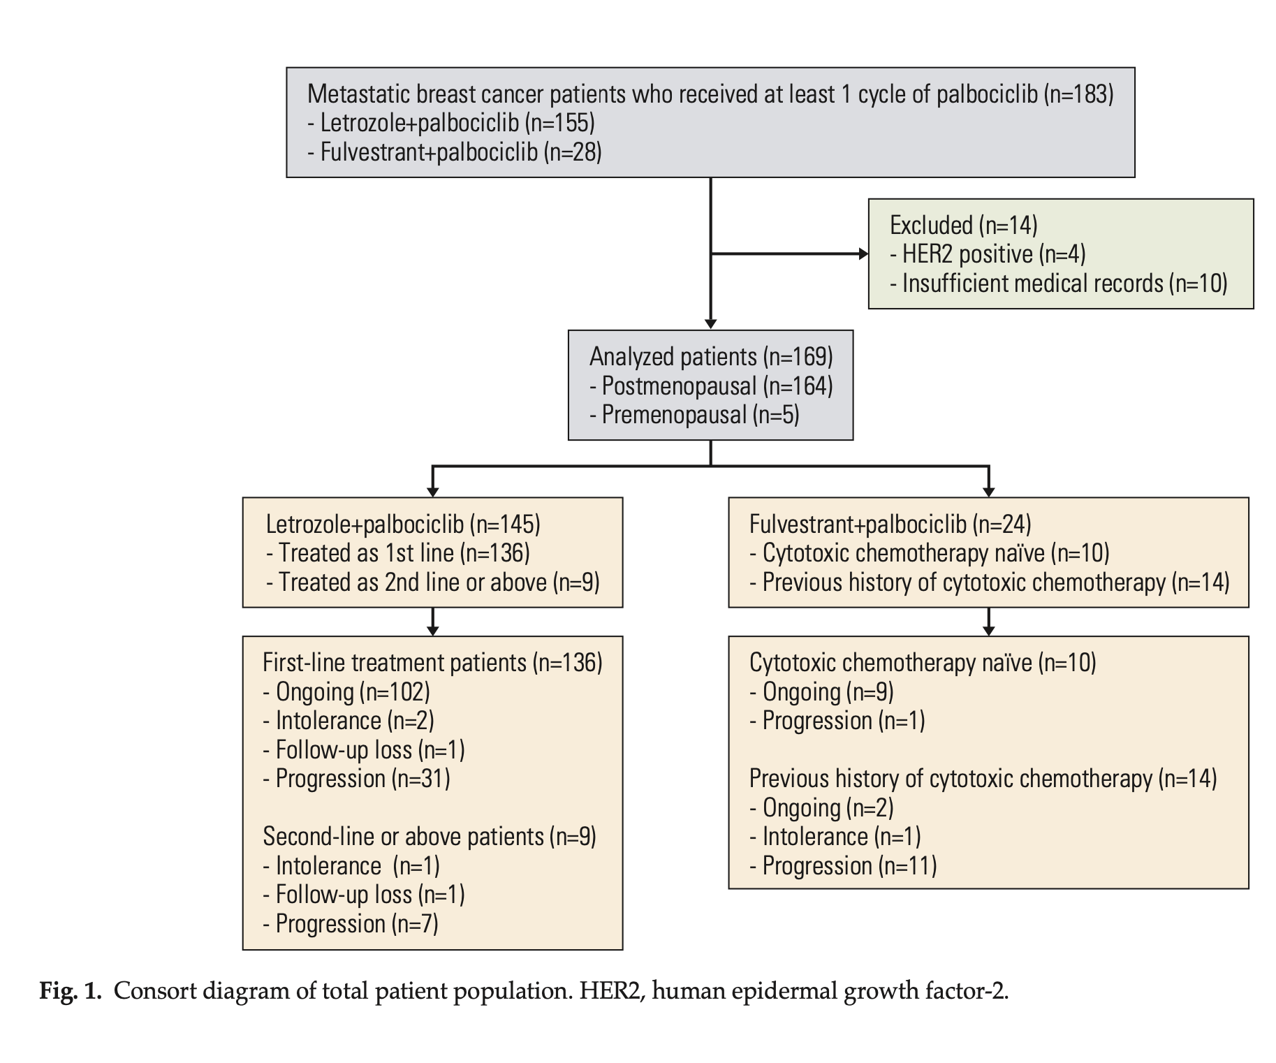
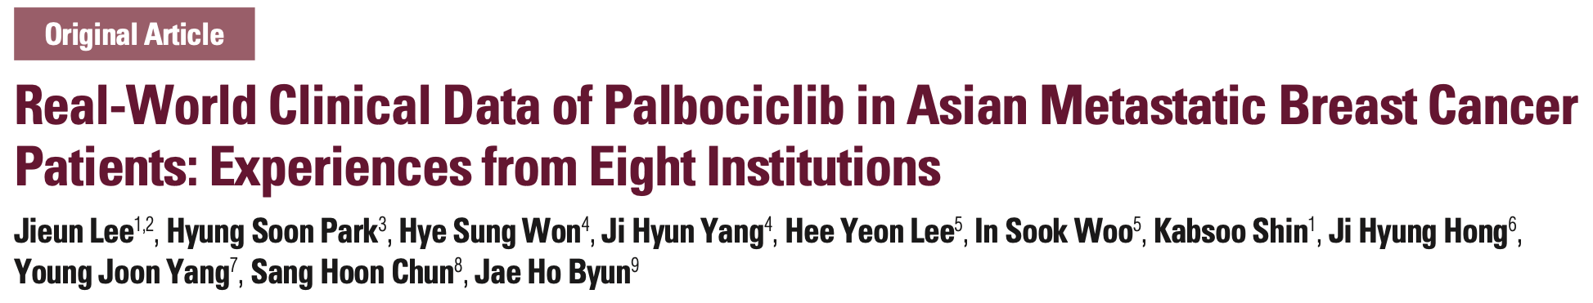

Slide 8
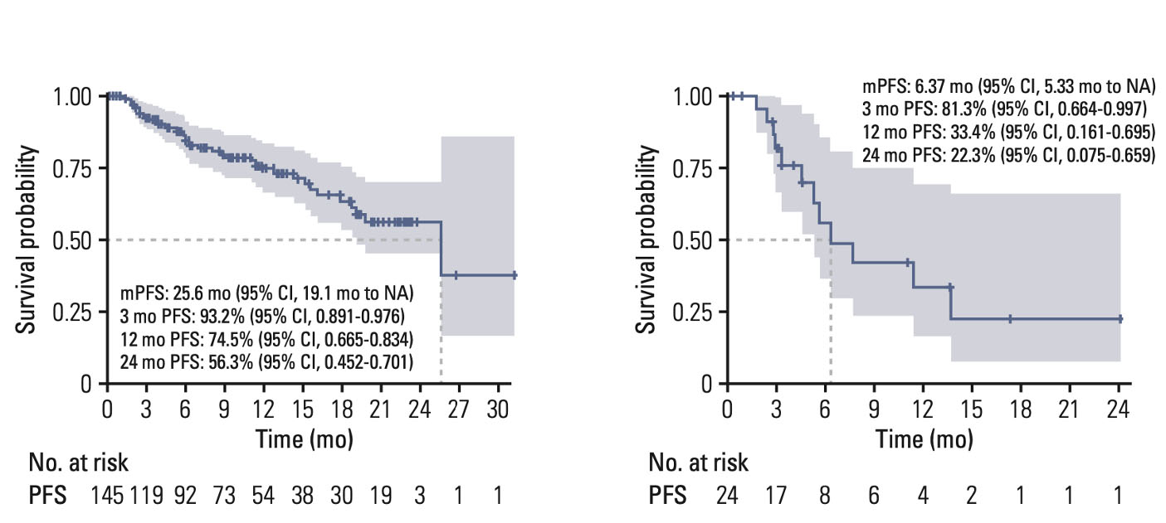
Progression-Free Survival in Palbociclib Treated Patients
Palbociclib + Letrozole
Palbociclib + Fulvestrant

Slide 9
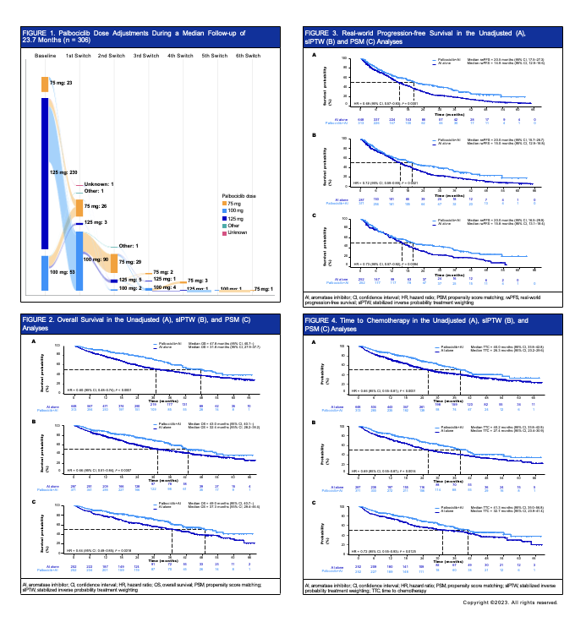
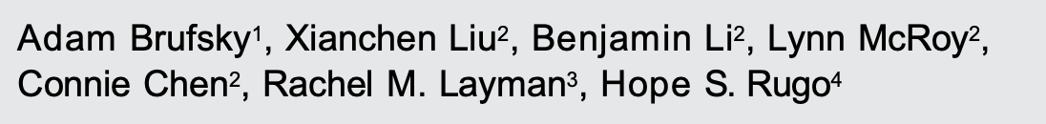
Real-world Treatment Patterns and Effectiveness of Palbociclib Plus an Aromatase Inhibitor in Patients with Metastatic Breast Cancer Aged 75 Years or Above

Slide 10
Overall Survival in the Unadjusted (A), sIPTW (B), and PSM (C) Analyses

Slide 11
Real-world Progression-free Survival in the Unadjusted (A), sIPTW (B), and PSM (C) Analyses

Slide 12
Palbociclib in HR+ Advanced Breast Cancer: a Multicenter, Prospective, Noninterventional Study (POLARIS)
HR+/HER2- ABC
receiving palbociclib + ET
N=1500
United States and Canada
Community + academic centers
Key research questions
Treatment patterns
MBC treatment sequence
Clinical outcomes (PFS, OS, ORR)
QOL as measured by EORTC QLQ-C30
Geriatric assessments
  G8 screening tool
  Activities of daily living
Biomarker assessments
Standard-of-care data collection*
QOL questionnaires
Blood sample collection
Prospective enrollment:
Approximately 2 years
Follow-up:
Approximately 3 years (longitudinal analyses)
Interim and ﬁnal reports
Notes:
Tripathy/2017/p1/col1/Figure1; col2/Methods/bullet 2
Tripathy/2017/p1/col1/Figure1
Tripathy/2017/p1/col1/Figure1
Tripathy/2017/p1/col1/Figure1
Karuturi/2019/abstract/p1/para2 (methods)
Tripathy/2017/p1/col3/Table1
Blum/2018/abst344/p1/col1/bullet11/subbullet 1; bullet 15

Slide 13
Real-world QoL in Patients with HR+/HER2– aBC Treated with Palbociclib: Final Analysis from POLARIS (2/2)
POLARIS final QoL outcomes assessment (ESMO 2022 update)
Mean Scores of QoL and Geriatric Assessments by Line of Therapy
n=842
n=548
n=365
n=269
n=172
n=110
n=261
n=162
n=106
n=318
n=180
n=113
n=103
n=60
n=37
n=101
n=57
n=37
Mean score
Mean score
Mean score
Mean Global QoL, ADL, and G8 scores were comparable between baseline, at months 6 and 12
in patients treated with PAL+ET regardless of line of therapy

Slide 14
Real-World Evidence in Special Populations
RWE helps with understanding CDK4/6 in special populations
HR consistent with RCTs in all scenarios
Absolute PFS consistent with RCT data for Asians and AAs
Data can be used for shared decision making

Slide 15



Looking for more resources
on this topic?
CME/CE in minutes
Congress highlights
Late-breaking data
Quizzes
Webinars
In-person events
Slides & resources
www.MedEdOTG.com

