Slide 1
RWE Supporting CDK 4/6 Inhibitor Use in HR+ Metastatic Breast Cancer
Christopher M. Gallagher, MD
Medical Director of Cancer Services
MedStar Washington Hospital Center
Washington, DC

Slide 2
Resource Information
About This Resource
These slides are one component of a continuing education program available online at MedEd On The Go titled RWE Where RCTs Fall Short: Optimizing Frontline Treatment of HR+/HER2- Metastatic Breast Cancer
Program Learning Objectives:
Critically evaluate components of RWE publications to distinguish high-quality from low-quality sources of information
Evaluate RWE of CDK4/6 inhibitors in HR+/HER2- MBC as it relates to clinical trial evidence
Apply RWE to make treatment decisions for patients regarding the choice of CDK4/6 inhibitors in HR+/HER2- MBC
Increase clinician awareness of the patient's perspective on the existence and utility of RWE as it applies to shared decision-making conversations
MedEd On The Go®
www.mededonthego.com
This content or portions thereof may not be published, posted online or used in presentations without permission.
This content can be saved for personal use (non-commercial use only) with credit given to the resource authors.
To contact us regarding inaccuracies, omissions or permissions please email us at support@MedEdOTG.com

Slide 3
Disclaimer
The views and opinions expressed in this educational activity are those of the faculty and do not necessarily represent the views of Total CME, LLC, the CME providers, or the companies providing educational grants. This presentation is not intended to define an exclusive course of patient management; the participant should use their clinical judgment, knowledge, experience, and diagnostic skills in applying or adopting for professional use any of the information provided herein. Any procedures, medications, or other courses of diagnosis or treatment discussed or suggested in this activity should not be used by clinicians without evaluation of their patient's conditions and possible contraindications or dangers in use, review of any applicable manufacturer’s product information, and comparison with recommendations of other authorities. Links to other sites may be provided as additional sources of information.

Slide 4
Real-World Study of Overall Survival with Palbociclib Plus Aromatase Inhibitor in HR+/HER2- Metastatic Breast Cancer (P-Reality X)
Data source: Flatiron (mostly community oncology practices)
N= 2888
Timeline 2/2015 – 3/2020
Demographics: median age 70, 68% non-Hispanic white, 30% visceral disease
Median follow up (months): 23.9 AI+P and 24.5 AI only
Endpoints: rwPFS and OS

Slide 5
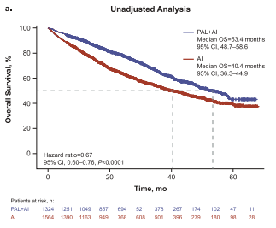
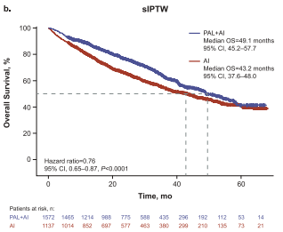
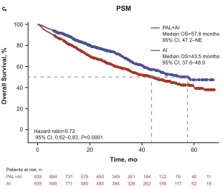
Real-World Study of Overall Survival with Palbociclib Plus Aromatase Inhibitor in HR+/HER2- Metastatic Breast Cancer (P-Reality X)
rwPFS (months)
Palbociclib + AI AI
Median unadjusted 19.8 13.9
sIPTW 19.3 13.9
PSM 19.8 14.9
OS (months)
Palbociclib +AI AI
Median unadjusted 53.4 40.4
sIPTW 49.1 43.2
PSM 57.8 43.5

Slide 6
Real-World Clinical Outcomes of Palbociclib Plus Endocrine Therapy (ET) in HR+ Advanced Breast Cancer: Results from the POLARIS Trial
Data source: prospective, observational, multi-institutional real-world study
N= 1242, 902 1st line therapy and 340 2nd line or later therapy
Demographics: median age 64, 82% non-Hispanic white, 68% recurrent disease, 39% visceral metastatic disease, and 34% bone only metastatic disease
Median follow up: 35.7 months
Endpoints: rwPFS, rwRR, rwCBR, OS

Slide 7
Real-World Clinical Outcomes of Palbociclib Plus Endocrine Therapy (ET) in HR+ Advanced Breast Cancer: Results from the POLARIS Trial
 | 1L (n=902) | ≥2L (n=340)
rwRR (%) | 33 | 21.5
rwCBR(%) | 68 | 58
rwPFS(mo) | 32.2 | 24.2
OS (mo) | 50.8 | 40.0
rwRR = physician-assessed response
rwCBR = CR+PR+SD 24 weeks
rwPFS = physician-documented progression or death due to any cause
OS = death due to any cause

Slide 8
Real-World Outcomes of Ribociclib and Aromatase Inhibitor Use in First Line HR+, HER2- Metastatic Breast Cancer
Data source: Medicine Access Program (Australia)
KARMA - registry of patients who received 1st line ribociclib and AI for HR+/HER2- metastatic breast cancer designed to analyze real-world treatment and survival outcomes
N= 160 , timeline 5/2017 – 6/2018
Demographics: median age 54, 24% pre-menopausal, 31% bone only metastatic disease, 36% visceral disease
Median Follow up: 36.4 months
Endpoints: PFS

Slide 9
Real-World Outcomes of Ribociclib and Aromatase Inhibitor Use in First Line HR+, HER2- Metastatic Breast Cancer
Median PFS – not reached (CI 29.9 – NR)
KARMA registry compared to the RCT (MONALEESA-2)
Younger patients – 54 vs 62 years old
Higher rates of bone-only metastatic disease – 31% vs 21%
Less visceral metastatic disease – 36% vs 59%
Fewer number of metastatic sites (>1 metastatic site) – 40% vs 69%
KARMA registry had superior PFS (>36.5 m) to MONALEESA-2 due to more favorable baseline characteristics and possible less frequent assessment scheduling
PFS | KARMA registry | MONALEESA-2
12m | 76% | 67%
18m | 73% | 63%

Slide 10
Real-World Characteristics, Utilization Patterns, and Outcomes of US Patients with HR+, HER2- Metastatic Breast Cancer Treated with Abemaciclib
RWE with abemaciclib (+ AI or FUL or monotherapy)
Data source: pharmacy claims (IBM Market Scan Research Database)
N= 454 , timeline 9/2017 – 10/2019
Demographics:
mean age 58
35% pre-menopausal
35% FUL, 29% AI, 10% monotherapy, 25% other
24% prior chemotherapy
50% prior CDK 4/6 inhibitor
50% visceral metastases
11.5% brain metastases
Endpoints: TTD, TTC, medication adherence, medication wastage

Slide 11
Real-World Characteristics, Utilization Patterns, and Outcomes of US Patients with HR+, HER2- Metastatic Breast Cancer Treated with Abemaciclib
73% initiated abemaciclib at the index dose of 150mg 2x/day
Patients who received prior CDK 4/6 inhibitor more likely started at a lower dose
31% had a dose reduction within 90 days of starting, lower than RCTs (drug wastage)
86% of patients refilled abemaciclib at least once (drug adherence)
Time-to-event outcomes |  | TTD (days) | TTC (days)
Abemaciclib + AI | no prior CDK 4/6i | NR | NR
 | prior CDK 4/6i | 196 | 347
Abemeciclib + FUL | no prior CDK 4/6i | 531 | NR
 | prior CDK 4/6i | 146 | 512
Abemaciclib monotherapy | no prior CDK 4/6i | 141 | 535
 | prior CDK 4/6i | 140 | NR

Slide 12
Looking for more resources on this topic?
CME/CE in minutes
Congress highlights
Late-breaking data
Quizzes
Webinars
In-person events
Slides & resources
www.MedEdOTG.com

