Slide 1
What is the Recommended
Monitoring Plan for Patients
Receiving RET Targeted Therapies
Justin F. Gainor, MD
Director, Center for Thoracic Cancers
Director, Targeted Immunotherapy
Massachusetts General Hospital
Harvard Medical School
Boston, MA

Slide 2
Disclaimer
The views and opinions expressed in this educational activity are those of the faculty and do not necessarily represent the views of TotalCME, Inc., the CME providers, or the companies providing educational grants. This presentation is not intended to define an exclusive course of patient management; the participant should use their clinical judgment, knowledge, experience, and diagnostic skills in applying or adopting for professional use any of the information provided herein. Any procedures, medications, or other courses of diagnosis or treatment discussed or suggested in this activity should not be used by clinicians without evaluation of their patient's conditions and possible contraindications or dangers in use, review of any applicable manufacturer’s product information, and comparison with recommendations of other authorities. Links to other sites may be provided as additional sources of information.

Slide 3
Selective RET TKIs
Agent | Ref | Post-Platinum |  |  | Treatment-naïve |  |  | Most Common AEs
 |  | N | ORR# | Median PFS | N | ORR# | Median PFS | Treatment-Related
Selpercatinib | Drilon A, et al. NEJM 2020 | 105 | 64% | 16.5 mo | 39 | 85% | NR | Dry mouth (36%), Diarrhea (22%), HTN (25%), elevated ALT/AST(20-22%), fatigue 19%
 | Drilon A, et al. JCO 2022 | 247 | 61% | 24.9 mo | 69 | 84% | 22.0
Pralsetinib | Gainor JF, et al. Lancet Oncol 2021 | 87 | 61% | 17.1 mo | 27 | 70% | 9.1 mo | Neutropenia (42%), AST increase (39%), anemia (38%), WBC decreased (30%), ALT increase (27%) HTN (25%)
 | Griesinger F, et al. Ann Oncol 2022 | 136 | 59% | 16.5 mo | 75 | 72% | 13.0 mo

Slide 4
My Monitoring Approach to RET-Targeted Therapy in NSCLC
Newly Diagnosed Patients Frontline
  Clinical assessments every 2 weeks (in person or virtually) with laboratory monitoring (CBC, comprehensive metabolic profile)
  Scan at 6 weeks
For patients responding to and tolerating RET-targeted therapy
  Visits every 4-6 weeks up until month 6; then every 3 months
  Scan every 3 months if responding after first assessment
Intracranial monitoring
  Patients with baseline brain metastases – brain MRI with each response assessment
  Patients without brain metastases at baseline, surveillance brain MRI every 6-12 months
Refer to approved prescribing information for pralsetinib and selpercatinib

Slide 5
My Monitoring Approach to RET-Targeted Therapy in NSCLC
Newly Diagnosed Patients Frontline
  Clinical assessments every 2 weeks (in person or virtually) with laboratory monitoring (CBC, comprehensive metabolic profile)
  Scan at 6 weeks
For patients responding to and tolerating RET-targeted therapy
  Visits every 4-6 weeks up until month 6; then every 3 months
  Scan every 3 months if responding after first assessment
Intracranial monitoring
  Patients with baseline brain metastases – brain MRI with each response assessment
  Patients without brain metastases at baseline, surveillance brain MRI every 6-12 months
Refer to approved prescribing information for pralsetinib and selpercatinib

Slide 6
My Monitoring Approach to RET-Targeted Therapy in NSCLC
Newly Diagnosed Patients Frontline
  Clinical assessments every 2 weeks (in person or virtually) with laboratory monitoring (CBC, comprehensive metabolic profile)
  Scan at 6 weeks
For patients responding to and tolerating RET-targeted therapy
  Visits every 4-6 weeks up until month 6; then every 3 months
  Scan every 3 months if responding after first assessment
Intracranial monitoring
  Patients with baseline brain metastases – brain MRI with each response assessment
  Patients without brain metastases at baseline, surveillance brain MRI every 6-12 months
Refer to approved prescribing information for pralsetinib and selpercatinib

Slide 7
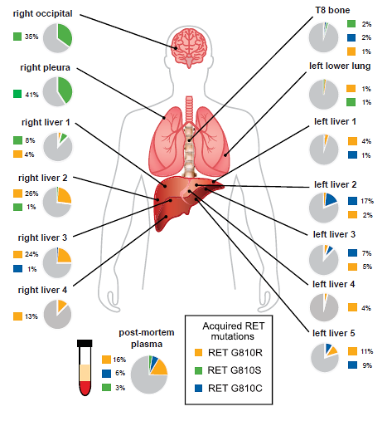
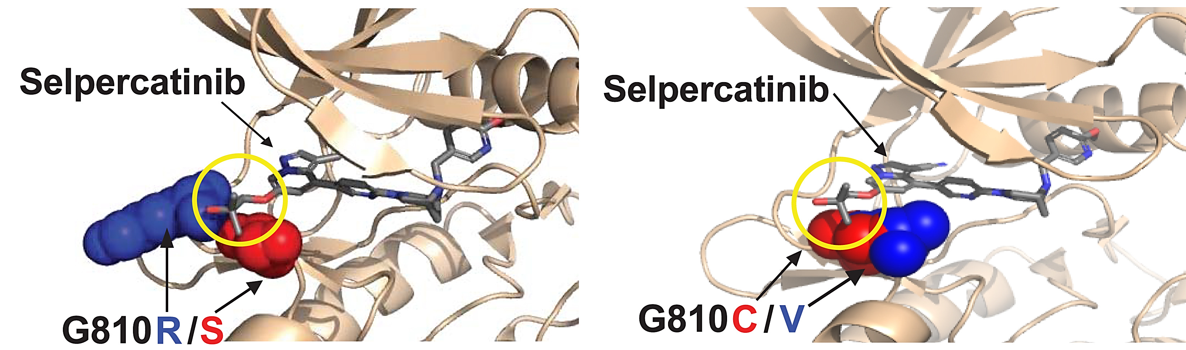
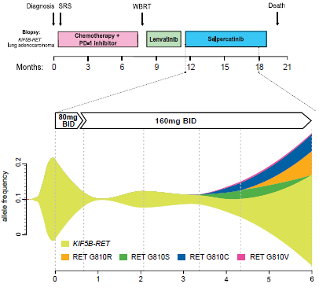
RET Inhibitor Resistance
RET Solvent Front Mutations cause acquired resistance to selpercatinib

Slide 8
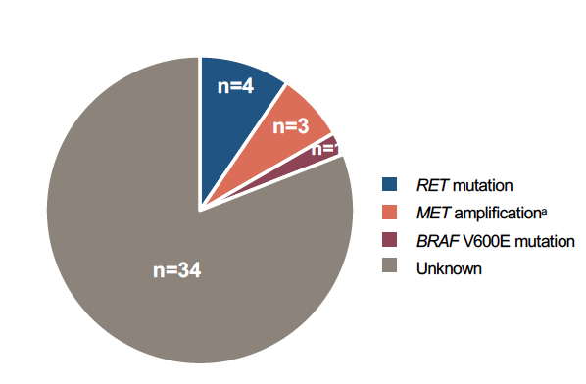
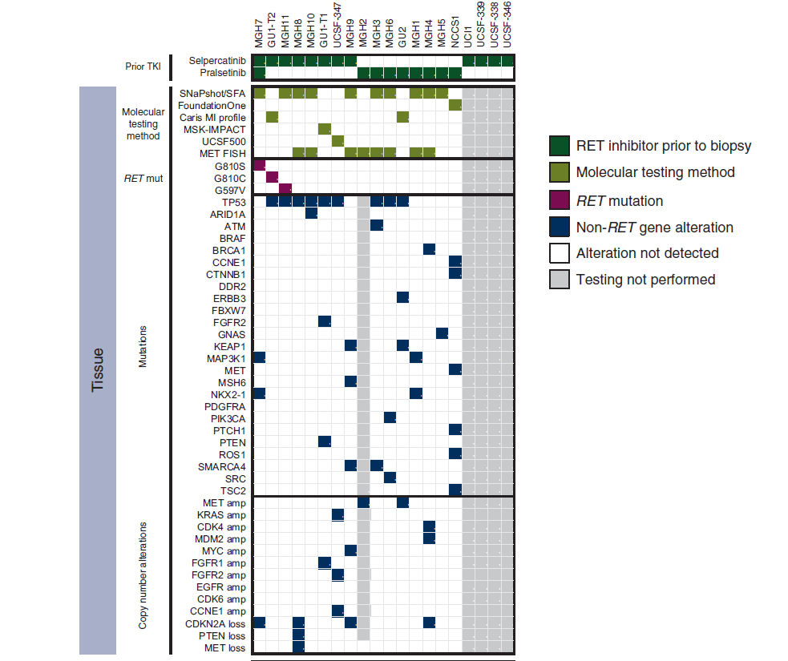
RET Inhibitor Resistance
Multi-Institutional Retrospective Analysis
ctDNA Analysis from ARROW
Initial Insights
On-target resistance is uncommon (~10%)
Several bypass signaling pathways identified, including MET amplification (10-15%)

Slide 9
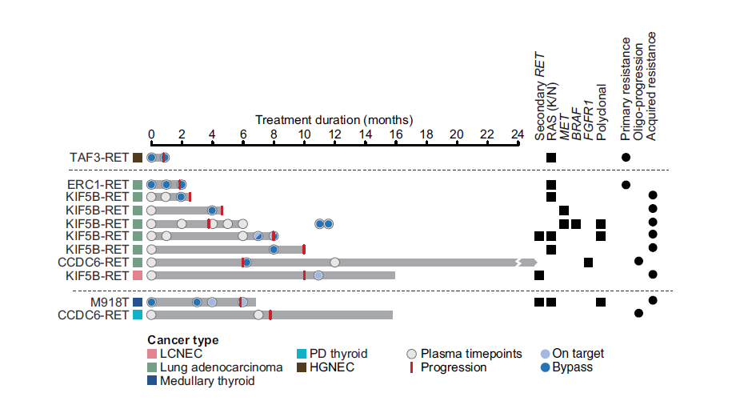
Mechanisms of RET Inhibitor Resistance

