Slide 1
Side-Effects of
RET-Targeted Therapy
Alexander Drilon, MD
Chief, Early Drug Development Service
Associate Attending Physician, Thoracic Oncology Service
Memorial Sloan Kettering Cancer Center
New York, NY

Slide 2
Disclaimer
The views and opinions expressed in this educational activity are those of the faculty and do not necessarily represent the views of TotalCME, Inc., the CME providers, or the companies providing educational grants. This presentation is not intended to define an exclusive course of patient management; the participant should use their clinical judgment, knowledge, experience, and diagnostic skills in applying or adopting for professional use any of the information provided herein. Any procedures, medications, or other courses of diagnosis or treatment discussed or suggested in this activity should not be used by clinicians without evaluation of their patient's conditions and possible contraindications or dangers in use, review of any applicable manufacturer’s product information, and comparison with recommendations of other authorities. Links to other sites may be provided as additional sources of information.

Slide 3
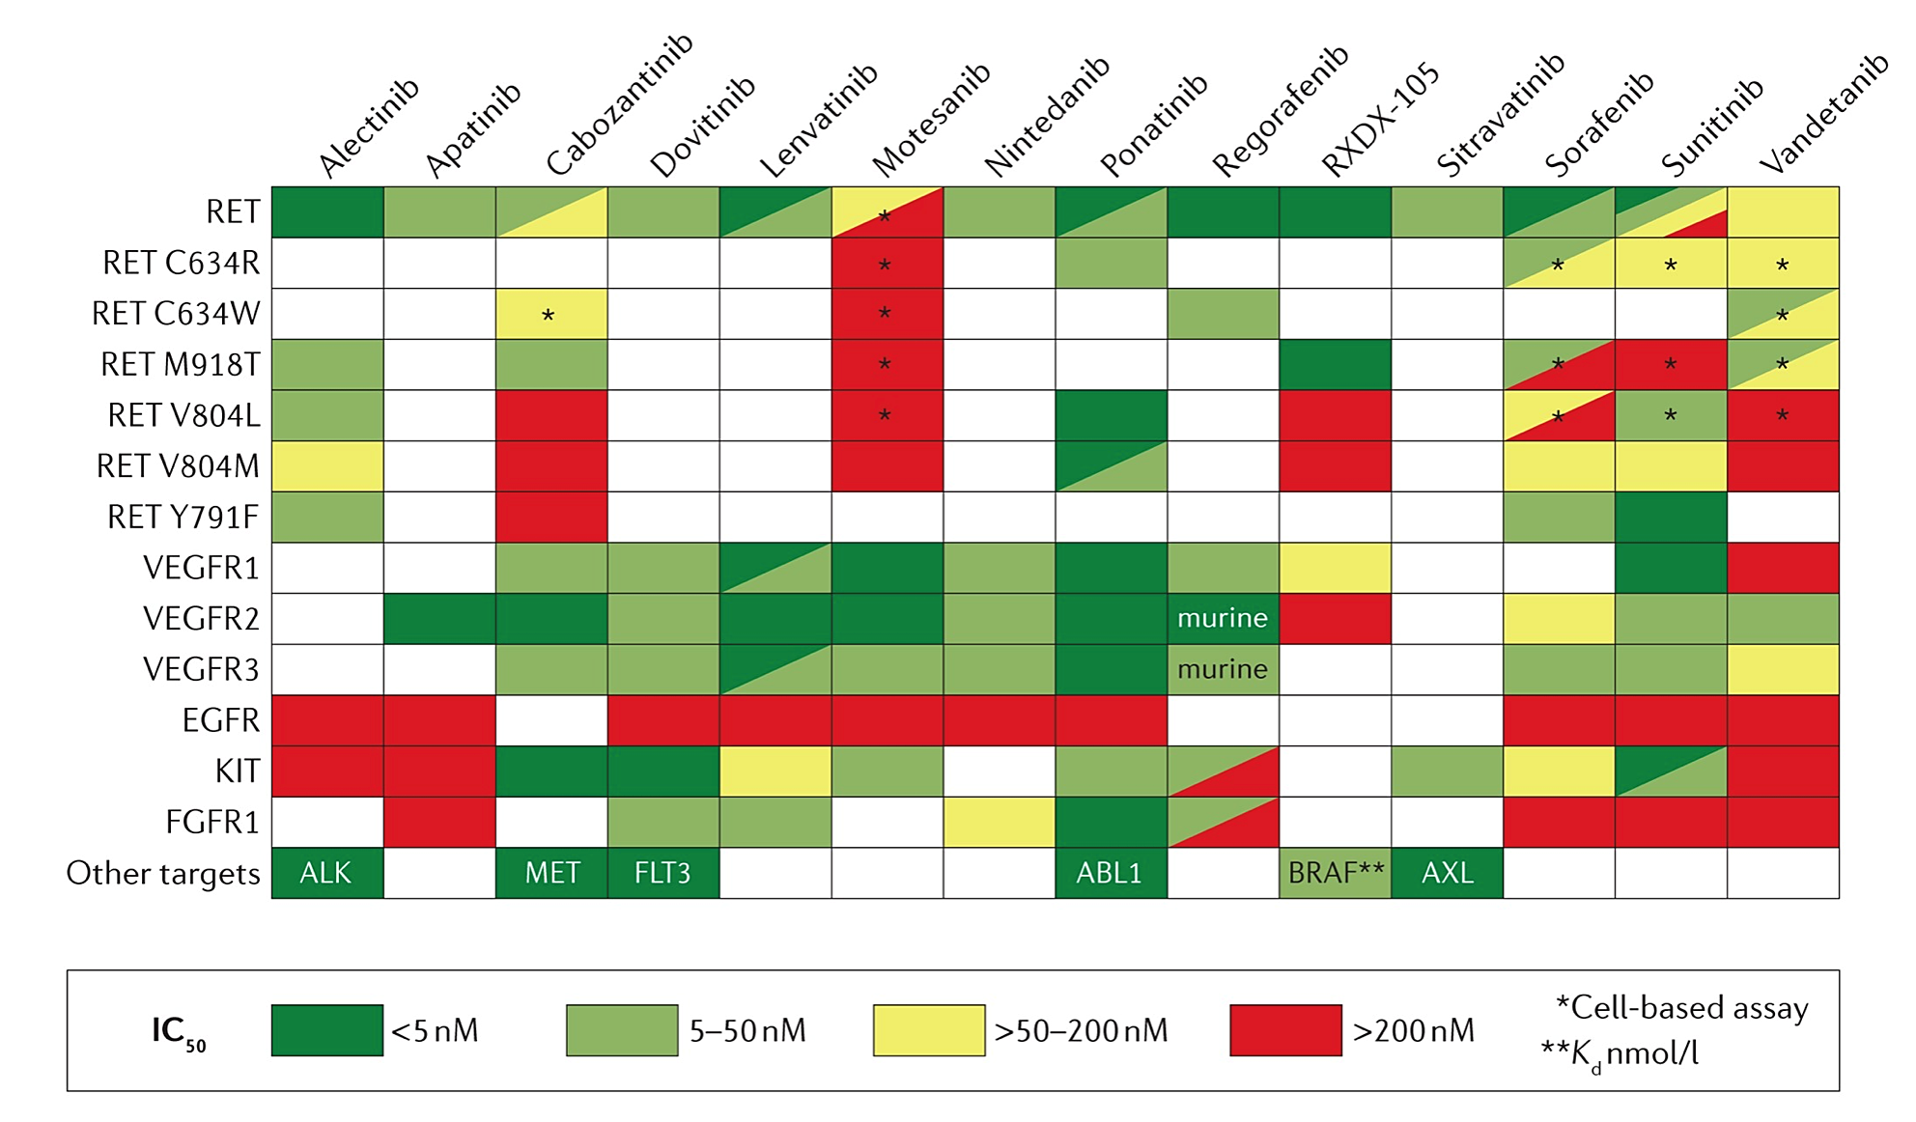
Older RET TKIs Were Multikinase Inhibitors

Slide 4
Multikinase Inhibitors Had Challenging Drug Properties

Slide 5
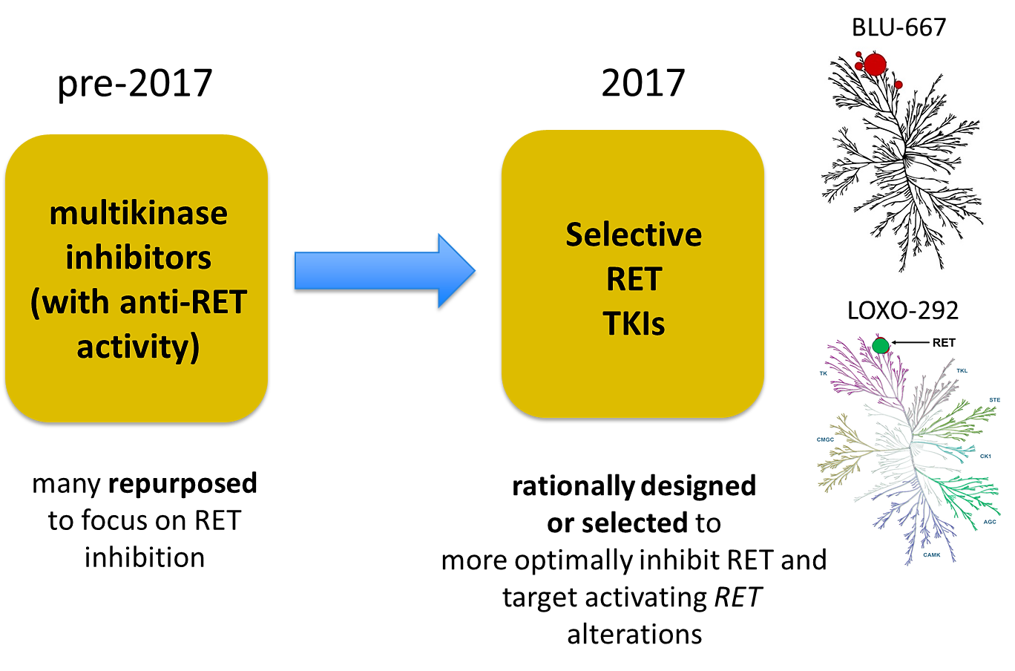
Selective RET Inhibitors Entered Clinical Testing in 2017
RET
RET
RET
RET
RET

Slide 6
Selective RET Inhibitors Are Well Tolerated
 | Selpercatinib (LIBRETTO-001)¹ | Pralsetinib (ARROW)²
Most common TRAEs (% all grade) | Dry mouth (39%) HTN (30%) AST increase (28%) ALT increase (26%) Fatigue (25%) Peripheral edema (18%) Diarrhea (17%) | AST increase (34%) Anemia (24%) ALT increase (23%) HTN (22%) Constipation (23%) WBC decrease (18%) Neutropenia (18%)
Discontinuation due to TRAEs | 2% | 4%

Slide 7
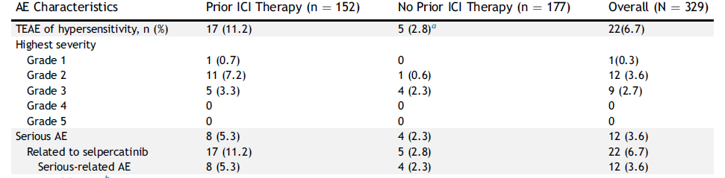
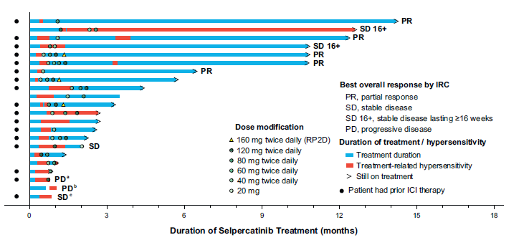
Hypersensitivity Can Occur With Selective RET Inhibition

Slide 8
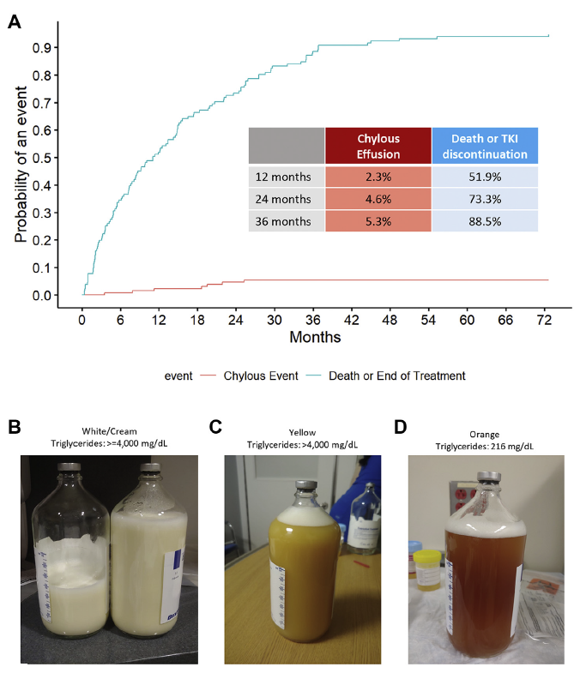
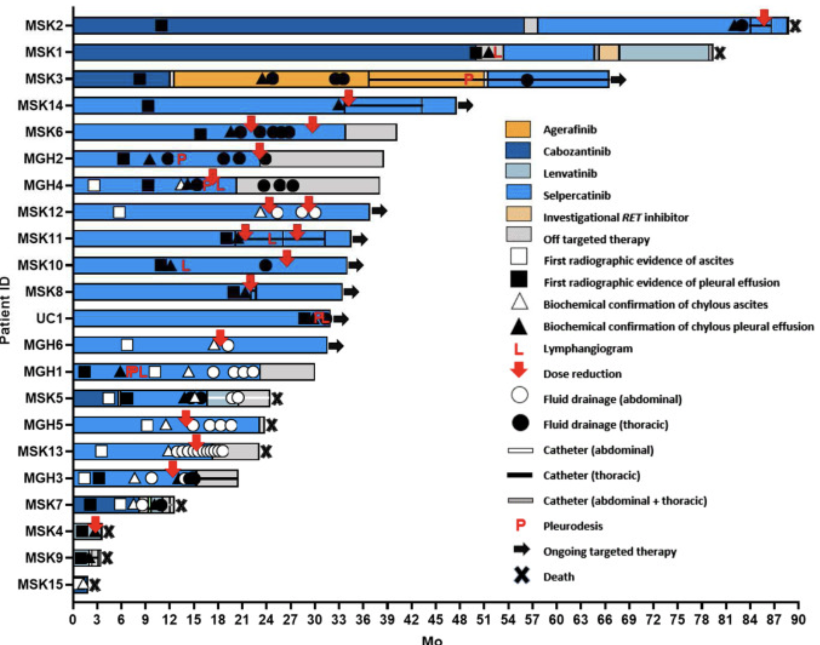
Chylous Effusions Can Occur With RET Inhibition

