Slide 1
Can I Use Targeted Therapy in
RET-Positive mNSCLC in
Pretreated Patients?
Justin F. Gainor, MD
Director, Center for Thoracic Cancers
Director, Targeted Immunotherapy
Massachusetts General Hospital
Harvard Medical School
Boston, MA

Slide 2
Disclaimer
The views and opinions expressed in this educational activity are those of the faculty and do not necessarily represent the views of TotalCME, Inc., the CME providers, or the companies providing educational grants. This presentation is not intended to define an exclusive course of patient management; the participant should use their clinical judgment, knowledge, experience, and diagnostic skills in applying or adopting for professional use any of the information provided herein. Any procedures, medications, or other courses of diagnosis or treatment discussed or suggested in this activity should not be used by clinicians without evaluation of their patient's conditions and possible contraindications or dangers in use, review of any applicable manufacturer’s product information, and comparison with recommendations of other authorities. Links to other sites may be provided as additional sources of information.

Slide 3
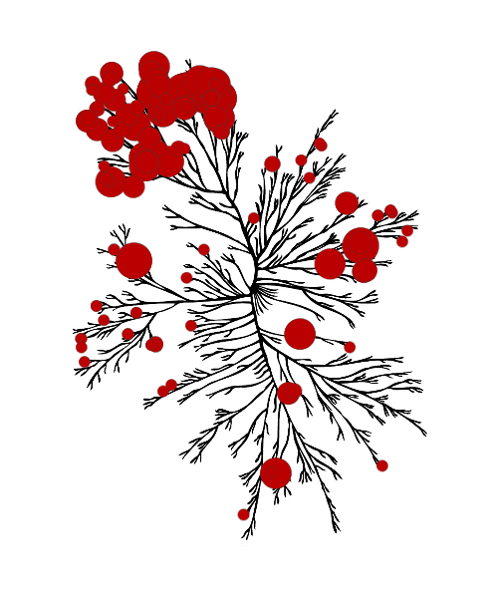
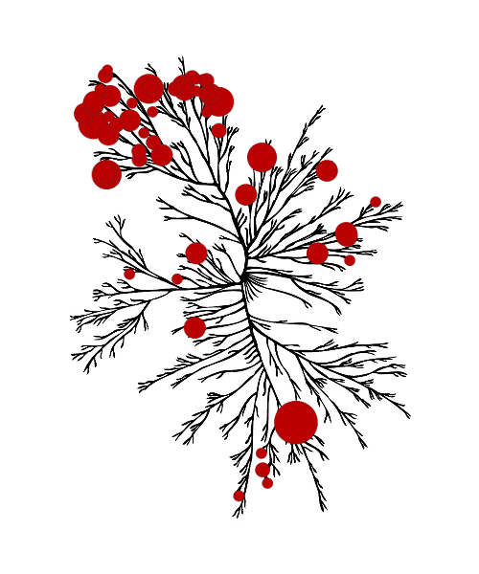
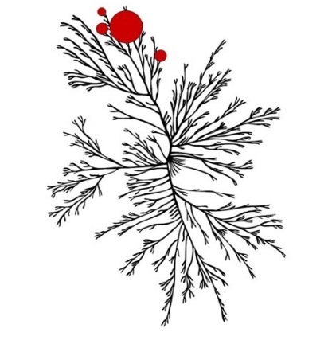
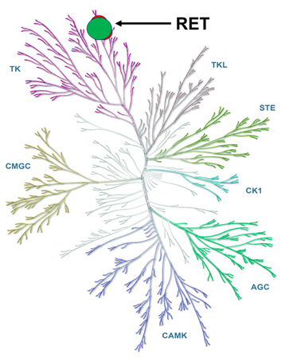
Selectivity Profile of RET Inhibitors
Multikinase Inhibitors (MKIs)
Selective RET Inhibitors
Pralsetinib
(BLU-667)
Selpercatinib
(LOXO-292)
Cabozantinib
Vandetanib

Slide 4
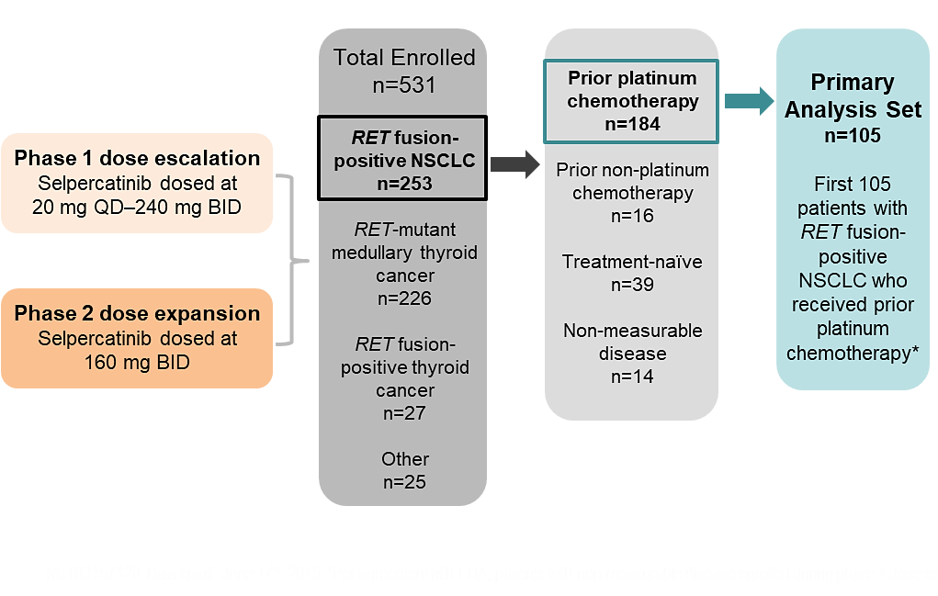
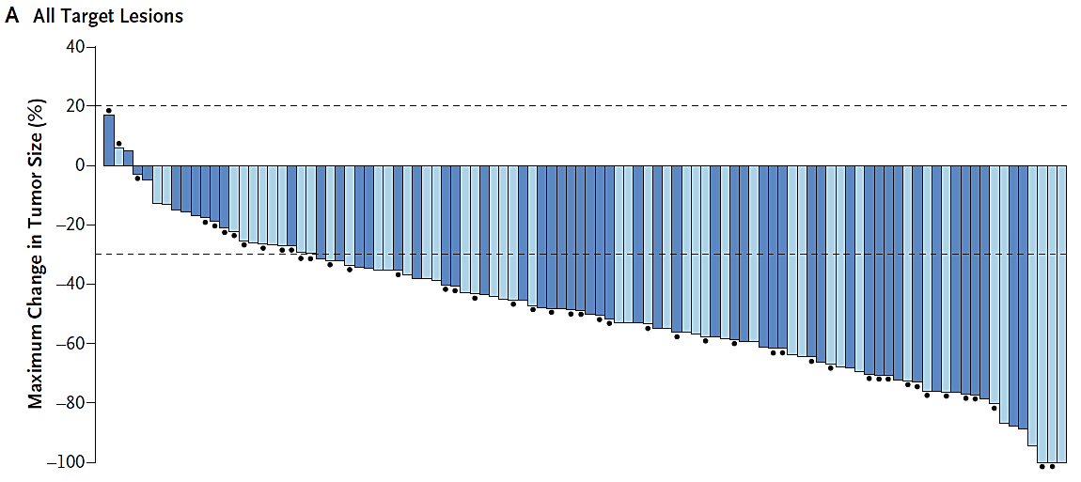
Libretto-001: Selpercatinib
Prior Platinum
ORR 64-70%

Slide 5
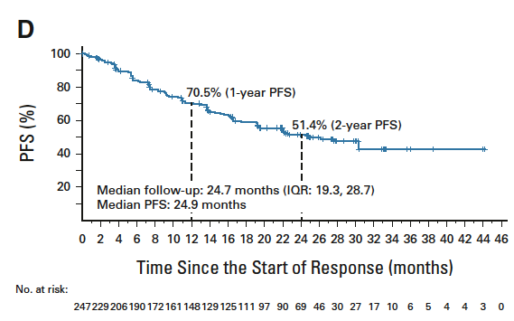
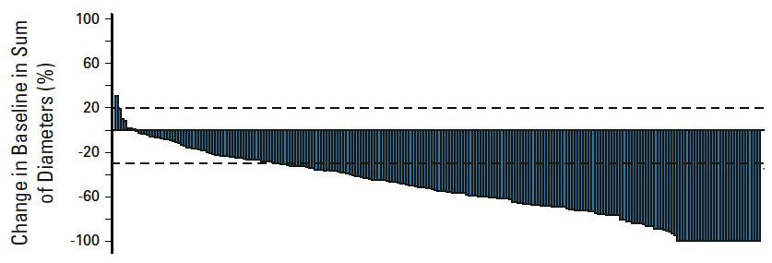
Libretto-001: Update
Prior Platinum (N=247)
ORR 61%

Slide 6
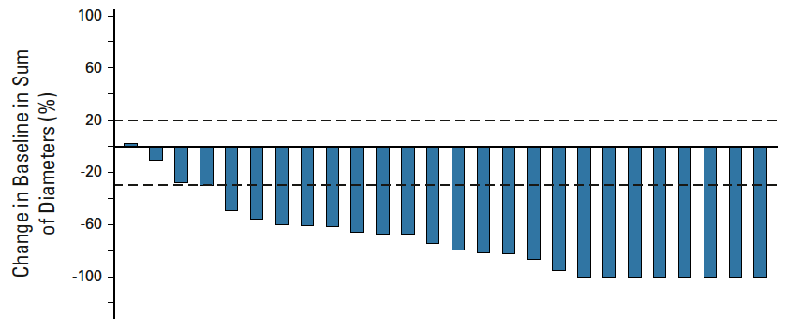
Selpercatinib: CNS Activity
Patients with Measurable Brain Metastases (N=26)
Intracranial ORR = 85%

Slide 7
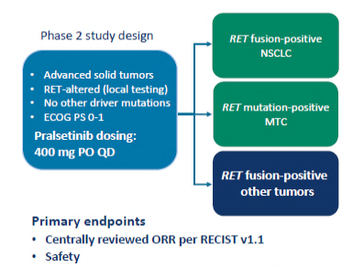
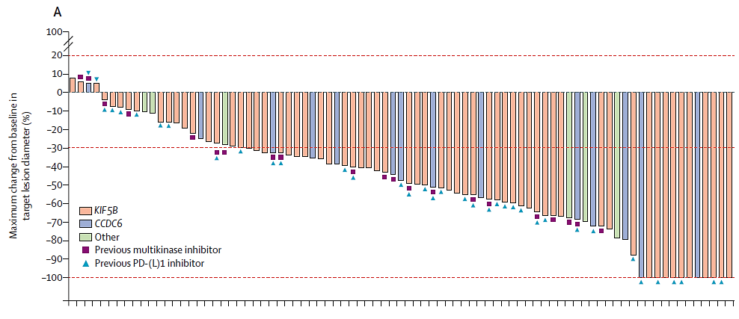
ARROW: Pralsetinib
Prior Platinum-Doublet
ORR 61%
n=87

Slide 8
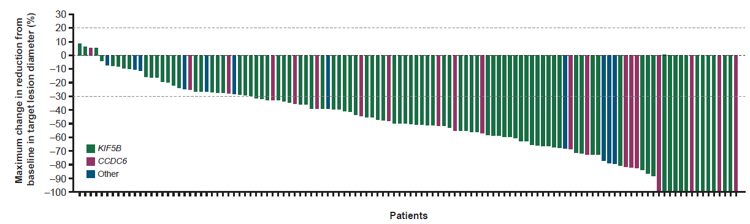
ARROW Update: Tumor Shrinkage in Patients With RET Fusion-Positive NSCLC Treated With Pralsetinib
Prior Platinum-Doublet
ORR 59%
n=120
The dotted lines represent the thresholds for progressive disease (+20%), partial response (-30%), and complete response (-100%) as per RECIST.

Slide 9
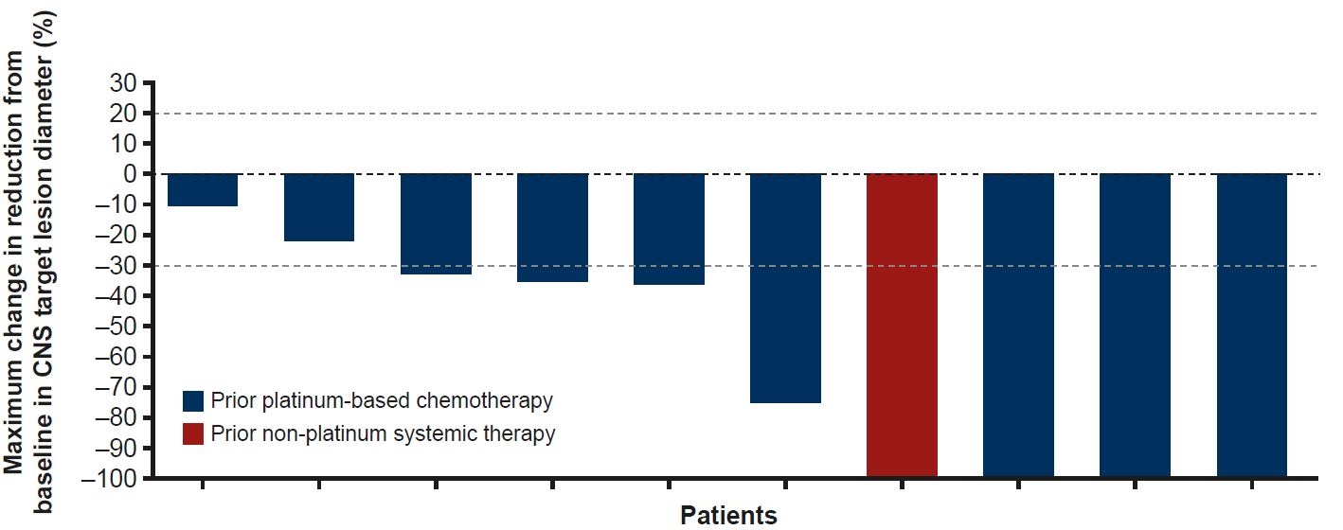
Pralsetinib: CNS Tumor Shrinkage
Intracranial ORR: 70%
(N=10 pts with measurable CNS disease)
CNS, central nervous system.

Slide 10
Selective RET TKIs
Agent | Ref | Post-Platinum |  |  | Treatment-naïve |  |  | Most Common AEs
 |  | N | ORR# | Median PFS | N | ORR# | Median PFS | Treatment-Related
Selpercatinib | Drilon A, et al. NEJM 2020 | 105 | 64% | 16.5 mo | 39 | 85% | NR | Dry mouth (36%), Diarrhea (22%), HTN (25%), elevated ALT/AST(20-22%), fatigue 19%
 | Drilon A, et al. JCO 2022 | 247 | 61% | 24.9 mo | 69 | 84% | 22.0
Pralsetinib | Gainor JF, et al. Lancet Oncol 2021 | 87 | 61% | 17.1 mo | 27 | 70% | 9.1 mo | Neutropenia (42%), AST increase (39%), anemia (38%), WBC decreased (30%), ALT increase (27%) HTN (25%)
 | Griesinger F, et al. Ann Oncol 2022 | 136 | 59% | 16.5 mo | 75 | 72% | 13.0 mo

