Slide 1
Targeted Therapy for Treatment-Naïve RET Fusion-Positive Lung Cancers
Alexander Drilon, MD
Chief, Early Drug Development Service
Associate Attending Physician, Thoracic Oncology Service
Memorial Sloan Kettering Cancer Center
New York, NY

Slide 2
Disclaimer
The views and opinions expressed in this educational activity are those of the faculty and do not necessarily represent the views of TotalCME, Inc., the CME providers, or the companies providing educational grants. This presentation is not intended to define an exclusive course of patient management; the participant should use their clinical judgment, knowledge, experience, and diagnostic skills in applying or adopting for professional use any of the information provided herein. Any procedures, medications, or other courses of diagnosis or treatment discussed or suggested in this activity should not be used by clinicians without evaluation of their patient's conditions and possible contraindications or dangers in use, review of any applicable manufacturer’s product information, and comparison with recommendations of other authorities. Links to other sites may be provided as additional sources of information.

Slide 3
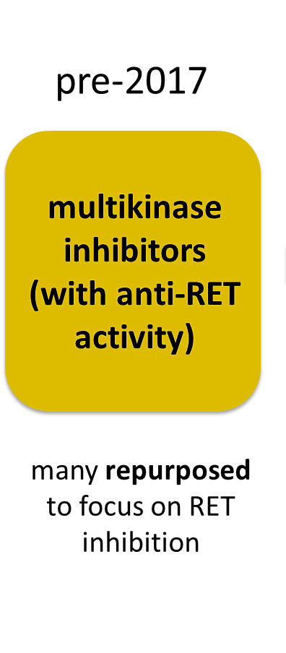
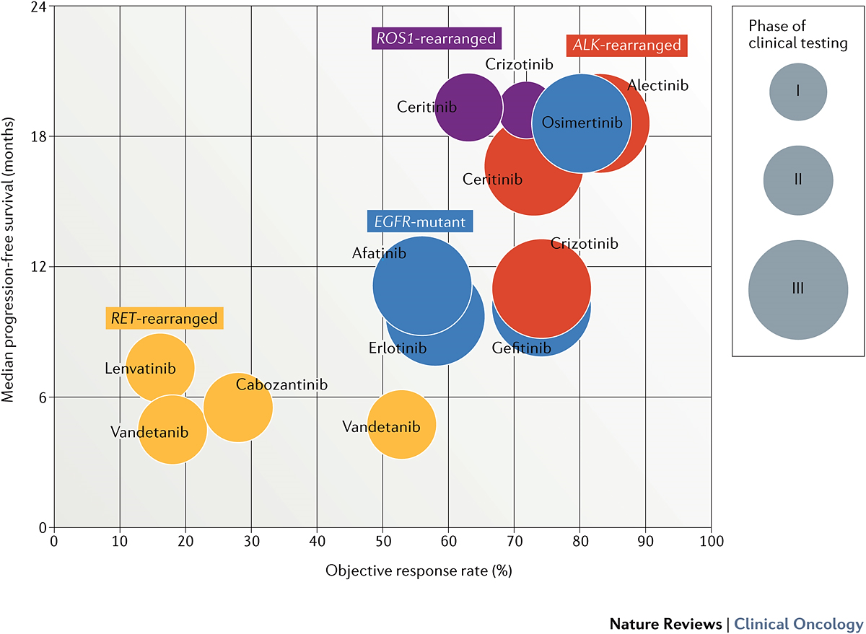
Multikinase Inhibitors Resulted in Modest Outcomes
RET
RET
RET

Slide 4

Selective RET Inhibitors Entered Clinical Testing in 2017
RET
RET
RET
RET
RET

Slide 5
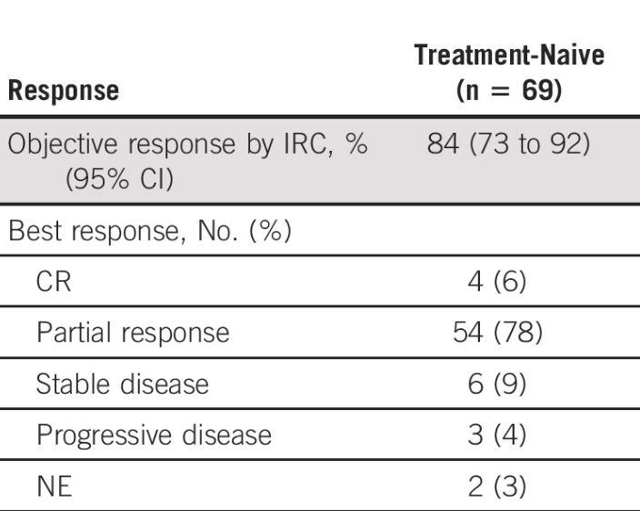
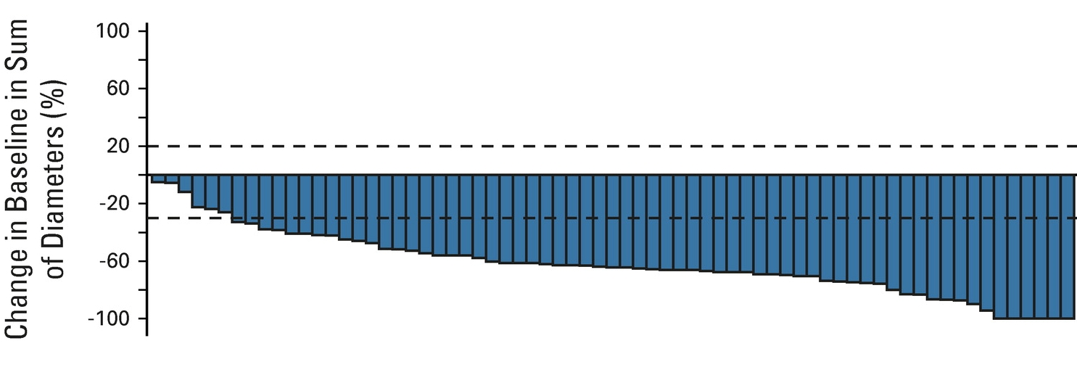
Selpercatinib Response in Treatment-Naïve RET Fusion+ NSCLCs
Vertical bars represent the best percent change from baseline in the sum of diameters for all target lesions. Progressive disease (120%) and partial response (–30%) are indicated by the dashed lines.

Slide 6
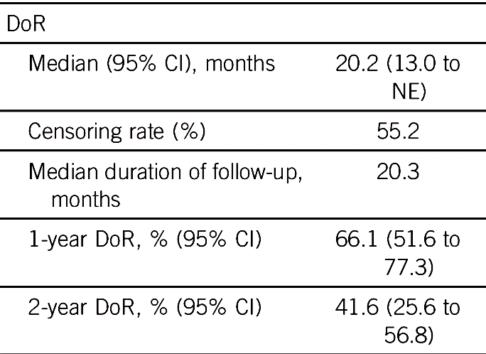
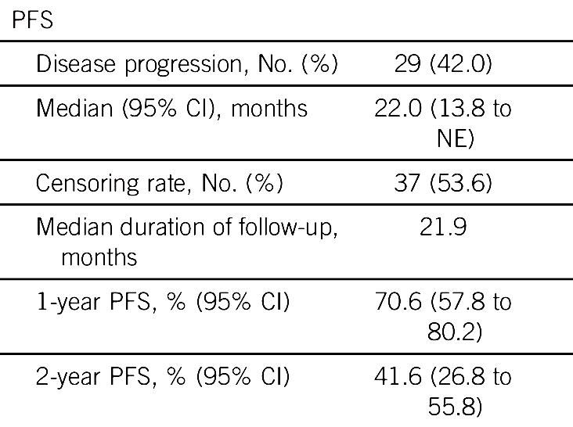
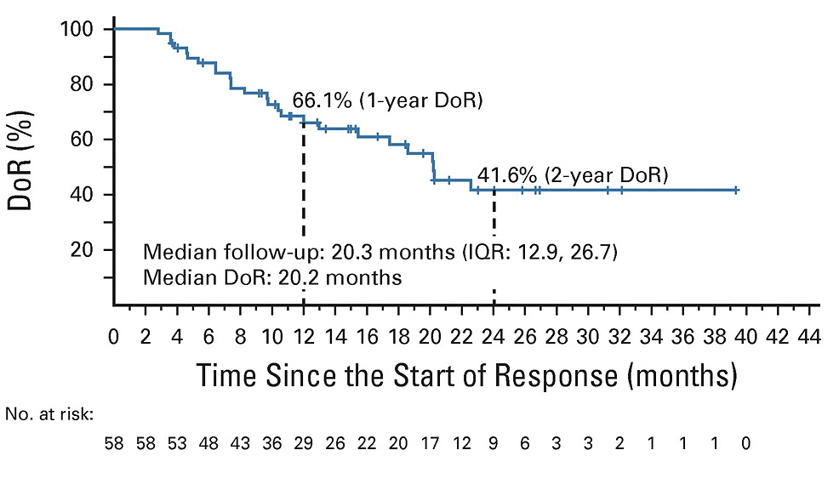
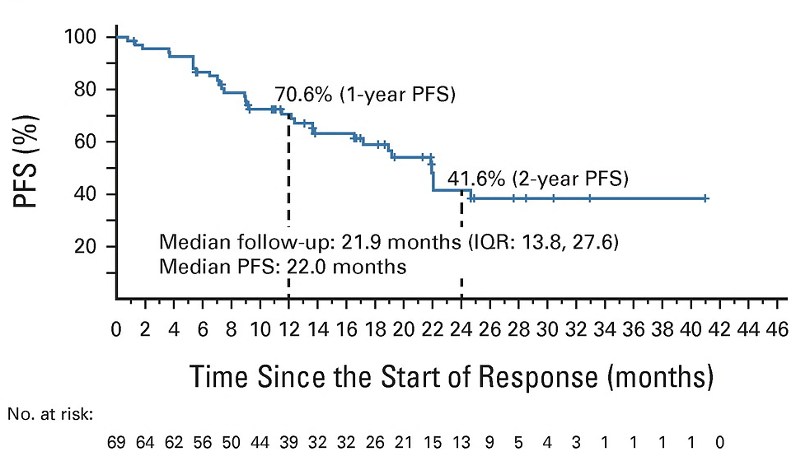
Selpercatinib Durability in Treatment-Naïve RET Fusion+ NSCLCs

Slide 7
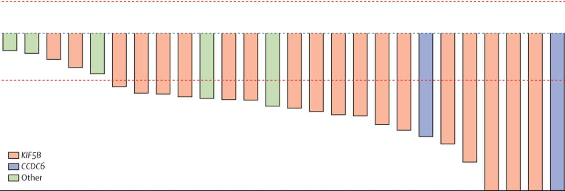
Pralsetinib Response in Treatment-Naïve RET Fusion+ NSCLCs
100
 |  | No previous systemic treatment group (n=27)
Overall response rate |  | 19 (70%; 50-86)
Disease control rate |  | 23 (85%; 66-96)
Best overall response
 | Complete response | 3 (11%)
 | Partial response | 16 (59%)
 | Stable disease | 4 (15%)
 | Progressive disease | 3 (11%)
 | Not evaluable | 1 (4%)
20
10
0
-10
-20
Maximum change from baseline in
target lesion diameter (%)
-30
-40
-50
-60
-70
KIF5B
CCDC6
Other
-80
-90
-100
Patients
The dotted lines are positioned at +20%, -30%, and -100%; these represent the thresholds for progressive disease, partial response, and complete response per RECIST.

Slide 8
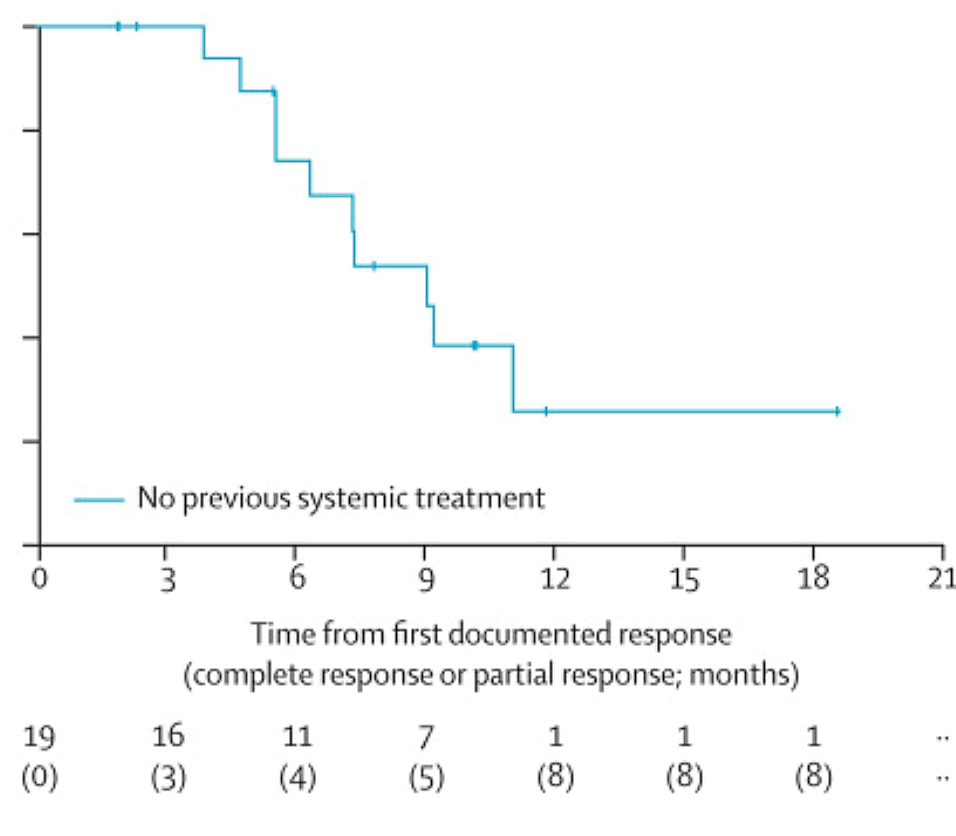
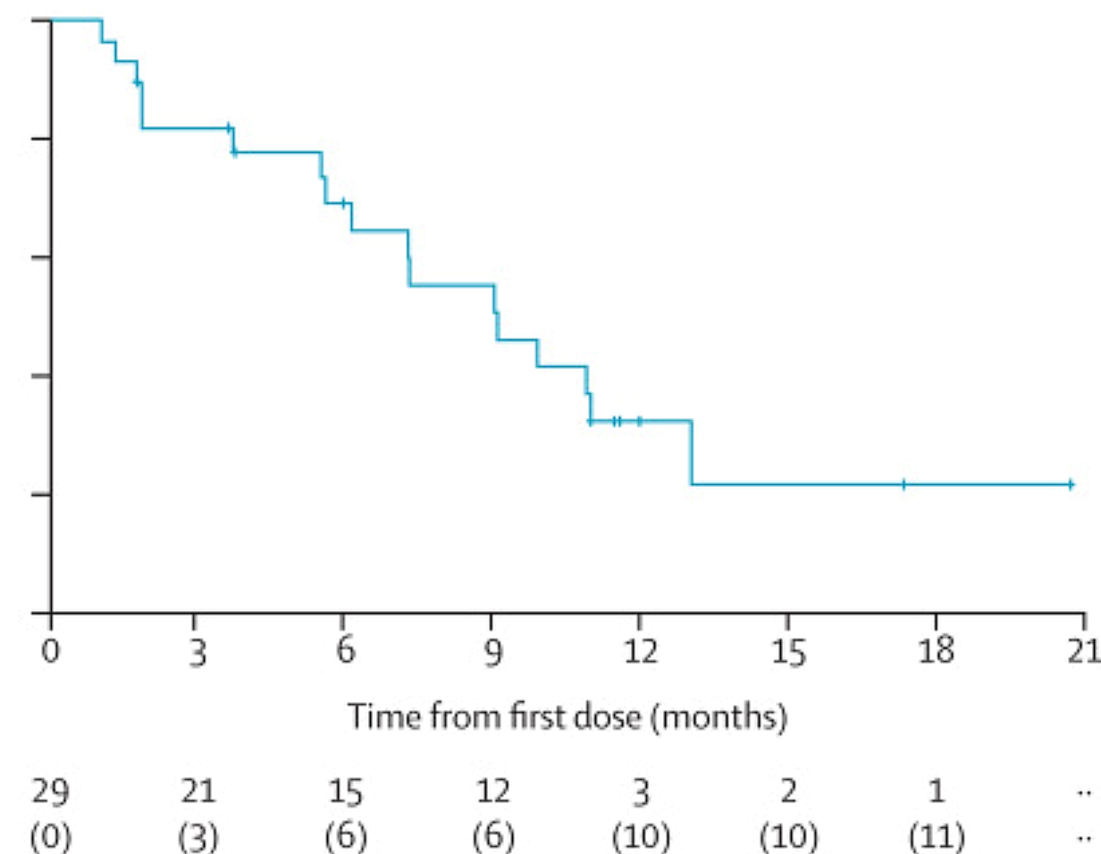
Pralsetinib Durability in Treatment-Naïve RET Fusion+ NSCLCs
DoR
PFS
Median duration of response, months |  | 9-0 (6-3-NE)
 | Rate at 6 months | 74%; 52-96
 | Rate at 12 months | 26%; 0-52
Clinical benefit rate§ | Stable disease | 70% (50-86)
Median progression-free survival: 9·1 months (95% CI 6·1–13·0)
Median follow-up of 14·7 months: 11·6 months (IQR 11·0–17·3)

Slide 9
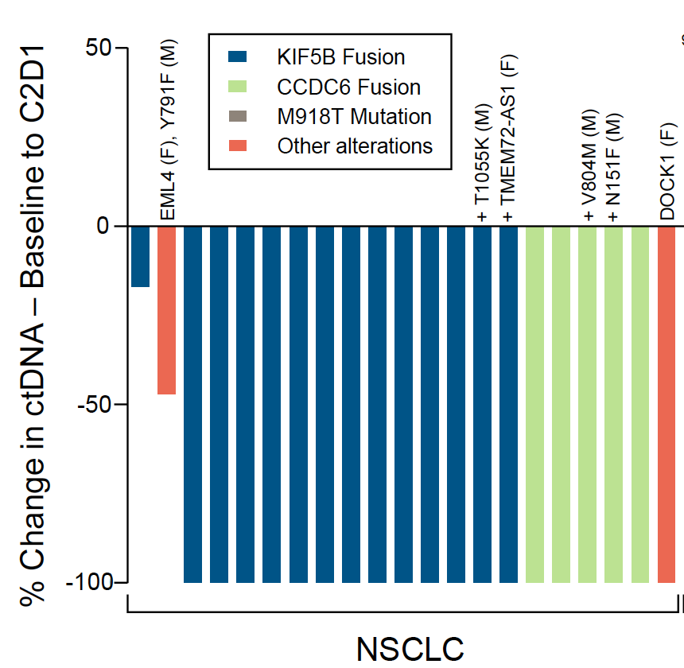
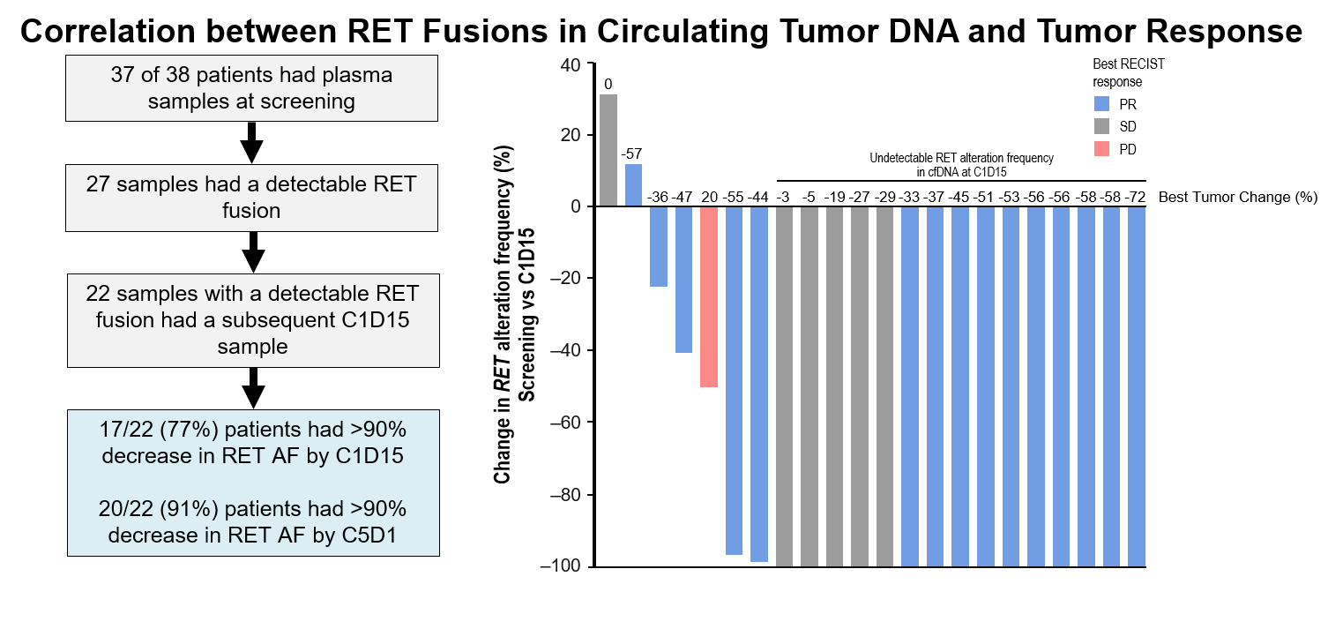
Selective RET Inhibitors Achieve Effective ctDNA Reduction
selpercatinib
pralsetinib
RET

Slide 10
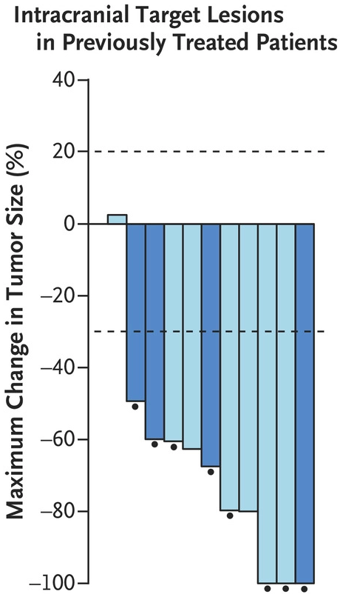
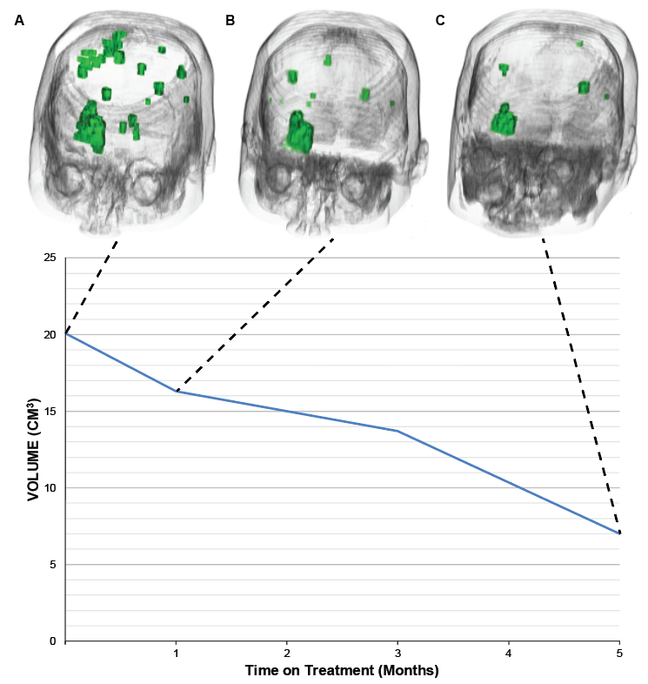
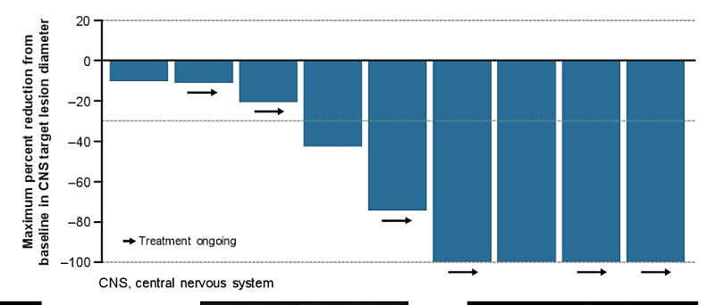
Selective RET Inhibitors Are Active in the CNS
Confirmed intracranial PR
Complete resolution of leptomeningeal disease
selpercatinib
pralsetinib
Intracranial ORR in 9 patients with measurable CNS metastases at baseline was 56%
A. baseline; B. 5 weeks; C. 21 weeks

Slide 11
Selective RET Inhibitors Achieve Durable Disease Control
 | Selpercatinib¹ Treatment-Naïve (n=69) | Pralsetinib² (Treatment-Naïve) (n=27)
ORR Treatment naïve | 84% | 70%
Median DoR Treatment naïve Median PFS Treatment naïve | 20.2 months 22.0 months | 9.0 months 9.1 months

Slide 12
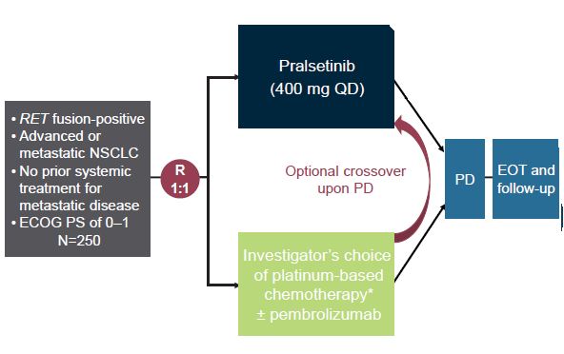
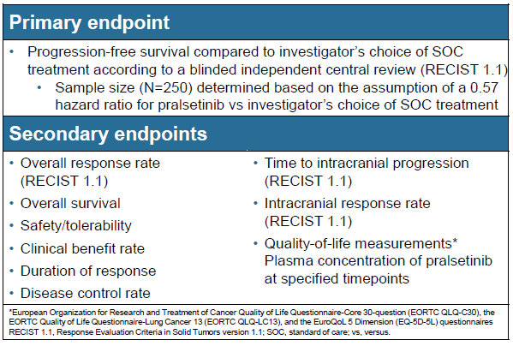
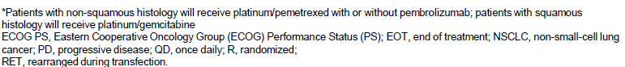
AcceleRET Lung: First-Line Pralsetinib with RET Fusion+ Adv/mNSCLC
Phase 3

Slide 13
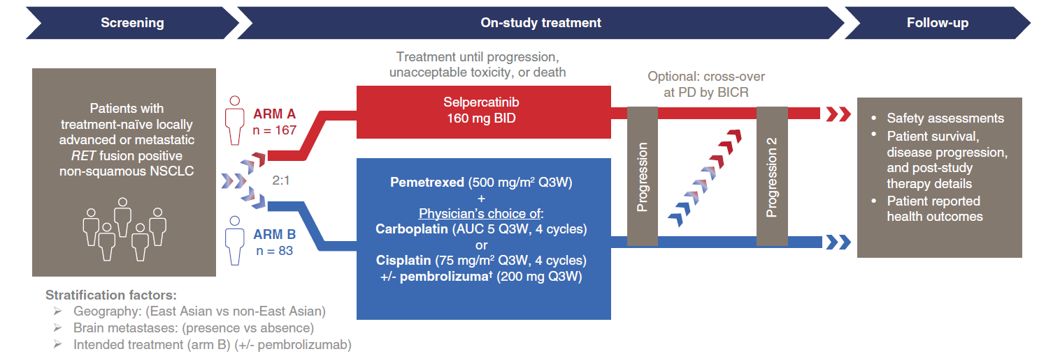
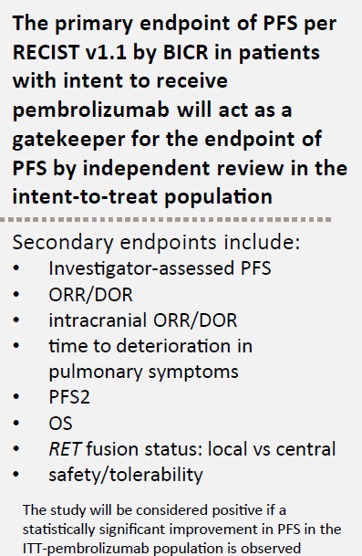
LIBRETTO-431: First-Line Selpercatinib vs. Chemotherapy ± Pembrolizumab in RET+ NSCLC
Endpoints

