Slide 1
What is the Preferred Molecular Testing Method to Detect RET Fusions in NSCLC
Justin F. Gainor, MD
Director, Center for Thoracic Cancers
Director, Targeted Immunotherapy
Massachusetts General Hospital
Harvard Medical School
Boston, MA

Slide 2
Disclaimer
The views and opinions expressed in this educational activity are those of the faculty and do not necessarily represent the views of TotalCME, Inc., the CME providers, or the companies providing educational grants. This presentation is not intended to define an exclusive course of patient management; the participant should use their clinical judgment, knowledge, experience, and diagnostic skills in applying or adopting for professional use any of the information provided herein. Any procedures, medications, or other courses of diagnosis or treatment discussed or suggested in this activity should not be used by clinicians without evaluation of their patient's conditions and possible contraindications or dangers in use, review of any applicable manufacturer’s product information, and comparison with recommendations of other authorities. Links to other sites may be provided as additional sources of information.

Slide 3
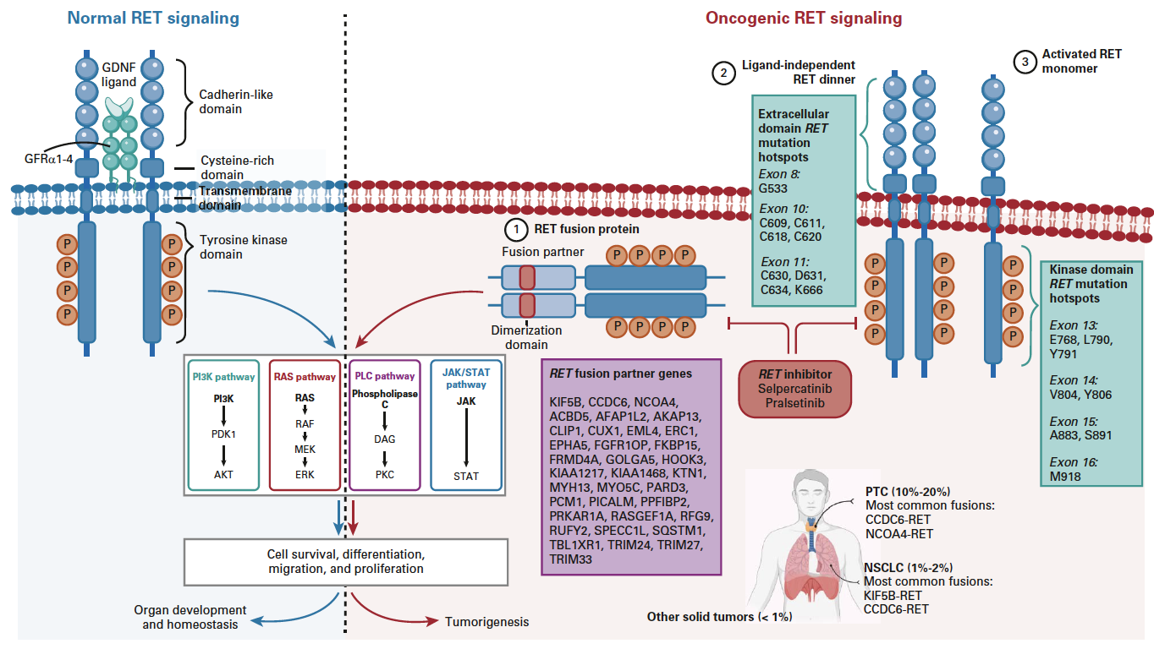
RET Fusions Across Cancers
RET
RET
RET
RET
RET

Slide 4
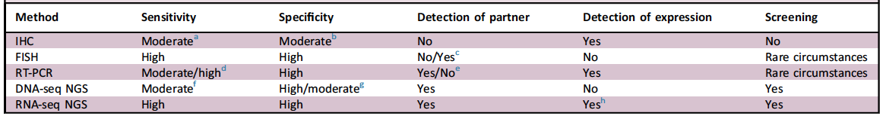
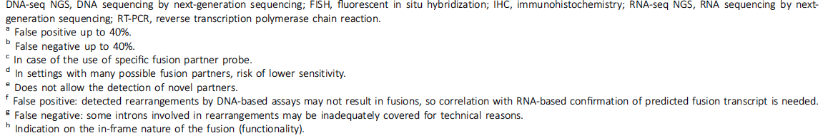
RET Testing

Slide 5
The Role of Liquid Biopsy Testing for RET Fusions in NSCLC
While not recommended as a replacement for a diagnostic tissue biopsy, consider liquid biopsy when FFPE tumor tissue is unavailable or insufficient for molecular profiling¹
NCCN Guidelines: principles of molecular and biomarker analysis in metastatic NSCLC²
Plasma ctDNA (liquid biopsy) should not be used in lieu of a histologic tissue diagnosis
Studies have demonstrated that liquid biopsy generally has a very high specificity but a significantly compromised sensitivity, with a false-negative rate of up to 30%
Standards and guidelines for liquid biopsy testing for genetic alterations have not been established

Slide 6
Recommended RET Testing for NSCLC
NSCLC, non-MTC, other solid tumor
FFPE specimen
available
FFPE specimen
not available
NGS available
NGS not available
Liquid biopsy
RET fusion positive in
NSCLC and non-MTC.
RET fusion/mutation
positive in other solid
tumors (pending results of clinical trials)
RET fusion/
mutation negative
FISH or RT-PCR for fusion
Q-PCR for mutation to be performed only in other
solid tumors (pending results of clinical trials)
RT-PCR for fusion
Q-PCR for mutation to be performed only in other
solid tumors (pending results of clinical trials)
Not eligible for RET
inhibitors
Eligible for RET
inhibitors
RET negative
RET positive
RET positive
RET negative
Consider NGS
Eligible for RET
inhibitors
Eligible for RET
inhibitors
Consider performing
tumor biopsy

Slide 7
Summary
It is important to be aware of available assays and their benefits and limitations
For RET fusions, it is important to identify these alterations to allow use of targeted therapies
RNA-based NGS is the preferred testing modality

