Slide 1
The Mechanism of Action of JAK Inhibitors for Myelofibrosis
John Mascarenhas, MD Director, Adult Leukemia Program Leader, Myeloproliferative Disorders Clinical Research Program Tisch Cancer Institute, Division of Hematology and Oncology Icahn School of Medicine at Mount Sinai New York, NY

Slide 2
Disclaimer
The views and opinions expressed in this educational activity are those of the faculty and do not necessarily represent the views of TotalCME, Inc., the CME providers, or the companies providing educational grants. This presentation is not intended to define an exclusive course of patient management; the participant should use their clinical judgment, knowledge, experience, and diagnostic skills in applying or adopting for professional use any of the information provided herein. Any procedures, medications, or other courses of diagnosis or treatment discussed or suggested in this activity should not be used by clinicians without evaluation of their patient's conditions and possible contraindications or dangers in use, review of any applicable manufacturer’s product information, and comparison with recommendations of other authorities. Links to other sites may be provided as additional sources of information.

Slide 3
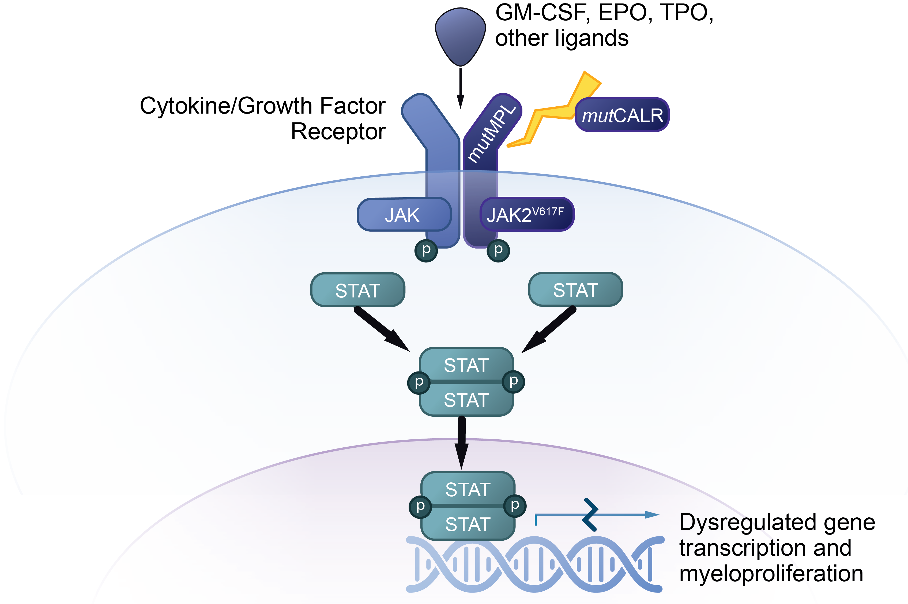
Constitutively Active JAK/STAT Pathway Considered Classic Driver of Myelofibrosis
JAK/STAT Pathway¹⁻³
JAK/STAT pathway plays a central role in cell proliferation, differentiation, and survival¹
Most patients with MF have acquired driver mutations in JAK2 (~60%) CALR (~30%), and/or MPL (~5%)^{2,3}
~10% of patients are reported as having triple-negative disease (no driver mutations), associated with poor prognosis³

Slide 4
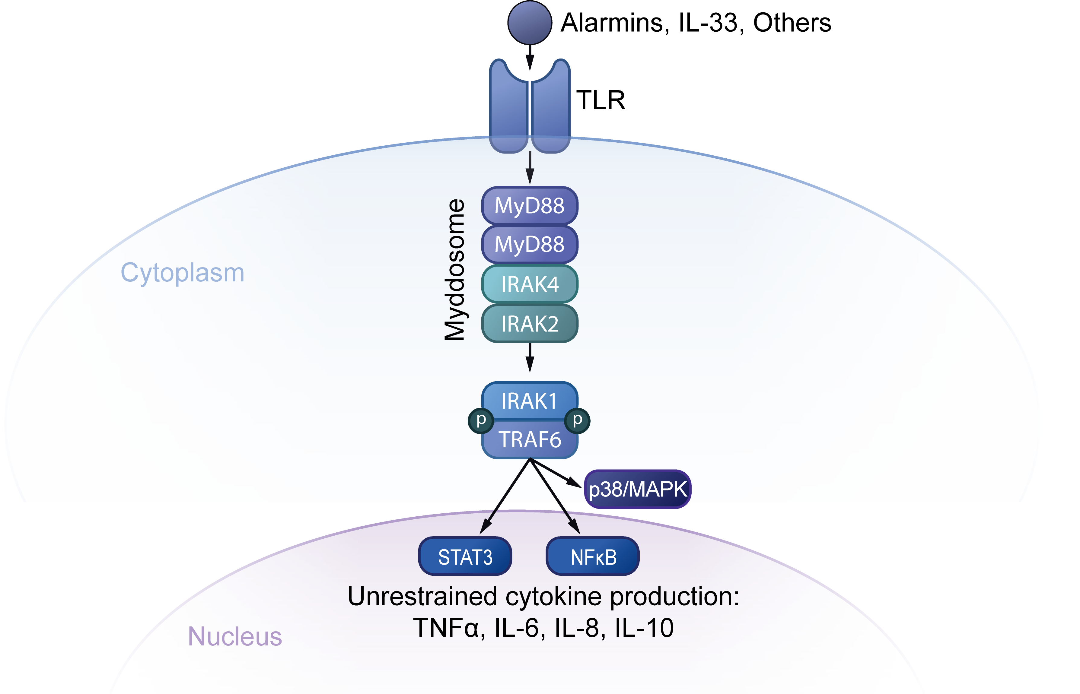
Inflammation May Contribute to Myelofibrosis
TLR/Myddosome/IRAK1 Pathway1
Recent studies implicate additional biological drivers in the disease pathogenesis in MF, including the TLR/Myddosome/IRAK1 inflammatory pathway¹⁻⁴
Signaling stimulates an unrestrained cascade of inflammatory cytokines, which are not extinguished by JAK1/2 inhibition¹⁻⁴

Slide 5
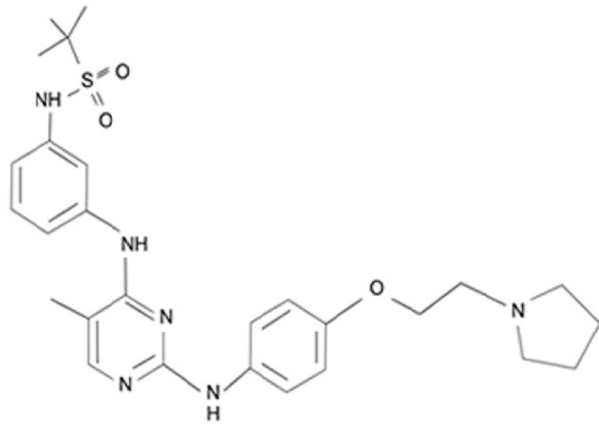
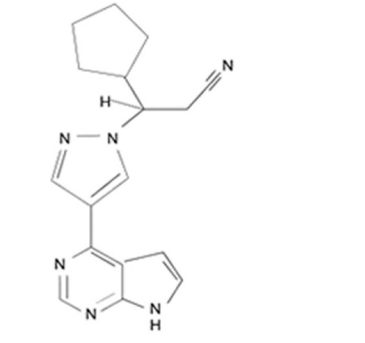
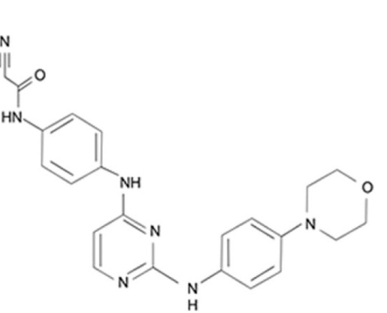
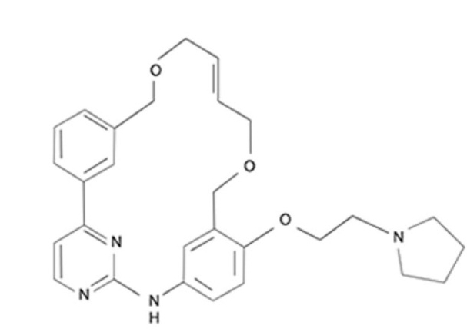
JAK Inhibitors A Molecular Overview
Ruxolitinib
Fedratinib
M929I mutation, gatekeeper mutation, JAK2 inhibitor
 | IC₅₀ (nanomolar) |  |  |  | AEs
 | JAK1 | JAK2 | JAK3 | TYK2
Ruxolitinib | 2.8 | 4.5 | 322 | 30 | Cytopenias (anemia, thrombocytopenia), infection
Fedratinib | 105 | 3 | > 1000 | 405 | GI, Wernicke encephalopathy
Momelotinib | 11 | 18 | 155 | 17 | Increased amylase/lipase, thrombocytopenia, PN
Pacritinib | 1280 | 6 | 18.3 | 27 | GI, bleeding
Crosses CNS, structurally similar to thiamine
Pyrrolopyrimidine
Momelotinib
Pacritinib
Inhibits JAK1, JAK2, and ACVR1
Inhibits JAK2, FLT3, IRAK1, and CSF1R
Macrocyclic
Anilinopyrimidine Derivatives

Slide 6
COMFORT-I Worst Hematologic Laboratory Test Abnormalities
Hematologic adverse reactions^{[a]} | Ruxolitinib n=155 |  | Placebo n=151
 | All grades, % | Grade 3/4, % | All grades, % | Grade 3/4, %
Thrombocytopenia | 69.7 | 12.9 | 30.5 | 1.3
Anemia | 96.1 | 45.2 | 86.8 | 19.2
Neutropenia | 18.7 | 7.1 | 4.0 | 2.0
Hematologic adverse reactions rarely led to treatment discontinuation. The following percentages are from both phase 3 studies: anemia (0.3%), thrombocytopenia (0.7%), neutropenia (1.0%)
Management of hematologic abnormalities^{[b]}
Thrombocytopenia: Generally reversible; usually managed by reducing the dose or by temporarily withholding ruxolitinib; if clinically indicated, platelet transfusions may be administered
Anemia: Some patients may require blood transfusions; dose modifications may also be considered
Neutropenia (ANC < 0.5 x 10⁹/L): Generally reversible; managed by temporarily withholding ruxolitinib

Slide 7
JAKARTA-1: First-Line Fedratinib in Primary or Secondary Myelofibrosis Adverse Events
Adverse event, % | Fedratinib 400 mg (n=96) |  | Fedratinib 500 mg (n=97) |  | Placebo (n=95)
 | All grades | Grade 3 or 4 | All grades | Grade 3 or 4 | All grades | Grade 3 or 4
Nonhematologic
Diarrhea | 66 | 5 | 56 | 5 | 16 | 0
Vomiting | 42 | 3 | 55 | 9 | 5 | 0
Nausea | 64 | 0 | 51 | 6 | 15 | 0
Constipation | 10 | 2 | 18 | 0 | 7 | 0
Asthenia | 9 | 2 | 16 | 4 | 6 | 1
Abdominal pain | 15 | 0 | 12 | 1 | 16 | 1
Fatigue | 16 | 6 | 10 | 5 | 1 | 0
Hematologic
Anemia | 99 | 43 | 98 | 60 | 91 | 25
Thrombocytopenia | 63 | 17 | 57 | 27 | 51 | 9
Lymphopenia | 57 | 21 | 66 | 27 | 54 | 21
Leukopenia | 47 | 6 | 53 | 16 | 19 | 3
Neutropenia | 28 | 8 | 44 | 18 | 15 | 4
Black box warning^{[b]}
Wernicke encephalopathy (ataxia, altered mental status, ophthalmoplegia) occurred in 8 of 608 (1.3%) patients receiving fedratinib in clinical trials
Considerations
Measure and address thiamine levels prior to treatment initiation
Do not start fedratinib in patients with thiamine deficiency

Slide 8
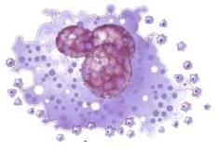
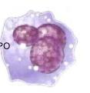

Kinome Profiling of the Approved JAK Inhibitors
JAK and Other Kinases IC₅₀ (nM)
Kinase | Pacritinib^{4,5} | Ruxolitinib^{4,6} | Fedratinib^{4,7}
JAK1 | 1280 | 2.8 | 105
JAK2 | 6.0 | 4.5 | 3.0
JAK2 V617F | 9.4 | NR | NR
JAK3 | 18.3 | 322 | >1000
FLT3 | 14.8 | >3000 | 13.0
TYK2 | 27.0 | 30 | 405
JAK1 inhibition impairs both megakaryopoiesis and platelet release in vitro and can exacerbate thrombocytopenia in MF.¹⁻³
JAK1i
Immature
Megakaryocyte
Mature
Megakaryocyte
Blood
Platelets
Non-Tyrosine Kinases of Interest IC₅₀ (nM)
Kinase | Pacritinib⁵ | Ruxolitinib⁶ | Fedratinib⁷
CSF1R | 39.5 | >3000 | 620
IRAK1 | 13.6 | 290 | 220
Eurofins “KINOMEscan” for RUX and FED
J Exp Pharm publication for PAC
Leukemia publication for PAC (JAK1)

Slide 9
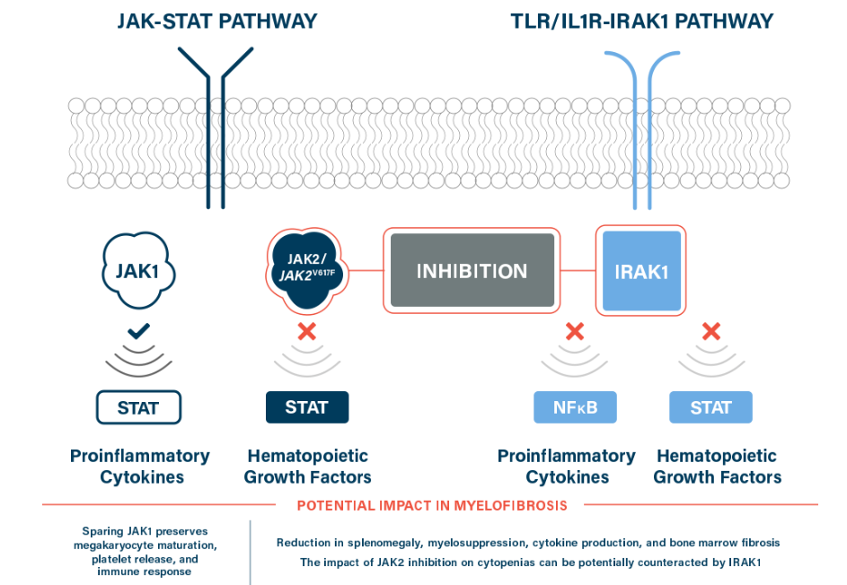
Pacritinib Leverages Two Discrete Constitutively Activated Pathways
1
2
3

Slide 10
PERSIST-2 Spleen Volume Responses ≥35% at Week 24
ITT Population
Patients With Platelets <50×10⁹/L
P =.001
Additional subgroup analyses demonstrated patients receiving pacritinib achieved SVR ≥35% regardless of subgroup (eg, sex, age, JAK2 V617F mutation status, prior treatment with JAK2 inhibitors, and baseline cytopenias)

Slide 11
PERSIST-2 Hematologic Stability
Clinical Improvement in Hemoglobin Levels in Patients With Baseline Anemia*
Pacritinib Reduced Transfusion Burden in Patients Not TI at Baseline
Transfusion Burden in Patients Who Received ≥1 RBC Transfusion on Study
Baseline to Week 24
Baseline to Week 24
Units per month

Slide 12
Off-Target Effects of MMB May Explain Potential Anemia Benefit
BMP Receptor (ACVR1)
Momelotinib
MMB also inhibits ACVR1
ACVR1 activation leads to increased hepcidin gene expression^{[a]}
Hepcidin decreases plasma iron, and hepcidin level is elevated in MF^{[b]}
MMB ameliorates anemia in a rodent ACD model^{[a]}
Hepatocyte
P
Smad 4
Smad 1/5/8
Smad 1/5/8
Iron Release
P
Smad 4
Smad 1/5/8
Peptide synthesis Processing Secretion
Hepcidin
Hepcidin

Slide 13
MOMENTUM: Momelotinib vs Danazol Transfusion Independence at Week 24, Mean Hemoglobin Over Time
P=.0064 (Noninferior)
Double-Blind
Randomization Period
Open-Label Period
35
11.0
31%
Momelotinib
Momelotinib
30
Danazol
Danazol → Momelotinib
10.0
25
20%
20
Mean hemoglobin levels (g/dL)
Transfusion independence rate (%)
9.0
15%
15
13%
10
8.0
5
BL
4
8
12
16
20
24
28
32
36
40
44
48
No. of patients
Weeks since randomization
0
Momelotinib
129
105
112
93
87
88
83
67
56
44
42
36
28
Baseline
Week 24
Baseline
Week 24
Momelotinib (N=130)
Danazol (N=65)
Danazol
65
54
50
38
36
36
29
31
21
19
18
13
7

Slide 14
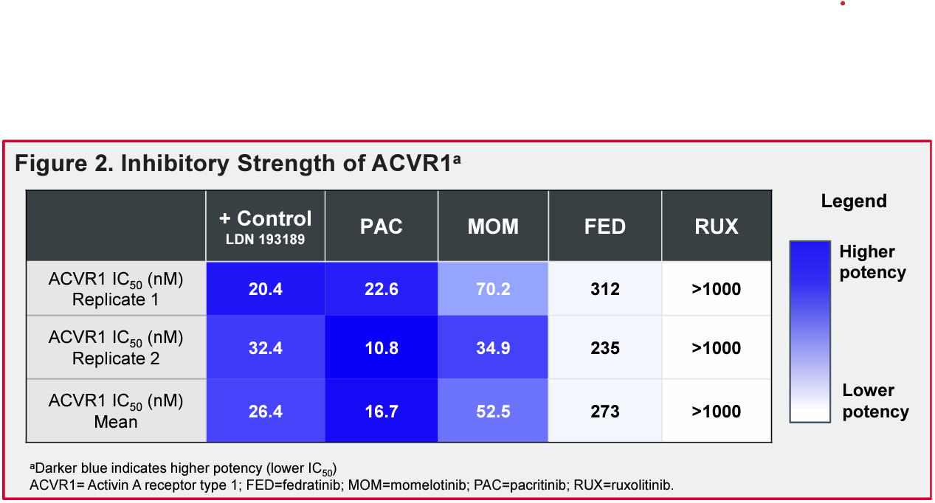
Pacritinib Is a Highly Potent Inhibitor of ACVR1

