Slide 1
How Do You Define and Manage No Response or Loss of Response to JAK Inhibitor Therapy?
Srdan Verstovsek, MD, PhD
Professor of Medicine, Department of Leukemia
University of Texas, MD Anderson Cancer Center
Houston, TX

Slide 2
Disclaimer
The views and opinions expressed in this educational activity are those of the faculty and do not necessarily represent the views of TotalCME, Inc., the CME providers, or the companies providing educational grants. This presentation is not intended to define an exclusive course of patient management; the participant should use their clinical judgment, knowledge, experience, and diagnostic skills in applying or adopting for professional use any of the information provided herein. Any procedures, medications, or other courses of diagnosis or treatment discussed or suggested in this activity should not be used by clinicians without evaluation of their patient's conditions and possible contraindications or dangers in use, review of any applicable manufacturer’s product information, and comparison with recommendations of other authorities. Links to other sites may be provided as additional sources of information.

Slide 3
Current Treatment for Myelofibrosis
TREATMENT FOR HIGHER-RISK MYELOFIBROSIS
Consider clinical trial
or
Pacritinib
Not a transplant candidate
Platelets
<50 x 10⁹/L
Transplant
candidate
Assess
symptom
burden using
MPN-SAF TSS
(MPN-10;)
if not done
previously
Allogeneic HCT
Transplant
candidate
Continue treatment
and monitor
for disease
progression
(MPN-10;)
Monitor
response and
signs/
symptoms
of disease
progression
(MPN-10;)
every 3-6
months
Response
Higher-risk
Ruxolitinib
(category 1)
or
Fedratinib
(category 1)
or
Clinical trial
Not a
transplant
candidate
No
response
or
Loss of
response
Clinical trial
or
Alternate JAK inhibitor
not used before and
monitor for disease
progression
(MPN-10;)
Platelets
≥50 x 10⁹/L
Not a transplant candidate
and symptomatic anemia
only
Disease
progression
Advanced-stage MF/
AML
FEDRATINIB, RUXOLITINIB, PACRITINIB

Slide 4
There Is No Consensus Definition for Ruxolitinib Treatment Failure
Heterogeneity of ruxolitinib failure¹⁻³
Primary resistance/refractoriness
Relapse or loss of initial response; secondary resistance (splenic relapse)
At ruxolitinib dose reduction or on a stable dose
Ruxolitinib intolerance; treatment-related toxicities
Myelosuppression, early-onset cytopenias, immunosuppression/opportunistic infections
Disease progression
Accelerated phase disease, leukemic transformation, late-onset cytopenias

Slide 5
Definitions of Ruxolitinib Treatment Failure in Clinical Trials
Eligibility Criteria Related to Prior/Current Ruxolitinib Exposure in JAK Inhibitor Trials
Study | Criteria
JAKARTA-2¹ | Met one of the following criteria:ª Refractory to ruxolitinib: Ruxolitinib for ≥3 months with spleen regrowth (<10% spleen volume reduction or <30% spleen size decrease from baseline) Relapse: Ruxolitinib for ≥3 months with spleen regrowth (<10% spleen volume reduction or <30% spleen size decrease from baseline) following an initial response^{b} Intolerance to ruxolitinib: Ruxolitinib for ≥28 days with development of RBC transfusion requirement (≥2 units per month for ≥2 months), or grade ≥3 thrombocytopenia, anemia, hematoma, and/or hemorrhage
FREEDOM² FREEDOM-2³ | Ruxolitinib for ≥3 months, or for ≥28 days with development of RBC transfusion requirement (≥2 units per month for 2 months) or grade ≥3 thrombocytopenia, anemia, hematoma, or hemorrhage
PERSIST-2⁴ | 1 or 2 prior JAK inhibitors allowed; no other criteria
ª Updated analysis using the new stringent criteria for ruxolitinib relapsed, refractory, or intolerant. ^{b} Response to ruxolitinib was defined as ≥50% reduction in spleen size for baseline spleen size >10 cm from the LCM (or ≥35% reduction from baseline spleen volume), a nonpalpable spleen for baseline spleen size between 5 and 10 cm from the LCM, or not eligible for spleen response for baseline spleen <5 cm from the LCM

Slide 6
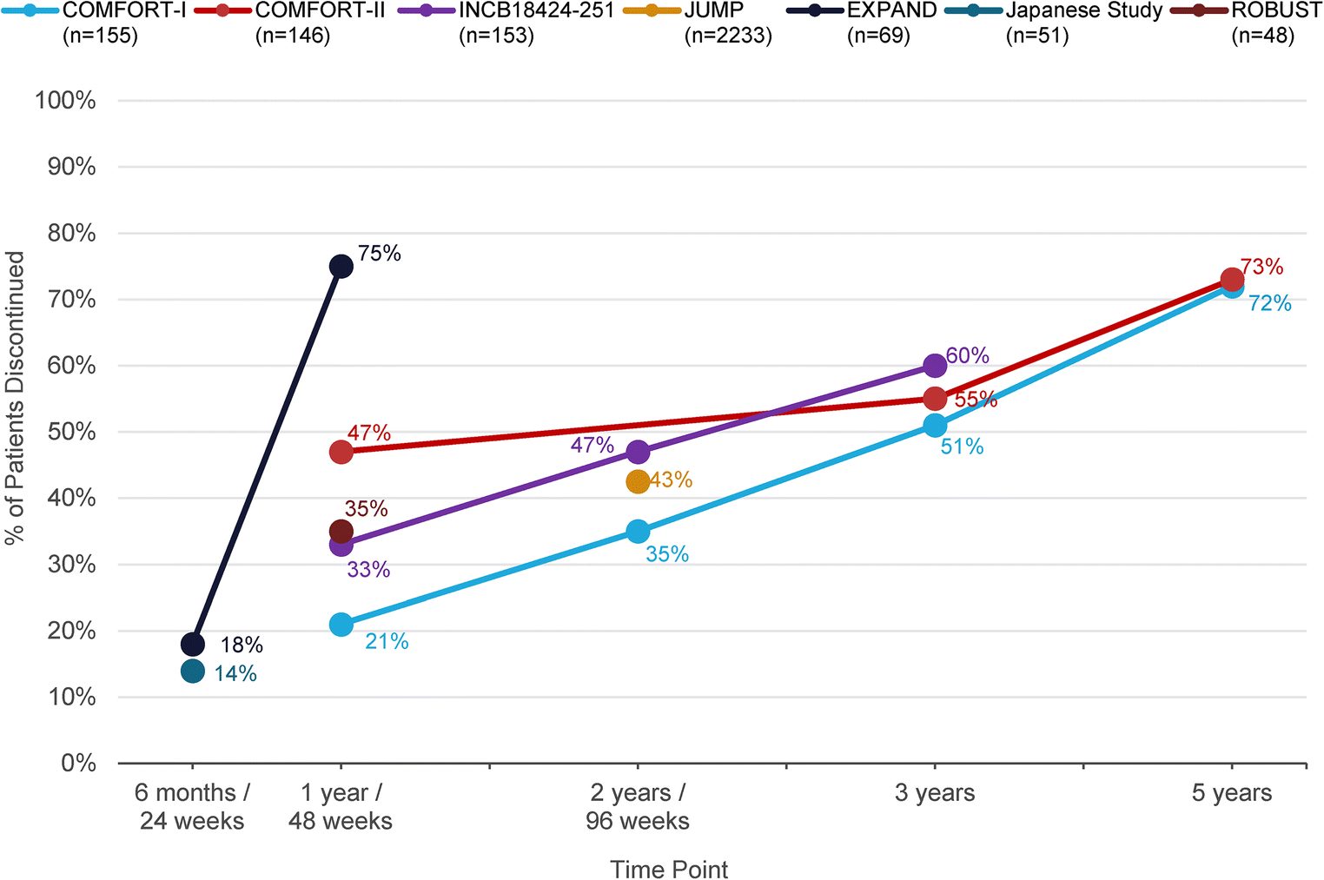
Rates of Ruxolitinib Treatment Discontinuation at Various Time Points in Large Clinical Trials

Slide 7
Rates of Ruxolitinib Treatment Discontinuation at Various Time Points in Large Clinical Trials

Slide 8
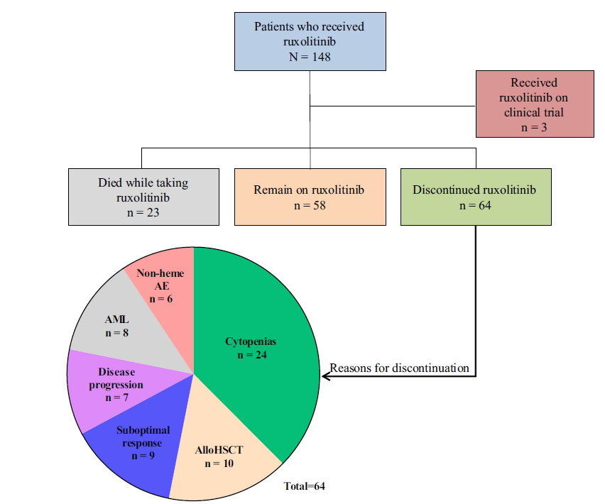
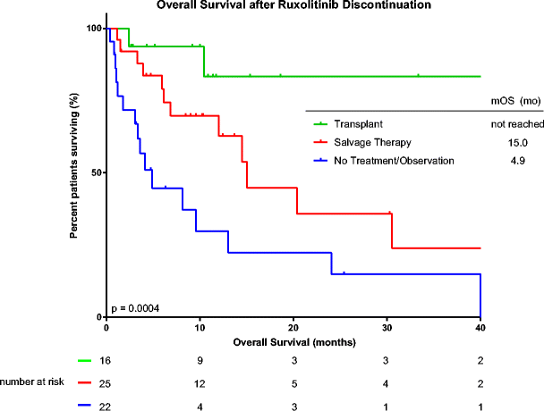
Survival After Ruxolitinib Discontinuation Is Poor: Real World Data
Median OS after ruxolitinib discontinuation was 13 months

Slide 9
Fedratinib in Myelofibrosis After Ruxolitinib
Phase 2 JAKARTA-2 Trial
Fedratinib in patients with INT-2/high-risk MF resistant or intolerant to ruxolitinib
Primary analysis
Reanalysis (2019)*
55%
30%
Spleen volume reduction ≥35%
Spleen volume reduction ≥35%
27%
Symptom burden reduction ≥50%
19.0%
*More stringent criteria for relapse, refractory, and intolerance to ruxolitinib
Discontinuation due to AEs
N=97
*N=79

Slide 10
Fedratinib in Myelofibrosis After Ruxolitinib
Phase 2 JAKARTA-2 Trial
Fedratinib in patients with INT-2/high-risk MF resistant or intolerant to ruxolitinib
Primary analysis
Reanalysis (2019)*
55%
30%
Spleen volume reduction ≥35%
Spleen volume reduction ≥35%
27%
Symptom burden reduction ≥50%
19.0%
*More stringent criteria for relapse, refractory, and intolerance to ruxolitinib
Discontinuation due to AEs
N=97
*N=79
Recommended dose: 400 mg once a day
The most common AEs: anemia, thrombocytopenia, gastrointestinal symptoms
Requires antiemetics, anti-diarrhea
Boxed warning: Encephalopathy: Check and correct thiamine at baseline

Slide 11
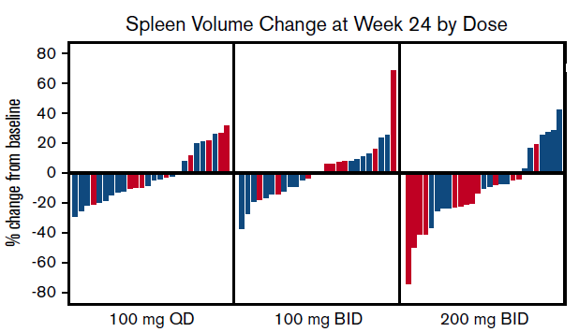
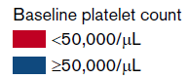
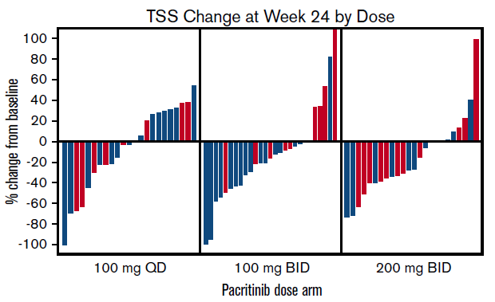
PAC203: Spleen and Symptom Responses Across Doses (Evaluable Population, Week 24) in Second-Line Thrombocytopenic Patients
Evaluable SVR in patients with severe thrombocytopenia (<50x10⁹/L) at baseline treated with 200 mg BID
31%
TSS analyzed as a continuous variable:
Deeper reductions with 200 mg BID

Slide 12
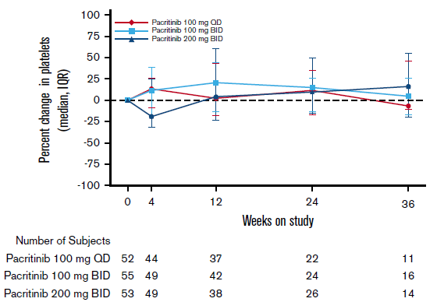

PAC203: Hematologic Stability/Improvement
Platelet counts were stable for most patients on study, including those with severe thrombocytopenia
Reductions in transfusion burden and achievement of transfusion independence occurred in patients in all arms
Percent Change in Platelet Count From Baseline
Hgb Increases in Patients With Baseline Anemia (Hgb ≤10 g/dL)
LARGER INCREASES IN Hgb IN MORE PATIENTS AT 200 MG BID
Baseline to Week 24

Slide 13
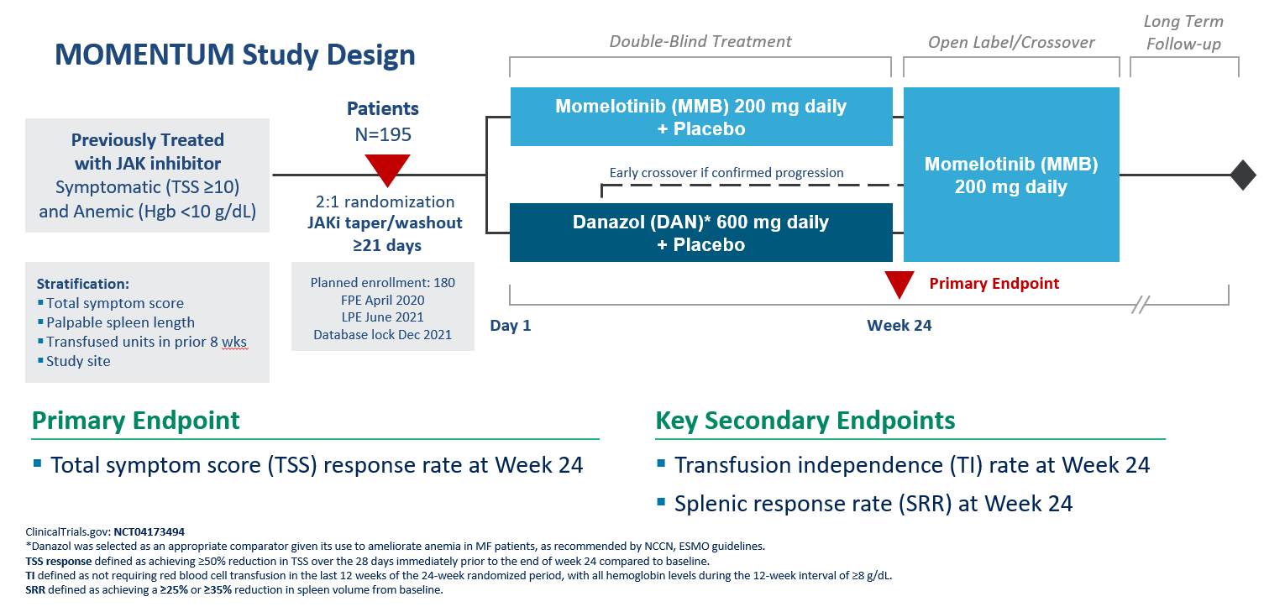
MOMENTUM Study Design: Momelotinib vs Danazol

Slide 14
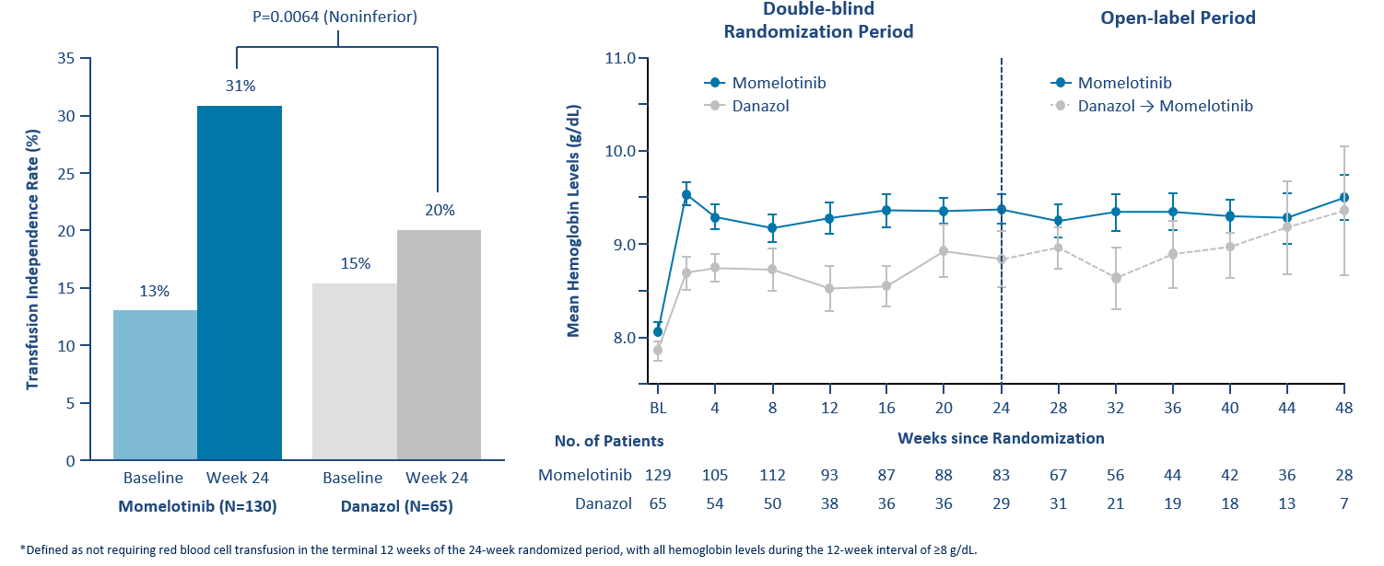
MOMENTUM: Transfusion Independence* at Week 24, Mean Hemoglobin Over Time

Slide 15
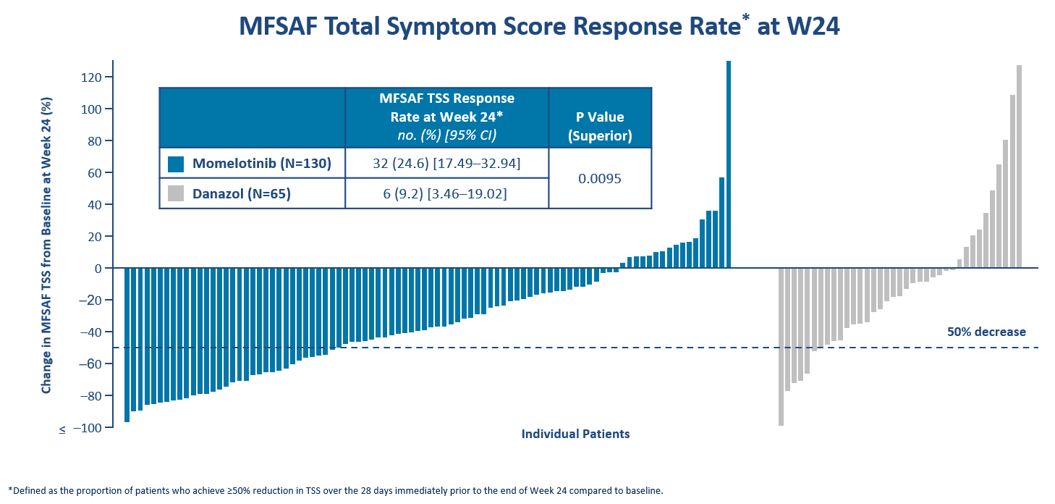
MOMENTUM: Total Symptom Score Response Rate* at Week 24

Slide 16
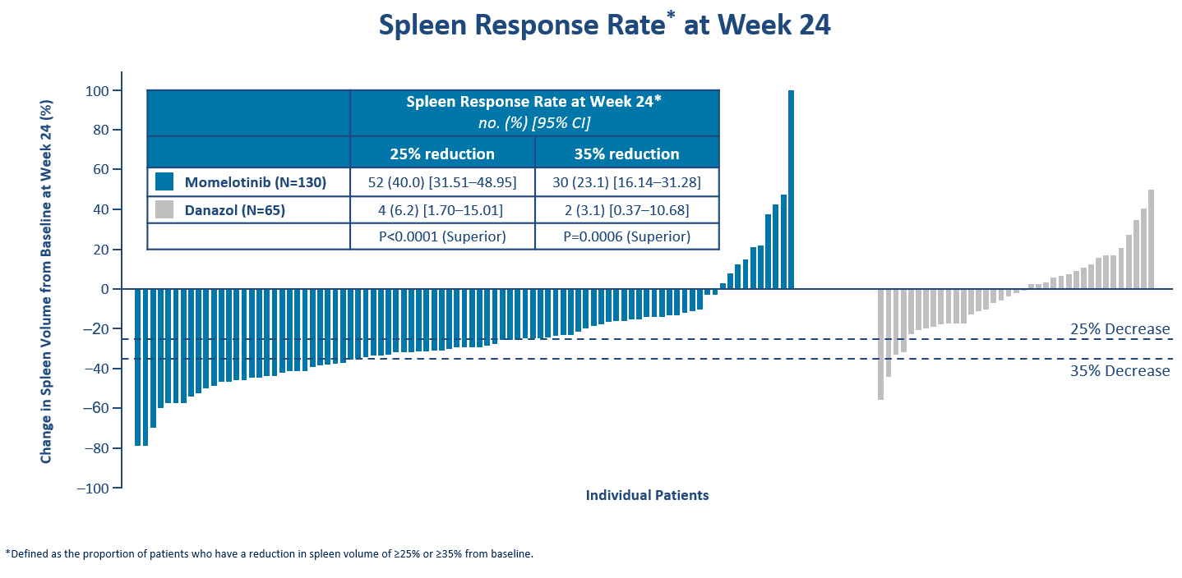
MOMENTUM: Spleen Response Rate* at Week 24

Slide 17
Summary
Cytopenia in myelofibrosis is a marker of poor prognosis disease
Cytopenic myelofibrosis patients may not be able to access standard drugs or maintain duration of benefit
Standard treatment options are limited
New therapeutic options have recently been developed:
Pacritinib was granted accelerated approval as therapy for myelofibrosis patients with low platelets
Momelotinib is under FDA review for approval as therapy for myelofibrosis patients with symptoms and anemia

