Slide 1
What Clinical Management Strategies Must be Deployed to Effectively Transition From the Acute to Post-Acute Setting When a Pediatric VTE Patient is at Risk for a Recurrent VTE?
Riten Kumar, MD, MSc
Associate Professor of Pediatrics, Harvard Medical School
Director, Thrombosis and Anticoagulation Program
Dana-Farber/Boston Children’s Cancer and Blood Disorders Center
Boston, MA

Slide 2
Disclaimer
The views and opinions expressed in this educational activity are those of the faculty and do not necessarily represent the views of TotalCME, Inc., the CME providers, or the companies providing educational grants. This presentation is not intended to define an exclusive course of patient management; the participant should use their clinical judgment, knowledge, experience, and diagnostic skills in applying or adopting for professional use any of the information provided herein. Any procedures, medications, or other courses of diagnosis or treatment discussed or suggested in this activity should not be used by clinicians without evaluation of their patient's conditions and possible contraindications or dangers in use, review of any applicable manufacturer’s product information, and comparison with recommendations of other authorities. Links to other sites may be provided as additional sources of information.

Slide 3
Choice of Agent for Secondary Thrombo-Prophylaxis
Pediatric patient has completed anticoagulation for acute VTE
CVL associated DVT
Cancer
Cardiac disease
Congenital thrombophilia
APS/ Mechanical valve
Recurrent VTE
DOACs
LMWH; DOACs
DOACs; VKA
DOACs
VKA
DOACS
Caution in patients with PIF/short gut syndrome
PREVAPIX-ALL – Apixaban – Leukemia/ Lymphoma + Asparaginase
UNIVERSE and SAXOPHONE trials – Rivaroxaban and Apixaban

Slide 4
Therapeutic vs. Prophylactic-Dose Anticoagulation for Secondary Prophylaxis?
Retrospective cohort study (2003 - 2013)
373 pediatric patients with CVL-associated VTE were included
64% required a subsequent CVL
~17% developed a recurrent VTE

Slide 5
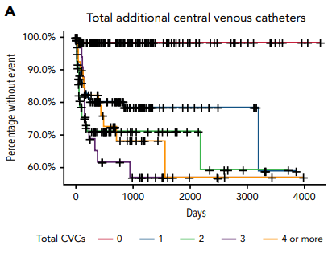
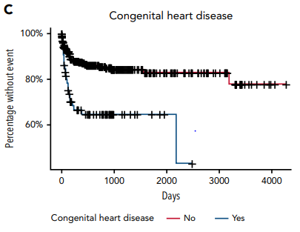
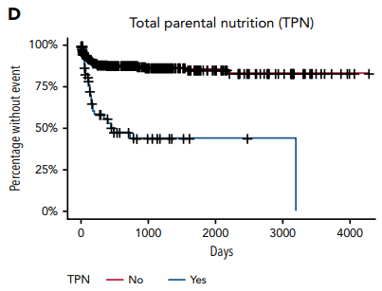
Therapeutic vs. Prophylactic-Dose Anticoagulation for Secondary Prophylaxis?
Retrospective cohort study (2003 - 2013)
373 pediatric patients with CVL-associated VTE were included
64% required a subsequent CVL
~17% developed a recurrent VTE
HR: 12
HR: 3.7
HR: 4

Slide 6
Therapeutic vs. Prophylactic-Dose Anticoagulation for Secondary Prophylaxis?
Secondary Prophylaxis | Multivariable Analysis OR (95% CI)
Prophylactic dosing | 0.6 (0.3-1.3)
Therapeutic dosing | 0.35 (0.2-0.65)
No secondary prophylaxis | Reference

Slide 7
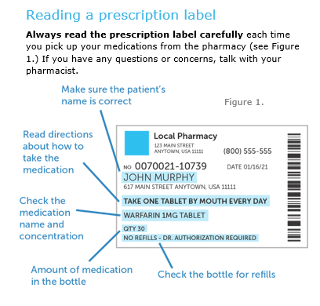
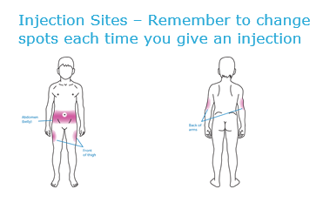
Practical Considerations
Patient Education
Patient education handouts
Contact information for anticoagulation team
Adherence
Close follow up is warranted
Medical Alert Bracelet

Slide 8
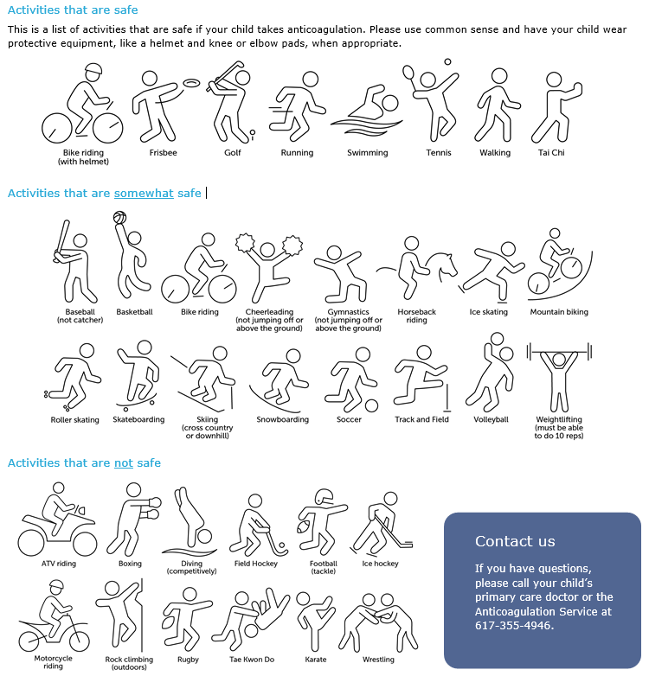
Practical Considerations Activity Restriction
Avoid contact and collision sports!

Slide 9
Practical Considerations
Food Interactions
LMWH: No food interaction
VKA: Vitamin K rich foods
Rivaroxaban and Dabigatran: Should be taken with meals
Renal Function
Phase III DOAC trials - creatinine clearance < 30 mL/min for Rivaroxaban (< 50 mL/min for Dabigatran)
Obesity
ISTH - standard dose Rivaroxaban/Apixaban for adults with weight > 120kg/ BMI > 40 kg/m²

Slide 10
Practical Considerations Drug Interactions
Avoid NSAIDs and aspirin in patients on anticoagulation
VKA: Multiple drug interaction
Dabigatran
P-glycoprotein inducers (e.g., Rifampin) and P-glycoprotein inhibitors (e.g., Ketoconazole)
Apixaban/Rivaroxaban
P-Glycoprotein and CYP3A4 inducers (e.g., Phenytoin, Rifampin, Carbamezapine) and P-Glycoprotein and CYP3A4 inhibitors (e.g., Azole Antifungals, Ritonavir)
Notes:
Dabigatran is a substrate for P-glycoprotein
All are, to varying degrees, renally cleared

Slide 11
Practical Considerations Anticoagulation Interruption
 | Minimal Bleeding Risk | Low Bleeding Risk | High Bleeding Risk
 | PICC removal Dental cleaning Dental filling | Cardiac catheterization CVL placement Arthroscopy Laparoscopic procedures Colonoscopy/Endoscopy Dental extraction | Lumbar puncture Major surgery Liver/Kidney biopsy Endoscopy/Colonoscopy + biopsy
DOAC | No interruption | 1 day before procedure | 2 days before procedure
LMWH |  | 12 hrs. before procedure | 24 hrs. before procedure
Fondaparinux |  | 36 - 42 hrs. before procedure | 48 - 96 hrs. before procedure
VKA |  | ~3 days before procedure | ~5 days before procedure (target INR < 1.5)

Slide 12
Practical Considerations Reversal Agents
LMWH
Partially reversed by protamine sulfate
VKA
Vitamin K + FFP/PCC
Dabaigatran
Idarucizumab - humanized monoclonal antibody
Rivaroxaban/Apixaban
Andexanet Alfa – decoy molecule – binds and sequesters factor Xa inhibitor

