Slide 1
What Do the Current Clinical Guidelines Recommend Regarding Post-Acute Management of VTE in Pediatric Patients?
Riten Kumar, MD, MSc
Associate Professor of Pediatrics, Harvard Medical School
Director, Thrombosis and Anticoagulation Program
Dana-Farber/Boston Children’s Cancer and Blood Disorders Center
Boston, MA

Slide 2
Disclaimer
The views and opinions expressed in this educational activity are those of the faculty and do not necessarily represent the views of TotalCME, Inc., the CME providers, or the companies providing educational grants. This presentation is not intended to define an exclusive course of patient management; the participant should use their clinical judgment, knowledge, experience, and diagnostic skills in applying or adopting for professional use any of the information provided herein. Any procedures, medications, or other courses of diagnosis or treatment discussed or suggested in this activity should not be used by clinicians without evaluation of their patient's conditions and possible contraindications or dangers in use, review of any applicable manufacturer’s product information, and comparison with recommendations of other authorities. Links to other sites may be provided as additional sources of information.

Slide 3
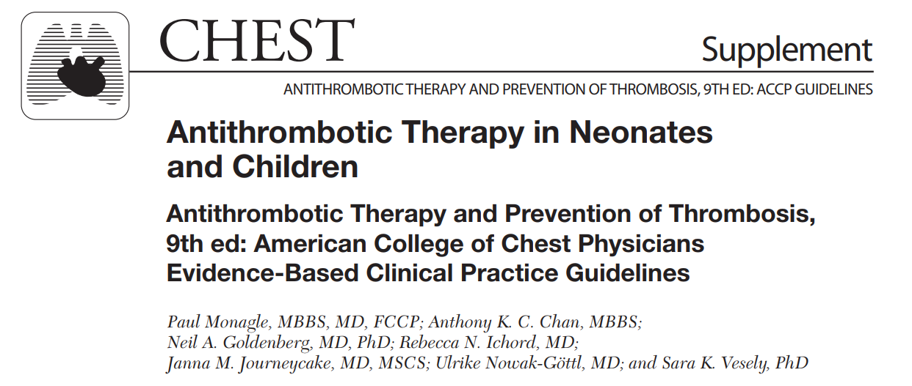

Slide 4
American College of Chest Physicians Persistent VTE Risk Factors
In children with ongoing, but potentially reversible risk-factors for VTE (e.g., nephrotic syndrome, asparaginase therapy), we suggest continuing anticoagulant therapy beyond 3-months in therapeutic or prophylactic doses (Grade 2C)
In children with central venous line (CVL) associated VTE who continue to require a CVL, we suggest that after initial 3-months of anticoagulant therapy, prophylactic dose of VKA (INR: 1.5-1.9) or LMWH (anti-FXa: 0.1-0.3 U/mL) be used till CVL is removed (Grade 2C)

Slide 5
American College of Chest Physicians Recurrent Idiopathic VTE/Anatomic Thrombophilia
In children with recurrent idiopathic VTE, we recommend indefinite anticoagulation with VTE (Grade 1A)
In children with recurrent VTE secondary to structural venous abnormalities (e.g., thoracic outlet syndrome, May-Thurner anomaly), we suggest indefinite anticoagulation till surgical interventions can be performed (Grade 2C)

Slide 6
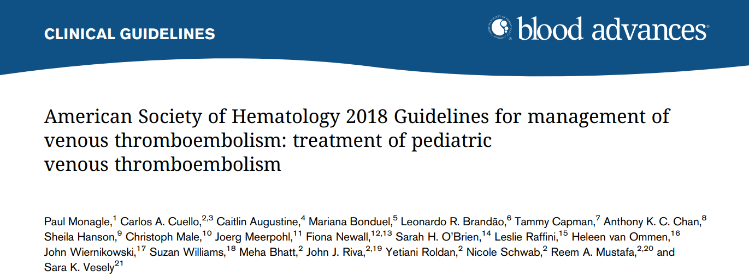

Slide 7
American Society of Hematology Choice of Anticoagulant
The ASH guideline recommends using LMWH or VKA in pediatric patients with VTE (conditional recommendation based on very low certainty in the evidence of effects)

