Slide 1
Direct Anticoagulants in Children: Application of Clinical Trial Findings in Practice
Guy Young, MD
Director, Hemostasis and Thrombosis Center
Professor of Pediatrics
Children's Hospital of Los Angeles
University of Southern California Keck School of Medicine
Los Angeles, CA

Slide 2
Disclaimer
The views and opinions expressed in this educational activity are those of the faculty and do not necessarily represent the views of TotalCME, Inc., the CME providers, or the companies providing educational grants. This presentation is not intended to define an exclusive course of patient management; the participant should use their clinical judgment, knowledge, experience, and diagnostic skills in applying or adopting for professional use any of the information provided herein. Any procedures, medications, or other courses of diagnosis or treatment discussed or suggested in this activity should not be used by clinicians without evaluation of their patient's conditions and possible contraindications or dangers in use, review of any applicable manufacturer’s product information, and comparison with recommendations of other authorities. Links to other sites may be provided as additional sources of information.

Slide 3
What Treatment Options Did We Have Before DOACs?
Oral
Warfarin
Parenteral (injectable)
Intravenous
Heparin
Argatroban and bivalirudin
Subcutaneous
Low molecular weight heparin (LMWH)
Fondaparinux

Slide 4
The Unmet Needs
Warfarin
Only pill form (not ideal for especially younger children)
Numerous drug interactions
Narrow therapeutic window
Bleeding even at therapeutic levels
Thrombosis (especially with low INR)
LMWH and fondaparinux
These have been quite useful
Generally safe and effective though not extensively studied prospectively
Longer half-life, minimal/no drug interactions
But…

Slide 5
Classical Coagulation Cascade
PK=Prekallikrein
K=Kallikrein
HMWK=High molecular weight kininogen
TF=Tissue factor
Ca++=Calcium
K
HMWK
PK
XII
XIIa
Ca++
VII
XI
XIa
TF
Ca++
VIIa
IX
IXa
VIII
VIIIa
Ca++
Ca++
X
Xa
X
Xa
Thrombin (IIa)
V
Va
XIII
Prothrombin (II)
Ca++
Thrombin (IIa)
Fibrinogen (I)
Fibrin
XIIIa
Cross-linked fibrin

Slide 6
Classical Coagulation Cascade
PK=Prekallikrein
K=Kallikrein
HMWK=High molecular weight kininogen
TF=Tissue factor
Ca++=Calcium
K
HMWK
PK
XII
XIIa
Ca++
VII
Warfarin
XI
XIa
TF
Ca++
VIIa
IX
IXa
VIII
VIIIa
Ca++
Ca++
X
Xa
X
Xa
Thrombin (IIa)
V
Va
XIII
Prothrombin (II)
Ca++
Thrombin (IIa)
Fibrinogen (I)
Fibrin
XIIIa
Cross-linked fibrin

Slide 7
Classical Coagulation Cascade
PK=Prekallikrein
K=Kallikrein
HMWK=High molecular weight kininogen
TF=Tissue factor
Ca++=Calcium
K
HMWK
PK
XII
XIIa
Ca++
VII
Rivaroxaban Apixaban
Edoxaban Betrixaban
XI
XIa
TF
Ca++
VIIa
IX
IXa
VIII
VIIIa
Ca++
Ca++
X
Xa
X
Xa
Thrombin (IIa)
V
Va
XIII
Prothrombin (II)
Ca++
Thrombin (IIa)
Fibrinogen (I)
Fibrin
XIIIa
Cross-linked fibrin

Slide 8
Classical Coagulation Cascade
PK=Prekallikrein
K=Kallikrein
HMWK=High molecular weight kininogen
TF=Tissue factor
Ca++=Calcium
K
HMWK
PK
XII
XIIa
Ca++
VII
XI
XIa
TF
Ca++
VIIa
IX
IXa
VIII
VIIIa
Ca++
Ca++
X
Xa
X
Xa
Thrombin (IIa)
V
Va
XIII
Prothrombin (II)
Ca++
Thrombin (IIa)
Dabigatran
Fibrinogen (I)
Fibrin
XIIIa
Cross-linked fibrin

Slide 9
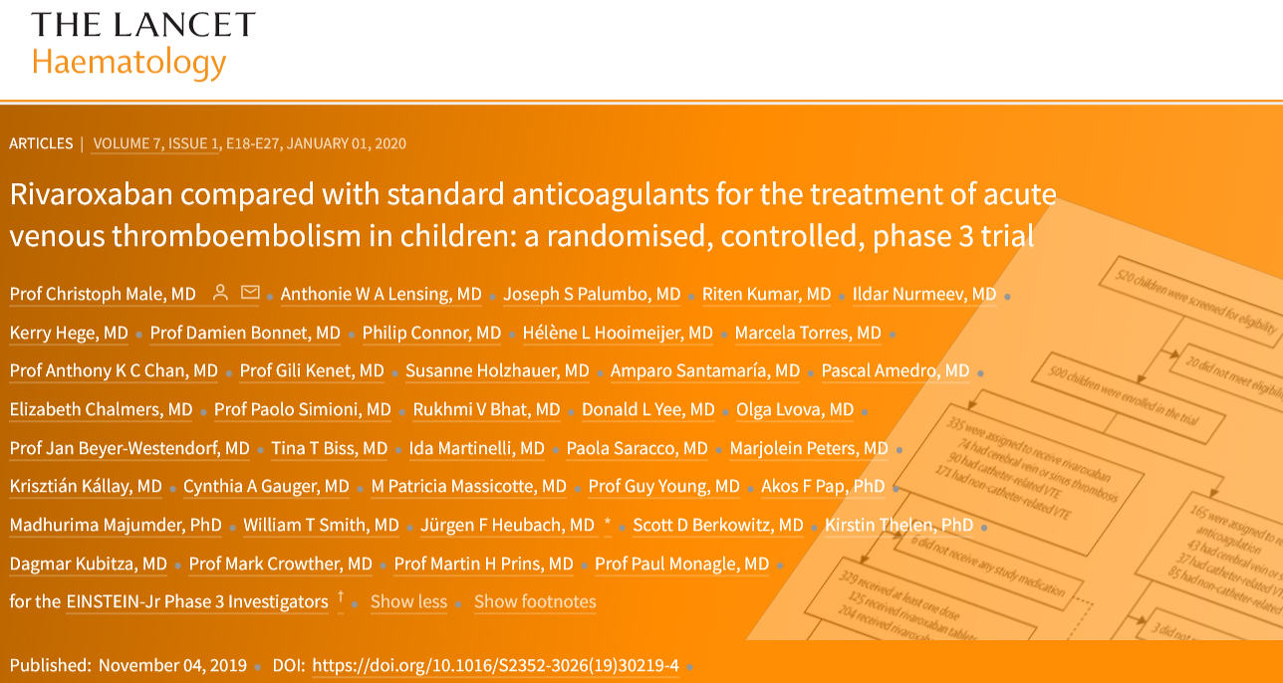

Slide 10
EINSTEIN-Jr. Phase III Study Design
Open-label, randomized (2:1) trial to assess efficacy and safety of bodyweight-adjusted rivaroxaban in a 20 mg-equivalent dose as compared with standard of care for treatment of children with acute VTE.
500 children aged birth-18 yr with confirmed acute VTE treated with heparins or fondaparinux
3 months*
Start study drug Day 6–9
N= 335 rivaroxaban
Extended treatment up to 12 months, or
30-day post-study follow-up
R
Day 1–9
N= 165 comparator (heparins/VKA)
Repeat
radiographic imaging
*Children <2 years with catheter-related VTE: 1 month
First patient included: Q4-2014
Last patient last visit: Q1-2019

Slide 11
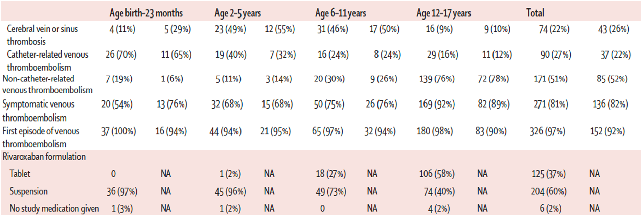
Types of Thrombosis by Age

Slide 12
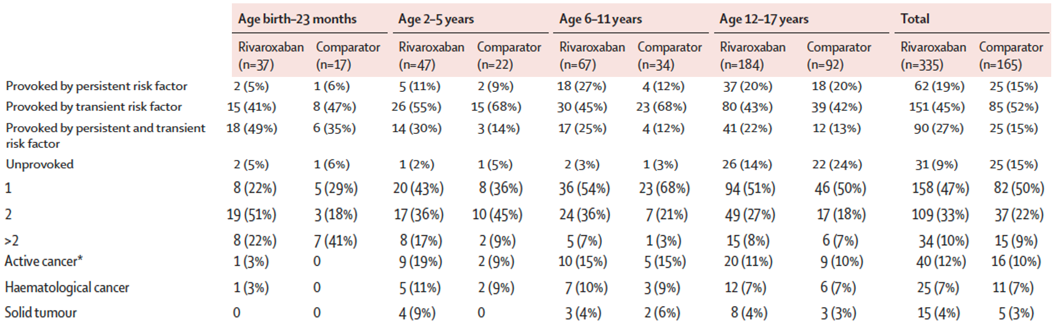
Risk Factors for Thrombosis by Age

Slide 13
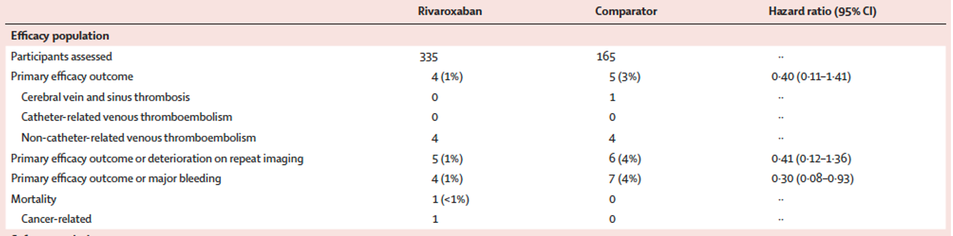
Efficacy Outcomes

Slide 14
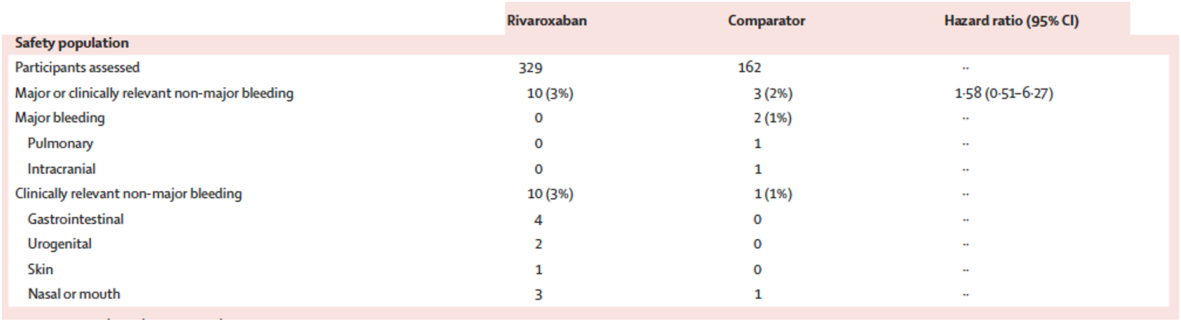
Safety Assessment

Slide 15
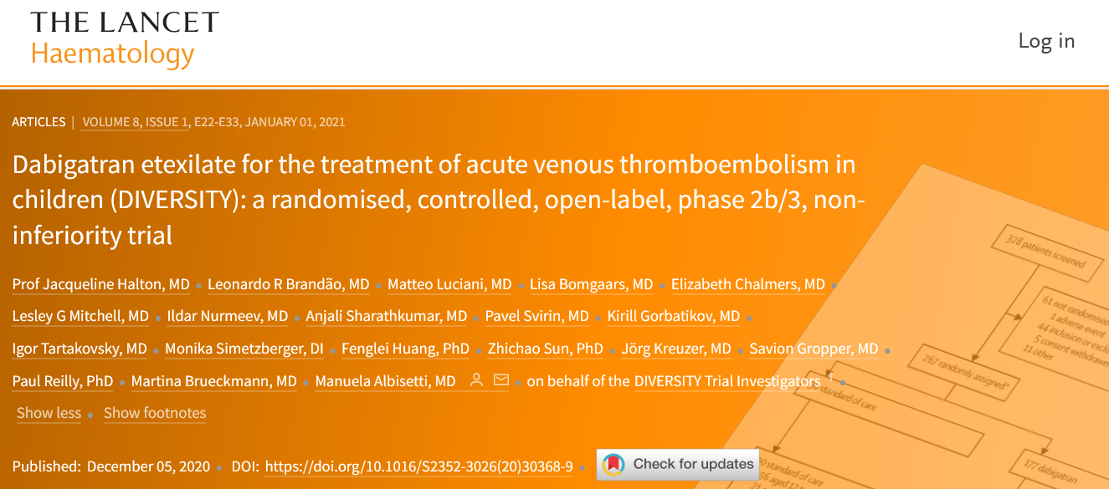

Slide 16
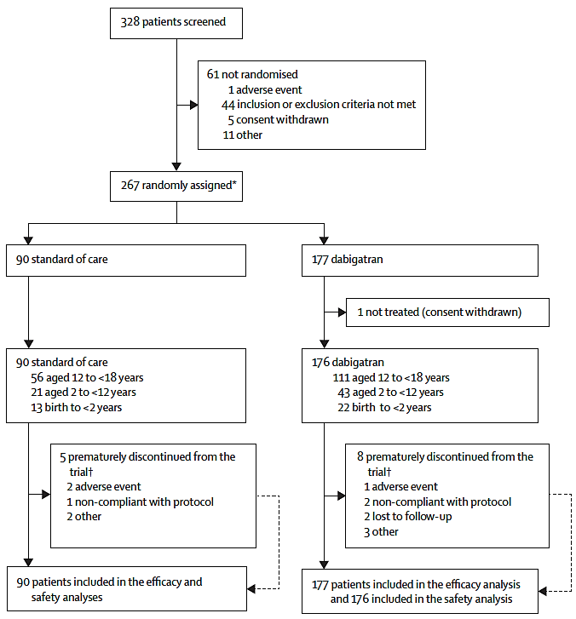

Slide 17
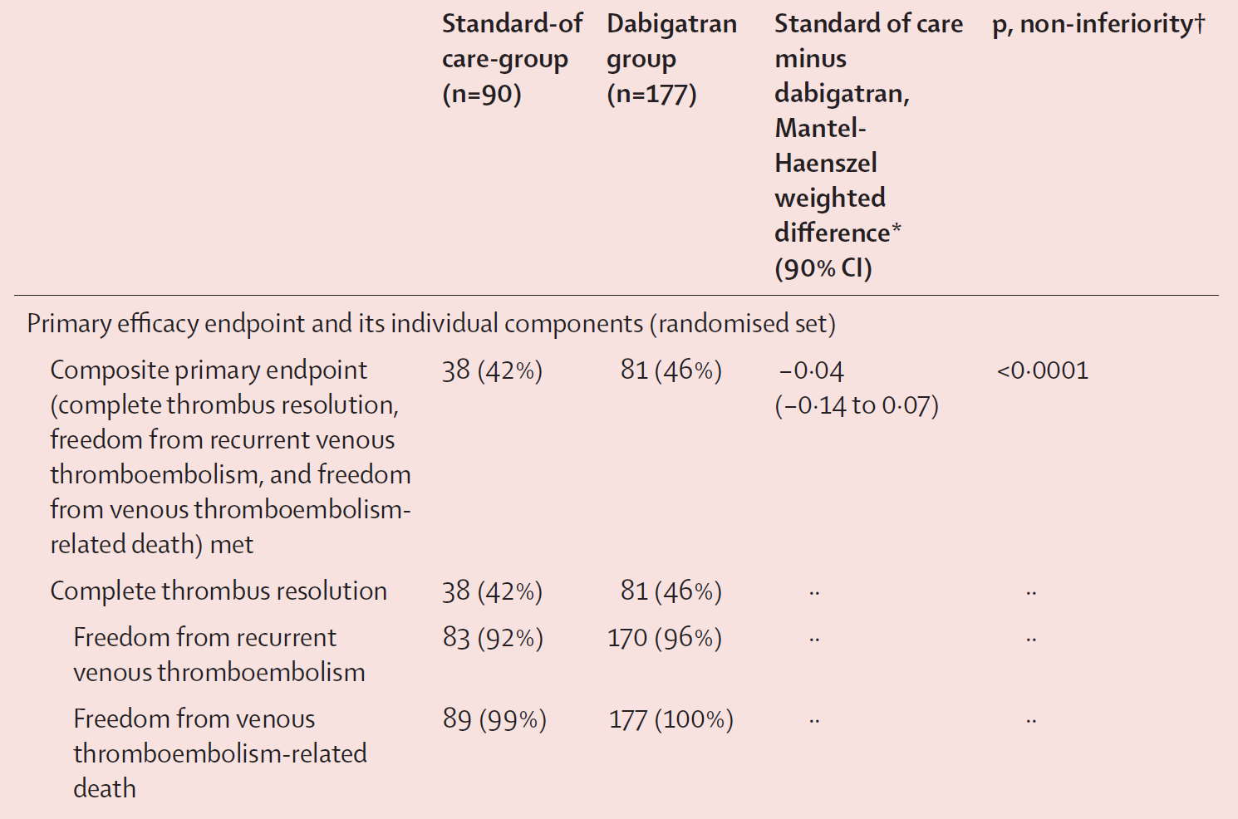

Slide 18
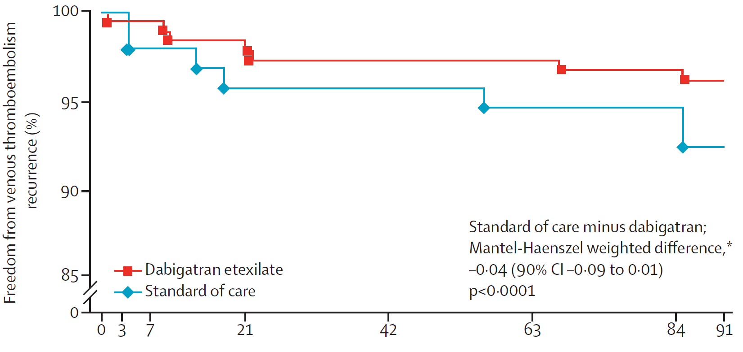

Slide 19
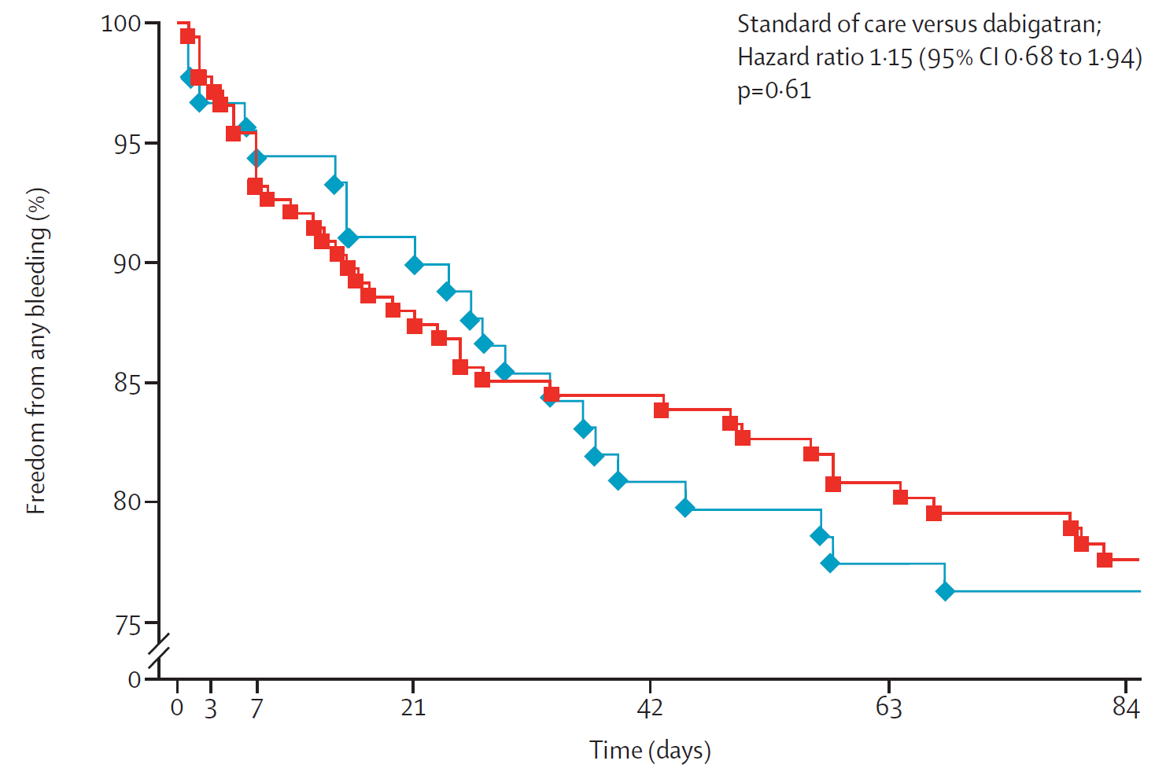

Slide 20



Idarucizumab
aDabi-Fab
Dabigatran
Thrombin
Deactivated Thrombin
Active Form of Thrombin

Slide 21
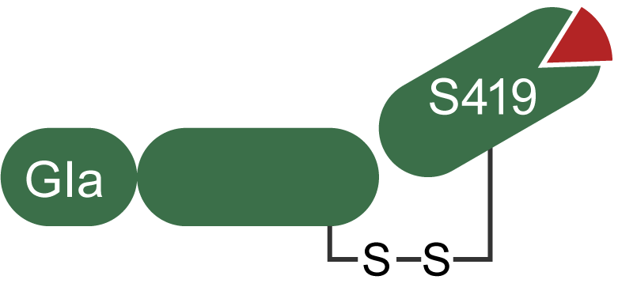
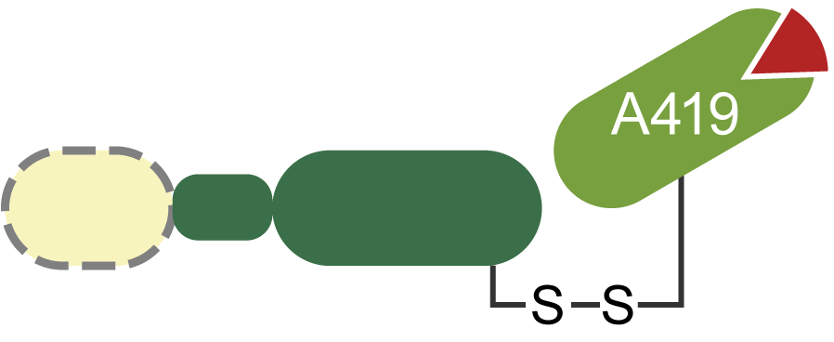
Andexanet alfa
Factor Xa Inhibitor
Factor Xa Inhibitor
Catalytic Domain
Factor Xa
Andexanet alfa

Slide 22
Take Home Messages
5 DOACs are licensed for various uses in adults
All have or are being studied in children
Rivaroxaban and dabigatran are licensed for children
Data on apixaban, edoxaban, and betrixaban are still being developed
DOACs will certainly replace warfarin, LMWH, and fondaparinux for most uses in children in the coming few years

