Slide 1
Which Pediatric Patients With Venous Thromboembolism Are at Risk for Recurrence?
Leslie Raffini, MD, MSCE
Director, Hemostasis and Thrombosis Center
Children’s Hospital of Philadelphia
Professor of Pediatrics
University of Pennsylvania
Philadelphia, PA

Slide 2
Disclaimer
The views and opinions expressed in this educational activity are those of the faculty and do not necessarily represent the views of TotalCME, Inc., the CME providers, or the companies providing educational grants. This presentation is not intended to define an exclusive course of patient management; the participant should use their clinical judgment, knowledge, experience, and diagnostic skills in applying or adopting for professional use any of the information provided herein. Any procedures, medications, or other courses of diagnosis or treatment discussed or suggested in this activity should not be used by clinicians without evaluation of their patient's conditions and possible contraindications or dangers in use, review of any applicable manufacturer’s product information, and comparison with recommendations of other authorities. Links to other sites may be provided as additional sources of information.

Slide 3
Recurrent VTE in Children: Things To Consider
What is the patient population?
Age – all children (0–18) vs. neonates or adolescents?
Provoked vs. unprovoked, CVC-VTE, antiphospholipid antibody syndrome?
What is the duration of follow-up?
When do recurrent events occur?
Can we identify those at highest risk of recurrence?

Slide 4
How Common Is Recurrent VTE in Children?
Population-Based Studies
Canadian registry¹
N=137; age, 1 m to < 18 yrs
Patients entered over 30 m
Recurrent thrombosis incidence, 18.5% (23/124)
Prospective 2-year registry in The Netherlands²
N=99; age, 0–18 yrs (50% newborns)
Recurrent thrombosis incidence, 7%
Database Studies
Pediatric Health Information System (PHIS)^{3,4}
N=11,337 (2001–2007); N=39,713 (2008–2019)
Recurrent thrombosis (> 1 admission with VTE code) incidence rates, 13% (2001–2007) and 18% (2008–19)
Recurrent events not validated

Slide 5
Recurrent VTE in Pediatric VTE Trials
DIVERSITY: N=267; age, 0–17 yrs; randomized (2:1) to dabigatran vs. standard anticoagulants; followed for 3 months¹
Symptomatic recurrent VTE occurred in 4% of children on dabigatran and in 8% of those receiving SOC
EINSTEIN-Jr: N=500; age, 0–17 yrs; randomized (2:1) to rivaroxaban vs. standard anticoagulants; followed for 3 months ( or for 31 d for patients < 2 yo)²
Symptomatic recurrent VTE occurred in 1% of children on rivaroxaban and in 3% of those receiving SOC
Kids-DOTT: N=417; randomized to 6-week vs. 3-month duration of anticoagulation for first provoked VTE with negative APA and non-occlusive thrombus at 6 weeks; followed for 1 yr³
Rate of recurrent VTE within 1 yr was very low
1.0% (0–2.4%) for 6-week group vs. 1.6% (0–3.4) for 3-month group

Slide 6
Recurrent VTE in Specific Pediatric Populations
Antiphospholipid Antibody Syndrome
Single-center study: 32% (17/53) with recurrence; median follow-up, 4 yrs¹
Similar to other pediatric studies (27–29%)^{2–4}
Cerebral Sinovenous Thrombosis
Multicenter cohort study⁵: N=396; age, 0–18 yrs; median follow-up, 36 m
6% (22/39) with recurrent VT
Factors associated with recurrence: age > 2 yrs at index event; persistent occlusion; non-anticoagulation

Slide 7
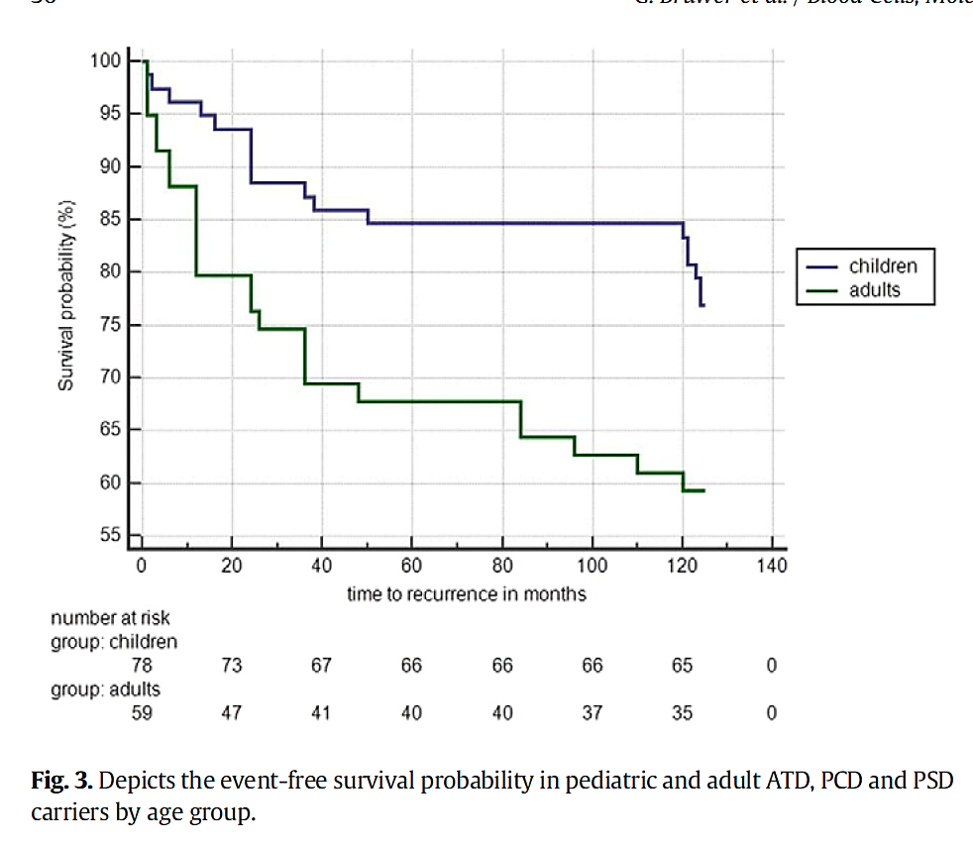
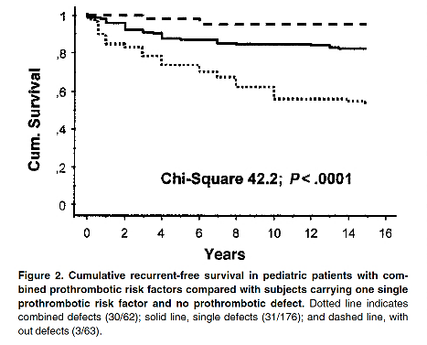
Recurrent VTE in Specific Pediatric Populations
“High-Risk” Thrombophilias
Multicenter German study¹ of consecutive children with VTE and protein C, S, or AT deficiency: N=85; 19% with recurrent event
Combined thrombophilias have highest risk
Unprovoked (Spontaneous) VTE
Multicenter German study²: N=301; median follow-up, 7 yrs; 21% with recurrent VTE (64/301)
Recurrence associated with thrombophilia 2 > 1

Slide 8
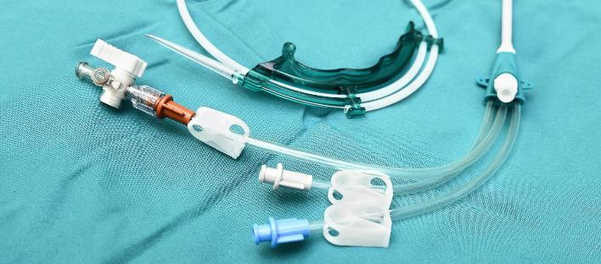
Recurrent VTE in Specific Pediatric Populations
Catheter-Related VTE
Children with chronic illnesses often require multiple CVCs
Patients with prior CVC-VTE have a high risk of recurrent CVC-VTE^{1–3}
27–34.3% of patients require a new catheter after incident event^{1,2}
Thrombophilia is not a strong predictor of recurrent CVC-VTE^{1,2}
Younger age¹, cardiac disease², and parenteral nutrition² are additional risk factors
Anticoagulation is associated with a low rate of recurrence^{1,2}

Slide 9
Recurrent Pediatric VTE: Summary
Rates of recurrent VTE vary widely across studies (1–34%)
Patients at highest risk include:
Those with prior CVC-VTE who need additional CVC
Those with unprovoked VTE
Those with antiphospholipid antibody syndrome
Patients at low risk include:
Those with provoked VTE (without prior VTE, malignancy, or SLE/APS) and with non-occlusive VTE at 6 weeks¹
Future studies should focus on evaluating safety and efficacy of extended treatment duration for high-risk patients

