Slide 1
The Prevalence and Severity of Recurrent VTE in Children
Julie Jaffray, MD, MS
Assistant Professor of Clinical Pediatrics
Thrombosis Program Director
Associate Clinical Director of Hematology
Children's Center for Cancer and Blood Diseases
Children's Hospital Los Angeles
Los Angeles, CA

Slide 2
Disclaimer
The views and opinions expressed in this educational activity are those of the faculty and do not necessarily represent the views of TotalCME, Inc., the CME providers, or the companies providing educational grants. This presentation is not intended to define an exclusive course of patient management; the participant should use their clinical judgment, knowledge, experience, and diagnostic skills in applying or adopting for professional use any of the information provided herein. Any procedures, medications, or other courses of diagnosis or treatment discussed or suggested in this activity should not be used by clinicians without evaluation of their patient's conditions and possible contraindications or dangers in use, review of any applicable manufacturer’s product information, and comparison with recommendations of other authorities. Links to other sites may be provided as additional sources of information.

Slide 3
What is Recurrent VTE?
“A venous thrombosis of a site that was either previously uninvolved or had interval documentation of incident DVT or PE resolution.”
Can occur during anticoagulation therapy
May be symptomatic or an incidental finding
Typically, the highest risk is within the first 6-12 months after the initial event

Slide 4
Consequences of Recurrent VTE
Post thrombotic syndrome (PTS): recurrent DVT in the same limb
  Chronic pain and swelling; venous insufficiency
Loss of venous access needed for lifesaving treatment: recurrent central venous catheter(CVC)-related VTE
Requirement of lifelong anticoagulation
Chronic thromboembolic pulmonary hypertension (CTEPH): recurrent PE leading to severe pulmonary hypertension

Slide 5
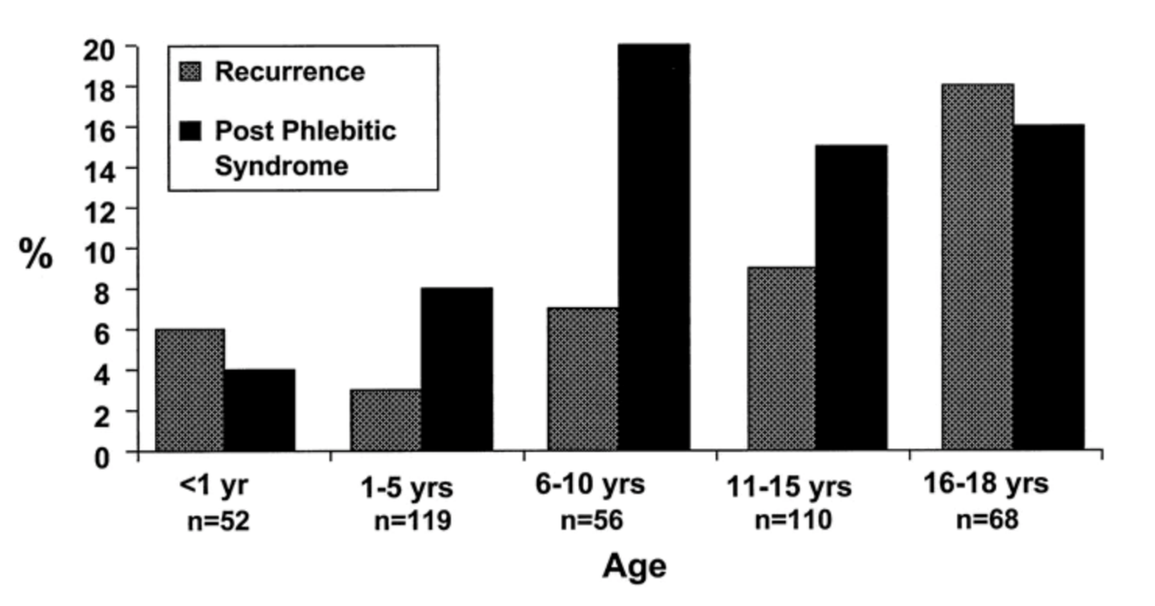

Incidence of Recurrence
Risk of recurrent VTE estimated to be 10% in children
The mean time from first thrombotic event to recurrence:
6 months (range 3 months to 5 years)
Recurrence
Post Thrombotic
Syndrome

Slide 6
Recurrence and Anticoagulation
Group of investigators from the Rivaroxaban pediatric trial described a cohort of patients with a VTE at their hospital from 2011-2016
346 children identified
  309 received anticoagulation and 17 (5.5%) had a recurrence
  37 without anticoagulation and 4 (10.5%) had a recurrence
 | CVC-VTE N = 227 | Non-CVC-VTE N = 119
During anticoagulation, n/N (%) | 6/199 (3.0) | 2/110 (1.8)
Following discontinuation of anticoagulants, n/N (%) | 8/199 (4.0) | 1/110 (0.9)
No anticoagulant group, n/N (%) | 4/28 (14.3) | 0/9 (0)

Slide 7
Recurrence in Higher Risk Groups
Children with thrombophilia¹
301 children with a history of VTE and FV Leiden, elevated lipoprotein a, prothrombin gene mutation, PC deficiency, PS deficiency or AT deficiency
21% of patients (median time 3.5 years) after stopping anticoagulation
Worse with combined defects → 48%
Children with a CVC-VTE and new CVC²
432 children with a history of CVC-associated VTE: 50% had a recurrence
Children with sickle cell disease³
119 children with SCD and VTE: 8% had recurrence at 1 year and 21% at 5 years from the index case
No thrombophilia defects
Single defect
Combined defects

Slide 8
Summary
Relevance of the results to current clinical practice:
Recurrent VTE can frequently occur in children—especially in those who do not receive anticoagulation
Children with a thrombophilia, history of a CVC-related VTE with a new CVC placement, and those with SCD have the highest incidence of recurrent VTE

