Slide 1
Divergence from the Archaic Norm of “Restrain and Sedate”
Optimization of ER Triage Strategies for Agitated Patients with Bipolar Disorder or Schizophrenia
Scott Zeller, MD
Assistant Clinical Professor of Psychiatry
University of California-Riverside School of Medicine
Riverside, CA

Slide 2
Disclaimer
The views and opinions expressed in this educational activity are those of the faculty and do not necessarily represent the views of TotalCME, Inc., the CME providers, or the companies providing educational grants. This presentation is not intended to define an exclusive course of patient management; the participant should use their clinical judgment, knowledge, experience, and diagnostic skills in applying or adopting for professional use any of the information provided herein. Any procedures, medications, or other courses of diagnosis or treatment discussed or suggested in this activity should not be used by clinicians without evaluation of their patient's conditions and possible contraindications or dangers in use, review of any applicable manufacturer’s product information, and comparison with recommendations of other authorities. Links to other sites may be provided as additional sources of information.

Slide 3
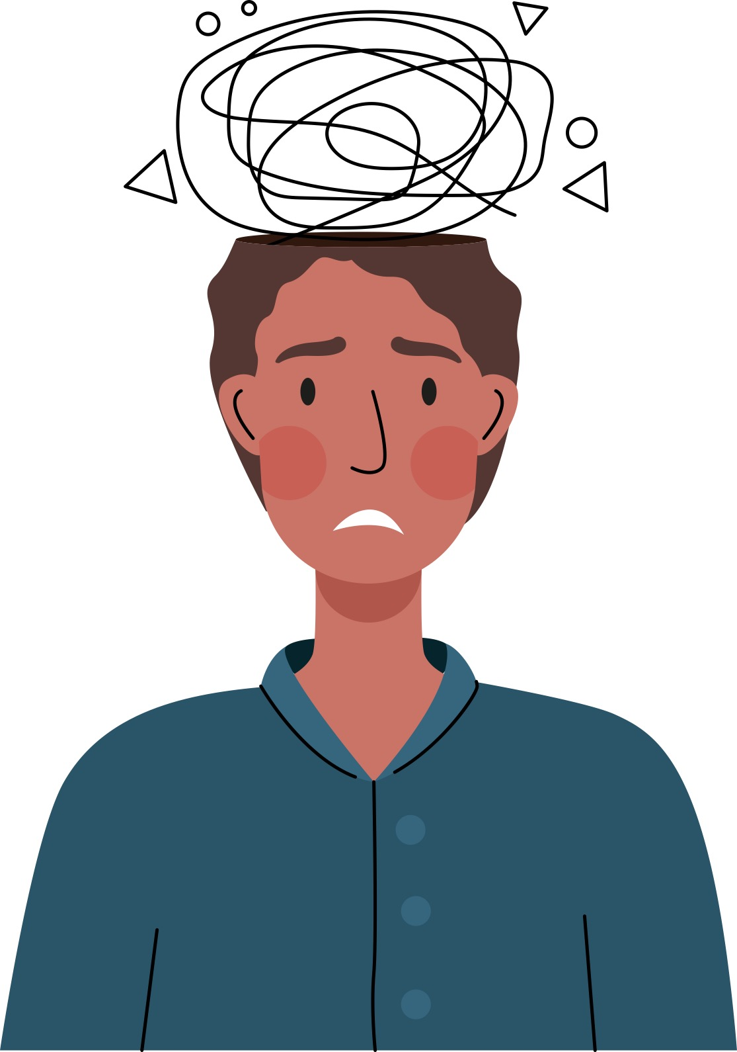
Screening for Mental Health Patients Does NOT Need to Be Over-exhaustive, but It Should Be Targeted
Focus on the presenting problem
Ensure that there are no causative or co-morbid serious medical issues (too often overlooked or ignored!)
Help stabilize the psychiatric problem without over-sedating or restraining the patient
Fulfill hospital Emergency Medical Treatment and Labor Act (EMTALA) obligations

Slide 4
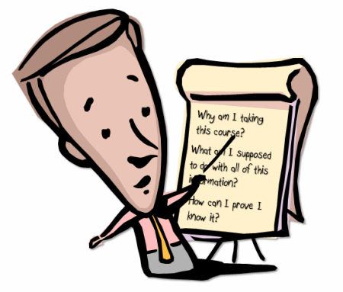
Essential Triage for Emergency Psychiatric Patients
Presenting problem
(why are they here?)
Pertinent history (a more
complete history can come later)
Vital signs
Visual evaluation
Rule out any serious
medical issues
Determination of risk,
observation levels

Slide 5
Medical Conditions that Can Mimic Psychiatric Illness
Head trauma
Encephalitis/meningitis/other infections
Encephalopathy, esp. kidney/liver failure
Metabolic (hypo-natremia, -glycemia, -calcemia)
Hypoxia
Thyroid disease
Toxic level of meds
(intentional OD or toxic buildup)
Seizure
Poisons

Slide 6
Behavioral Activity Rating Scale (BARS)
1 = difficult or unable to rouse
2 = asleep but responds normally to verbal or physical contact
3 = drowsy, appears sedated
4 = quiet and awake (normal level of activity)
5 = signs of overt (physical or verbal) activity, calms down with instructions
6 = extremely or continuously active, not requiring restraint
7 = violent, requires restraint

Slide 7

Improving Throughput Times
Calming techniques and de-escalation can avoid the need for restraints and oversedation, leading to more prompt disposition; they are well worth the short amount of time that they take to attempt
Beginning appropriate medications in the ED – not using “chemical restraints” – can facilitate transfer to psych in appropriate patients and make time spent in the ED part of treatment rather than merely screening
Restraint use leads to a length of stay of psychiatric patients in EDs averaging 4.2 hours longer than that of patients not requiring restraints¹

Slide 8
De-escalation
Medical Evaluation
Psychiatric Evaluation
Medication
De-
escalation
Seclusion Restraint

Slide 9

Benefits of Mastering Skills
Verbal de-escalation usually takes less time than the process of restraint and involuntary medication
Avoiding “containment” procedures will result in fewer injuries to both staff members and patients
Patients are more trusting when not restrained or forcibly medicated
Receiving facilities may be more willing to accept a patient who has not been restrained, improving throughput

Slide 10
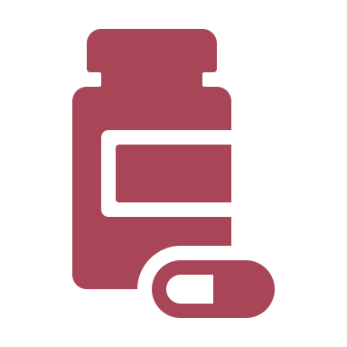
General Medication Recommendations
Medications are not chemical restraints; they are agents for treating symptoms
Non-pharmacologic approaches should be used first
Medication is used to calm, not to induce sleep – multiple complications are caused by oversedation
Patients should be involved in the process of
selecting medication
  Oral medications are preferred over IM medications

