Slide 1
Development of a Care Pathway Using Specific Reversal Agents for Anticoagulated Patients with ICH
Adrian R. Parry-Jones, FRCP, PhD
Geoffrey Jefferson Brain Research Centre University of Manchester Manchester, UK

Slide 2



Resource Information
About This Resource
These slides are one component of a continuing education program available online at MedEd On The Go titled Real World Data and the Management of Intracranial Hemorrhages (ICH) in Anticoagulated Patients
Program Learning Objectives:
Employ appropriate treatment management strategies to address the critical clinical aspects of ICH and hematoma expansion
Explain when and how to initiate appropriate reversal agents in ICH bleeds
Discuss the need to develop and implement protocols and local care pathways based on existing evidence-based medicine guidelines to improve the management of ICH bleeds
MedEd On The Go®
www.mededonthego.com
This content or portions thereof may not be published, posted online or used in presentations without permission.
This content can be saved for personal use (non-commercial use only) with credit given to the resource authors.
To contact us regarding inaccuracies, omissions or permissions please email us at support@MedEdOTG.com

Slide 3
Disclaimer
The views and opinions expressed in this educational activity are those of the faculty and do not necessarily represent the views of Total CME, LLC, the CME providers, or the companies providing educational grants. This presentation is not intended to define an exclusive course of patient management; the participant should use their clinical judgment, knowledge, experience, and diagnostic skills in applying or adopting for professional use any of the information provided herein. Any procedures, medications, or other courses of diagnosis or treatment discussed or suggested in this activity should not be used by clinicians without evaluation of their patient's conditions and possible contraindications or dangers in use, review of any applicable manufacturer’s product information, and comparison with recommendations of other authorities. Links to other sites may be provided as additional sources of information.

Slide 4



Supportive Care: Stroke Unit / Critical Care
Haematoma evacuation
evacuation
secondary injury
clearance
expansion
Anticoagulant reversal
BP lowering

Slide 5
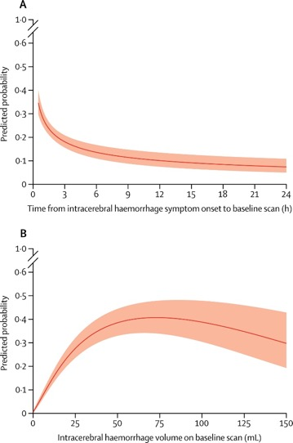




Haematoma Expansion
Occurs in around 20% of patients
Clinical predictors: Time, size, antithrombotics
Imaging predictors: Spot sign, NCCT signs

Slide 6
The ABC Care Bundle
A
Anticoagulant reversal: Reversal agents delivered as quickly as possible
Blood pressure lowering: Using intravenous antihypertensives for rapid, intensive BP lowering
Care pathway: Prompt referral of appropriate patients to neurosurgery
B
C

Slide 7

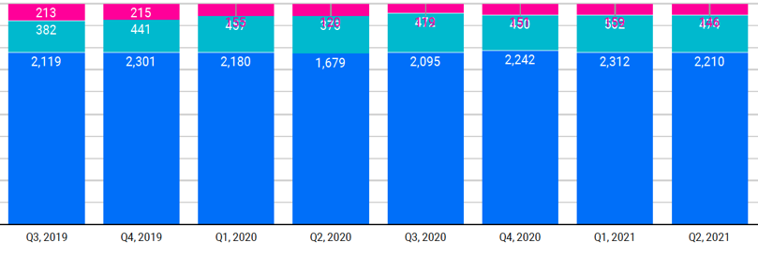
Haematoma Expansion: Anticoagulants
155
120
119
151
159
146
457
373
472
450
502
474
Prothrombin complex concentrate
Vitamin K
Vitamin K antagonist
Dabigatran
Idarucizumab
FXa inhibitors
Prothrombin complex concentrate
Andexanet alfa

Slide 8

Improving Onset-to-Treatment Times
Scene-to-door
Door-to-scan
Scan-to-treatment
Monitor data and apply QI methodology
Consider targeting common delays
Rapid brain imaging on arrival
Quick decision on treatment, establish last dose and onset
Simplify protocols, remove delays
Easy access to treatments

Slide 9
Improving Door-to-Needle Times (VKA)
QI project to improve speed of PCC treatment
55 patients included in final analysis
Primary outcome: Scan-to-needle time
Three key changes to reduce delays:
PCC stock in the ED
Point-of-care INR device
Standard protocol to deliver PCC without Haematology referral for every case

Slide 10
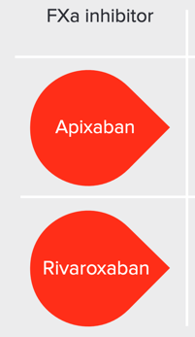
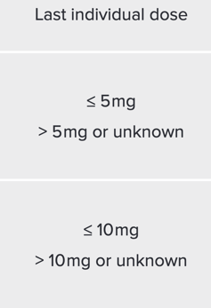
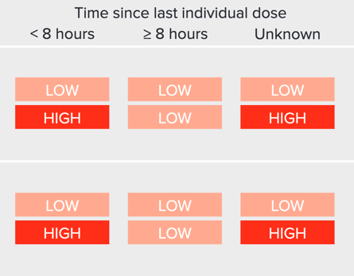
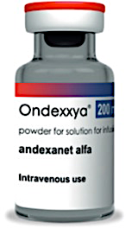
Improving DNTs (Andexanet)
 | Bolus | Infusion
Low dose | 400 mg over 15 min 2 vials | 480 mg over 120 min 3 vials
High dose | 800 mg over 30 min 4 vials | 960 mg over 120 min 5 vials

Slide 11
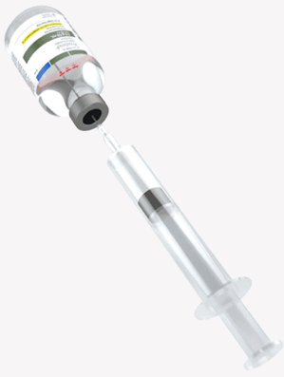
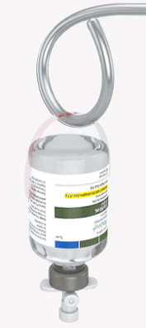
Improving DNTs (Idarucizumab)
Dose: 5 g
Packaged as 2 vials of 2.5 g/50 mL
No reconstitution needed
Can be transferred to syringe for bolus
Can be delivered as an infusion

Slide 12
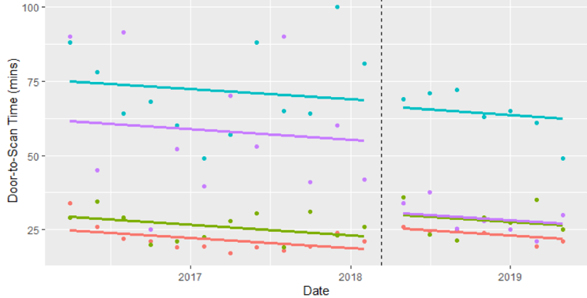
Prehospital Prealert for Anticoagulants
Prealert: Suspected strokes 4 to 48 hours post onset on anticoagulants
Introduced 13 March 2018
Data from national audit (SSNAP): 1 March 2016 to 31 May 2019
n=4206 before
n=2408 after
31.4 min reduction (95% CI: -46.8 to -16.1; P <0.0001)
4-48 h, no anticoag
4-48 h, anticoag
<4 h, anticoag
<4 h, no anticoag

Slide 13
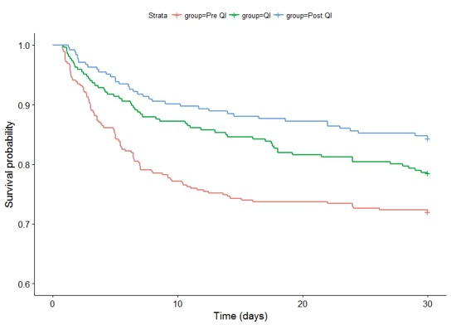
30-Day Case Fatality at Salford
Pre QI
Salford | 35.5%
SSNAP | 31.6%
Difference (pp) | +3.9 pp
QI / Post QI
Salford | 24.2%
SSNAP | 31.1%
Difference (pp) | -6.9 pp
After (n=243)
During (n=266)
Before (n=354)
Difference in difference (Salford vs England and Wales): -10.8 pp (95% CI -17.9 to -3.7), P=0.003
Parry-Jones AR, et al. Ann Neurol. 2019;86(4):495-503.

Slide 14
Summary
Anticoagulant reversal is a key part of delivering a hyperacute care bundle in ICH
Approximately 20% of ICH occurs on anticoagulants
Delay in treatment increases the risk of haematoma expansion
Real-time data monitoring and QI methodology underpin consistent, timely care
Rapid recognition, quick decision-making, streamlined protocols, and staff training are key

Slide 15



Looking for more resources on this topic?
CME/CE in minutes
Congress highlights
Late-breaking data
Quizzes
Webinars
In-person events
Slides & resources
www.MedEdOTG.com

