Slide 1
Management of a Patient With Factor Xa-Associated ICH Using Specific Reversal Therapy
David Seiffge, MD
Professor of Neurology Department of Neurology, Inselspital University Hospital Bern University of Bern Bern, Switzerland

Slide 2
Resource Information
About This Resource
These slides are one component of a continuing education program available online at MedEd On The Go titled Real World Data and the Management of Intracranial Hemorrhages (ICH) in Anticoagulated Patients
Program Learning Objectives:
Employ appropriate treatment management strategies to address the critical clinical aspects of ICH and hematoma expansion
Explain when and how to initiate appropriate reversal agents in ICH bleeds
Discuss the need to develop and implement protocols and local care pathways based on existing evidence-based medicine guidelines to improve the management of ICH bleeds
MedEd On The Go®
www.mededonthego.com
This content or portions thereof may not be published, posted online or used in presentations without permission.
This content can be saved for personal use (non-commercial use only) with credit given to the resource authors.
To contact us regarding inaccuracies, omissions or permissions please email us at support@MedEdOTG.com

Slide 3
Disclaimer
The views and opinions expressed in this educational activity are those of the faculty and do not necessarily represent the views of Total CME, LLC, the CME providers, or the companies providing educational grants. This presentation is not intended to define an exclusive course of patient management; the participant should use their clinical judgment, knowledge, experience, and diagnostic skills in applying or adopting for professional use any of the information provided herein. Any procedures, medications, or other courses of diagnosis or treatment discussed or suggested in this activity should not be used by clinicians without evaluation of their patient's conditions and possible contraindications or dangers in use, review of any applicable manufacturer’s product information, and comparison with recommendations of other authorities. Links to other sites may be provided as additional sources of information.

Slide 4
Case 1: Nonspecific Reversal Therapy
86-year-old female patient
History of hypertension and atrial fibrillation (CHA₂DS₂-Vasc: 4, HAS-BLED 1)
Rivaroxaban 20 mg
Clinical presentation on admission
NIHSS: 6
GCS: 15
First blood pressure: 157/97 mmHg
GFR: 39 ml/min
Time from last intake to ICH onset: 4 hours
Time from ICH onset to admission: 45 minutes
Calibrated anti-Xa activity: 623 ng/ml

Slide 5
Case 1: Nonspecific Reversal Therapy
1000 IU of 4-factor PCC
(~25 IU/kg)
Enrolled in TICH-NOAC
Baseline CT
ICH volume: 1 ml
No IVH
CT after 12 hours
ICH volume: 36.8 ml
IVH volume 12.5 ml
CT after 24 hours
ICH volume: 75.3 ml
IVH volume 15.1 ml

Slide 6
Case 1: Nonspecific Reversal Therapy
Day 2: GCS 6
Day 7: dead
1000 IU of 4-factor PCC
(~25 IU/kg)
Enrolled in TICH-NOAC
Baseline CT
ICH volume: 1 ml
No IVH
CT after 12 hours
ICH volume: 36.8 ml
IVH volume 12.5 ml
CT after 24 hours
ICH volume: 75.3 ml
IVH volume 15.1 ml

Slide 7
Case 2: Specific Reversal Therapy
90-year-old female patient
History of hypertension and atrial fibrillation
History of hypertension and atrial fibrillation (CHA₂DS₂-Vasc: 4, HAS-BLED 2)
Apixaban 2x5mg
Clinical presentation on admission
NIHSS: 20 First blood pressure: 165/85 mmHg GFR: 66 ml/min
Time from last intake to ICH onset: 3 hours
Time from ICH onset to admission: 90 minutes
Calibrated anti-Xa activity: 114 ng/ml

Slide 8
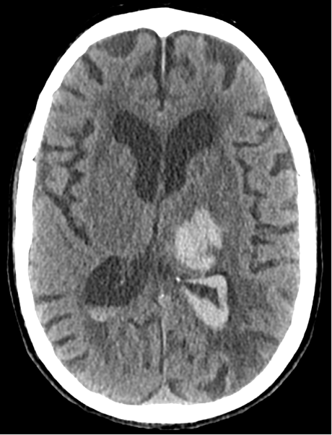
Case 2: Specific Reversal Therapy
3 months: mRS 3
Low-dose andexanet alfa
MRI on admission
ICH volume: 20 ml
IVH volume: 5 ml
CT at 24 hours
ICH-volume 20 ml
IVH-volume 5 ml

Slide 9
Looking for more resources on this topic?
CME/CE in minutes
Congress highlights
Late-breaking data
Quizzes
Webinars
In-person events
Slides & resources
www.MedEdOTG.com

