Slide 1
Reversal of Factor Xa Inhibitor ICH: ANNEXA-4, ANNEXA-I, and Real-World Evidence
David Seiffge, MD
Professor of Neurology Department of Neurology, Inselspital University Hospital Bern University of Bern Bern, Switzerland

Slide 2



Resource Information
About This Resource
These slides are one component of a continuing education program available online at MedEd On The Go titled Real World Data and the Management of Intracranial Hemorrhages (ICH) in Anticoagulated Patients
Program Learning Objectives:
Employ appropriate treatment management strategies to address the critical clinical aspects of ICH and hematoma expansion
Explain when and how to initiate appropriate reversal agents in ICH bleeds
Discuss the need to develop and implement protocols and local care pathways based on existing evidence-based medicine guidelines to improve the management of ICH bleeds
MedEd On The Go®
www.mededonthego.com
This content or portions thereof may not be published, posted online or used in presentations without permission.
This content can be saved for personal use (non-commercial use only) with credit given to the resource authors.
To contact us regarding inaccuracies, omissions or permissions please email us at support@MedEdOTG.com

Slide 3
Disclaimer
The views and opinions expressed in this educational activity are those of the faculty and do not necessarily represent the views of Total CME, LLC, the CME providers, or the companies providing educational grants. This presentation is not intended to define an exclusive course of patient management; the participant should use their clinical judgment, knowledge, experience, and diagnostic skills in applying or adopting for professional use any of the information provided herein. Any procedures, medications, or other courses of diagnosis or treatment discussed or suggested in this activity should not be used by clinicians without evaluation of their patient's conditions and possible contraindications or dangers in use, review of any applicable manufacturer’s product information, and comparison with recommendations of other authorities. Links to other sites may be provided as additional sources of information.

Slide 4
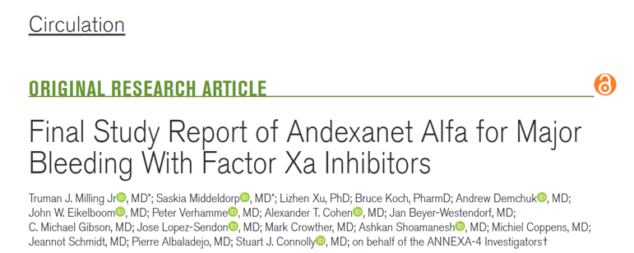
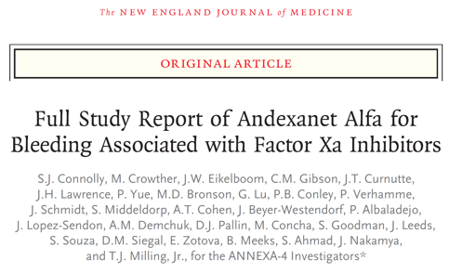
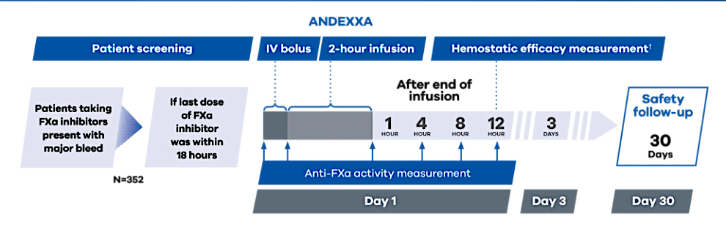
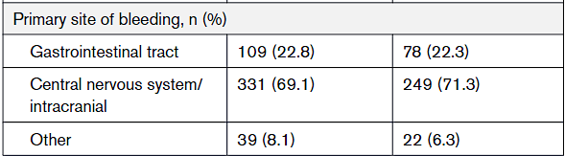
ANNEXA-4
N=479
www.andexxa.com
Single arm (no control group)
Major bleeds (mixed population)

Slide 5
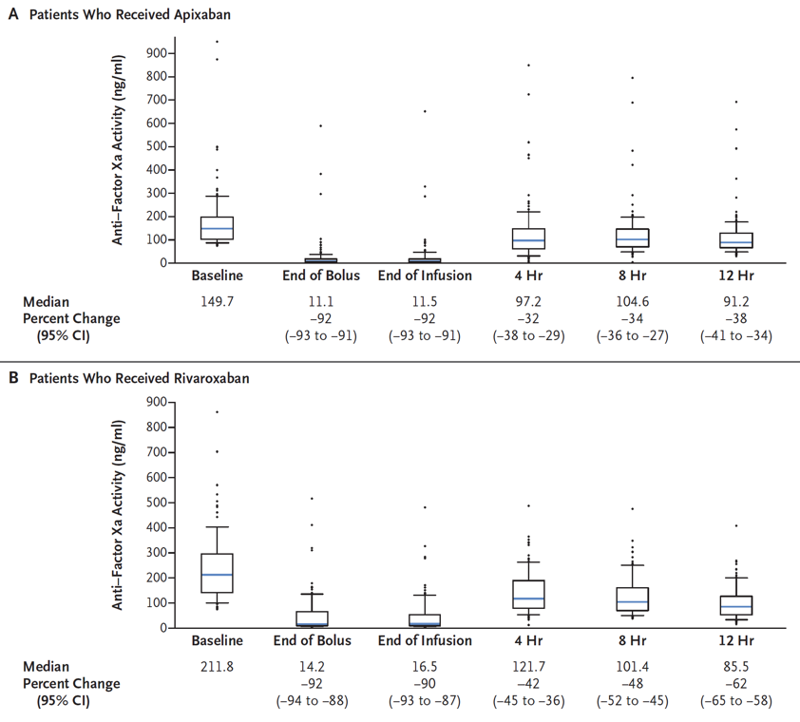
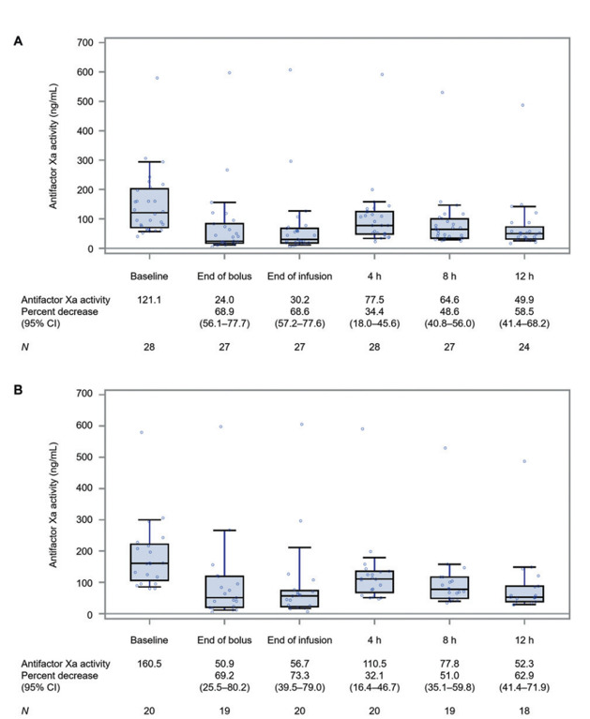
ANNEXA-4 Main Results
Edoxaban

Slide 6
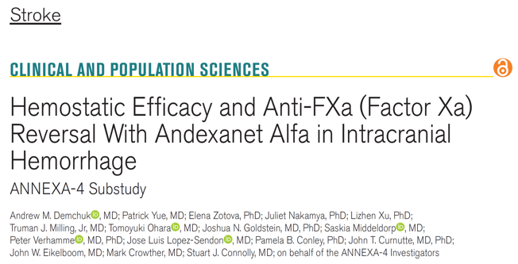
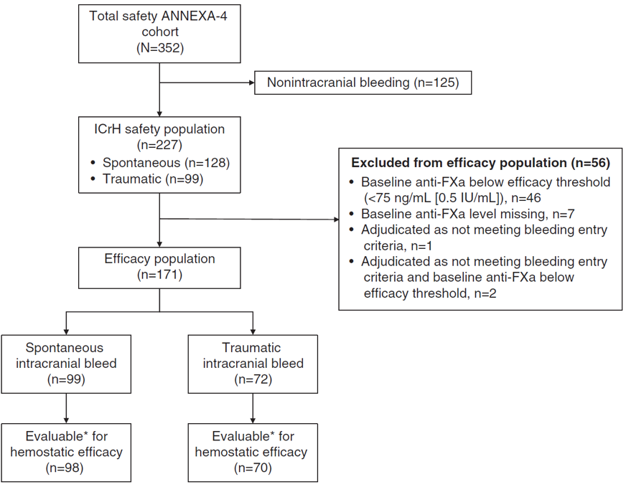
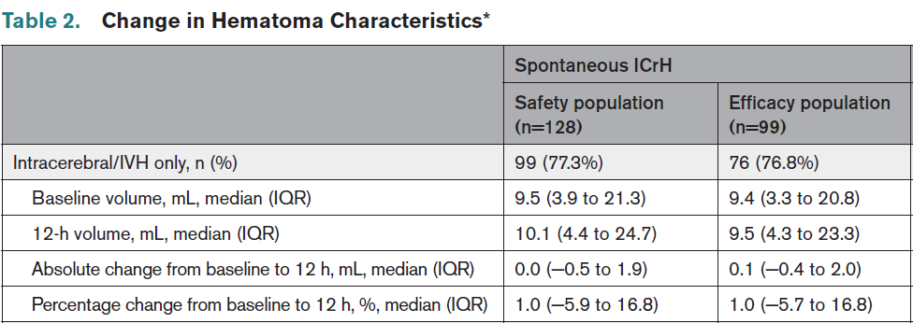
ANNEXA-4: Subgroup of ICH

Slide 7
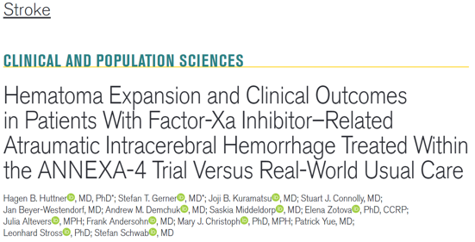
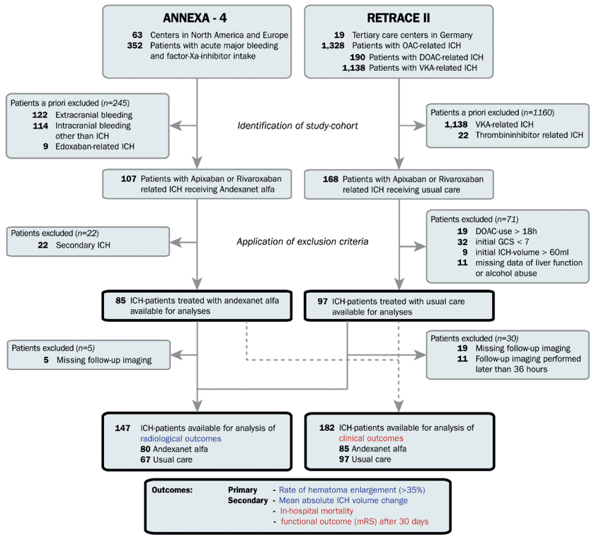
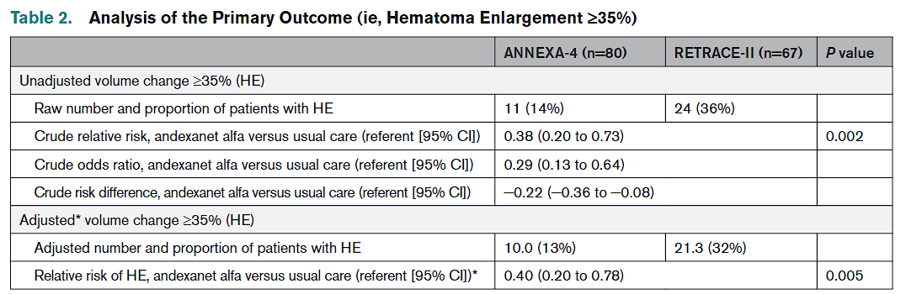
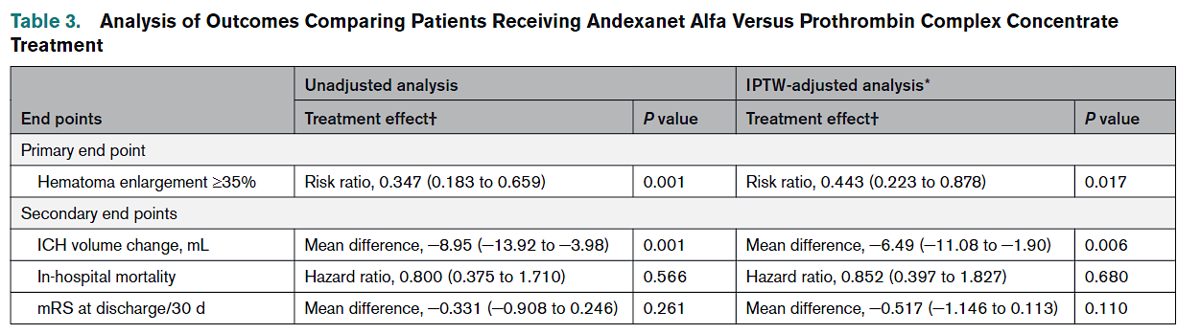
ANNEXA-4 Versus “Real-World”

Slide 8

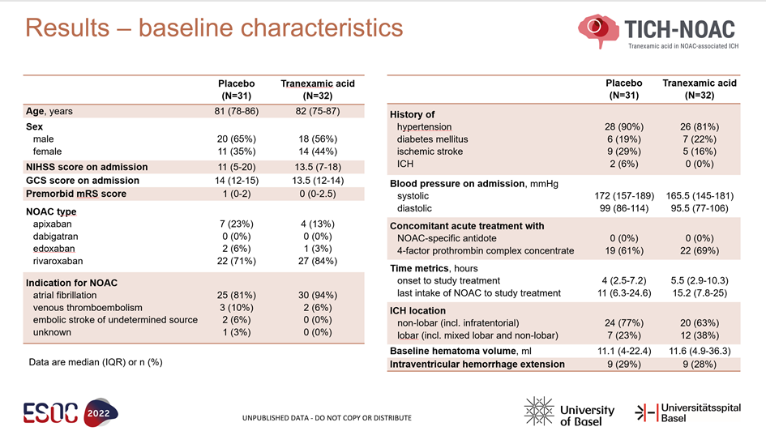
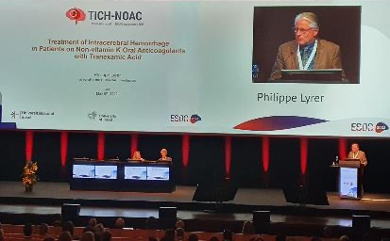
TICH-NOAC
RCT of patients with DOAC-ICH tranexamic acid versus placebo as add-on therapy to standard of care (mostly PCC)
Nonspecific treatment

Slide 9


ANNEXA-4 Versus TICH-NOAC: Aggregate Data Comparison
 | ANNEXA-4 (n=98) | TICH-NOAC (n=63)
Baseline variables
Age (median) | 78.8 years | 81.0 years
NIHSS baseline | 8 points | 11 points
Time from onset to treatment | 4.4 hours | 4.5 hours
Time since last DOAC intake | 11 hours | 12 hours
ICH volume at baseline (median) | 13 ml | 11 ml
Outcomes
Haematoma expansion | 14% | 44%
Favourable outcome (mRS 0-3) | 35% (at 30 days) | 27% (at 90 days)
Thrombembolic events | 10% (at 30 days) | 9.5% (at 90 days)

Slide 10
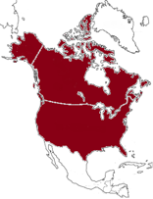
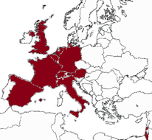
ANNEXA-I RCT (NCT03661528)
Design | Randomized (1:1), partially blinded, controlled
Control | Usual care therapy
Sample Size | 900
Key Inclusion Criteria | Patients ≥18 years with acute ICH within 15 hours after last FXa inhibitor dose (apixaban, rivaroxaban, edoxaban)
Key Exclusion Criteria | PCC/coag factor/VKA use within 7 days; planned surgical intervention within 12 hours; symptoms to scan >12 hours
Endpoints | Haemostatic efficacy at 12 hours (composite of hematoma volume and NIHSS) Anti-fXa activity
Follow Up | 30 days
Status: Enrollment ongoing

Slide 11



Looking for more resources on this topic?
CME/CE in minutes
Congress highlights
Late-breaking data
Quizzes
Webinars
In-person events
Slides & resources
www.MedEdOTG.com

