Slide 1
Management of a Patient with Vitamin K Antagonist-Associated Intracranial Hemorrhage (ICH)
Natalie Kreitzer, MD, MS Associate Professor Emergency Medicine and Neurocritical Care University of Cincinnati Cincinnati, OH, USA

Slide 2
Resource Information
About This Resource
These slides are one component of a continuing education program available online at MedEd On The Go titled Real World Data and the Management of Intracranial Hemorrhages (ICH) in Anticoagulated Patients
Program Learning Objectives:
Employ appropriate treatment management strategies to address the critical clinical aspects of ICH and hematoma expansion
Explain when and how to initiate appropriate reversal agents in ICH bleeds
Discuss the need to develop and implement protocols and local care pathways based on existing evidence-based medicine guidelines to improve the management of ICH bleeds
MedEd On The Go®
www.mededonthego.com
This content or portions thereof may not be published, posted online or used in presentations without permission.
This content can be saved for personal use (non-commercial use only) with credit given to the resource authors.
To contact us regarding inaccuracies, omissions or permissions please email us at support@MedEdOTG.com

Slide 3
Disclaimer
The views and opinions expressed in this educational activity are those of the faculty and do not necessarily represent the views of Total CME, LLC, the CME providers, or the companies providing educational grants. This presentation is not intended to define an exclusive course of patient management; the participant should use their clinical judgment, knowledge, experience, and diagnostic skills in applying or adopting for professional use any of the information provided herein. Any procedures, medications, or other courses of diagnosis or treatment discussed or suggested in this activity should not be used by clinicians without evaluation of their patient's conditions and possible contraindications or dangers in use, review of any applicable manufacturer’s product information, and comparison with recommendations of other authorities. Links to other sites may be provided as additional sources of information.

Slide 4
Anticoagulation
Any patient with intracranial bleed:
Anticoagulant medication
What is dose? When was last dose?
Laboratory tests
CBC with platelet count, INR, PTT

Slide 5
Case
67-year-old man
Fall from standing
On warfarin
INR: 3.0
GCS: 7 (2/2/3)
Next steps?
When is it safe to place a monitor?

Slide 6
Reversal of Vitamin K Antagonists After ICH
AHA Guidelines:
In patients with VKA associated spontaneous ICH, intravenous vitamin K should be administered directly after coagulation factor replacement (PCC or other) to prevent later increase in INR and subsequent HE (Class I; Level of Evidence C).
In patients with VKA associated spontaneous ICH with INR 1.3 to 1.9, it may be reasonable to use PCCs to achieve rapid correction of INR and limit HE. (Class IIb; Level of Evidence B).

Slide 7
VKA Reversal
Majeed et al: 135 retrospective patients had smaller ICH volume (64.5 vs 36.0, P=0.021)
Frontera et al: Prospective observational study. Lower risk of death or severe disability at 3 months (P=0.039) when compared to FFP alone
INCH trial: Enrolled 50 patients. Endpoint of INR 1.2 at 3 hours post infusion favored PCC group (adjusted OR 30.6, P =0.0003)

Slide 8
Indications for Reversal
Almost all patients with acute ICH
Pitfalls
Ultra-early prognostication
Waiting for a decline in exam to reverse
Not reversing “small” hemorrhages
Considerations
Time since last dose of DOAC or INR
Age and comorbidities
Location and size of hemorrhage
Institutional guidelines

Slide 9
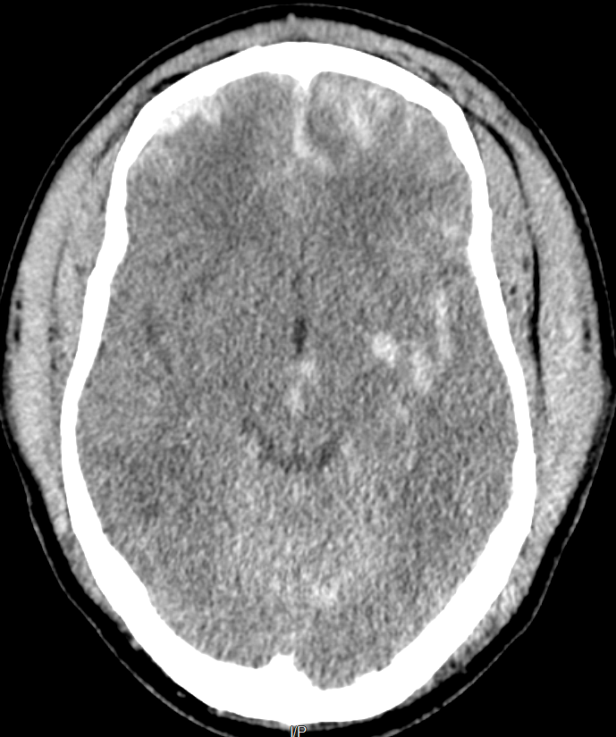
Case
Received 4F-PCCs
Admitted to Neuroscience ICU
Monitor placed when INR < 1.4
Discharged to Inpatient Rehabilitation at 14 days
At 6 months, was home, speaking, required assistance with most tasks

Slide 10
Looking for more resources on this topic?
CME/CE in minutes
Congress highlights
Late-breaking data
Quizzes
Webinars
In-person events
Slides & resources
www.MedEdOTG.com

