Slide 1
Repletion or Reversal? Optimizing Specific Therapy for Direct Oral Anticoagulant
(DOAC)-Related Life-Threatening Bleeding Using Real-World Experience
Natalie Kreitzer, MD, MS
Associate Professor
Emergency Medicine and Neurocritical Care
University of Cincinnati
Cincinnati, OH, USA

Slide 2



Resource Information
About This Resource
These slides are one component of a continuing education program available online at MedEd On The Go titled Real World Data and the Management of Intracranial Hemorrhages (ICH) in Anticoagulated Patients
Program Learning Objectives:
Employ appropriate treatment management strategies to address the critical clinical aspects of ICH and hematoma expansion
Explain when and how to initiate appropriate reversal agents in ICH bleeds
Discuss the need to develop and implement protocols and local care pathways based on existing evidence-based medicine guidelines to improve the management of ICH bleeds
MedEd On The Go®
www.mededonthego.com
This content or portions thereof may not be published, posted online or used in presentations without permission.
This content can be saved for personal use (non-commercial use only) with credit given to the resource authors.
To contact us regarding inaccuracies, omissions or permissions please email us at support@MedEdOTG.com

Slide 3
Disclaimer
The views and opinions expressed in this educational activity are those of the faculty and do not necessarily represent the views of Total CME, LLC, the CME providers, or the companies providing educational grants. This presentation is not intended to define an exclusive course of patient management; the participant should use their clinical judgment, knowledge, experience, and diagnostic skills in applying or adopting for professional use any of the information provided herein. Any procedures, medications, or other courses of diagnosis or treatment discussed or suggested in this activity should not be used by clinicians without evaluation of their patient's conditions and possible contraindications or dangers in use, review of any applicable manufacturer’s product information, and comparison with recommendations of other authorities. Links to other sites may be provided as additional sources of information.

Slide 4
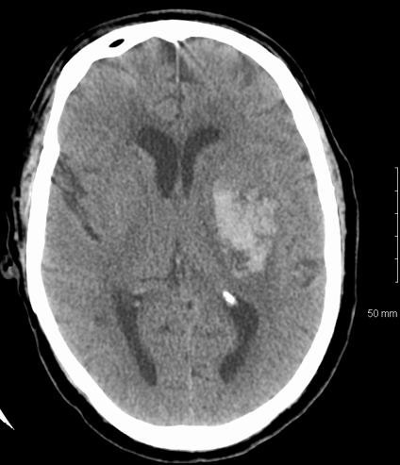
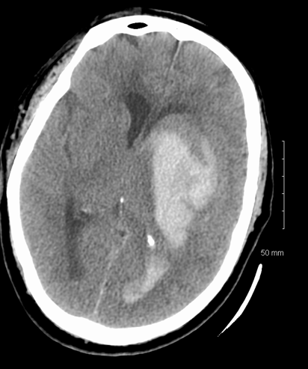
Hemorrhage Expansion

Slide 5
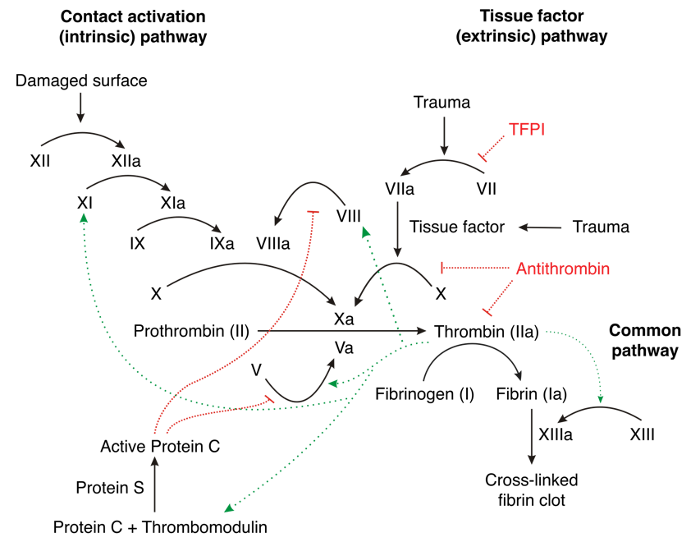
Vitamin K Antagonists and Direct Oral Anticoagulants

Slide 6
Repletion and Reversal
Reversal
  Factor Xa inhibitors: Andexanet alfa
  Direct thrombin inhibitors: Idarucizumab
Repletion
  Fresh frozen plasma (FFP)
  4-factor prothrombin complex concentrates (PCCs)
  Vitamin K dependent: II, VII, IX, X
  Approved for warfarin repletion
  Off-label for DOAC reversal

Slide 7
Repletion Strategies
Recommend treatment for INR >1.3 in VKA bleeding Vitamin K: 10 mg IV
FFP
  Factors I (fibrinogen), II, V, VII, IX, X, XI, XIII, and antithrombin
  Large volumes often needed
  (10-15 ml/kg)
  Time to prepare and administer, risk fluid overload
  Risk transfusion reaction
PCC
  4-factor: II, VII, IX, X
  3-factor: II, IX, X
  Activated versus inactivated
  Dose: Fixed or based on INR and weight
  Faster reversal, less volume
  Increased cost

Slide 8
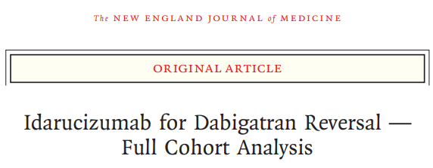
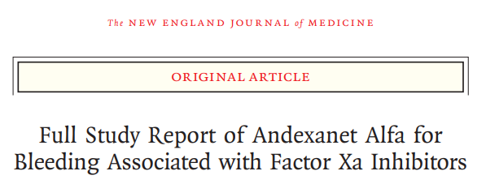
Reversal Strategies in Setting of Major Bleeding
Monoclonal antibody that binds to dabigatran
May be needed if last dose within 12 to 24 hours
Lab to follow: PTT and thrombin time
Dose: 5 grams (2.5 grams x 2)
Recombinant modified human “decoy” factor Xa protein
May be needed if last dose within 18 hours
Lab to follow: Anti-Xa level
Dose: High dose or low dose
  Xa inhibitor dose
  Time since taken

Slide 9
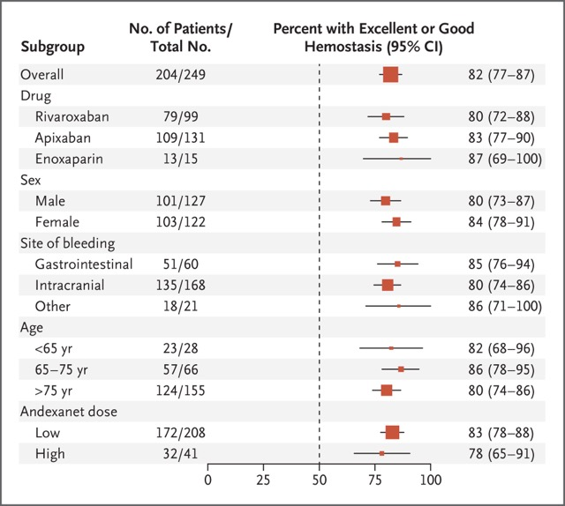
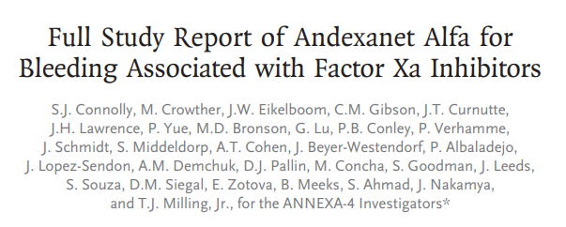

Slide 10
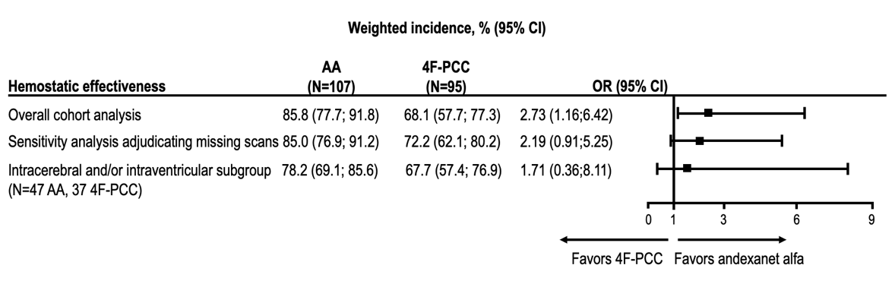
Hematoma Expansion
Propensity Matched Real-World Data
Weighted incidence, % (95% CI)
Hemostatic effectiveness | AA (N=107) | 4F-PCC (N=95) | OR (95% CI)
Overall cohort analysis | 85.8 (77.7; 91.8) | 68.1 (57.7; 77.3) | 2.73 (1.16;6.42)
Sensitivity analysis adjudicating missing scans | 85.0 (76.9; 91.2) | 72.2 (62.1; 80.2) | 2.19 (0.91;5.25)
Intracerebral and/or intraventricular subgroup (N=47 AA, 37 4F-PCC) | 78.2 (69.1; 85.6) | 67.7 (57.4; 76.9) | 1.71 (0.36;8.11)
0
1
3
6
9
Favors 4F-PCC Favors andexanet alfa

Slide 11
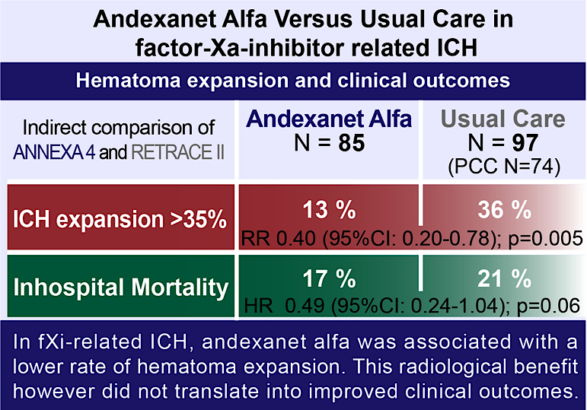
Hematoma Expansion in ICH Real-World Management
36 %
RR 0.40 (95%CI: 0.20-0.78); p=0.005
21 %
HR 0.49 (95%CI: 0.24-1.04); p=0.06

Slide 12



Looking for more resources
on this topic?
CME/CE in minutes
Congress highlights
Late-breaking data
Quizzes
Webinars
In-person events
Slides & resources
www.MedEdOTG.com

