Slide 1
How Are ARIs Being Used to Intensify Therapy for High-Risk Localized Prostate Cancer After Local Therapy?
Rana R. McKay
Associate Professor of Medicine and Urology
Co-Lead, Genitourinary Oncology Program
Associate Director, Translational Sciences
UC San Diego Medical Center
San Diego, CA

Slide 2



Resource Information
About This Resource
These slides are one component of a continuing education program available online at MedEd On The Go titled Prostate Cancer: Focusing Androgen Receptor Inhibitors on High-Risk Localized & Locally Advanced Disease
Program Learning Objectives:
Describe the risk of developing metastases and cancer-related mortality based on risk stratification in localized prostate cancer
Assess the evolving changes in guideline recommendations for high-risk localized and locally advanced prostate cancer and where ARIs fit into these recommendations
Evaluate the efficacy and safety of second-generation ARI therapy in patients with newly diagnosed prostate cancer who have high-risk localized or locally advanced disease
Employ effective multidisciplinary adverse effect management strategies to improve ARI treatment adherence
MedEd On The Go®
www.mededonthego.com
This content or portions thereof may not be published, posted online or used in presentations without permission.
This content can be saved for personal use (non-commercial use only) with credit given to the resource authors.
To contact us regarding inaccuracies, omissions or permissions please email us at support@MedEdOTG.com

Slide 3
Disclaimer
The views and opinions expressed in this educational activity are those of the faculty and do not necessarily represent the views of Total CME, LLC, the CME providers, or the companies providing educational grants. This presentation is not intended to define an exclusive course of patient management; the participant should use their clinical judgment, knowledge, experience, and diagnostic skills in applying or adopting for professional use any of the information provided herein. Any procedures, medications, or other courses of diagnosis or treatment discussed or suggested in this activity should not be used by clinicians without evaluation of their patient's conditions and possible contraindications or dangers in use, review of any applicable manufacturer’s product information, and comparison with recommendations of other authorities. Links to other sites may be provided as additional sources of information.

Slide 4
Clinical States of Prostate Cancer
Opportunity to Cure
Clinical Metastases
Hormone Sensitive
Clinically Localized Disease
Clinical Metastases Castration Resistance
Rising PSA
Rising PSA
Castration Resistance
Neoadjuvant
Adjuvant
Salvage

Slide 5
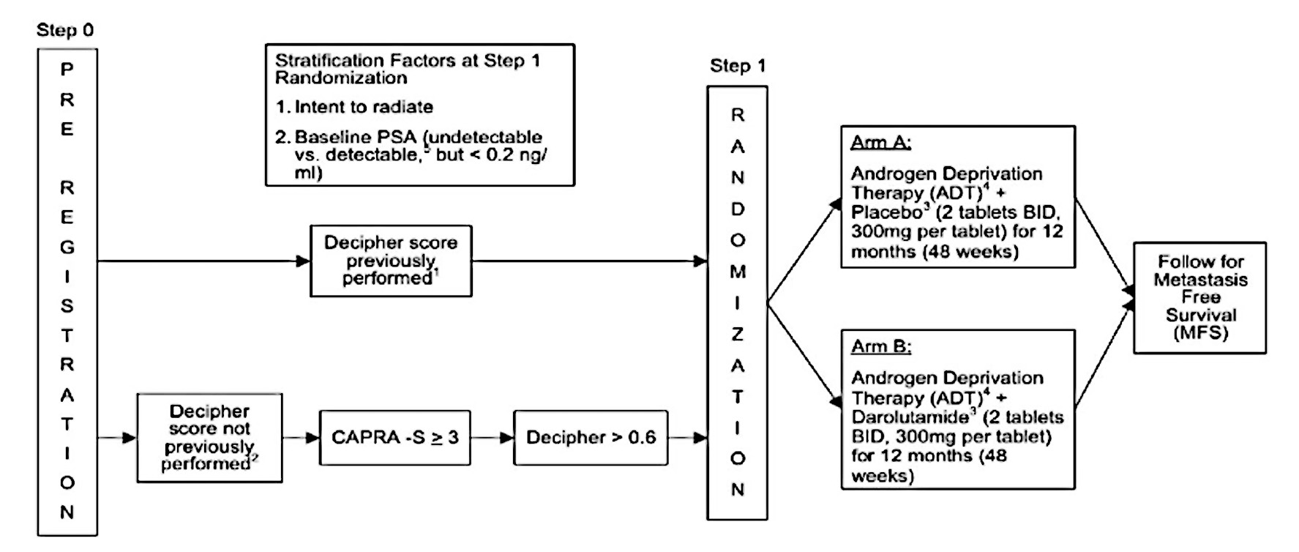
ERADICATE
ClinicalTrials.gov NCT04484818

Slide 6
ADAM Trial
Post RP
D’Amico high-risk criteria
PSA <0.2
Apalutamide x 30
28-day cycles
Observation (optional adjuvant radiation therapy for positive margins)
N=260
Primary Endpoint – PFS
ClinicalTrials.gov NCT04295447

Slide 7
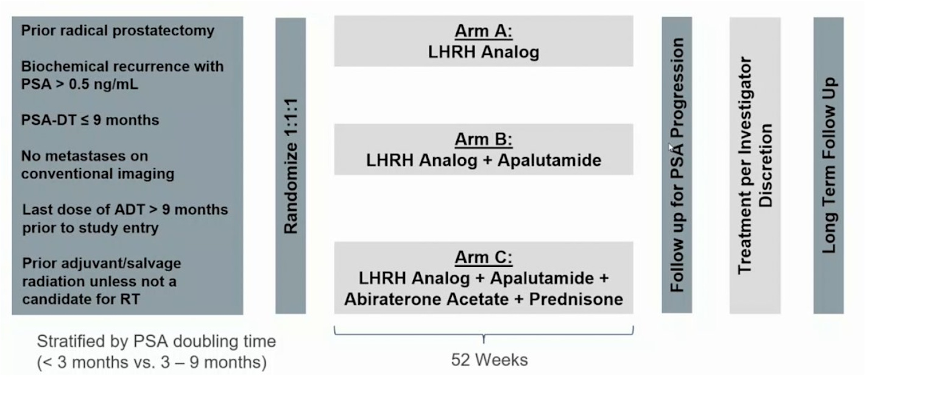
PRESTO Trial
LHRH, luteinizing hormone-releasing hormone; PSA-DT, prostate-specific antigen doubling time; RT, radiation therapy.
Aggarwal R, et al. ESMO 2022. Abstract LBA63; Alliance Foundation Trials, LLC. Clinical Trials.gov Identifier: NCT03009981. Updated July 5, 2023.

Slide 8
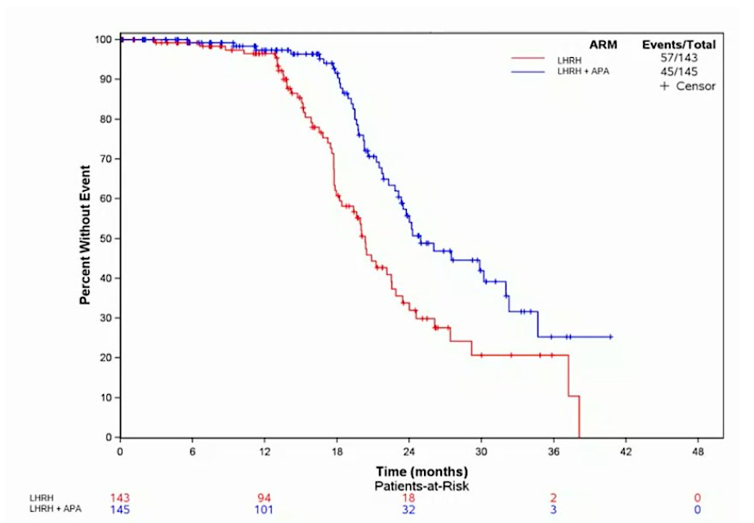
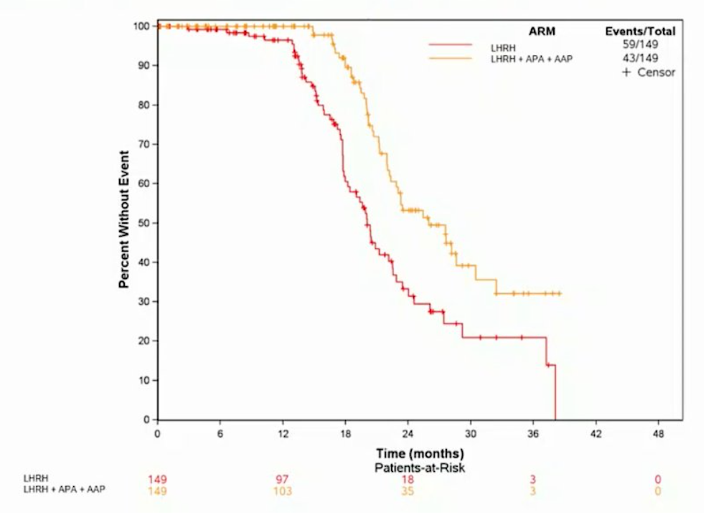


PRESTO – Results
At the first planned interim analysis (median follow-up 21.5 months), both experimental arms had significantly prolonged bPFS compared to that in the control arm: median 24.9 months for ADT + apalutamide versus 20.3 months for ADT, HR 0.52 (95% CI 0.35–0.77).
Median 26.0 months for ADT + apalutamide + abiraterone acetate plus prednisone versus 20.0 months for ADT, HR 0.48 (95% CI 0.32–0.71):
AAP, abiraterone acetate plus prednisone; APA, apalutamide; bPFS, biochemical progression-free survival; CI, confidence interval; HR, hazard ratio.
Aggarwal R, et al. ESMO 2022. Abstract LBA63.

Slide 9
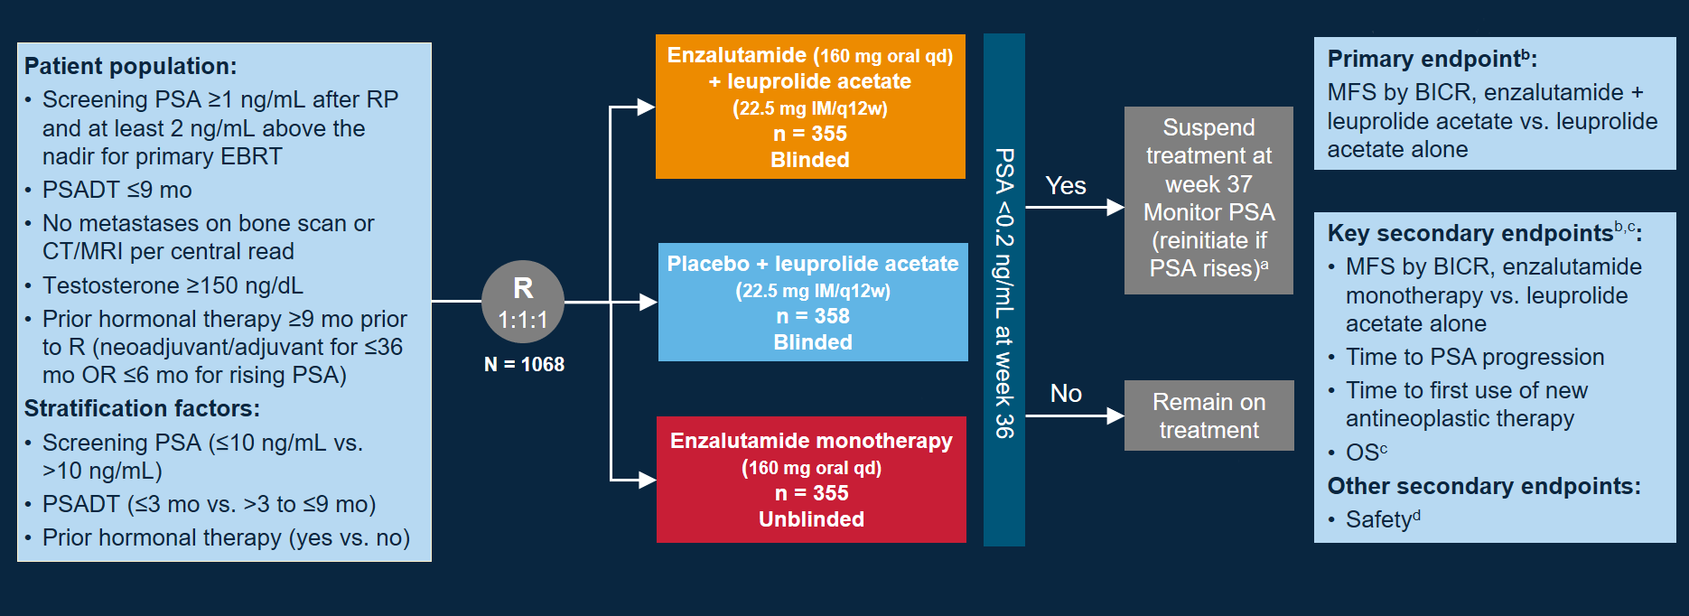
EMBARK Trial
BICR, blinded independent central review; EBRT, external beam radiation therapy; OS, overall survival; PSADT, prostate-specific antigen doubling time; R, randomized.
Pfizer. ClinicalTrials.gov Identifier: NCT02319837. Updated April 27, 2023; Shore N, et al. Journal of Urology. 2023;210(1);224-26.

Slide 10
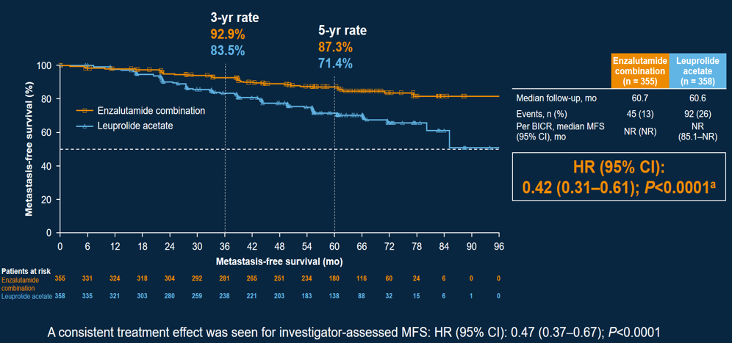
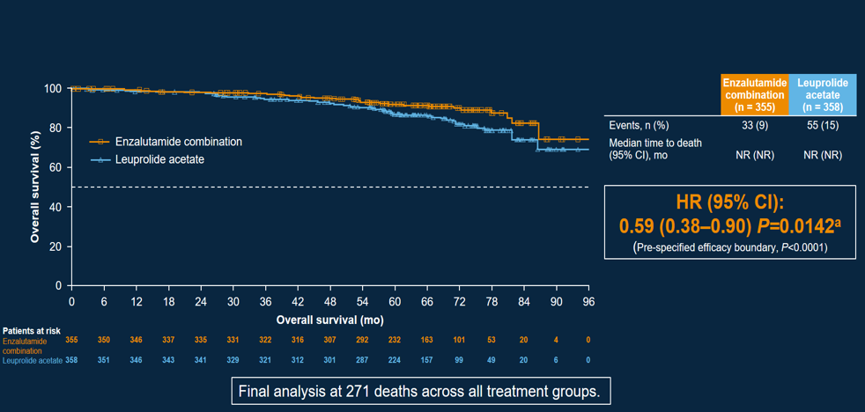
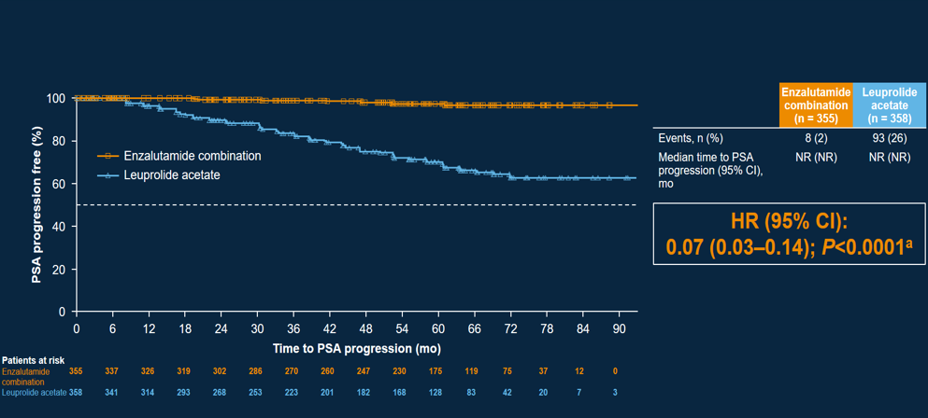
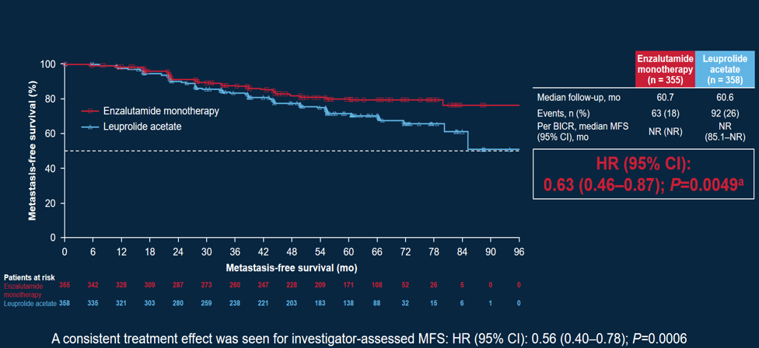
EMBARK Results
NR, not reported.
Shore N, et al. Journal of Urology. 2023;210(1);224-26.

Slide 11
Conclusions
Several studies are currently ongoing investigating ARSIs following definitive local therapy
Adjuvant darolutamide and apalutamide following RP is being investigated
Enzalutamide and apalutamide demonstrated promising efficacy in two phase 3 trials in the BCR setting
ARSI, androgen receptor signaling inhibitor; BCR, biochemical recurrence.

Slide 12



Looking for more resources
on this topic?
CME/CE in minutes
Congress highlights
Late-breaking data
Quizzes
Webinars
In-person events
Slides & resources
www.MedEdOTG.com

