Slide 1
Can ARIs Be Combined With Radiation Therapy in High-Risk Localized Prostate Cancer?
Neeraj Agarwal, MD, FASCO
Professor of Medicine
Senior Director for Clinical Translation, Huntsman Cancer Institute (HCI)
Presidential Endowed Chair of Cancer Research
Director, Center of Investigational Therapeutics
Director, Genitourinary Oncology Program
Huntsman Cancer Institute, University of Utah (NCI-CCC)
Salt Lake City, UT

Slide 2



Resource Information
About This Resource
These slides are one component of a continuing education program available online at MedEd On The Go titled Prostate Cancer: Focusing Androgen Receptor Inhibitors on High-Risk Localized & Locally Advanced Disease
Program Learning Objectives:
Describe the risk of developing metastases and cancer-related mortality based on risk stratification in localized prostate cancer
Assess the evolving changes in guideline recommendations for high-risk localized and locally advanced prostate cancer and where ARIs fit into these recommendations
Evaluate the efficacy and safety of second-generation ARI therapy in patients with newly diagnosed prostate cancer who have high-risk localized or locally advanced disease
Employ effective multidisciplinary adverse effect management strategies to improve ARI treatment adherence
MedEd On The Go®
www.mededonthego.com
This content or portions thereof may not be published, posted online or used in presentations without permission.
This content can be saved for personal use (non-commercial use only) with credit given to the resource authors.
To contact us regarding inaccuracies, omissions or permissions please email us at support@MedEdOTG.com

Slide 3
Disclaimer
The views and opinions expressed in this educational activity are those of the faculty and do not necessarily represent the views of Total CME, LLC, the CME providers, or the companies providing educational grants. This presentation is not intended to define an exclusive course of patient management; the participant should use their clinical judgment, knowledge, experience, and diagnostic skills in applying or adopting for professional use any of the information provided herein. Any procedures, medications, or other courses of diagnosis or treatment discussed or suggested in this activity should not be used by clinicians without evaluation of their patient's conditions and possible contraindications or dangers in use, review of any applicable manufacturer’s product information, and comparison with recommendations of other authorities. Links to other sites may be provided as additional sources of information.

Slide 4
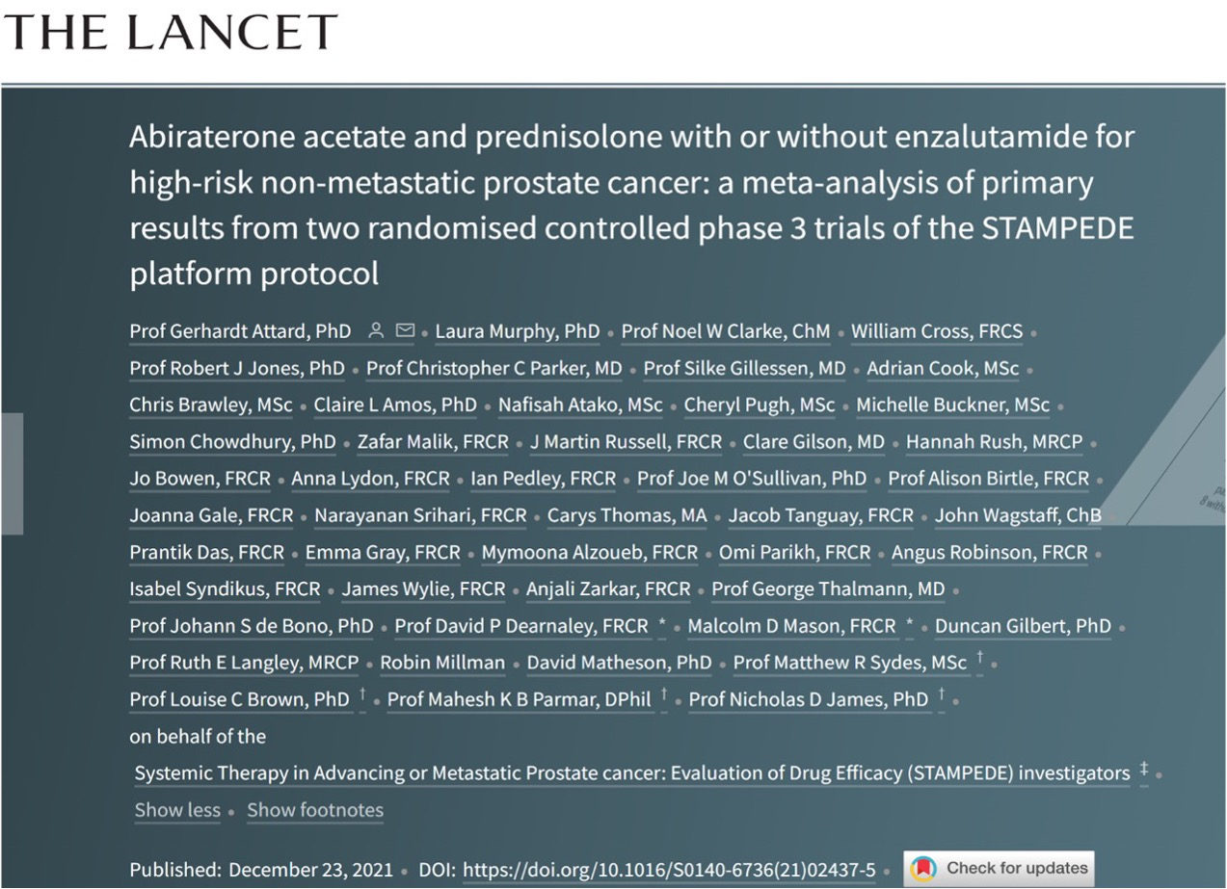

Slide 5
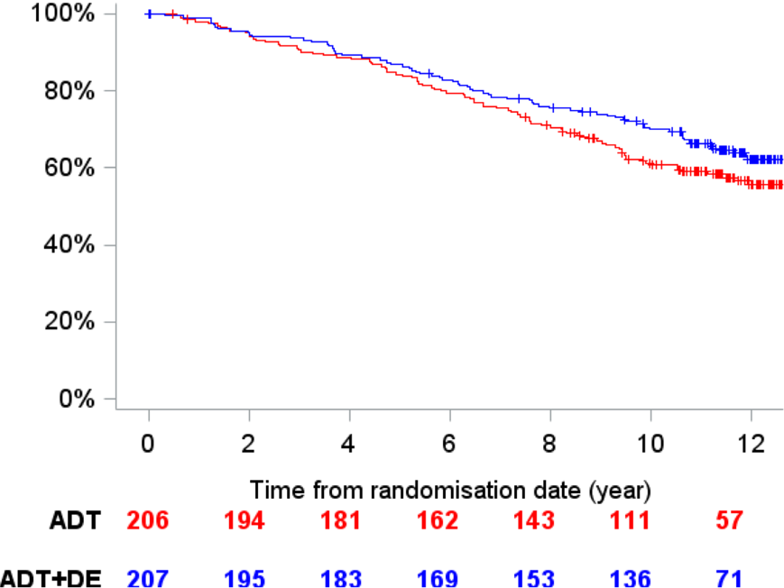
Background: docetaxel
Docetaxel improves survival in M1 PCa but no improvement in MFS/OS in M0
STAMPEDE trial
GETUG-12 trial
1.0
ADT + Docetaxel
1.0
ADT + Docetaxel + Estramustine
0.8
0.8
Metastasis-free survival
Metastasis-free survival
ADT
Metastasis-free survival
ADT
0.6
0.6
0.4
0.4
0.2
HR 0.89, 95% CI: 0.66-1.19 P=0.425
0.2
HR: 0.81, 95% CI: 0.60-1.09
P=0.1609
0.0
0.0
0
1
2
3
4
5
6
7
8
9
0
2
4
6
8
10
12
460
433
409
Years since randomization
Years since randomization
ADT
391
360
293
195
127
81
48
ADT
206
194
181
162
143
111
57
230
217
210
198
186
147
41
21
ADT + DE
ADT + D
95
56
207
195
183
169
153
136
71
James N, et al. ESMO 2019, abstract 855PD.
Fizazi K,et al. ESMO 2018, abstract 791O.

Slide 6
STAMPEDE Trial: Study Design
M0 pts in AAP comparison: continued FU with no further efficacy inspections
2019 - amended the reporting plan* to split M1 & M0, power the 1ary end-point on MFS, meta-analyse with new data from AAP+ENZ comparison
N=1974
2011
2012
2013
2014
2015
2016
No overlapping controls
Same protocol & eligibility criteria
2 years AAP+/-ENZ
No evidence of OS benefit with AAP+/-ENZ in mCRPC
SOC: ADT x 3 years + RT^
1:1 randomisation
SOC + AAP (2y)
SOC + AAP+ENZ (2y)
SOC, standard of care
^when indicated
Morris MJ, et al. J Clin Oncol 2019;37:5008.
Attard G, et al. Lancet 2021;399(10323):447-60.
Solid bars: period of accrual

Slide 7
STAMPEDE Trial: Patient Population
M0
No evidence of metastases on bone and CT scan of pelvis, abdo, chest
(pre-defined stratification criterion)
Newly-diagnosed
Any of:
  Node-Positive
  ≥2 of: Stage T3 or T4
  PSA≥40ng/ml
  Gleason 8, 9 or 10
  Relapsing after previous RP or RT
  Any of:
  Node-positive
  PSA≥4ng/ml, rising & doubling time <6m
  PSA≥20ng/ml
All patients
  Written informed consent
  Fit for all protocol treatment
  Fit for follow-up
Full criteria: www.stampedetrial.org
Attard G, et al. Lancet 2022;399(10323):447-60.

Slide 8
STAMPEDE Trial: Patient Characteristics
Randomized groups were well balanced (N=1974)
Median age = 68 years
Median PSA = 34 ng/ml
N1 = 39%
3% relapsing after prior treatment
Median follow-up = 72 months
(85 months AAP comparison & 60 months AAP+ENZ comparison)
Attard G, et al. Lancet 2022;399(10323):447-60.

Slide 9
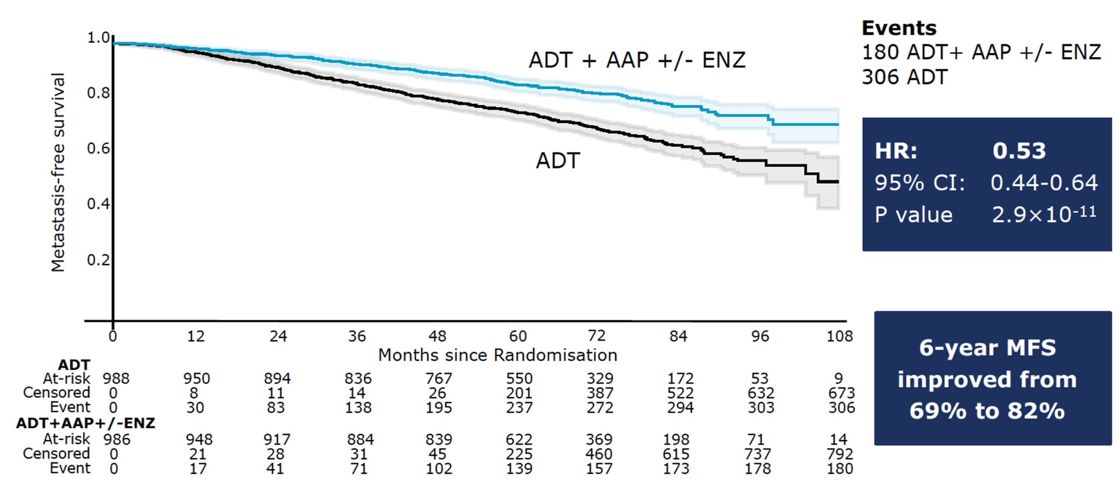
STAMPEDE Trial: Metastasis-free Survival
Kaplan-Meier estimates with 95% CI in lighter shade
AAP, abiraterone acetate + prednisone; ADT, androgen deprivation therapy; ENZ, enzalutamide.
Non-proportional hazards P=0.46
Attard G, et al. Lancet 2022;399(10323):447-60.

Slide 10
STAMPEDE Trial: Metastasis-free Survival: Subgroup Analysis
dashed vertical line = overall HR
weighting is by sample size
Attard G, et al. Lancet 2022;399(10323):447-60.

Slide 11
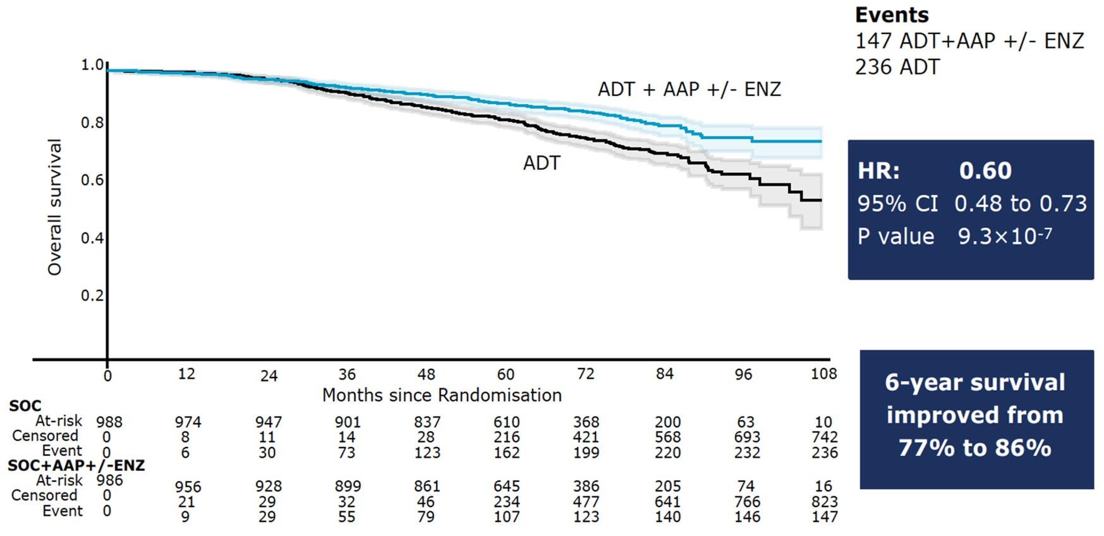
STAMPEDE Trial: Overall Survival
Kaplan-Meier estimates with 95% CI in lighter shade
Non-proportional hazards P=0.1
AAP, abiraterone acetate + prednisone; ADT, androgen deprivation therapy; ENZ, enzalutamide.
Attard G, et al. Lancet 2022;399(10323):455..

Slide 12
Conclusions
2 years of AAP-based therapy significantly improves MFS & overall survival of high-risk M0 PCa starting ADT and should be considered a new standard of care
Adding ENZ to AAP increases toxicity but has no discernible effect on efficacy
AAP, abiraterone acetate + prednisone; ENZ, enzalutamide.

Slide 13
Darolutamide Augments Standard Therapy for Localized Very High-Risk Cancer of the Prostate (DASL-HiCaP)
Key Eligibility
Men aged ≥ 18 years with histologically proven PC
Planned for primary RT and at very high risk for recurrence based on:
GG5
GG4 AND one or more of the following: clinical T2b-4 OR MRI with seminal vesicle invasion OR extracapsular extension OR PSA > 20ng/mL, OR
Pelvic nodal involvement
Post-radical prostatectomy ≤ 365 days prior to randomization and planned for RT, with very high risk of recurrence based on:
GG5, OR
GG4 AND pT3a or higher, OR
Pelvic nodal involvement
-No prior use of ARPIs
Stratification factors
Use of adjuvant docetaxel
Pelvic nodal involvement
R
A
N
D
O
M
I
Z
E
D
n=1100
Darolutamide 600 mg BID for 96 weeks
+
LHRH analogue
+
RT
Efficacy end points
Primary:
Metastasis-free survival
Secondary:
Overall survival
Prostate cancer-specific survival
PSA-progression free survival
Time to subsequent hormonal therapy
Time to castration-resistance
Frequency and severity of adverse events
Health related quality of life
Fear of cancer recurrence
Placebo
+
LHRH analogue
+
RT
www.clinicaltrials.gov: (NCT04136353)
ARPI, androgen receptor pathway inhibitor; GG, Gleason grade; LHRH, luteinizing hormone=releasing hormone; MRI, magnetic resonance imaging; PC, prostate cancer; pT3a, pathologic T3aRT; RT, radiation therapy.

Slide 14
Enzalutamide in Androgen Deprivation Therapy With Radiation Therapy for High Risk, Clinically Localized, Prostate Cancer (ENZARAD)
Stratification factors
Gleason score (<=7 versus 8-10),
Regional lymph nodes involvement (N0 versus N1)
Clinical T-stage (T2 and below versus T3 and above),
PSA (<20ng/mL versus ≥ 20ng/mL)
Brachytherapy (yes versus no)
Pelvic Field (yes versus no)
Key Eligibility
Men aged ≥ 18 years with histologically proven prostate adenocarcinoma
Planned for primary RT and at high risk of recurrence:
Gleason score 8-10 OR
Gleason score of 4+3 AND clinical T2b-4 AND PSA >20ng/mL OR
N1 disease (at or below common iliac artery bifurcation)
ECOG 0-1
No h/o seizures or condition predisposing to seizures
R
A
N
D
O
M
I
Z
E
D
n=800
Enzalutamide 160 mg qd for 24 months
+
LHRH analogue
+
RT
Efficacy end points
Primary:
Metastasis-free survival
Secondary:
Overall survival
Prostate cancer-specific survival
PSA-progression free survival
Clinical progression-free survival
Time to subsequent hormonal therapy
Time to castration-resistance
Safety
Health related quality of life
Health outcomes relative to costs
Conventional non-steroidal anti-androgen
+
LHRH analogue
+
RT
www.clinicaltrials.gov: (NCT02446444)
LHRH, luteinizing hormone=releasing hormone; RT, radiation therapy.

Slide 15


Looking for more resources
on this topic?
CME/CE in minutes
Congress highlights
Late-breaking data
Quizzes
Webinars
In-person events
Slides & resources
www.MedEdOTG.com

