Slide 1
Risk Assessment: Who Is Most Susceptible for a Secondary VTE Event?
Scott Kaatz, DO, MSc, FACP, SFHM
Clinical Professor of Medicine, Michigan State University College of Human Medicine
Clinical Professor of Medicine, Wayne State University School of Medicine
Medical Director for Professional Development and Research
Co-director, Anticoagulation Clinics
Henry Ford Hospital
Detroit, MI

Slide 2
Resource Information
About This Resource
These slides are one component of a continuing education program available online at MedEd On The Go titled Primary Prevention, Initial Treatment & Management of VTE, Secondary VTE Prevention Strategies
Program Learning Objectives:
Discuss patient populations that are particularly susceptible to blood clot development, emphasizing the importance of risk assessment and stratification for the primary prevention of VTE and the secondary prevention of recurrent VTE
Illustrate how to implement evidence-based medicine, clinical guideline statements, and real-world clinical data in clinical practice to improve outcomes for primary prevention of VTE, initial treatment and management of VTE, and the secondary prevention of recurrent VTE
MedEd On The Go®
www.mededonthego.com
This content or portions thereof may not be published, posted online or used in presentations without permission.
This content can be saved for personal use (non-commercial use only) with credit given to the resource authors.
To contact us regarding inaccuracies, omissions or permissions please email us at support@MedEdOTG.com

Slide 3
Disclaimer
The views and opinions expressed in this educational activity are those of the faculty and do not necessarily represent the views of Total CME, LLC, the CME providers, or the companies providing educational grants. This presentation is not intended to define an exclusive course of patient management; the participant should use their clinical judgment, knowledge, experience, and diagnostic skills in applying or adopting for professional use any of the information provided herein. Any procedures, medications, or other courses of diagnosis or treatment discussed or suggested in this activity should not be used by clinicians without evaluation of their patient's conditions and possible contraindications or dangers in use, review of any applicable manufacturer’s product information, and comparison with recommendations of other authorities. Links to other sites may be provided as additional sources of information.

Slide 4
Case
42-year-old male with pulmonary embolism several days after 2-day hospitalization for pneumonia
Pneumonia not COVID
No ICU for pneumonia or PE
Has been on full dose DOAC for 3-6 months
No signs of recurrent VTE, feels well, no shortness of breath, fully recovered
No increased bleeding risk
Would you continue anticoagulation?
Yes
No

Slide 5
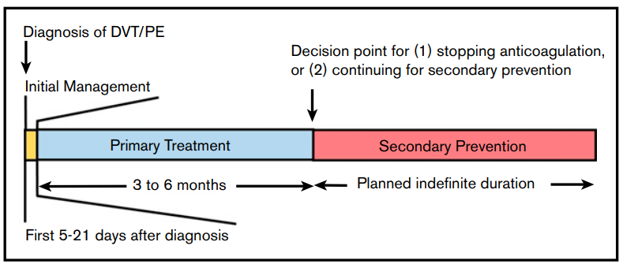
VTE Treatment Phases Terminology
American Society of Hematology (ASH) Guidelines
American College of Chest Physicians (ACCP) Guidelines
Initiation phase
Parenteral or high-dose anticoagulation for approximately 5 to 21 days
Treatment phase
3 months
Extended phase
Full or reduced dose for secondary prevention

Slide 6
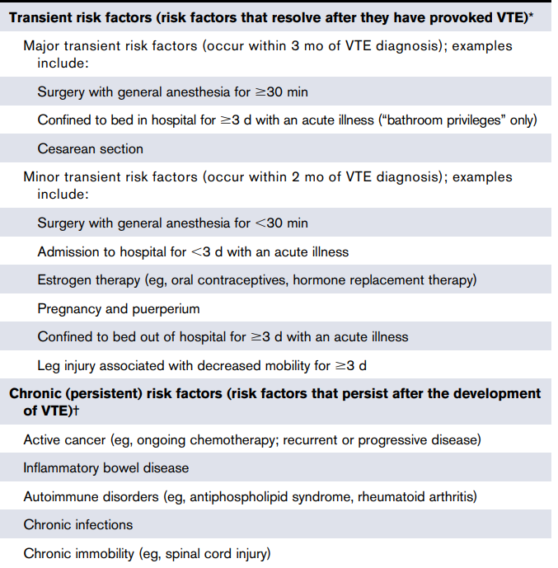
Definition of Risk Factor for Recurrent VTE
ACCP
ASH
VTE provoked by a major transient risk factor
E.g. surgery with general anesthesia for greater than 30 min
Confinement to bed in hospital (only “bathroom privileges”) for at least 3 days with an acute illness
Cesarean section
VTE provoked by a minor transient risk factor
E.g. surgery with general anesthesia for less than 30 min
Admission to hospital for less than 3 days with an acute illness
Estrogen therapy
Pregnancy or puerperium
Confinement to bed out of hospital for at least 3 days with an acute illness
Leg injury associated with reduced mobility for at least 3 days
Flight 8 or more hours
Unprovoked VTE

Slide 7
Guidelines for Extended-Phase Therapy
ACCP
ASH
In patients with VTE diagnosed in the setting of a major transient risk factor (see text), we recommend against offering extended-phase anticoagulation
In patients with VTE diagnosed in the setting of a minor transient risk factor (see text), we suggest against offering extended-phase anticoagulation
In patients with VTE diagnosed in the absence of transient provocation (unprovoked VTE or provoked by persistent risk factor), we recommend offering extended-phase anticoagulation
After completion of primary treatment for patients with DVT and/or PE provoked by a chronic risk factor, the ASH guideline panel suggests indefinite antithrombotic therapy over stopping anticoagulation
Remarks: Patients with DVT and/or PE provoked by a transient risk factor typically do not require antithrombotic therapy after completion of primary treatment
After completion of primary treatment for patients with unprovoked DVT or PE, the ASH guideline panel suggests indefinite antithrombotic therapy over stopping anticoagulation

Slide 8
Guidelines on Recurrent VTE Risk Assessment Models
ACCP
Current risk assessment systems are imperfect at predicting the risk of thrombosis in the absence of extended-phase therapy, or the risk of bleeding with extended-phase therapy
Studies validating these risk models, however, have been performed or are underway, yet await further validation preferably in pooled analyses before they can inform patients and physicians on the optimal risk-to-benefit balance in individual cases
ASH
For patients with unprovoked DVT and/or PE, the ASH guideline panel suggests against routine use of prognostic scores (recommendation 15), D-dimer testing (recommendation 16), or ultrasound to detect residual vein thrombosis (recommendation 17) to guide the duration of anticoagulation
Remarks state can use in certain circumstances

Slide 9
Case
42-year-old male with pulmonary embolism several days after 2-day hospitalization for pneumonia
Pneumonia not COVID
No ICU for pneumonia or PE
Has been on full DOAC for 3 to 6 months
No signs of recurrent VTE, feels well, no shortness of breath, fully recovered
No increase bleeding risk
Would you do a hypercoagulable work up?
Yes
No

Slide 10
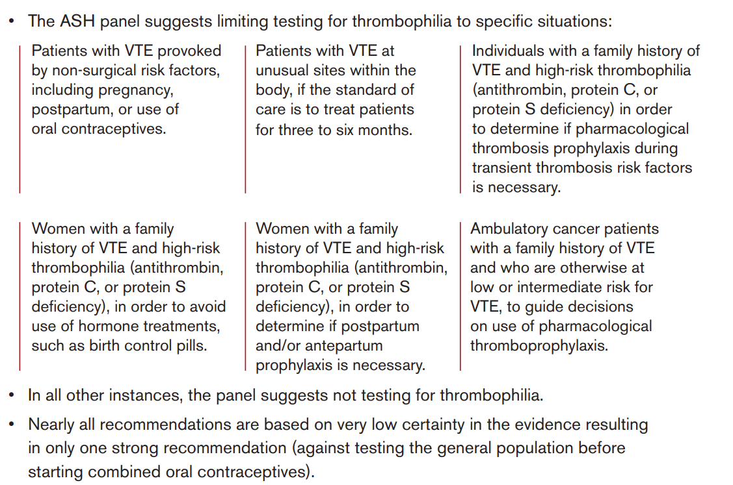
ASH Guideline
Recommendation

Slide 11
ASH Guideline Thrombophilia Testing
Recommendation 3: For patients with VTE provoked by a nonsurgical major transient risk factor who have completed primary short-term treatment:
The ASH guideline panel suggests testing for thrombophilia to guide anticoagulant treatment duration
The panel suggests indefinite anticoagulant treatment for patients with thrombophilia and stopping anticoagulant treatment for patients without thrombophilia

Slide 12
Looking for more resources on this topic?
CME/CE in minutes
Congress highlights
Late-breaking data
Quizzes
Webinars
In-person events
Slides & resources
www.MedEdOTG.com

