Slide 1

What Options Are Available Prophylactically for My Acute and Post-Acute Medically Ill Patients?
Alfonso J Tafur MD MS MBA RPVI
Director, Vascular Medicine & Cardiovascular Research
Endeavor Health
Evanston IL
Clinical Professor of Medicine
Director, Vascular Medicine Fellowship
Pritzker School of Medicine
University of Chicago
Chicago IL

Slide 2



Resource Information
About This Resource
These slides are one component of a continuing education program available online at MedEd On The Go titled Primary Prevention, Initial Treatment & Management of VTE, Secondary VTE Prevention Strategies
Program Learning Objectives:
Discuss patient populations that are particularly susceptible to blood clot development, emphasizing the importance of risk assessment and stratification for the primary prevention of VTE and the secondary prevention of recurrent VTE
Illustrate how to implement evidence-based medicine, clinical guideline statements, and real-world clinical data in clinical practice to improve outcomes for primary prevention of VTE, initial treatment and management of VTE, and the secondary prevention of recurrent VTE
MedEd On The Go®
www.mededonthego.com
This content or portions thereof may not be published, posted online or used in presentations without permission.
This content can be saved for personal use (non-commercial use only) with credit given to the resource authors.
To contact us regarding inaccuracies, omissions or permissions please email us at support@MedEdOTG.com

Slide 3
Disclaimer
The views and opinions expressed in this educational activity are those of the faculty and do not necessarily represent the views of Total CME, LLC, the CME providers, or the companies providing educational grants. This presentation is not intended to define an exclusive course of patient management; the participant should use their clinical judgment, knowledge, experience, and diagnostic skills in applying or adopting for professional use any of the information provided herein. Any procedures, medications, or other courses of diagnosis or treatment discussed or suggested in this activity should not be used by clinicians without evaluation of their patient's conditions and possible contraindications or dangers in use, review of any applicable manufacturer’s product information, and comparison with recommendations of other authorities. Links to other sites may be provided as additional sources of information.

Slide 4

MEDENOX
Hospital
VTE Prevention
Historical Journey
SYMPTOMS
Enoxaparin versus placebo
2020
2015
2010
ARTEMIS
Fondaparinux versus placebo
2005
Mottier D, et al. NEJM Evid. 2023;2(8); Cohen AT, et al. BMJ. 2006;332(7537):325-9; Samama MM, et al. N Engl J Med. 1999;341(11):793-800.
2000
Enoxaparin versus placebo

Slide 5
Hospitalized Medically Ill
+ VTE Risk -
LMWH, LDUH, Fonda
Grade 1B
*LMWH, Fonda > UFC (conditional)
LMWH over DOACs (strong)
Pharmacological over mechanical
None
Grade 1B
+ Bleeding Risk -
Mechanical only (GCS, IPC)
Grade 2C
None
Grade 1B

Slide 6
Hospitalized Medically Ill
+ VTE Risk -
LMWH, LDUH, Fonda
Grade 1B
LMWH (strong), UFH, Fonda (monderate)
*LMWH, Fonda > UFC (conditional)
LMWH over DOACs (strong)
Pharmacological over mechanical
None
Grade 1B
Risk based
+ Bleeding Risk -
Mechanical only (GCS, IPC)
Grade 2C
None
Grade 1B
Risk based

Slide 7
Extended
VTE Prevention
Historical Journey
MARINER
Rivaroxaban versus placebo
2020
APEX
Betrixaban versus placebo
MAGELLAN
2015
Rivaroxaban versus placebo
ADOPT
Apixaban versus placebo
2010
EXCLAIM
Enoxaparin versus placebo
2005
Spyropoulos AC, et al. N Engl J Med. 2018;379(12):1118-1127; Cohen AT, et al. N Engl J Med. 2016;375(6):534-44; Cohen AT, et al. N Engl J Med. 2013;368(6):513-23; Goldhaber SZ, et al. N Engl J Med. 2011;365(23):2167-77; Hull RD, et al. Ann Intern Med. 2010;153(1):8-18.
2000

Slide 8
Extended Medically Ill
Risk assessment at discharge (strong)
May consider LMWH or rivaroxaban on an individual basis (moderate)
IUA
Inpatient over inpatient plus extended (strong)
ASH

Slide 9
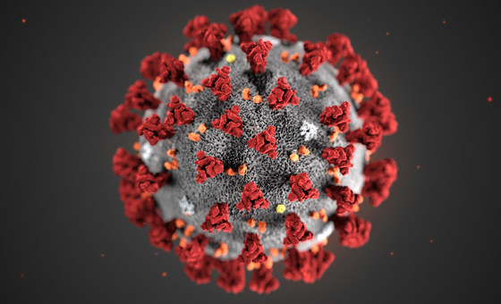
Post COVID (h)
VTE Prevention
Historical Journey
ACTIV 4C
Apixaban versus placebo
MICHELLE
Rivaroxaban versus placebo
2020
2015
2010
2005
Wang TY, et al. Ann Intern Med. 2023;176(4):515-523;
Ramacciotti E, et al. Lancet. 2022;399(10319):50-59..
2000

Slide 10
COVID Post Hospitalization
ICU
Standard Dosing Heparins
Non ICU
Therapeutic dose heparins
(REMAP- CAP, ATTACC, ACTIV-4a, RAPID, and HEP-COVID, COVID-DOSE)
Against Therapeutic dose rivaroxaban.
Discharge
IMPROVE VTE Score ≥4 or 2-3 with D-dimer >500 ng/ mL
Rivaroxaban 10 mg daily for 35 days
NIH
IUA
ISTH

Slide 11
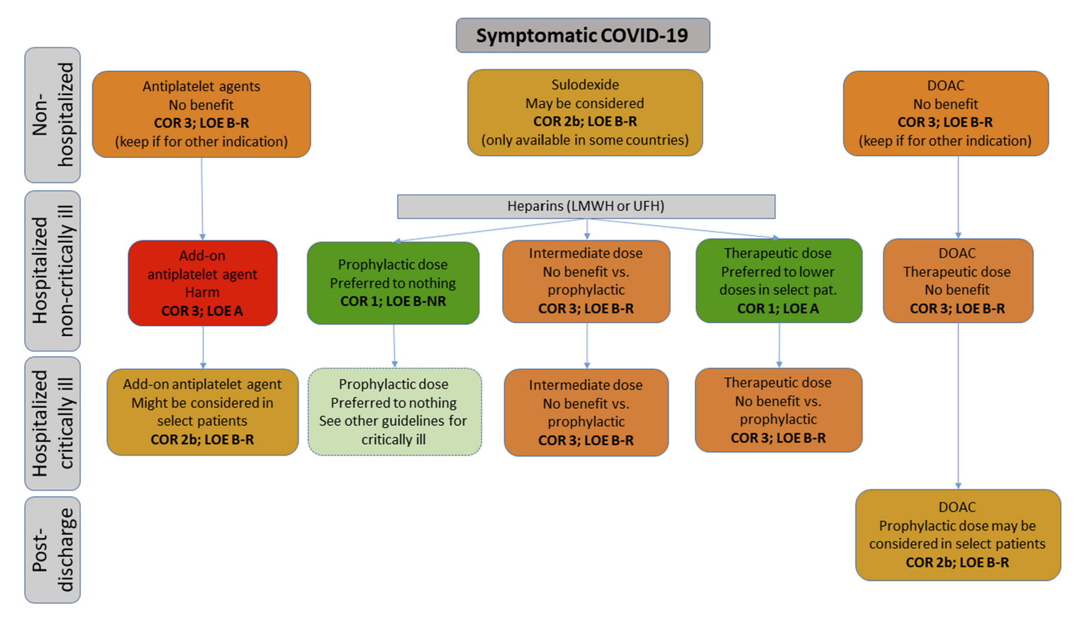
COVID Post Hospitalization
ICU
Standard Dosing Heparins
Non ICU
Therapeutic dose heparins
(REMAP- CAP, ATTACC, ACTIV-4a, RAPID, and HEP-COVID, COVID-DOSE)
Against Therapeutic dose rivaroxaban.
Discharge
IMPROVE VTE Score ≥4 or 2-3 with D-dimer >500 ng/ mL
Rivaroxaban 10 mg daily for 35 days
NIH
IUA
ISTH

Slide 12
MEDENOX
Hospital
Extended
Post COVID (h)
VTE Prevention
Historical Journey
ACTIV 4C
SYMPTOMS
MARINER
MICHELLE
2020
APEX
2015
MAGELLAN
ADOPT
2010
EXCLAIM
ARTEMIS
2005
Mottier D, et al. NEJM Evid. 2023;2(8); Spyropoulos AC, et al. N Engl J Med. 2018;379(12):1118-1127; Cohen AT, et al. N Engl J Med. 2016;375(6):534-44; Cohen AT, et al. N Engl J Med. 2013;368(6):513-23; Goldhaber SZ, et al. N Engl J Med. 2011;365(23):2167-77; Hull RD, et al. Ann Intern Med. 2010;153(1):8-18; Cohen AT, et al. BMJ. 2006;332(7537):325-9; Samama MM, et al. N Engl J Med. 1999;341(11):793-800; Wang TY, et al. Ann Intern Med. 2023;176(4):515-523; Ramacciotti E, et al. Lancet. 2022;399(10319):50-59.
2000

Slide 13



Looking for more resources on this topic?
CME/CE in minutes
Congress highlights
Late-breaking data
Quizzes
Webinars
In-person events
Slides & resources
www.MedEdOTG.com

