Slide 1
Case: Diagnosis & Initial Evaluation of a Patient with Atrial Fibrillation
John H. Alexander, MD, MHS
Professor of Medicine/Cardiology
Duke Clinical Research Institute
Duke Health
Durham, NC

Slide 2
Resource Information
About This Resource
These slides are one component of a continuing education program available online at MedEd On The Go titled Treating and Preventing Clots: Anticoagulation in Atrial Fibrillation and Venous Thromboembolism
Program Learning Objectives:
Discuss appropriate diagnostic criteria and challenges faced in screening patients who may be at risk for blood clots due to either AF or VTE
Identify appropriate candidates for oral anticoagulation when AF or VTE is detected
Develop evidence-based, individualized treatment plans for patients with an indication for oral anticoagulation
MedEd On The Go®
www.mededonthego.com
This content or portions thereof may not be published, posted online or used in presentations without permission.
This content can be saved for personal use (non-commercial use only) with credit given to the resource authors.
To contact us regarding inaccuracies, omissions or permissions please email us at support@MedEdOTG.com

Slide 3
Disclaimer
The views and opinions expressed in this educational activity are those of the faculty and do not necessarily represent the views of Total CME, LLC, the CME providers, or the companies providing educational grants. This presentation is not intended to define an exclusive course of patient management; the participant should use their clinical judgment, knowledge, experience, and diagnostic skills in applying or adopting for professional use any of the information provided herein. Any procedures, medications, or other courses of diagnosis or treatment discussed or suggested in this activity should not be used by clinicians without evaluation of their patient's conditions and possible contraindications or dangers in use, review of any applicable manufacturer’s product information, and comparison with recommendations of other authorities. Links to other sites may be provided as additional sources of information.

Slide 4
Disclosures
This program is supported by Pfizer
I have research grants from: Artivion/CryoLife, Bayer, Bristol-Myers Squibb, CSL Behring, Ferring, U.S. FDA, Humacyte, U.S. NIH
I receive advisory board/consulting payments from: AbbVie, Akros, Artivion/CryoLife, AtriCure, Bayer, Bristol-Myers Squibb, Ferring, GlaxoSmithKline, Janssen, Novostia, Pfizer, Portola, Theravance, Veralox

Slide 5
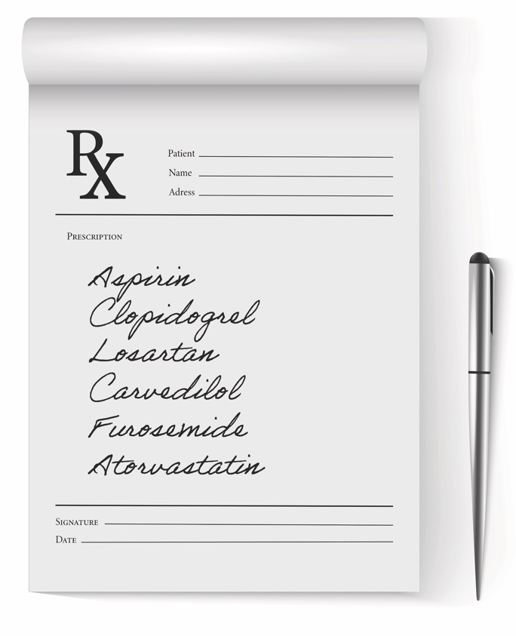
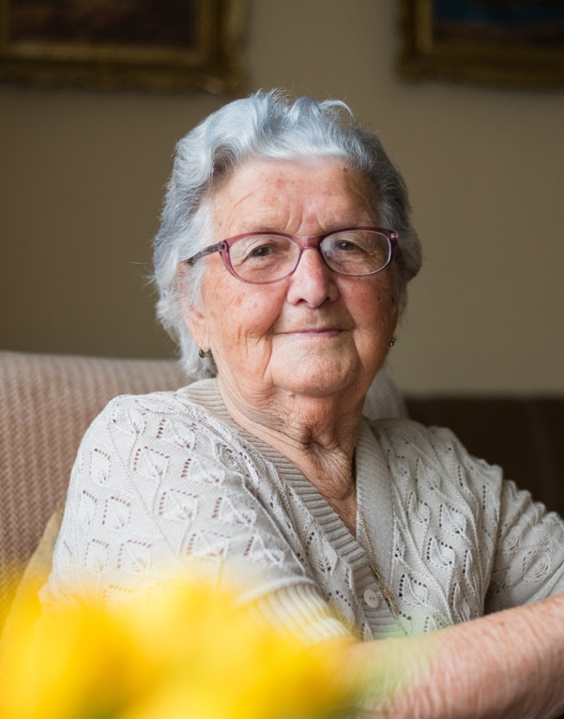
Case
78 y.o. woman
HTN, HFpEF, CAD, Aortic Stenosis
s/p PCI (2020), s/p TAVR (2022)
Wt. 64 kg
Fluttering in chest intermittently for 6 weeks
HR 126 irregular, BP 150/70
ECG atrial fibrillation
Cr 1.3 mg/dL (CrCl 36 ml/min)

Slide 6
Thromboembolic Risk CHA2DS2-VASc Score
CHF/ LV dysfunction 1
Hypertension 1
Age ≥75 2
Diabetes mellitus 1
Stroke/TIA/TE 2
Vascular disease 1
Age 65-74 1
Female sex 1
Case
CHF/LV dysfunction 1
Hypertension 1
Age ≥75 2
Vascular disease 1
Female sex 1
Total 6
~20% risk of stroke/year
Score 0 – 9
Validated in 1084 NVAF patients not on OAC with known TE status at 1 year in Euro Heart Survey
Notes:
6

Slide 7
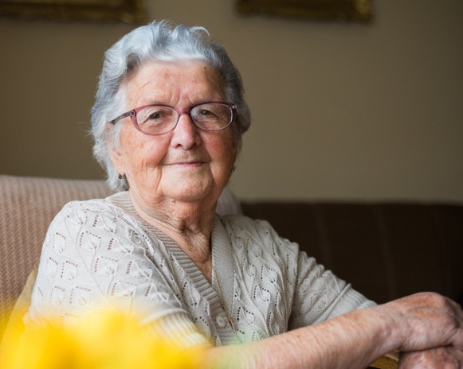
Thromboembolism Prophylaxis
Aspirin
Warfarin (INR 2-3)
DOACs
Apixaban | 5 mg BID | 2/3 of age greater than 80 yrs., wt. less than 60 kg, Cr greater than 1.5 ml/dl
Dabigatran | 150 mg BID | None
Edoxaban | 30 mg QD* | CrCl 30-50 ml/min or wt. less than 60 kg
Rivaroxaban | 15 mg QD* | CrCl 30-50 ml/min
Case
Age 78 yrs.
Wt. 64 kg
Cr 1.3 mg/dl
CrCl 36 ml/min
*Dose reduction for select population

Slide 8
Modifiable Risk Factors for Bleeding
Hypertension/elevated SBP
Concomitant antiplatelet therapy
NSAIDS
Excessive alcohol intake
Non-adherence to OAC
Hazardous hobbies/occupations
Bridging therapy with heparin
INR control (2-3), target TTR less than 70%
Appropriate choice of OAC and dosing
Case
Hypertension
Antiplatelet therapy
DOAC choice and dosing

Slide 9
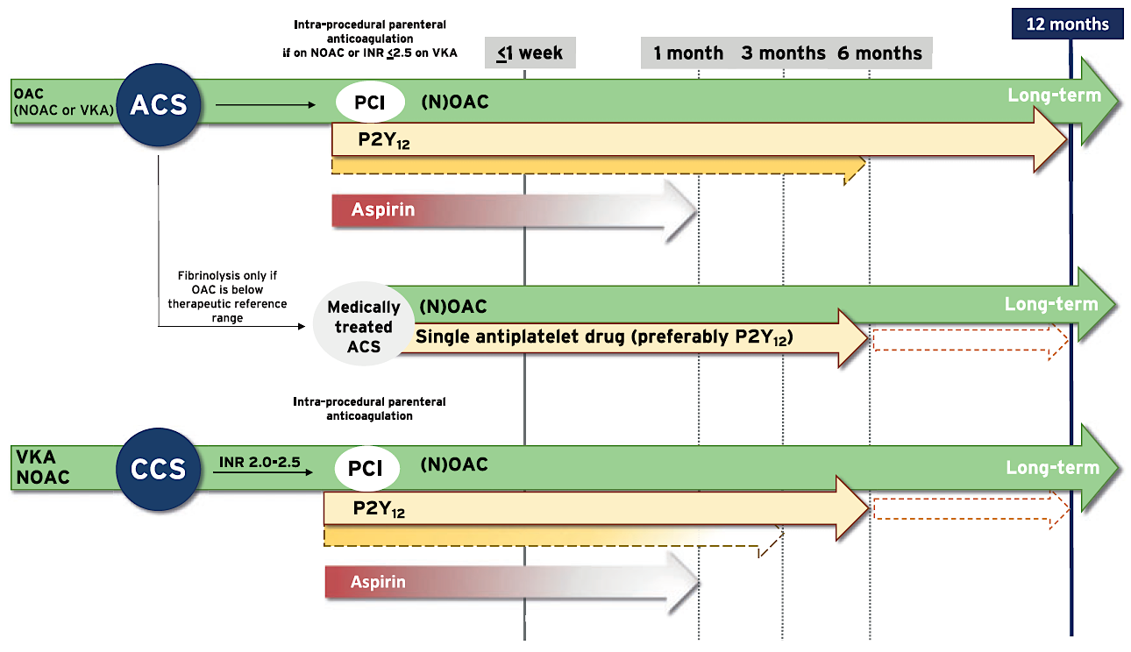
OAC in Patients with AF and PCI 2020 ESC Guidelines
Case
Stop aspirin
Stop clopidogrel
Notes:
9

Slide 10
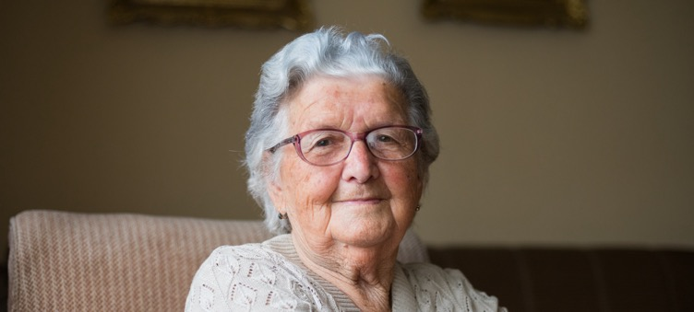
Back to the Case
Start apixaban 5 mg BID
Reduces annual stroke risk from ~ 20% to ~6%
Apixaban 5 mg BID preferred over 2.5 mg BID
Stop clopidogrel and aspirin
Reduces risk of bleeding
Other AF management issues
Rate control
Better BP control (BP <130/80 mmHg)
DCCV after 3 to 4 weeks of OAC
Rhythm control
Antiarrhythmic drug therapy
AF ablation
Case
78 y.o. woman
HTN, HFpEF, CAD, Aortic Stenosis
s/p PCI (2020), s/p TAVR (2021)
Wt. 64 kg
Intermittent fluttering
HR 126 irregular, BP 150/70
ECG atrial fibrillation
Cr 1.3 mg/dL (CrCl 36 ml/min)

Slide 11
Looking for more resources on this topic?
CME/CE in minutes
Congress highlights
Late-breaking data
Quizzes
Webinars
In-person events
Slides & resources
www.MedEdOTG.com

