Slide 1
Initial Approaches: Starting Anticoagulation Treatment
Tatjana Potpara, MD, PhD, FESC
Associate Professor
Belgrade University
Department Head, Intensive Arrhythmia Care
Clinical Center of Serbia
Serbia

Slide 2



Resource Information
About This Resource
These slides are one component of a continuing education program available online at MedEd On The Go titled Treating and Preventing Clots: Anticoagulation in Atrial Fibrillation and Venous Thromboembolism
Program Learning Objectives:
Discuss appropriate diagnostic criteria and challenges faced in screening patients who may be at risk for blood clots due to either AF or VTE
Identify appropriate candidates for oral anticoagulation when AF or VTE is detected
Develop evidence-based, individualized treatment plans for patients with an indication for oral anticoagulation
MedEd On The Go®
www.mededonthego.com
This content or portions thereof may not be published, posted online or used in presentations without permission.
This content can be saved for personal use (non-commercial use only) with credit given to the resource authors.
To contact us regarding inaccuracies, omissions or permissions please email us at support@MedEdOTG.com

Slide 3
Disclaimer
The views and opinions expressed in this educational activity are those of the faculty and do not necessarily represent the views of Total CME, LLC, the CME providers, or the companies providing educational grants. This presentation is not intended to define an exclusive course of patient management; the participant should use their clinical judgment, knowledge, experience, and diagnostic skills in applying or adopting for professional use any of the information provided herein. Any procedures, medications, or other courses of diagnosis or treatment discussed or suggested in this activity should not be used by clinicians without evaluation of their patient's conditions and possible contraindications or dangers in use, review of any applicable manufacturer’s product information, and comparison with recommendations of other authorities. Links to other sites may be provided as additional sources of information.

Slide 4
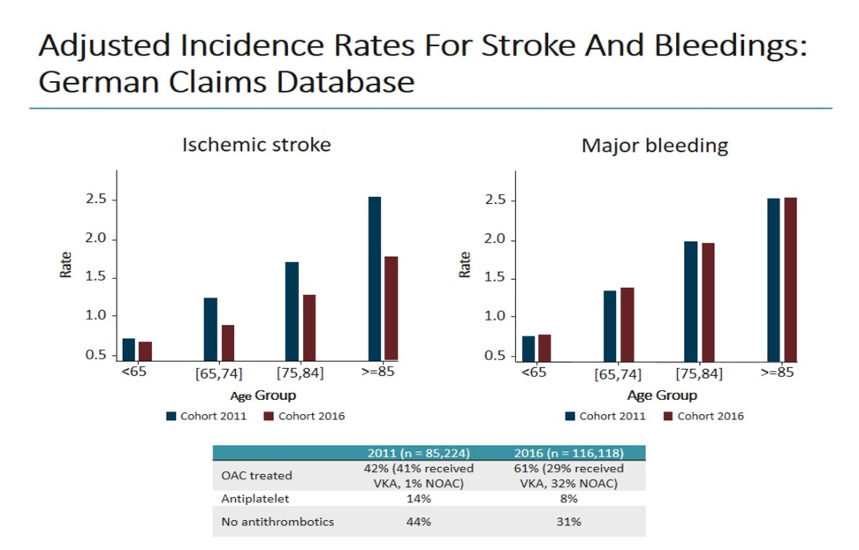
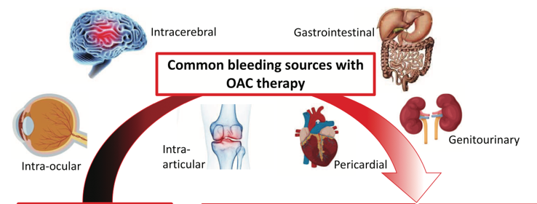
Increasing OAC Use Results in Decreased Stroke Rates Without an Increase in Bleeding Event Rates
Adjusted Incidence Rates for Stroke and Bleedings:
German Claims Database

Slide 5
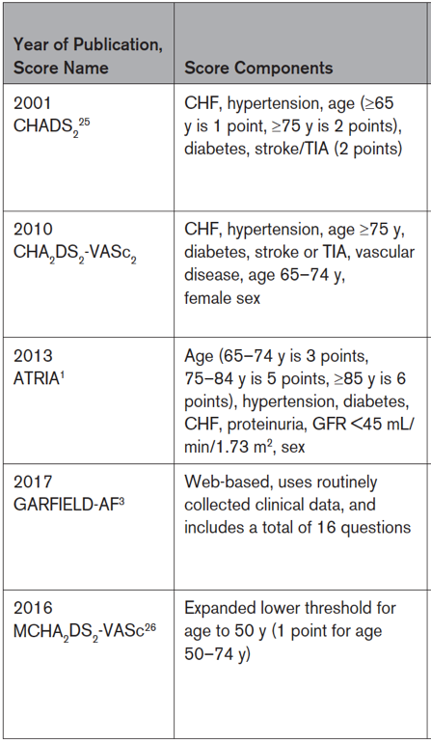
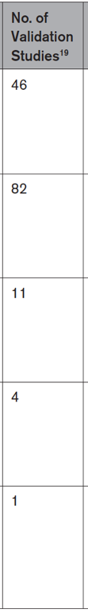
Individual Patient’s Risk of Stroke Depends on Presence of Specific Stroke Risk Factor(s)
Not all stroke risk factors carry the same weight
Selected widely known stroke
risk assessment scores
 | A systematic review of stroke risk factors
Stroke risk factors | Relative Risk for stroke | Positive studies/ All studies
HF/LV dysfunction | 1.85 | 7/18
Hypertension | 2.27 | 11/20
Aged ≥75 years | 1.46* | 9/13
Diabetes mellitus | 1.62 | 9/14
Stroke/TIA/TE | 2.86 | 15/16
Vascular disease | 2.61 | 6/17
Aged 65–74 years | 1.46* | 9/13
Sex category (female) | 1.67 | 8/22
**
*Per decade increase
**Vascular disease, prior myocardial infarction, peripheral artery disease or aortic plaque.

Slide 6
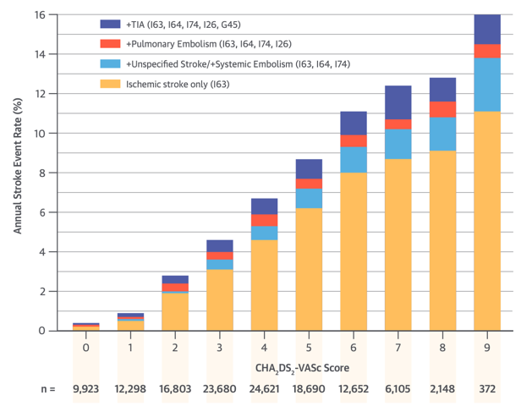
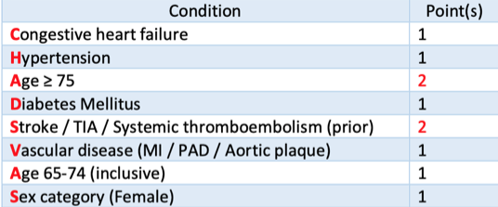
Annual stroke rates per CHA2DS2-VASc score value
Swedish National Registry Cohort
Stroke Rates Generally Increase with Increasing CHA2DS2-VASc Score Value, But Actual Stroke Rates Vary Depending on the Observed Cohort
Risk scores are simplifications that help
decision-making
Clinical risk scores have modest predictive value for identification of high-risk patients
More complicated risk scores and biomarkers only marginally improve on prediction (statistical significance is not same as clinical significance), and a score’s predictivity needs to be balanced with practical application
The CHA₂DS₂-VASc score

Slide 7
Risk Factor-Based Approach to Stroke Risk Management in Patients with AF
✓
1. First identify low-risk patients:
CHA₂DS₂-VASc score of 0 (males) or 1 (females) who should not be offered stroke prevention therapy
✓
2. Then offer stroke prevention if:
CHA₂DS₂-VASc 1 or greater (males) or 2 (females)
Assess bleeding risk, address modifiable bleeding risk factors
✓
3. Choose OAC (NOAC or VKA)

Slide 8
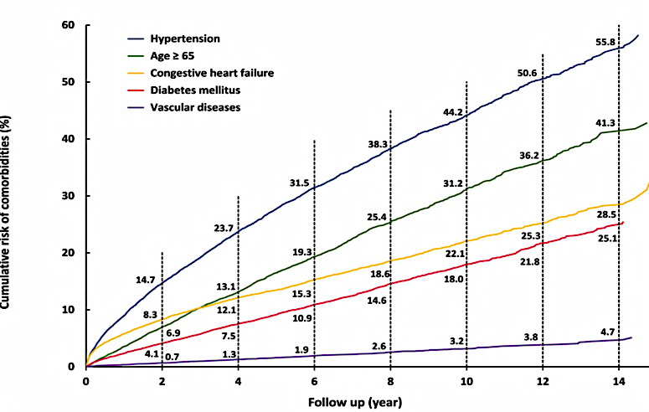
Stroke and Bleeding Risks Are DYNAMIC
In 80% of patients who acquired a comorbidity (HF, hypertension, diabetes or vascular disease), the new condition occurred after 4.2 months of AF diagnosis
Time from incident comorbidity to ischaemic stroke was greater than 4.4 months for 90% of patients suffering stroke
Stroke and bleeding risk reassessment at periodic intervals is recommended to inform treatment decisions (e.g. initiation of OAC in patients no longer at low risk of stroke) and address potentially modifiable bleeding risk factors (Class I,B)
In patients with AF initially at low risk of stroke, first reassessment of stroke risk should be made at 4 to 6 months after the index evaluation (Class IIa, B)

Slide 9
What Do the Guidelines Say?
ESC 2020 | ACC/AHA/HRS 2023
For stroke risk assessment, a risk-factor−based approach is recommended, using the CHA₂DS₂-VASc clinical stroke risk score to initially identify patients at ‘low stroke risk’ (CHA₂DS₂-VASc= 0 in men, or 1 in women) who should not be offered antithrombotic therapy (Class I, A) | Patients with AF should be evaluated for their annual risk of thromboembolic events using a validated clinical risk score, such as CHA₂DS₂-VASc (Class I, B-NR)
 | Patients with AF at intermediate annual risk of thromboembolic events by risk scores (e.g. equivalent to CHA₂DS₂-VASc score of 1 in men or 2 in women), who remain uncertain about the benefit of anticoagulation, can benefit from consideration of factors that might modify their risk of stroke to help inform the decision (Class IIa, C-LD)
OAC is recommended for stroke prevention in AF patients with CHA₂DS₂-VASc score 2 or higher in men 3 or higher in women Class I, A | For patients with AF and an estimated annual thromboembolic risk of 2% or greater per year (e.g. CHA₂DS₂-VASc score of ≥2 in men and ≥3 in women), anticoagulation is recommended to prevent stroke and systemic thromboembolism (Class I, A)
OAC should be considered for stroke prevention in AF patients with a CHA₂DS₂-VASc score of 1 in men or 2 in women. Treatment should be individualized based on net clinical benefit and consideration of patient values and preferences (Class IIa, B) | For patients with AF and an estimated annual thromboembolic risk of 1% or greater but less than 2% per year (equivalent to CHA₂DS₂-VASc score of 1 in men and 2 in women), anticoagulation is reasonable to prevent stroke and systemic thromboembolism (Class IIa, A)
Stroke and bleeding risk reassessment at periodic intervals is recommended to inform treatment decisions (e.g. initiation of OAC in patients no longer at low risk of stroke) and address potentially modifiable bleeding risk factors (Class I, B) | In patients with AF at risk for stroke, re-evaluation of the need for and choice of stroke risk reduction therapy at periodic intervals is recommended to reassess stroke and bleeding risk, net clinical benefit, and proper dosing(Class I, B-NR)

Slide 10
Summary
OAC effectively reduces the risk of stroke in patients with AF, but use of OAC is associated with increased risk of bleeding
Balancing the benefit from stroke prevention against the risk of bleeding with OAC in individual AF patients is an integral part of stroke risk management
Risk of stroke is not homogenous among AF patients but depends on the presence of specific stroke risk factors
A risk factor-based approach using stroke risk assessment scores is recommended to identify low-risk patients who would not benefit from stroke prevention therapy, while all other patients should be offered OAC if not contraindicated
Stroke risk is not static, but changes with ageing and development of new comorbidity(ies); needs to be re-assessed at periodic intervals

Slide 11



Looking for more resources
on this topic?
CME/CE in minutes
Congress highlights
Late-breaking data
Quizzes
Webinars
In-person events
Slides & resources
www.MedEdOTG.com

