Slide 1
Identifying Patients at Risk for Atrial Fibrillation
Tatjana Potpara, MD, PhD, FESC
Associate Professor
Belgrade University
Department Head, Intensive Arrhythmia Care
Clinical Center of Serbia
Serbia

Slide 2



Resource Information
About This Resource
These slides are one component of a continuing education program available online at MedEd On The Go titled Treating and Preventing Clots: Anticoagulation in Atrial Fibrillation and Venous Thromboembolism
Program Learning Objectives:
Discuss appropriate diagnostic criteria and challenges faced in screening patients who may be at risk for blood clots due to either AF or VTE
Identify appropriate candidates for oral anticoagulation when AF or VTE is detected
Develop evidence-based, individualized treatment plans for patients with an indication for oral anticoagulation
MedEd On The Go®
www.mededonthego.com
This content or portions thereof may not be published, posted online or used in presentations without permission.
This content can be saved for personal use (non-commercial use only) with credit given to the resource authors.
To contact us regarding inaccuracies, omissions or permissions please email us at support@MedEdOTG.com

Slide 3
Disclaimer
The views and opinions expressed in this educational activity are those of the faculty and do not necessarily represent the views of Total CME, LLC, the CME providers, or the companies providing educational grants. This presentation is not intended to define an exclusive course of patient management; the participant should use their clinical judgment, knowledge, experience, and diagnostic skills in applying or adopting for professional use any of the information provided herein. Any procedures, medications, or other courses of diagnosis or treatment discussed or suggested in this activity should not be used by clinicians without evaluation of their patient's conditions and possible contraindications or dangers in use, review of any applicable manufacturer’s product information, and comparison with recommendations of other authorities. Links to other sites may be provided as additional sources of information.

Slide 4
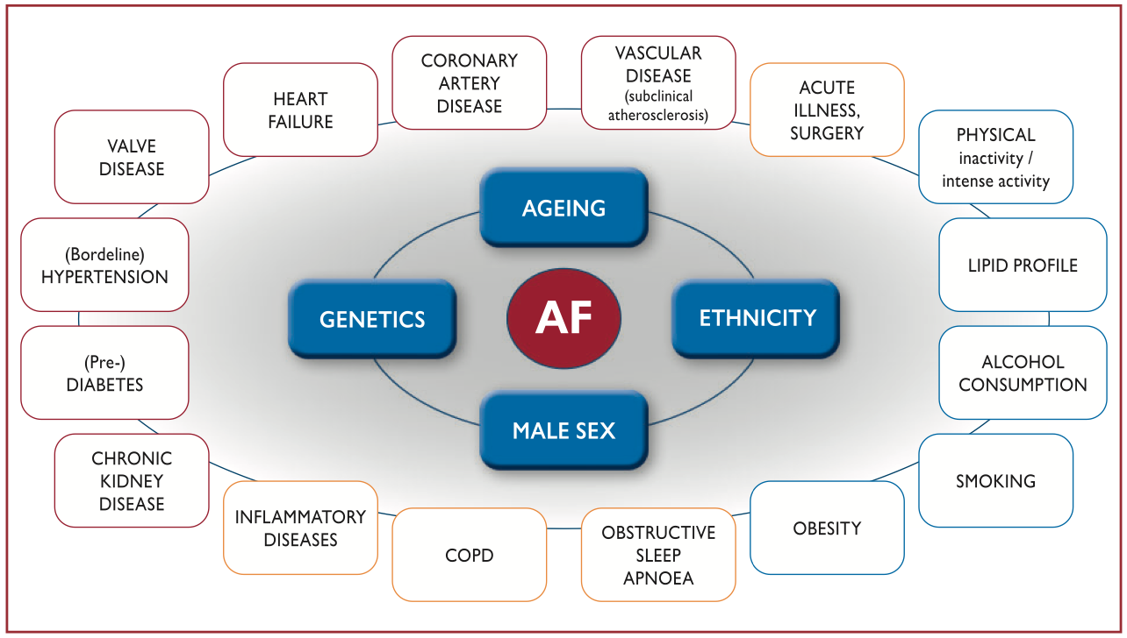
Risk Factors for Incident AF: Overview

Slide 5
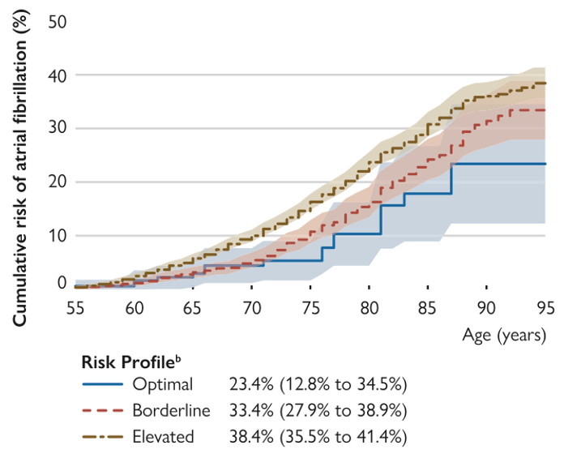
Risk of AF Increases with Age and Increasing Risk Factor Burden
Cumulative risk (%) for AF according to risk factor burden at index age 55 y.
Participants entered the study between ages 55 and less than 60 y.
The number at risk increased from age 55 years to less than 60 y.

Slide 6
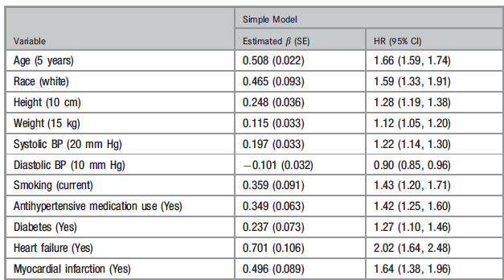
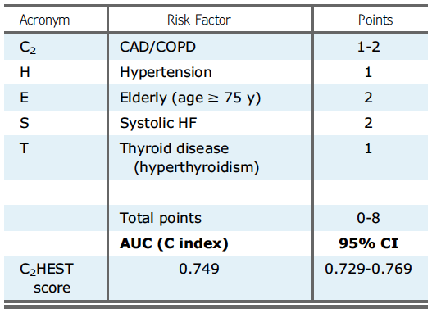
Risk Scores for Prediction of Incident AF
There are greater than 20 risk prediction models for incident AF
The most widely replicated risk prediction model for newly diagnosed AF is CHARGE-AF in Caucasians and C₂HEST score in Asian cohorts
CHARGE-AF Risk Score
C₂HEST Risk Score

Slide 7
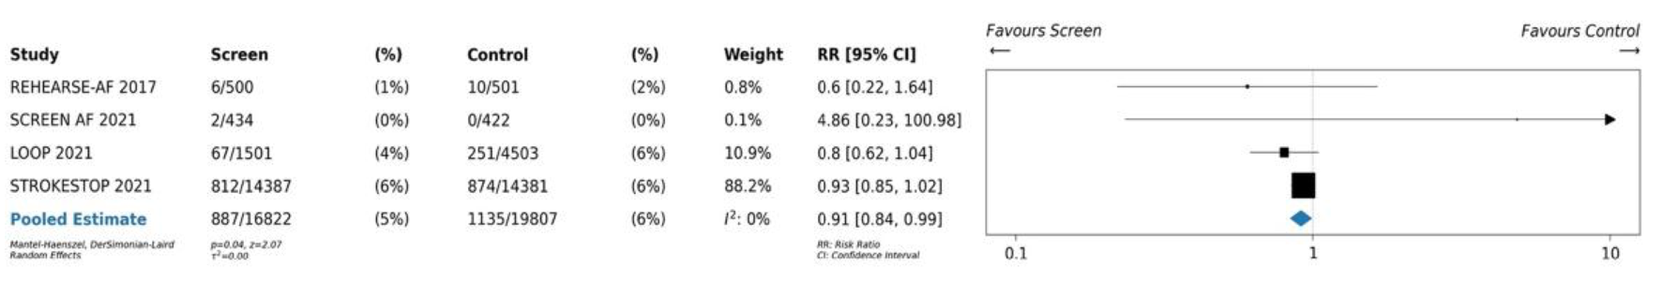
Why Look for Undiagnosed AF?
Treatment to prevent stroke
Asymptomatic older adults
Screening
Health outcomes
All-cause mortality
Stroke
Stroke-related morbidity and mortality
Quality of life
Diagnosis
of atrial fibrillation
Forest plot of published RCTs of AF screening for stroke prevention.

Slide 8
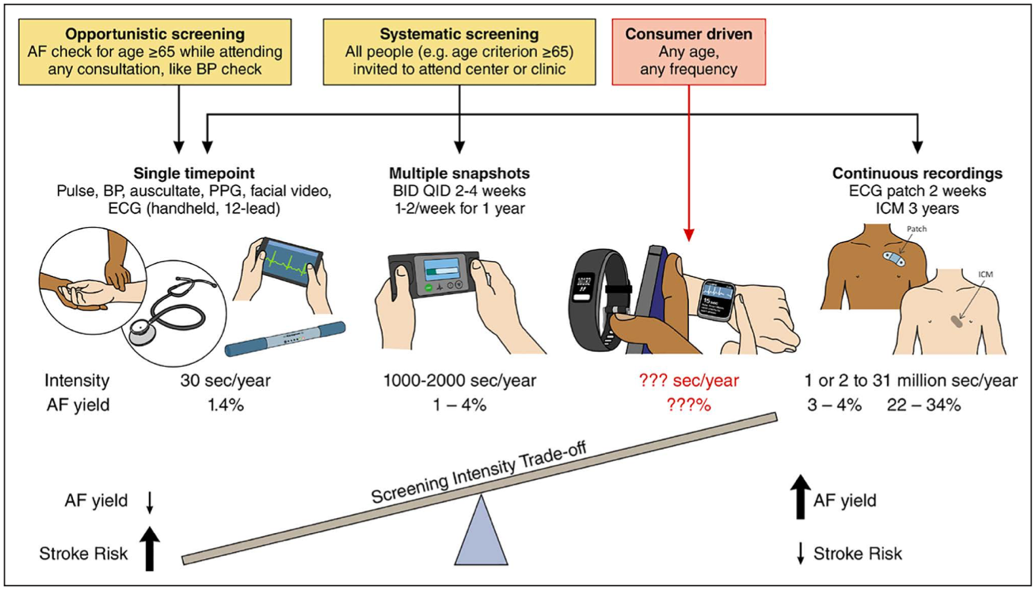
The More You Look, the More AF Will Be Found; However…
Trade-off between duration/intensity of screening for detection of AF and AF stroke risk

Slide 9
What Do the Guidelines Say?
ESC 2020
ACC/AHA/ACCP/HRS 2023
Class Ib recommendations:
Opportunistic screening by pulse taking or ECG rhythm strip in patients 65 years and older
Individuals undergoing screening to be informed about implications of detecting AF
A structured referral platform to be organised for screen-positive cases
Class IIa recommendations:
Systematic ECG screening should be considered in individuals 75 years or older or at high risk of stroke.
Most screening RCTs have shown higher AF detection using intermittent or continuous ECG recordings and focusing on patients with higher predicted risk for AF
An AI-guided selection of individuals for AF screening was recently associated with increased AF detection
Conversely, mass population screening with a smartwatch app only rarely detected a new diagnosis of AF
Ultimately, for risk stratification models and screening programs to be useful, they would need to improve outcomes and be cost-effective
It is not yet established that patients at high risk of developing AF by a validated risk score benefit from screening and interventions to improve rates of ischemic stroke, systemic embolism, and survival

Slide 10



Looking for more resources
on this topic?
CME/CE in minutes
Congress highlights
Late-breaking data
Quizzes
Webinars
In-person events
Slides & resources
www.MedEdOTG.com

