Slide 1
Develop the Plan, Work the Plan: Integrating Ongoing Patient Assessments for Parkinson’s Disease Psychosis
Rajesh Pahwa, MD
Professor of Neurology
University of Kansas Medical Center
Kansas City, KS

Slide 2
Disclaimer
The views and opinions expressed in this educational activity are those of the faculty and do not necessarily represent the views of TotalCME, Inc., the CME providers, or the companies providing educational grants. This presentation is not intended to define an exclusive course of patient management; the participant should use their clinical judgment, knowledge, experience, and diagnostic skills in applying or adopting for professional use any of the information provided herein. Any procedures, medications, or other courses of diagnosis or treatment discussed or suggested in this activity should not be used by clinicians without evaluation of their patient's conditions and possible contraindications or dangers in use, review of any applicable manufacturer’s product information, and comparison with recommendations of other authorities. Links to other sites may be provided as additional sources of information.

Slide 3




PD Psychosis is Common as the Disease Progresses
PD Diagnosis
Illusions
Hallucinations, etc
PDP Treatment
Reemergence
of PDP
Ask all patients with Parkinson’s Disease (PD) about possible psychosis at every visit

Slide 4


Screen for Parkinson’s Disease Psychosis (PDP) at Every Visit
Pre-visit screener
Clinician Assessment
Does the patient see, hear, or otherwise sense things that others do not?
For example, seeing people or animals that are not there, hearing music, or misidentifying objects
Does the patient have hallucinations or delusions that affect or disrupt any of his/her behaviors or activities, or cause distress (including to the caregiver)?
If Yes
Does the patient believe thing others do not believe to be true?
For example, that their spouse is cheating, others are causing them harm or deceiving them, or conspiring against them
If No
Reassess at next visit

Slide 5
Results The prevalence of PSY-PD at baseline was 3%; the incidences at 12 and 24 months were 5.2% and 7.7%, respectively. Longer disease duration and prescription of dopamine agonists at baseline were associated with the development of PSY-PD over the 24 month period. At this follow-up time, worse disease severity, decline in cognitive performances, presence of depressive symptoms and anxiety were more frequently observed in PSY-PD.

Slide 6
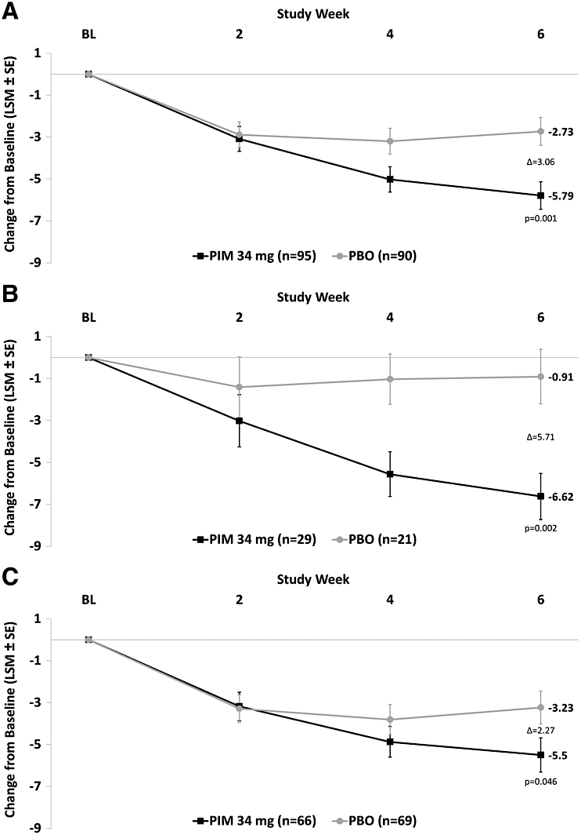
Pimavanserin and Cognitive-enhancing Medications
TOTAL Population
MMSE 21-24
MMSE > 24

Slide 7
Long Term Issues with PDP
Falls
Urinary tract infections
Worsening of psychosis
Disease progression

Slide 8
Caregiver Stressors
Patient hallucinations
Patient confusion
Patient depression
Early intervention and treatment
Psychosocial interventions
Support groups
Education
Stressors
Caregiver
Interventions

Slide 9

PDP Long Term Concerns
Increased ER Visits
Increased Inpatient Care
Increased Outpatient Visit
Increased Nursing Home Placements

Slide 10

Multidisciplinary Approach
Nurse
Neurologist
Internist
Psychologist
Pharmacist
Patient
Social Worker
OT/PT/ST/Dietician

Slide 11
Palliative Care and Hospice
Palliative Care
In Common
Hospice Care
Helps people with PD and care partners better manage any stage of PD
Can be provided alongside other therapies
Provides proactive support and guidance to prepare patient and family for
the future
Helps ensure better quality of life and provide comfort
Option for those with advanced PD
Helps care partners and families
Care team can include doctors, nurses, social workers, nutritionists, chaplains and therapists
Generally eligible with Medicare, Medicaid and insurance
Addresses physical symptoms (like pain management), emotional, social and spiritual needs for person with PD and care partner
Provides maximum amount of dignity and comfort during end of life
Care can occur at residence
Works with treating physician

Slide 12
Summary
Patients should be screened for PDP at every visit
Patients with PDP should be evaluated and treated for depression, anxiety and depression
Worsening of psychosis may require additional antipsychotics
Caregiver stressors should be evaluated and managed
Palliative care and hospice should be included in long term plans

