Slide 1
Psychotic Symptoms in Parkinson’s Disease Psychosis Disrupts Lives: Early Treatment Intervention Makes a Difference
Stuart Isaacson, MD Director Parkinson’s Disease and Movement Disorders Center of Boca Raton Boca Raton, FL

Slide 2
Disclaimer
The views and opinions expressed in this educational activity are those of the faculty and do not necessarily represent the views of TotalCME, Inc., the CME providers, or the companies providing educational grants. This presentation is not intended to define an exclusive course of patient management; the participant should use their clinical judgment, knowledge, experience, and diagnostic skills in applying or adopting for professional use any of the information provided herein. Any procedures, medications, or other courses of diagnosis or treatment discussed or suggested in this activity should not be used by clinicians without evaluation of their patient's conditions and possible contraindications or dangers in use, review of any applicable manufacturer’s product information, and comparison with recommendations of other authorities. Links to other sites may be provided as additional sources of information.

Slide 3
Parkinson’s Disease Psychosis (PDP) Is Underreported
Over 50% patients with Parkinson’s disease (PD) develop psychosis over the course of their disease¹
In a series of studies, 90% of PD patients did not voluntarily disclose the presence of hallucinations or delusions to their physician^{2,4,5}
Patients and caregivers often underreport psychosis due to:
Fear of embarrassment, or anxiety²⁻⁴
Symptoms not being recognized as part of PD⁴
Office visits that may be focused on motor symptom management⁴
PDP Risk Factors
Endogenous factors
Advanced age^{6,7}
Cognitive impairment/dementia^{6,7}
Duration and severity of PD^{6,7}
Presence of sleep disturbances^{6,7}
Presence of psychiatric symptoms⁶
Visual abnormalities/loss of visual acuity⁷
Exogenous factors
Medication for the treatment of PD
Other medications^{6,7}

Slide 4
Progressive, Widespread Synuclein Neurodegeneration
Braak Hypothesis
Loss of serotonergic neurons in the raphe nuclei occurs early, probably before PD diagnosis, and progresses throughout the disease course
Results in upregulation of 5HT-2a receptors in cortex
Leads to visual hallucinations and descending drive to mesolimbic dopaminergic pathway

Slide 5

The Course of Parkinson’s Disease Psychosis
As symptoms progress, patients may find these symptoms to be threatening and may respond/act aggressively, creating behavioral disturbances⁹
Hallucinations begin¹
Hallucinations progress³
Nursing home placement⁶
Onset of delusions⁵
Insight is retained⁴
Insight is lost⁴
Caregiver burden increases²

Slide 6
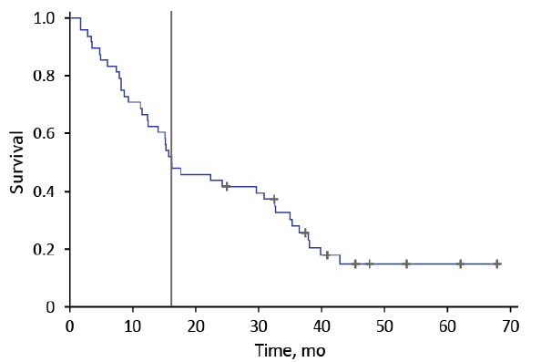
Early Illusions and Hallucinations Are Not Benign!
A study followed 48 PD patients with “benign” hallucinations (UPDRS thought disorder score of 2) who were receiving no treatment for hallucinations for at least 3 years or until a thought disorder score of 3 or 4 occurred
81% progressed to thought disorder scores of 3 or 4
9 patients retained a thought disorder score of 2. 7 of the 9 patients had their PD medications reduced to treat hallucinations and 3 were given antipsychotics
Only 2 patients (4%) were stable (ie, stable, untreated benign hallucinations over time)
Kaplan-Meier curve showing the time frame from study enrollment with a UPDRS thought disorder score of 2 and no treatment for hallucinations to a UPDRS thought disorder score of 3 or 4. Vertical bar represents time at which 50% of the patients had progressed to a score of 3 or 4.

Slide 7
PDP Has Tremendous Impacts on Patients and Caregivers
Stigma, social isolation, and significant impact on QOL
Impacts patients, caregivers, and family life
PDP with PD increases caregiver burden
Caregivers report higher levels of depression
Over 40% reported that their own health had suffered

Slide 8
PDP Limits Optimal Management of PD
Dopaminergic medications stop being increased, and are often lowered
Leads to suboptimal treatment of motor symptoms
More difficult to perform activities of daily living
Quality of life
Increased risk of falls

Slide 9
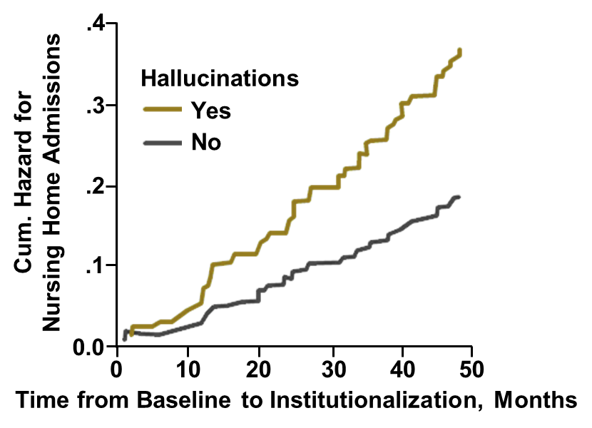
PD Psychosis Increases Risk of Hospitalization, Nursing Facility Placement, and Mortality
PDP precipitates and prolongs hospitalization¹
24% of all hospitalizations of PD patients
29% of prolonged hospitalizations and repeat admissions
Strongest independent predictor of nursing home placement
Long term care placement is often permanent²
Increased mortality
4-year cumulative risk for nursing home admission for PD versus PD psychosis³

Slide 10
Current Management of PD Psychosis
Identify triggers of PD psychosis
Minimize polypharmacy
Treat co-morbid illnesses (e.g., infections)
Utilize psycho-social interventions
Attempts to reduce dopaminergic therapy
Leads to increased motor symptoms
Psychosis often persists/recurs despite dose reduction
Only pimavanserin is FDA-approved for PD psychosis
Off-label use of quetiapine and clozapine; all others need to be avoided due to D2 receptor blockade worsens PD

Slide 11
Pimavanserin Treatment Resulted in Clinically Meaningful Improvement Within 6 Weeks
Pimavanserin 34 mg showed a 37% improvement in SAPS-PD from baseline at Week 6 versus 14% for placebo (P=0.006)²
No change from baseline to week 6 in UPDRS parts II+III
In exploratory analysis, caregivers of patients receiving pimavanserin reported less burden
Placebo
Pimavanserin
-2.73
-5.79

Slide 12

Example of Patient Improving 3 Points on SAPS Rating for Visual Hallucinations After 4-6 Weeks
Scale | Severity | Subject Response
0 | None | None
1 | Questionable | Questionable
2 | Mild | Subject experiences visual hallucinations; they occur only occasionally
3 | Moderate | Clear evidence of visual hallucinations; they have occurred at least weekly
4 | Marked | Clear evidence of visual hallucinations which occur almost every day
5 | Severe | Hallucinations occur often every day

Slide 13
Example of Patient Improving with Complete Resolution of Symptoms After 4-6 Weeks
Before treatment:
Daily persecutory delusions
Daily visual hallucinations
Frequent auditory hallucinations
Occasional tactile hallucinations
Complete resolution of:
Persecutory delusions
Visual hallucinations
Auditory hallucinations
Tactile hallucinations
Complete resolution reported in 14% of pivotal trial participants

Slide 14
Untreated PDP Has Significant Consequences: Summary
Onset of psychosis is a poor prognostic sign
Associated with increased caregiver burden
A leading cause of nursing home placement in PD patients
May prolong hospitalizations
May increase mortality
Increased health-related costs
Suboptimal treatment for PD motor symptoms
Earlier treatment may have benefit versus later treatment

