Slide 1
Routine Screening for Psychotic Symptoms in Individuals with Parkinson’s Disease Psychosis Leads to Earlier Diagnosis
Daniel Kremens, MD, JD Associate Professor Vice Chair for Education Co-Director, Movement Disorders Program Thomas Jefferson University Philadelphia, PA

Slide 2
Disclaimer
The views and opinions expressed in this educational activity are those of the faculty and do not necessarily represent the views of TotalCME, Inc., the CME providers, or the companies providing educational grants. This presentation is not intended to define an exclusive course of patient management; the participant should use their clinical judgment, knowledge, experience, and diagnostic skills in applying or adopting for professional use any of the information provided herein. Any procedures, medications, or other courses of diagnosis or treatment discussed or suggested in this activity should not be used by clinicians without evaluation of their patient's conditions and possible contraindications or dangers in use, review of any applicable manufacturer’s product information, and comparison with recommendations of other authorities. Links to other sites may be provided as additional sources of information.

Slide 3
Parkinson’s Disease (PD) Psychosis is Common
PD has been described as a pandemic, with both US and global prevalence projected to more than double in the next 2‐3 decades^{1,2}
It is estimated that greater than 50% of patients will experience PD psychosis during the course of their disease³

Slide 4
Parkinson’s Disease Psychosis (PDP) Has a Distinct Clinical Profile: 2007 Provisional NINDS/NIMH Diagnostic Criteria¹
Presence of ≥1 of the following in a patient with PD:
Hallucinations
Delusions
Illusions
Presence
Primary diagnosis of PD
PDP symptoms must occur after the onset of PD
Must be recurrent/continuous for ≥1 month
May occur with or without insight, dementia, and PD treatment
Other medical or psychological causes have been ruled out

Slide 5
PDP Risk Factors
Endogenous Factors
Exogenous Factors
Advanced age^{1,2}
Cognitive impairment/dementia^{1,2}
Duration and severity of PD^{1,2}
Presence of sleep disturbances^{1,2}
Presence of psychiatric symptoms¹
Visual abnormalities/loss of visual acuity²
Medication for the treatment of PD¹
Other medications^{1,2}

Slide 6
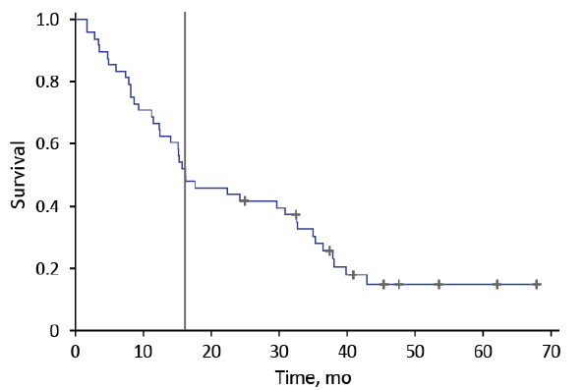
There Are No “Benign” Hallucinations!
A study followed 48 PD patients with “benign” hallucinations (UPDRS thought disorder score of 2) who were receiving no treatment for hallucinations for at least 3 years or until a thought disorder score of 3 or 4 occurred
81% of patients progressed to thought disorder scores of 3 or 4
9 patients retained a thought disorder score of 2. 7 of the 9 patients had their PD medications reduced to treat hallucinations and 3 were given antipsychotics
Only 2 patients (4%) were stable (ie, stable, untreated benign hallucinations over time)
Kaplan-Meier curve showing the time frame from study enrollment with a UPDRS thought disorder score of 2 and no treatment for hallucinations to a UPDRS thought disorder score of 3 or 4. Vertical bar represents time at which 50% of the patients had progressed to a score of 3 or 4.

Slide 7
PDP Has Tremendous Impact on Patients, Caregivers and Society
Psychosis was responsible for 24% of all hospital admissions as well as increased mortality in patients with PD
PDP is a predictor of long-term care placement, and its treatment is associated with over double the costs compared to that of PD patients without psychosis
Caregivers of patients with PDP reported higher levels of depression and over 40% reported that their own health had suffered

Slide 8
Symptoms of PDP Are Underreported
An international, multicenter study investigated non-declared non-motor symptoms in 242 patients with PD¹
The non-motor symptoms included in the study were the 30 non-motor symptoms included on the NMSQ
Patients were asked whether their symptoms were declared during an appointment with a physician and whether they were declared in a symptom survey
Symptoms were not disclosed to the physicians by 41.5% of patients who had experienced hallucinations and 65.2% of those who had experienced delusions

Slide 9
Why Are Symptoms Underreported?
Patients often underreport symptoms, perhaps due to embarrassment¹
It may not be clear to patients that the non-motor symptoms they are experiencing are related to Parkinson’s disease¹
Office visits may be focused on motor symptom management¹

Slide 10
Screening Is Critical for Early Diagnosis of PDP
Existing screening tools and rating scales for PDP that were developed for clinical trials are too lengthy for routine clinical use or do not clearly define psychotic symptoms enough to inform treatment decisions¹
The lack of a simple, straightforward, and standardized screening and diagnostic approach limits the identification of patients suffering from PDP, thus lowering the likelihood of early and effective treatment
Pahwa et al. recently proposed a simple two -part screening tool to facilitate the diagnosis and treatment of patients with PDP²

Slide 11


The Screening Tool
The first part of the screening tool consists of 2 broad questions which are administered in the waiting room prior to the visit in either paper or digital form. These questions may be answered by the patient or the caregiver.
If the patient answers yes to either of the questions, the clinician assessment should be completed in order to make decisions regarding treatment
PRE-VISIT SCREENER
Does the patient see, hear, or otherwise sense things that others do not?
For example, seeing people or animals that are not there, hearing music, or misidentifying objects
Does the patient believe thing others do not believe to be true?
For example, that their spouse is cheating, others are causing them harm or deceiving them, or conspiring against them

Slide 12
The Clinician Assessment
To simplify the clinician assessment, specific examples of hallucinations and delusions that would need to be treated were not included
A single question for the clinician assessment portion of the tool was developed:
‘‘Does the patient have hallucinations or delusions that affect or disrupt any of his/her behaviors or activities, or cause distress (including to the caregiver)?’’
This allows the clinician to evaluate and discuss with the patient and caregiver how often hallucinations and delusions occur and how disruptive they are in order to make a decision regarding treatment. The wording ‘‘affect or disrupt’’ implies a negative impact on patient activity or behavior in any way

Slide 13
Conclusion
Untreated symptoms of psychosis in PD are associated with progressive PDP symptoms, poorer outcomes, impaired quality of life, and significant distress to the caregiver and patient
Patients often do not discuss PDP symptoms, and physicians often do not ask about them
A recently proposed 2-part screening tool may allow for earlier identification and intervention in the management of PDP

