Slide 1
What is the Role of CAR T-Cell Therapy in the Second-Line Treatment of DLBCL?
Peter Riedell, MD
Assistant Professor of Medicine
The University of Chicago Department of Medicine
Chicago, IL

Slide 2
Disclaimer
The views and opinions expressed in this educational activity are those of the faculty and do not necessarily represent the views of TotalCME, Inc., the CME providers, or the companies providing educational grants. This presentation is not intended to define an exclusive course of patient management; the participant should use their clinical judgment, knowledge, experience, and diagnostic skills in applying or adopting for professional use any of the information provided herein. Any procedures, medications, or other courses of diagnosis or treatment discussed or suggested in this activity should not be used by clinicians without evaluation of their patient's conditions and possible contraindications or dangers in use, review of any applicable manufacturer’s product information, and comparison with recommendations of other authorities. Links to other sites may be provided as additional sources of information.

Slide 3
Salvage Chemotherapy and AutoSCT: A Standard of Care in 2L DLBCL
Relapsed less than 12m s/p diagnosis
CORAL Study
R-ICE vs R-DHAP in R/R DLBCL
If responsive disease, then proceed to AutoSCT
ORR (~63%)
EFS (3-year ~21%)
Large phase 3 trials recently compared CAR T-cell therapy to salvage chemotherapy and AutoSCT in large cell lymphoma
1-yr EFS <20%
Relapsed more than 12m s/p diagnosis
1-yr EFS ~50%

Slide 4
Phase III Studies in Second Line R/R DLBCL
Early relapse (≤ 12m s/p conclusion of induction) or primary refractory disease
Transplant-eligible
ZUMA-7
(NCT03391466)
High Dose-Chemotherapy + AutoSCT vs Axi-cel
Primary Endpoint: EFS
TRANSFORM
(NCT03575351)
High Dose-Chemotherapy + AutoSCT vs Liso-cel
Primary Endpoint: EFS
N = 359
No apheresis prior to randomization
No bridging therapy permitted
Median f/u: 24.9 months
N = 184
All patients underwent apheresis prior to randomization
Only one cycle of bridging therapy permitted
Median f/u: 6.2 months

Slide 5
Phase 3 ZUMA-7: Axi-Cel Versus SOC as 2L Treatment for R/R LBCL
With 24.9 months medium follow-up:
 | Patients, N | Median EFS (95% CI), mo
Axi-cel | 180 | 8.3 (4.5-15.8)
SOC | 179 | 2.0 (1.6-2.8)
Stratified HR for event or death = 0.40 (95% CI, 0.31-1.51); P < .001
Axi-cel
SOC
The primary endpoint of EFS met
24-mo EFS rates were 41% vs 16% in axi-cel vs SOC, respectively
ORR and CR rates were higher with axi-cel vs SOC (ORR: 83% vs 50%; P < .0001; CR: 65% vs 32%)
Median OS favored axi-cel vs SOC, although it did not meet statistical significance
+
EFS, %
+
+
+
+
+
+
+
+
+
+
+
+
+
+
+
+
+
+
+
+
+
+
+
+
+
+
+
+
+
+
+
+
+
+
+
+
+
+
+
+
+
+
+
+
+
+
+
+
+
+
+
+
+
+
+
+
+
+
+
+
+
+
+
+
+
+
+
+
+
+
+
+
+
+
+
+
+
+
+
+
+
+
+
+
+
+
+
+
+
+
Time, mo
No. at Risk
Axi-cel | 180 | 163 | 106 | 92 | 91 | 87 | 85 | 82 | 74 | 67 | 52 | 40 | 26 | 12 | 12 | 6
SOC | 179 | 86 | 54 | 45 | 38 | 32 | 29 | 27 | 25 | 24 | 20 | 12 | 9 | 7 | 6 | 3 | 1 | 0
4/1/2022: Axi-cel FDA approved for patients with R/R LBCL refractory to 1L chemoimmunotherapy or that relapses within 12 months of 1L chemoimmunotherapy

Slide 6
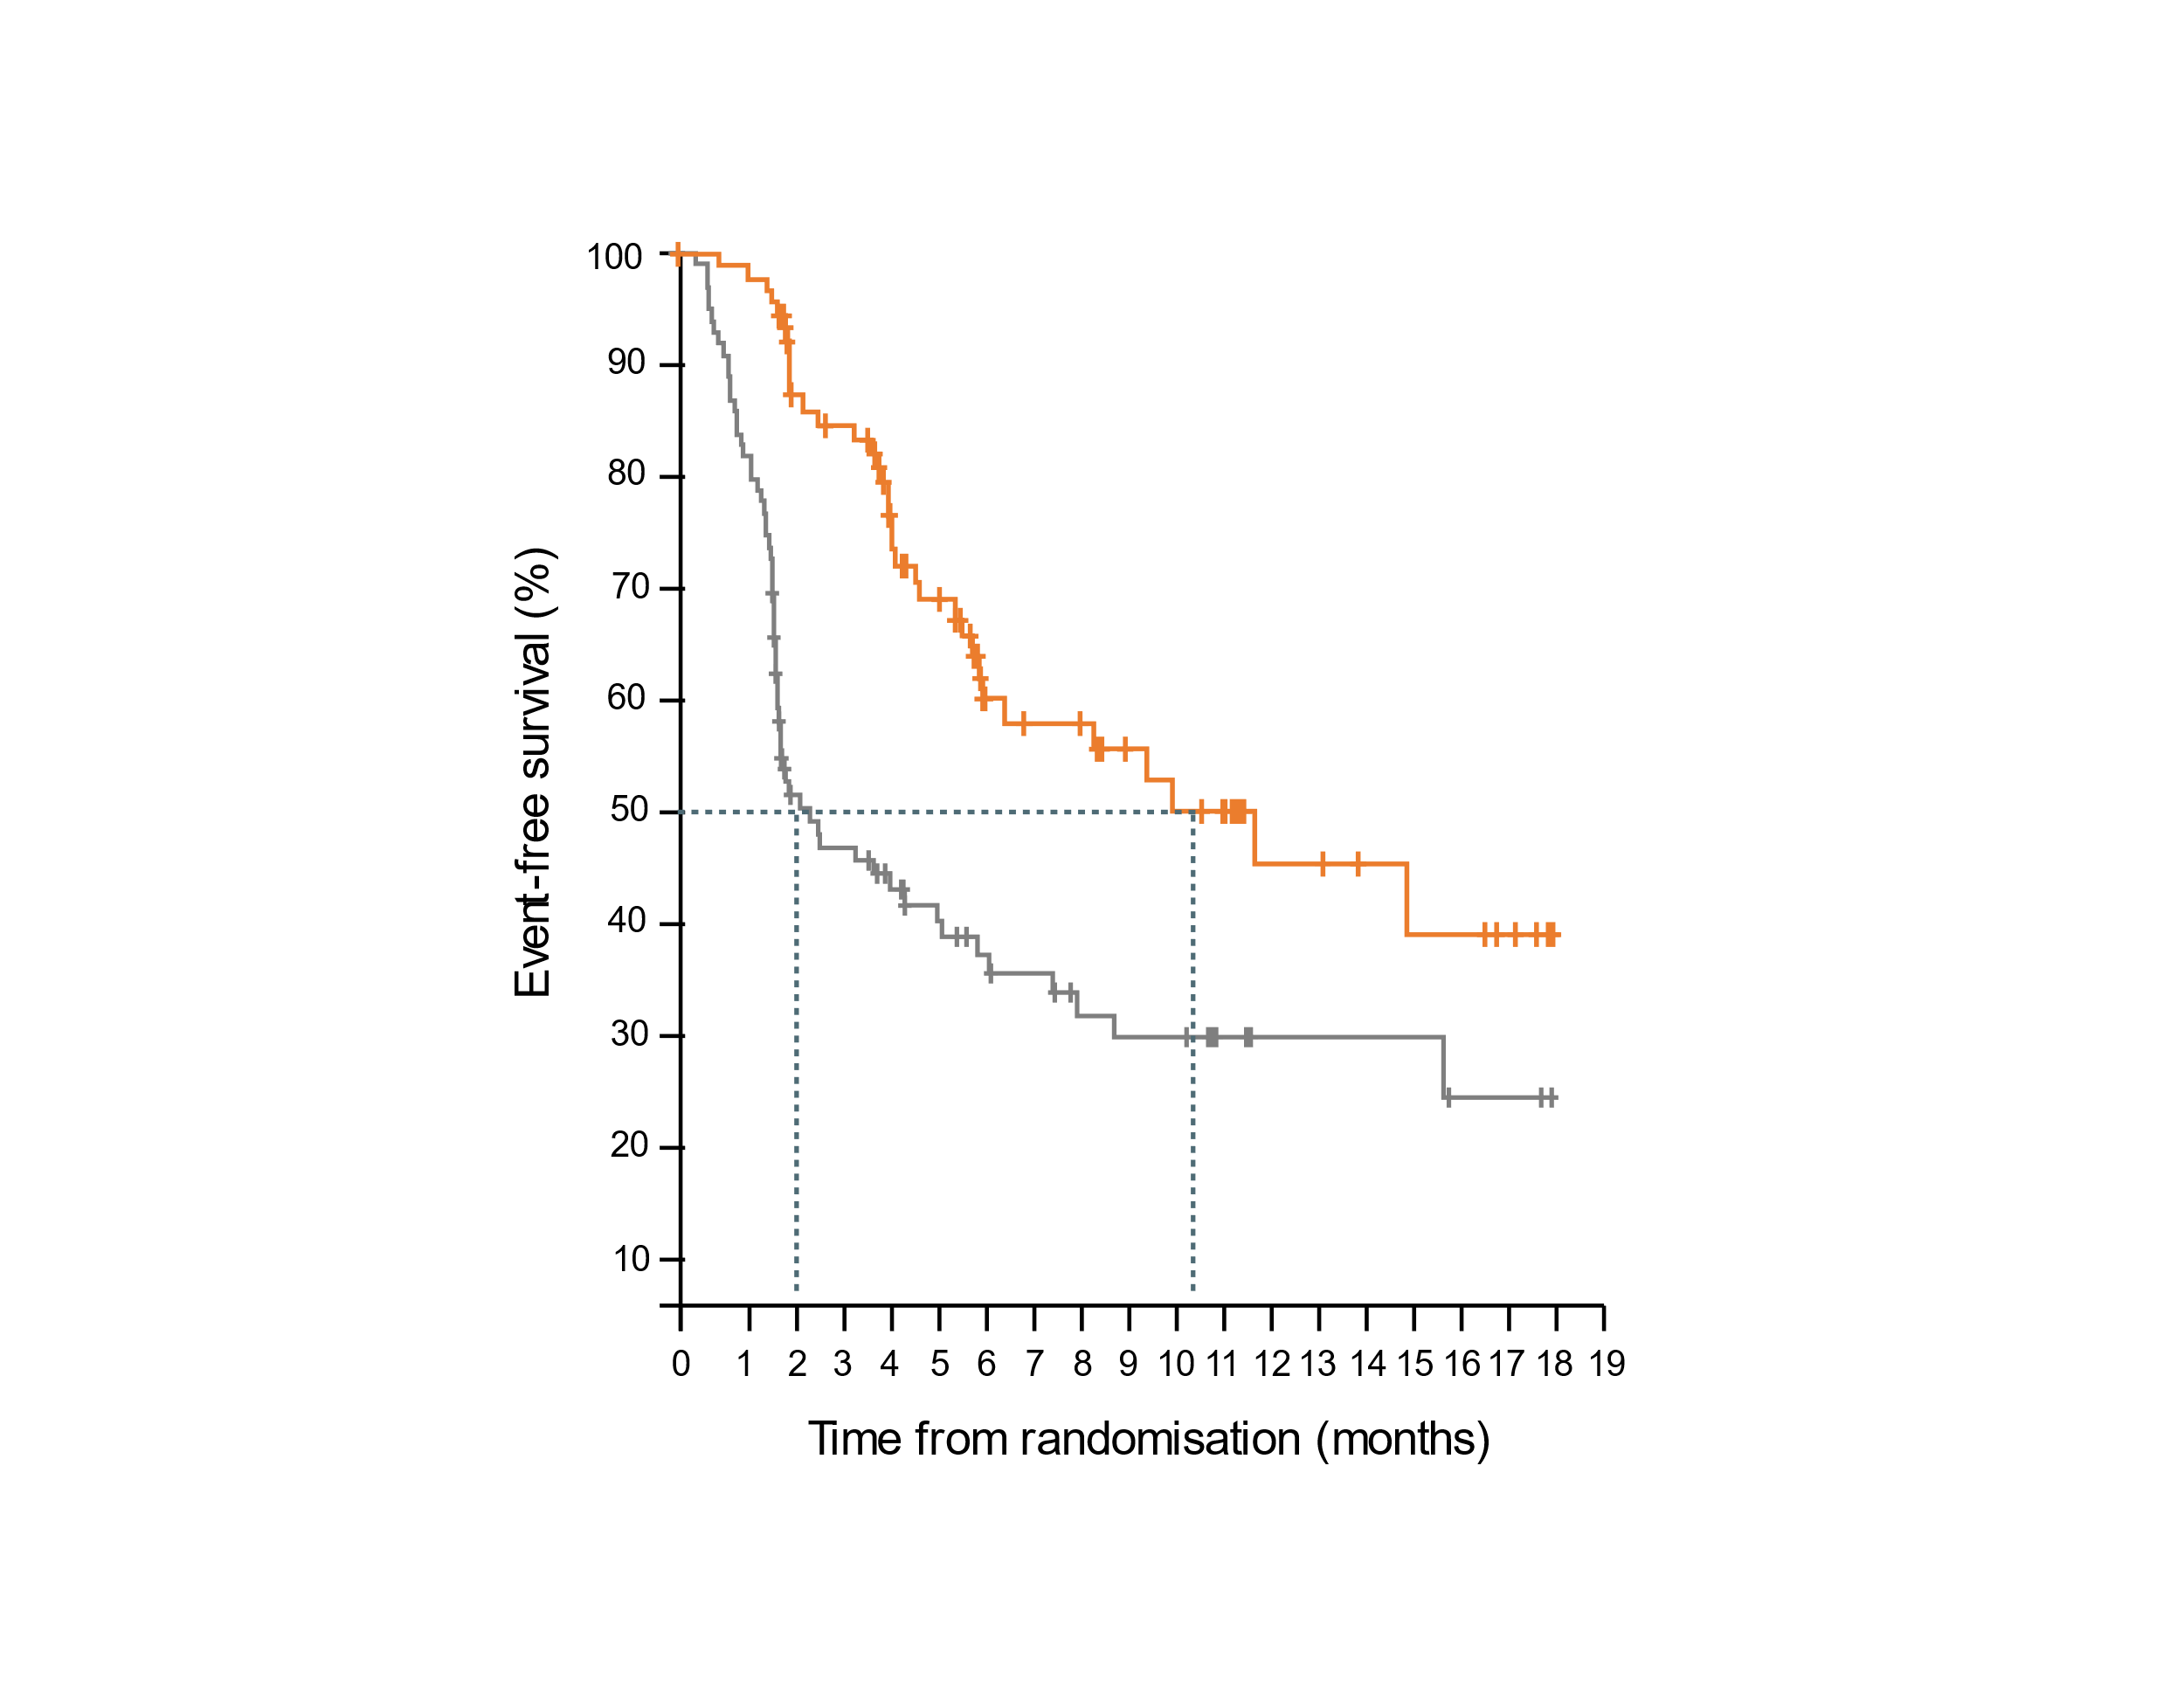
Phase 3 TRANSFORM: Liso-Cel Versus SOC as 2L Treatment for R/R LBCL
Prespecified interim analysis; median follow-up in both arms was 6.2 months
Event-Free Survival
Efficacy, IRC assessedª | SOC Arm A (ITT; n = 92) | Liso-Cel Arm B (ITT; n = 92)
EFS, median [95% Cl], mo | 2.3 [2.2-4.3] | 10.1 (6.1-NR]
 | HR = 0.349 (0.229-0.530); P < .0001
EFS rate at 6 mo, % | 33.4 | 63.3
EFS rate at 12 mo, % | 23.7 | 44.5
ORR, n (%) [95% Cl] | 44 (48) [37.3-58.5] | 79 (86) [77.0-92.3]
CR rate | 36 (39) [29.1-49.9] | 61 (66) [55.7-75.8]
PFS, median [95% Cl], mo | 5.7 [3.9-9.4] | 14.8 [6.6-NR]
 | HR = 0.406 (0.250-0.659); P = .0001
OS, median [95% Cl], mo | 16.4 [11-NR] | NR [15.8-NR]
 | HR = 0.509 (0.258-1.004); P = .0257
HR 0.35
(95% CI, 0.23–0.53)
P < .0001
SOC median EFS: 2.3 months 95% Cl, 2.2–4.3
Liso-cel median EFS: 10.1 months 95% Cl, 6.1–NR
Liso-cel demonstrated a statistically significant and clinically meaningful improvement in EFS, CR rate, and PFS compared with SOC as 2L therapy in patients with LBCL primary refractory to or relapsed ≤ 12 months after 1L therapy

Slide 7
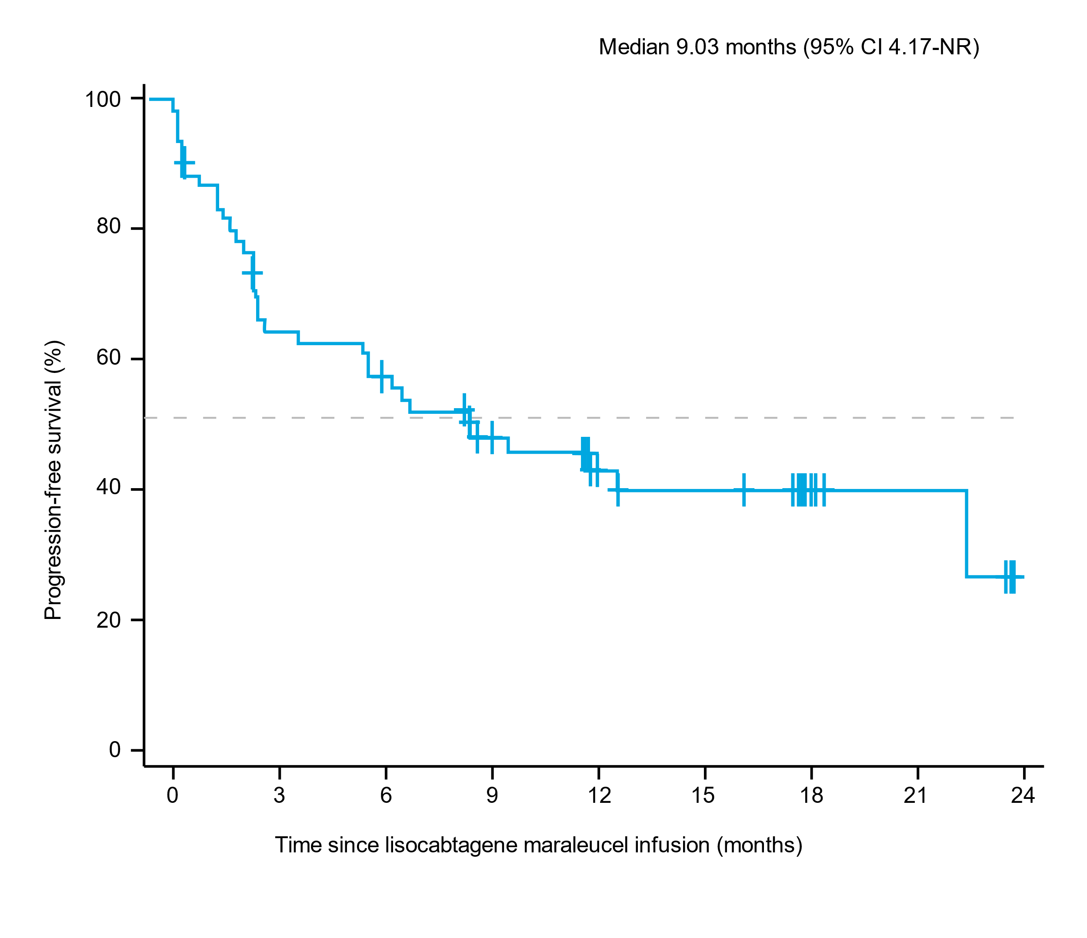
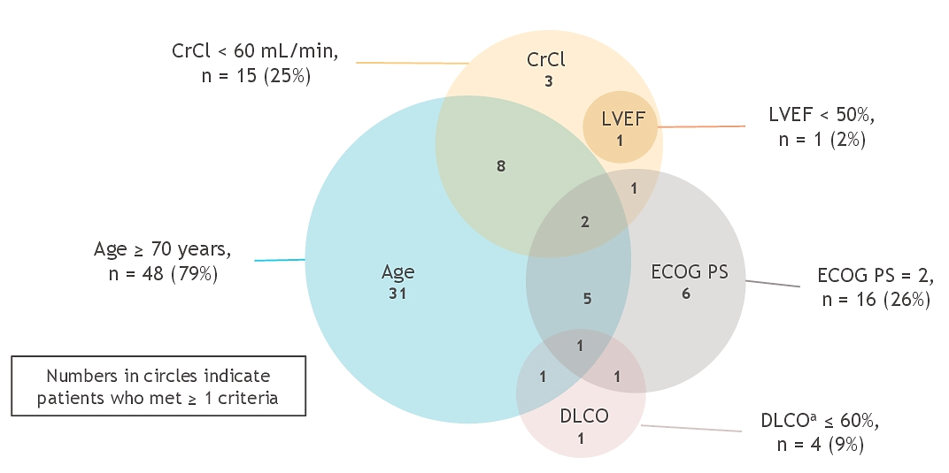
PILOT: 2L Liso-cel in Patients With LBCL Not Intended for AutoSCT
Progression-Free Survival
Rationale Transplant Not Intended
ORR: 80%, CR: 54%
6/24/2022: Liso-cel FDA approved for 1) adult patients with LBCL refractory to first-line CIT or relapse within 12 months of first-line CIT and 2) for refractory disease to first-line CIT or relapse after first-line CIT who are not eligible for AutoSCT due to comorbidities or age

Slide 8
The Evolving Treatment Landscape of 2L DLBCL
R-CHOP or similar
Relapsed/Refractory
Cure
Time to relapse after 1L therapy
Of patients who relapse, ~75% of relapse in ≤1 year
Of patients who relapse, ~25% of relapse >1 year
Eligible for CAR-T
Eligible for ASCT
~70% eligible for CAR-T
~30% ineligible for CAR-T
~50% are eligible for ASCT
~50% ineligible for ASCT
2L CAR-T
Noncellular therapies
2L CAR-T
High-dose Chemotherapy and AutoSCT

Slide 9
Conclusions
CAR T-cell therapy is FDA-approved for early relapsing (≤ 12m) or primary refractory DLBCL after one prior line of therapy based on improvements in EFS compared to SOC
Axi-cel
Liso-cel
Liso-cel also FDA approved for R/R DLBCL after one prior line of therapy in those not eligible for AutoSCT due to age or comorbidities
Clinicians should consider CAR T-cell referral for all subjects with R/R DLBCL

