Slide 1
What is the Role of CAR T-Cell Therapies for R/R DLBCL Patients Following Two Prior Lines of Therapy?
Peter Riedell, MD
Assistant Professor of Medicine
The University of Chicago Department of Medicine
Chicago, IL

Slide 2
Disclaimer
The views and opinions expressed in this educational activity are those of the faculty and do not necessarily represent the views of TotalCME, Inc., the CME providers, or the companies providing educational grants. This presentation is not intended to define an exclusive course of patient management; the participant should use their clinical judgment, knowledge, experience, and diagnostic skills in applying or adopting for professional use any of the information provided herein. Any procedures, medications, or other courses of diagnosis or treatment discussed or suggested in this activity should not be used by clinicians without evaluation of their patient's conditions and possible contraindications or dangers in use, review of any applicable manufacturer’s product information, and comparison with recommendations of other authorities. Links to other sites may be provided as additional sources of information.

Slide 3
Third-Line and Subsequent Therapy in DLBCL
Third-Line and Subsequent Therapy
Anti-CD19 CAR-T cell therapy Axicabtagene ciloleucel Lisocabtagene maraleucel Tisagenlecleucel Loncastuximab tesirine Selinexor (only after ≥ 2 lines of systemic therapy; including patients with disease progression after transplant or CAR-T cell therapy)

Slide 4
Pivotal CD19 CAR T-Cell Trials
Characteristic | ZUMA-1 | JULIET | TRANSCEND
Cellular therapy | Axicabtagene ciloleucel | Tisagenlecleucel | Lisocabtagene maraleucel
Co-stimulatory domain | CD28 | 4-1BB | 4-1BB
Number (enrolled/treated) | 111/101 | 165/115 | 344/269
Median age (range), yr | 58 (23-76) | 56 (22-76) | 63 (18-86)
Prior autoSCT | 21% | 49% | 33%
Bridging therapy | 0% | 92% | 59%
Median turnaround time, d | 17 | 54 | 24

Slide 5
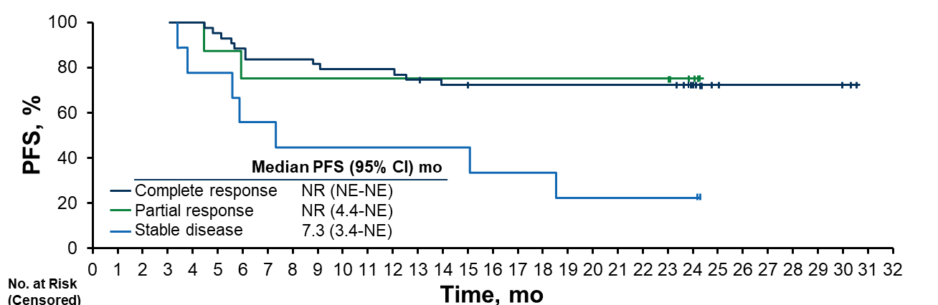
Phase 2 ZUMA-1: Axi-Cel Was Highly Active in R/R DLBCL
Outcomes | Investigator Assessed-Responses
Objective Response, n (%) | 84 (83)
CR, n (%) | 59 (58)
Median DOR, mo | 11.1
Median OS, mo | NR
Median PFS, mo | 5.9
Median follow-up
of 27.1 months¹

Slide 6
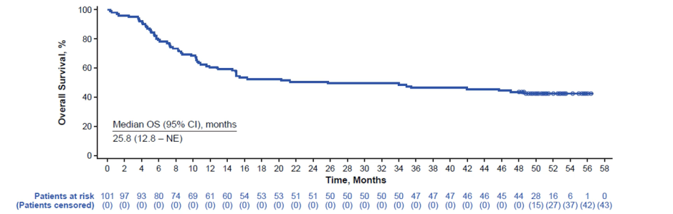
Phase 2 ZUMA-1: Updated Findings Continue to Show Overall Survival Benefits in R/R DLBCL
mITTª population: n = 101
Median follow-up: 51.1 months
5-year OS of 43% among infused patients
ª mITT: Axi-cel-treated patients; ITT: enrolled patients (N = 111)

Slide 7
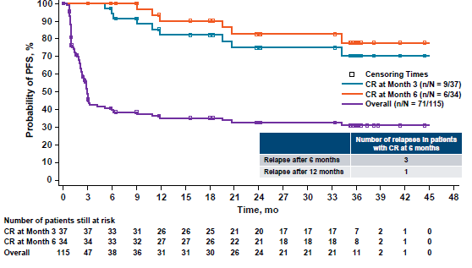
JULIET: Long-Term Outcomes With Tisa-Cel in DLBCL
100
90
80
Best ORR 53% (39% CR)
PFS:
  24-month: 33%
  36-month: 31%
Among responders, 60% were estimated to maintain that response at 24 and 36 months
70
60
Censoring Times
CR at Month 3 (n/N = 9/37)
CR at Month 6 (n/N = 6/34)
Overall (n/n = 71/115)
Probability of PFS, %
50
40
30
20
Number of relapses in patients
With CR at 6 months
10
Relapse after 6 months
3
0
Relapse after 12 months
1
0
3
6
9
12
15
18
21
24
27
30
33
36
39
42
45
48
Time, mo
Number of patients still at risk
CR at Month 2
CR at Month 6
Overall
0
34
115
37
34
47
33
33
38
31
32
36
26
27
31
26
27
31
25
26
30
21
22
26
20
21
24
17
18
21
17
18
21
17
18
21
7
8
11
2
2
2
1
1
1
0
0
0
Median follow-up: 40.3 months

Slide 8
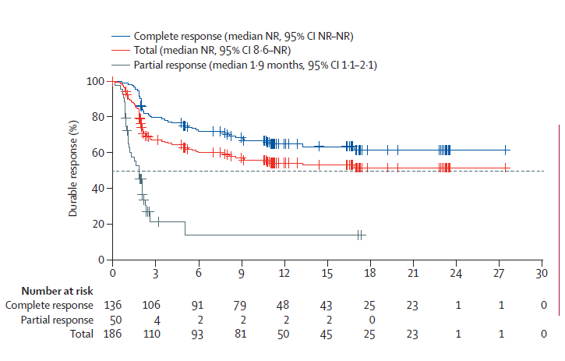
Deep and Durable Response to Liso-cel
Median Follow-Up: 12.0 mo (95% CI, 11.2-16.7)
Efficacy-Evaluable Patients (N = 256)
ORR (95% CI) | 73 (66.8-78.0)
CR (95% CI) | 53 (46.8-59.4)
PR (95% CI) | 20 (14.9-24.9)
Estimated DOR rate at one year was 55% (95% CI, 46.7-62.0) for total population and 65% (56.2-72.8) among those who achieved a CR

Slide 9
TRANSCEND NHL 001: PFS and OS
PFS Median Follow-Up: 12.3 mo (95% CI, 12.0-17.5)
OS Median Follow-Up: 17.6 mo (95% CI, 13.5-18.0)
100
100
80
Median: NR (NR-NR)
80
Median: NR (NR-NR)
CR
CR
60
60
Median: 21.1 mo (95% CI, 13.3-NR)
Probability of PFS, %
Probability of PFS, %
40
Total
40
Total
Median: 6.8 mo (95% CI, 3.3-14.1)
PR median: 9.0 mo (95% CI, 6.0-10.4)
20
PR median: 2.8 mo (95% CI, 2.1-3.0)
20
SD/PD median: 5.1 mo (95% CI, 2.9-6.5)
SD/PD median: 1.1 mo (95% CI, 1.0-1.6)
0
0
0
3
6
9
12
15
18
21
24
27
30
0
3
6
9
12
15
18
21
24
27
30
33
36
39
42
45
Time, mo
Time, mo
No. at Risk
CR
PR
SD/PD
Total
136
116
98
85
63
45
31
23
14
1
0
No. at Risk
CR
PR
SD/PD
Total
136
135
128
113
94
68
48
36
26
16
13
8
5
1
0
50
14
2
2
2
2
2
0
50
45
33
20
8
3
3
0
70
3
0
70
41
27
14
7
3
1
1
1
1
1
1
1
0
256
133
100
87
65
47
33
23
14
1
0
256
221
188
147
109
74
52
37
27
17
14
9
6
1
0
Liso-cel demonstrated durable remissions with estimated 2-year DOR and PFS rates of 49.5% and 40.6%, respectively

Slide 10
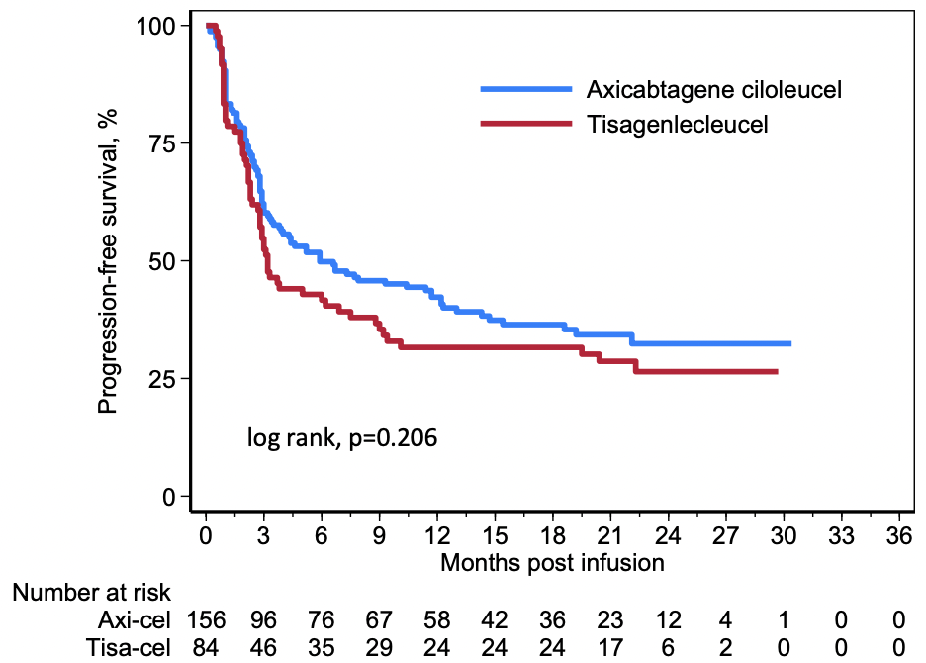
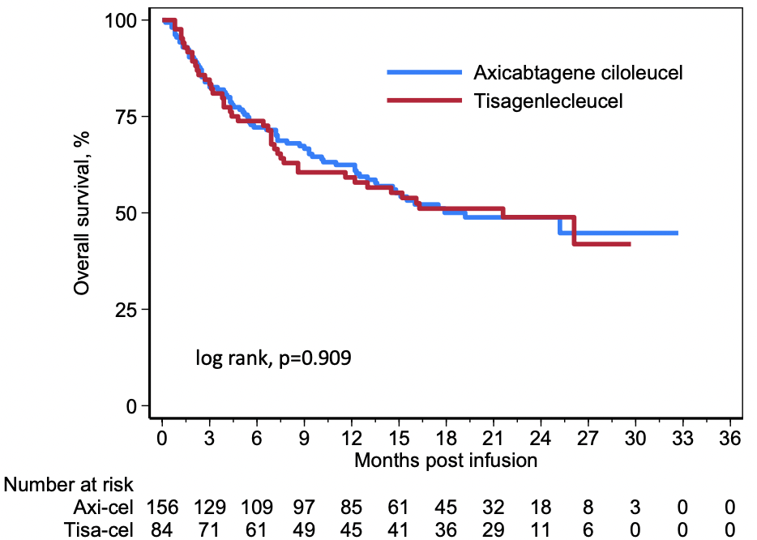
Axicabtagene Ciloleucel and Tisagenlecleucel:
SOC Use Across Centers
Progression-Free Survival
Overall Survival

Slide 11
Real world experience with CD19 CAR T-cell
Poor ECOG PS and elevated LDH likely reflective of rapidly progressive disease
PFS by baseline ECOG PS
PFS by LDH at LDc

Slide 12
Conclusions
CAR T-cell therapy produces impressive ORR and CR rates in R/R aggressive B-NHL
  Remissions appear durable in 35-45% of patients
Multiple CAR-T constructs appear to have relatively similar efficacy accounting for difference in patient populations/trial design
Comparable results seen in “real world” population
  Drive to expand pool of eligible patients who may benefit from therapy
Encourage early referral for discussion of CAR-T treatment

