Slide 1
How Do I Optimize Use of Non-Cellular CD19 Targeted Therapies in R/R DLBCL?
Paolo F. Caimi, MD
Staff Physician
Department of Hematology and Oncology
Cleveland Clinic Taussig Cancer Center
Associate Professor
Cleveland Clinic Lerner College of Medicine
Cleveland, OH

Slide 2
Disclaimer
The views and opinions expressed in this educational activity are those of the faculty and do not necessarily represent the views of TotalCME, Inc., the CME providers, or the companies providing educational grants. This presentation is not intended to define an exclusive course of patient management; the participant should use their clinical judgment, knowledge, experience, and diagnostic skills in applying or adopting for professional use any of the information provided herein. Any procedures, medications, or other courses of diagnosis or treatment discussed or suggested in this activity should not be used by clinicians without evaluation of their patient's conditions and possible contraindications or dangers in use, review of any applicable manufacturer’s product information, and comparison with recommendations of other authorities. Links to other sites may be provided as additional sources of information.

Slide 3
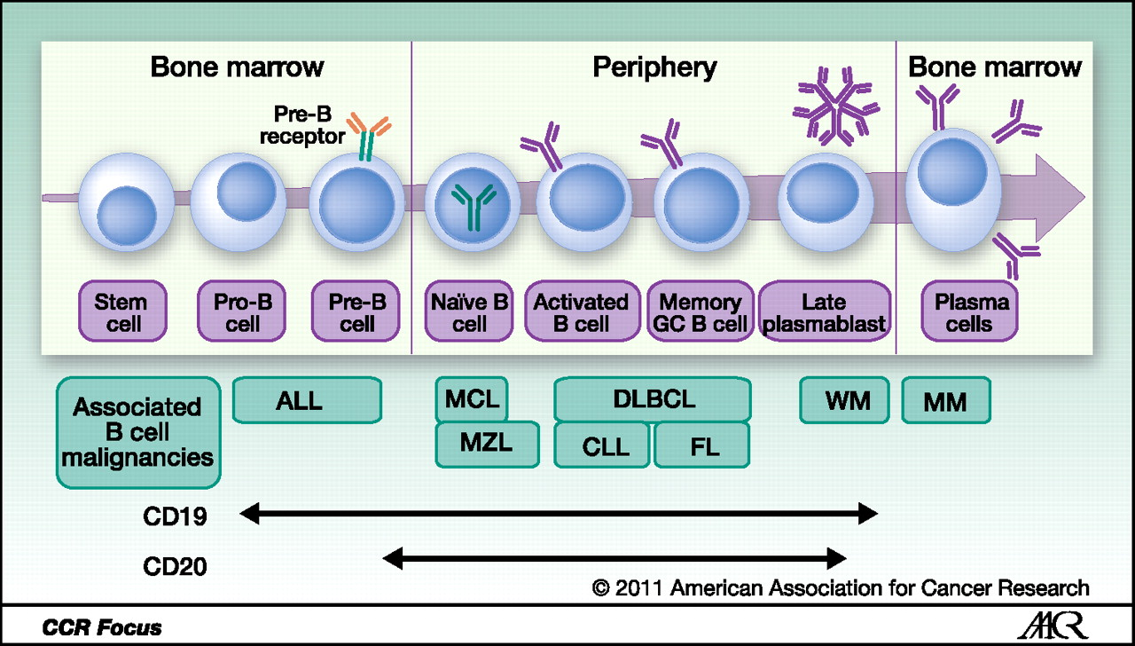
CD19 as Target for Immunotherapy

Slide 4
CD19 Targeting Immunotherapy
Tafasitamab
Loncastuximab
CAR T-cells

Slide 5
Tafasitamab
Monoclonal antibody directed against CD19
  “Fc enhanced”: Increased affinity for Fcγ receptor
  Humanized
  Mediates antibody-dependent cellular cytotoxicity (ADCC) and antibody-dependent cellular phagocytosis
  Has direct cytotoxicity

Slide 6
Tafasitamab: Eligibility & Pt. Characteristics
L-MIND
  Phase 2 trial
Eligibility
  DLBCL
    Including transformed indolent
    Excluding double/triple hit
  Relapsed / refractory to 1 - 3 lines of therapy
    Primary refractory (up to three months after initial therapy)
  Not candidates for ASCT:
    Older than 70 years
    Organ dysfunction
    Failed previous ASCT
    No response to salvage therapy
    Refused
    Inability to collect CD34 cells
81 patients enrolled
Median age: 72 years (62 -76)
Transformed indolent: 9%
Median previous therapies: 2 (1 - 4)
(50% had received one line)
Refractory to last therapy: 44%
Bulky disease: 19%
ASCT ineligibility
Age > 70 years: 46%
Chemorefractory: 23%
Refusal: 16%
Comorbidities: 14%
Other: 1%

Slide 7
Tafasitamab
L-MIND Trial Results
DoR
DoR by best response
PFS
OS

Slide 8
Tafasitamab: L-MIND Safety
Most common AE was neutropenia (49%); grade ≥3 48%
  Use of G-CSF in 44% of patients
Other hematologic toxicity common
Non hematologic AEs included
  Grade 1 - 2 rash (27%), diarrhea (32%), asthenia (17%), peripheral edema (22%)
  Grade 3 rash (9%), pneumonia (6%), pulmonary embolism (4%)

Slide 9
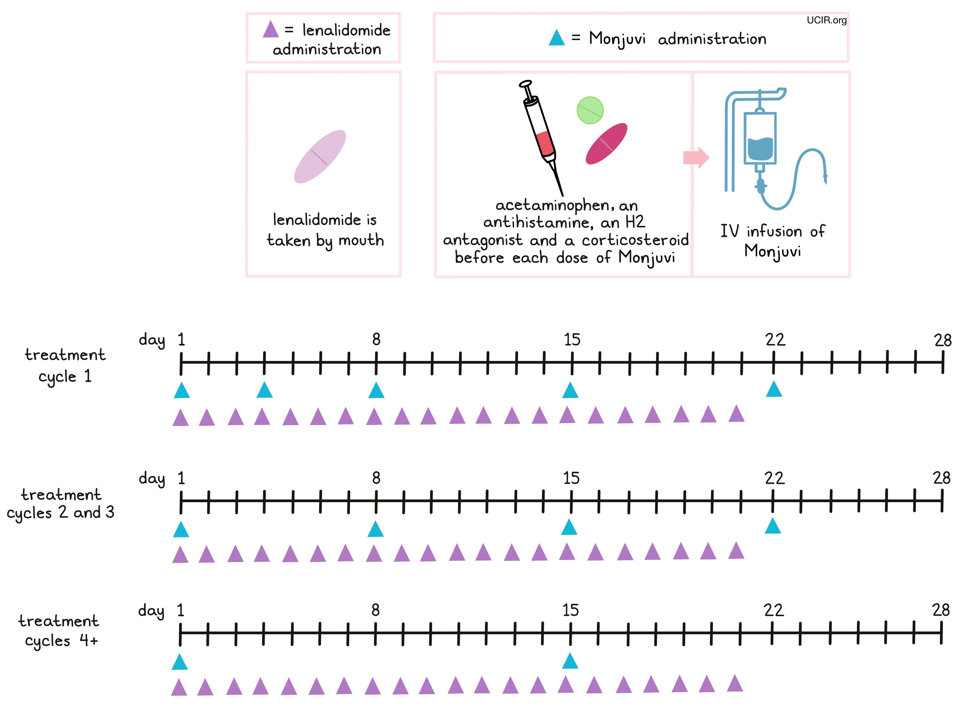
lenalidomide
administration
tafasitamab-cxix administration
acetaminophen, an
antihistamine, an H2
antagonist and a corticosteroid
before each dose of tafasitamab-cxix
lenalidomide is
taken by mouth
IV infusion of
tafasitamab-cxix
treatment
cycle 1
treatment
cycles 2 and 3
treatment
cycles 4+

Slide 10
Tafasitamab Optimization
Patient selection is relevant
  Second line for transplant and CAR-T ineligible patients (50% had 1 line of therapy)
  Not studied in high risk DLBCL patients
  Well-tolerated and hematologic toxicity is manageable
  Schedule of infusions is intensive

Slide 11
Loncastuximab Tesirine
Antibody drug conjugate
  Anti-CD19
  Payload is pyrrolobenzodiazepine (PBD) toxin
    DNA cross-linking

Slide 12
Phase II Trial (LOTIS-2)
30-minute infusion of Lonca Q3W for up to 1 year
Q12W for up to 3 years
150 µg/kg
75 µg/kg
Follow-up
First 2 cycles
After 2 cycles
Eligibility
DLBCL
  Including transformed indolent
  Including double/triple hit
  Including primary refractory
Excluded:
  Bulky disease (> 10 cm)
  ASCT within 30 days; AlloHCT within 60 days
  CNS disease
Relapsed/refractory to ≥ 2 lines of therapy
If prior CAR-T cell therapy, repeat biopsy with CD19+ required

Slide 13
LOTIS-2: Results
145 Patients
Median age | 66 years (56 - 71)
Lymphoma
DLBCL, NOS | 88%
HGBCL | 8%
BCL | 5%
Double hit | 10%
Transformed | 20%
Primary refractory | 20%
Refractory to last regimen | 58%
Median previous therapies | 3 (2-7)

Slide 14

LOTIS-2: Results
DoR:
10.3 months
(13.4 for CR)
v
PFS:
4.9 months
OS:
9.9 months

Slide 15
LOTIS-2: Results
Subgroup Analysis
High-risk subgroup analysis of ORR
Subgroup
Patients (n/N)
ORR
ORR (95% CI)
Subgroup
Patients (n/N)
ORR
ORR (95% CI)
ORR
All
Age
<65 years
≥65 years
Double/triple hit
No
Yes
Transformed disease
Transformed
De novo
Cell-of-origin
GCB
ABC
Double/triple expressor
No
Yes
WHO classification
DLBCL NOS
PMBCL
HGBCL
70/145
32/65
38/80
65/130
5/15
13/29
57/116
26/48
11/23
60/125
10/20
64/127
1/7
5/11
48.3 (39.9, 56.7)
49.2 (36.6, 61.9)
47.5 (36.2, 59.0)
50.0 (41.1, 58.9)
33.3 (11.8, 61.6)
44.8 (26.4, 64.3)
49.1 (39.7, 58.6)
54.2 (39.2, 68.6)
47.8 (26.8, 69.4)
48.0 (39.0, 57.1)
50.0 (27.2, 72.8)
50.4 (41.4, 59.4)
14.3 (0.4, 57.9)
45.5 (16.7, 76.6)
All
First-line response*
Relapse
Refractory†
Last-line response*
Relapse
Refractory†
Response to any prior line*
Relapse
Refractory†
Prior stem cell transplant
Yes
No
Prior CAR-T therapy
Yes
No
Prior systemic therapies
2 prior lines
3 prior lines
>3 prior lines
70/145
53/99
11/29
29/43
31/84
60/115
9/25
14/24
56/121
6/13
64/132
30/63
17/35
23/47
48.3 (39.9, 56.7)
53.5 (43.2, 63.6)
37.9 (20.7, 57.7)
67.4 (51.5, 80.9)
36.9 (26.6, 48.1)
52.2 (42.7, 61.6)
36.0 (18.0, 57.5)
58.3 (36.6, 77.9)
46.3 (37.2, 55.6)
46.2 (19.2, 74.9)
48.5 (39.7, 57.3)
47.6 (34.9, 60.6)
48.6 (31.4, 66.0)
48.9 (34.1, 63.9)
0.0
0.2
0.4
0.6
0.8
1.0
0.0
0.2
0.4
0.6
0.8
1.0

Slide 16
LOTIS-2: Results
Safety
LOTIS-2 Updated Results
TEAEs in ≥ 20% of the all-treated population
Most common (≥ 10%) grade ≥ 3 TEAEs were:
Neutropenia (38 patients; 26.2%)
Thrombocytopenia (26 patients; 17.9%)
GGT increased (25 patients; 17.2%)
Anemia (15 patients; 10.3%)
 | PATIENTS N (%)
PREFERRED TERM | < 65 YEARS (N = 65) | ≥ 65 (N = 80) | TOTAL (N = 145)
Patients with any TEAE | 65 (100) | 78 (97.5) | 143 (98.6)
GGT increased | 33 (50.8) | 27 (33.8) | 60 (41.4)
Neutropenia | 34 (52.3) | 24 (30.0) | 58 (40.0)
Thrombocytopenia | 28 (43.1) | 20 (25.0) | 48 (33.1)
Fatigue | 21 (32.3) | 19 (23.8) | 40 (27.6)
Anemia | 23 (35.4) | 15 (18.8) | 38 (26.2)
Nausea | 17 (26.2) | 17 (21.3) | 34 (23.4)
Cough | 19 (29.2) | 13 (16.3) | 32 (22.1)
Alkaline phosphatase increased | 18 (27.7) | 11 (13.8) | 29 (20.0)
Peripheral edema | 11 (16.9) | 18 (22.5) | 29 (20.0)
Treatment-related TEAEs leading to treatment discontinuation occurred in 26 (17.9%) patients, most commonly (≥ 2%):
GGT increased (16 patients; 11.0%)
Peripheral edema (4 patients; 2.8%)
Localized edema (3 patients; 2.1%)

Slide 17
Loncastuximab Optimization
Active in multiple risk subgroups
Can be used post CAR-T or post ASCT in CAR-T ineligible patients
Adverse event rate is comparable to others, but safety profile is different
Photosensitivity and avoiding sun exposure relevant reminder for prescribers
Pre/post medication with dexamethasone important to increased tolerability

Slide 18
Conclusions
Several new agents for CD19
Choice based on trials and safety profile
Treatment schedule can be relevant
Much more to be learned about sequences

