Slide 1
Algorithm for Assessing Excessive Daytime Sleepiness in Obstructive Sleep Apnea
Neomi Shah, MD, MPH, MSc
System Vice Chair of Medicine
Professor of Medicine
Division of Pulmonary, Critical Care and Sleep Medicine
Icahn School of Medicine at Mount Sinai
New York, NY

Slide 2



Resource Information
About This Resource
These slides are one component of a continuing education program available online at MedEd On The Go titled Obstructive Sleep Apnea: Emerging Therapies for Excessive Daytime Sleepiness
Program Learning Objectives:
Utilize validated diagnostic tools when assessing residual EDS due to OSA.
Understand the burden, risk factors, and prevalence of EDS due to OSA.
Develop an evidence-based, comprehensive treatment plan for the management of EDS due to OSA.
MedEd On The Go®
www.mededonthego.com
This content or portions thereof may not be published, posted online or used in presentations without permission.
This content can be saved for personal use (non-commercial use only) with credit given to the resource authors.
To contact us regarding inaccuracies, omissions or permissions please email us at support@MedEdOTG.com

Slide 3
Disclaimer
The views and opinions expressed in this educational activity are those of the faculty and do not necessarily represent the views of Total CME, LLC, the CME providers, or the companies providing educational grants. This presentation is not intended to define an exclusive course of patient management; the participant should use their clinical judgment, knowledge, experience, and diagnostic skills in applying or adopting for professional use any of the information provided herein. Any procedures, medications, or other courses of diagnosis or treatment discussed or suggested in this activity should not be used by clinicians without evaluation of their patient's conditions and possible contraindications or dangers in use, review of any applicable manufacturer’s product information, and comparison with recommendations of other authorities. Links to other sites may be provided as additional sources of information.

Slide 4

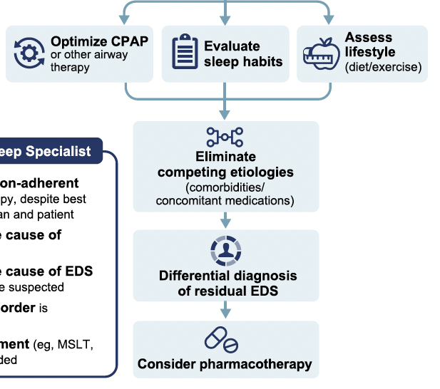

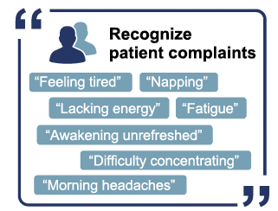
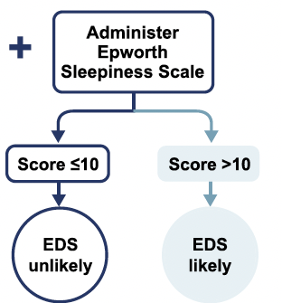
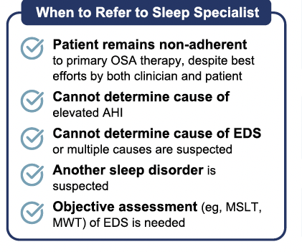
All patients treated for OSA
Clinical Consultation

Slide 5
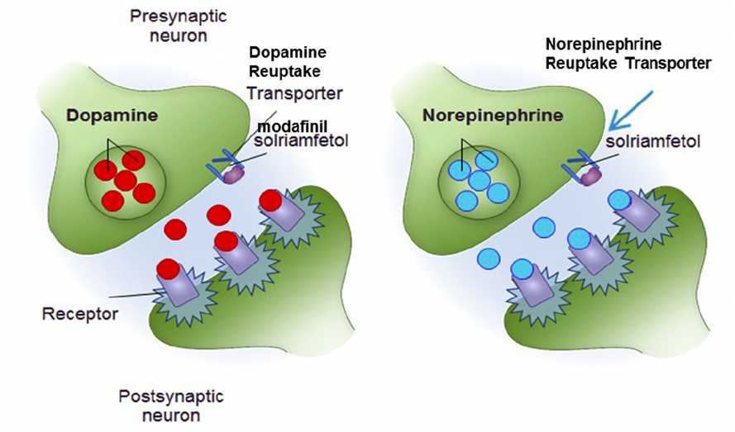
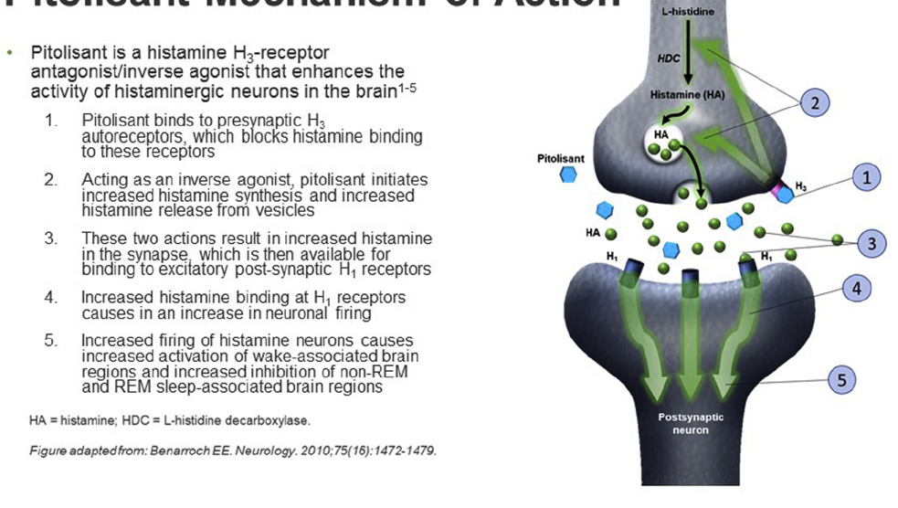
Mechanism of Action of Wake Promoting Drugs: Modafinil, Solriamfetol, Pitolisant
Solriamfetol
Pitolisant

Slide 6
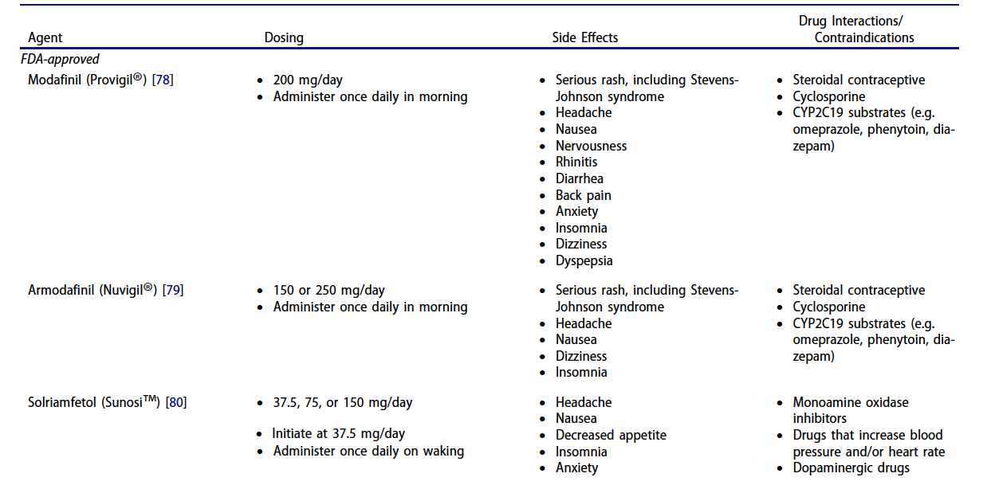

Slide 7
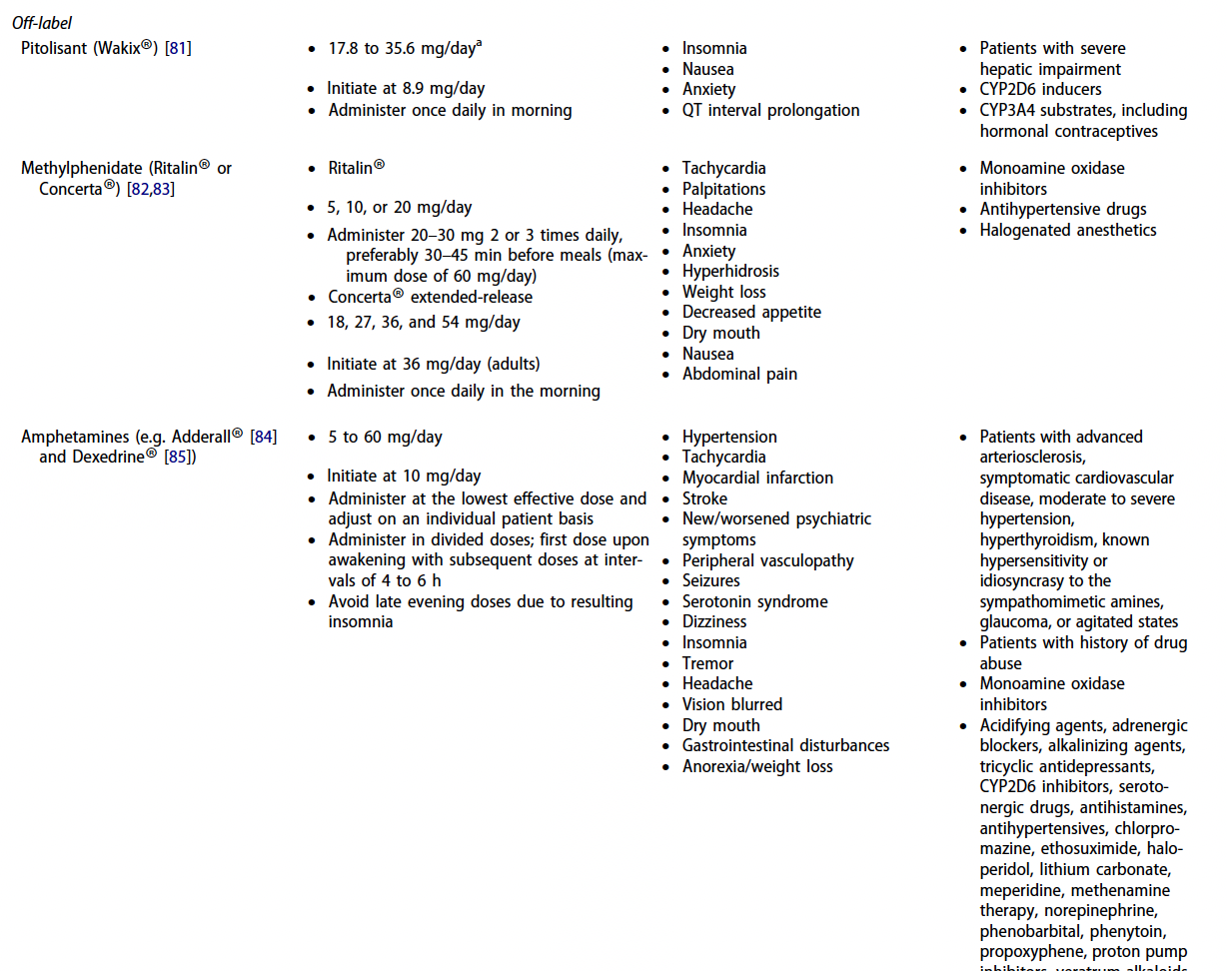

Slide 8
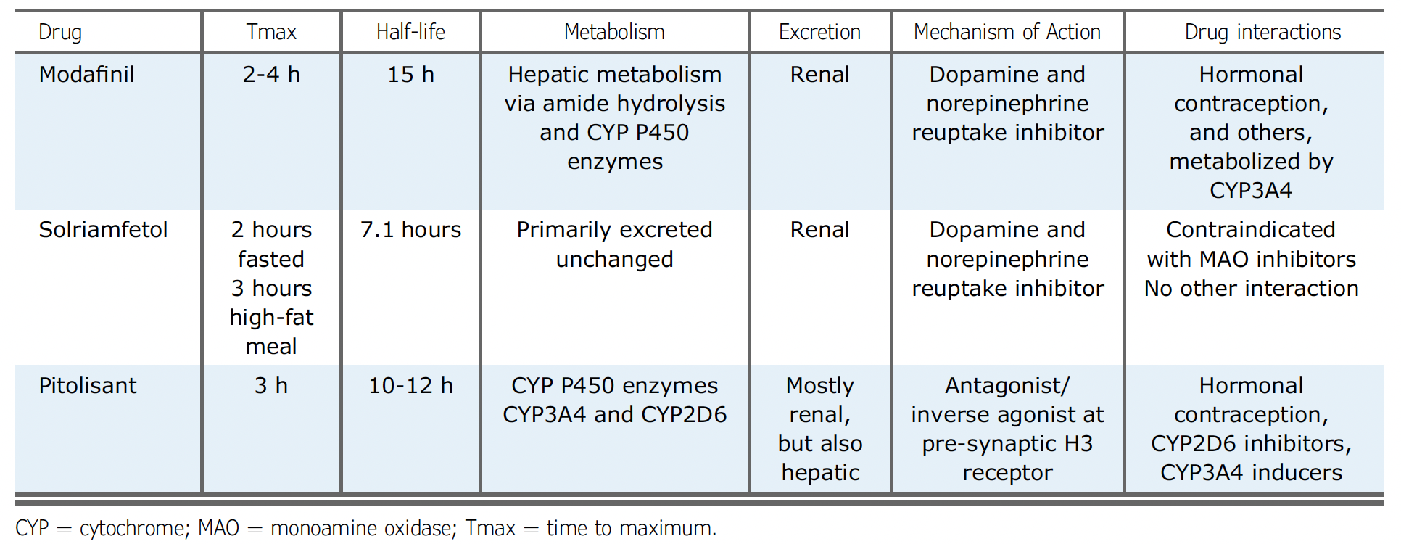
Pharmacokinetics of Wake Promoting Drugs

Slide 9
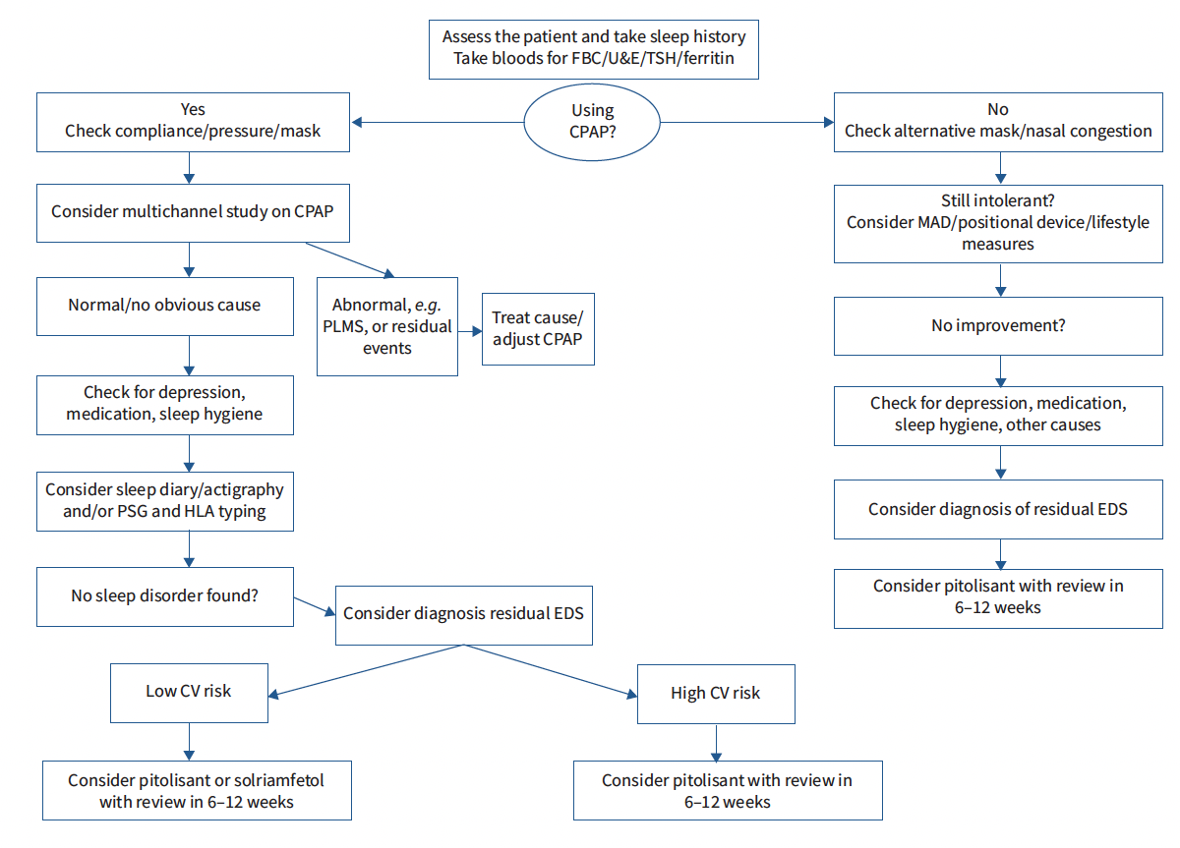
Example of How Novel Therapies Can Fit into
Clinical Practice

Slide 10



Looking for more resources
on this topic?
CME/CE in minutes
Congress highlights
Late-breaking data
Quizzes
Webinars
In-person events
Slides & resources
www.MedEdOTG.com

