Slide 1
Negative Impacts of Excessive Daytime Sleepiness Due to Obstructive Sleep Apnea
Neomi Shah, MD, MPH, MSc System Vice Chair of Medicine Professor of Medicine Division of Pulmonary, Critical Care and Sleep Medicine Icahn School of Medicine at Mount Sinai New York, NY

Slide 2
Resource Information
About This Resource
These slides are one component of a continuing education program available online at MedEd On The Go titled Obstructive Sleep Apnea: Emerging Therapies for Excessive Daytime Sleepiness
Program Learning Objectives:
Utilize validated diagnostic tools when assessing residual EDS due to OSA.
Understand the burden, risk factors, and prevalence of EDS due to OSA.
Develop an evidence-based, comprehensive treatment plan for the management of EDS due to OSA.
MedEd On The Go®
www.mededonthego.com
This content or portions thereof may not be published, posted online or used in presentations without permission.
This content can be saved for personal use (non-commercial use only) with credit given to the resource authors.
To contact us regarding inaccuracies, omissions or permissions please email us at support@MedEdOTG.com

Slide 3
Disclaimer
The views and opinions expressed in this educational activity are those of the faculty and do not necessarily represent the views of Total CME, LLC, the CME providers, or the companies providing educational grants. This presentation is not intended to define an exclusive course of patient management; the participant should use their clinical judgment, knowledge, experience, and diagnostic skills in applying or adopting for professional use any of the information provided herein. Any procedures, medications, or other courses of diagnosis or treatment discussed or suggested in this activity should not be used by clinicians without evaluation of their patient's conditions and possible contraindications or dangers in use, review of any applicable manufacturer’s product information, and comparison with recommendations of other authorities. Links to other sites may be provided as additional sources of information.

Slide 4
Normal Versus Excessive Sleepiness: Definitions and Terminology
Normal sleepiness
A biological drive state of decreased ability to maintain wakefulness or an increased propensity to fall asleep
Excessive sleepiness
A symptom of difficulty in maintaining wakefulness and an increased propensity to fall asleep, even in inappropriate circumstances and in situations that interfere with activities of daily living

Slide 5
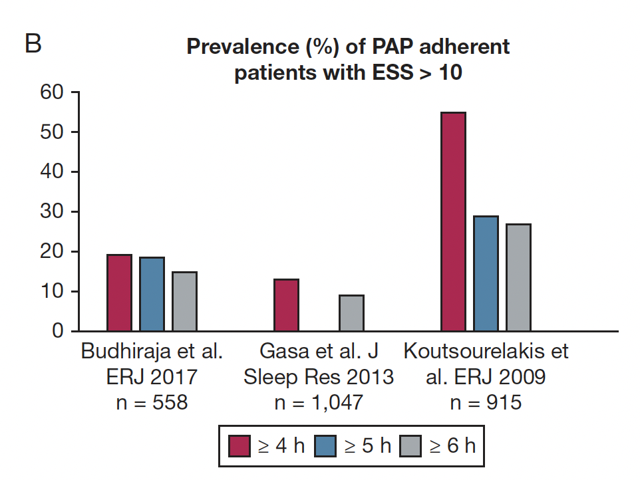
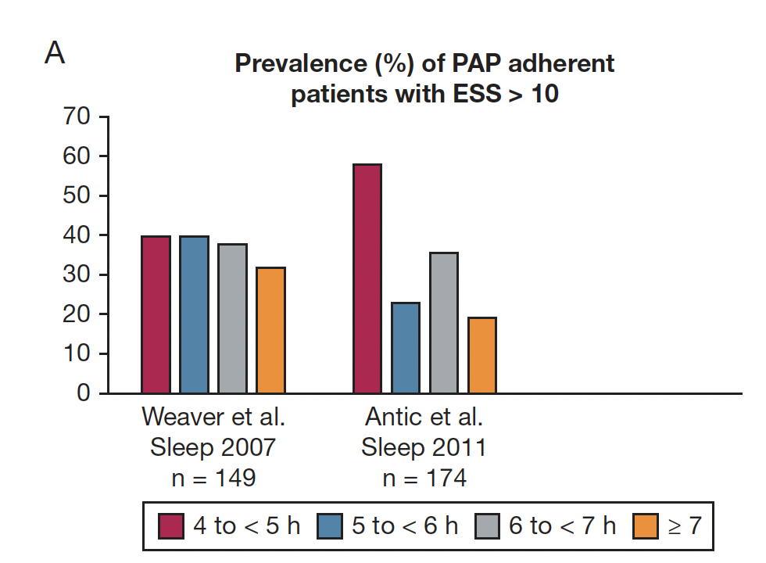
EDS in OSA

Slide 6
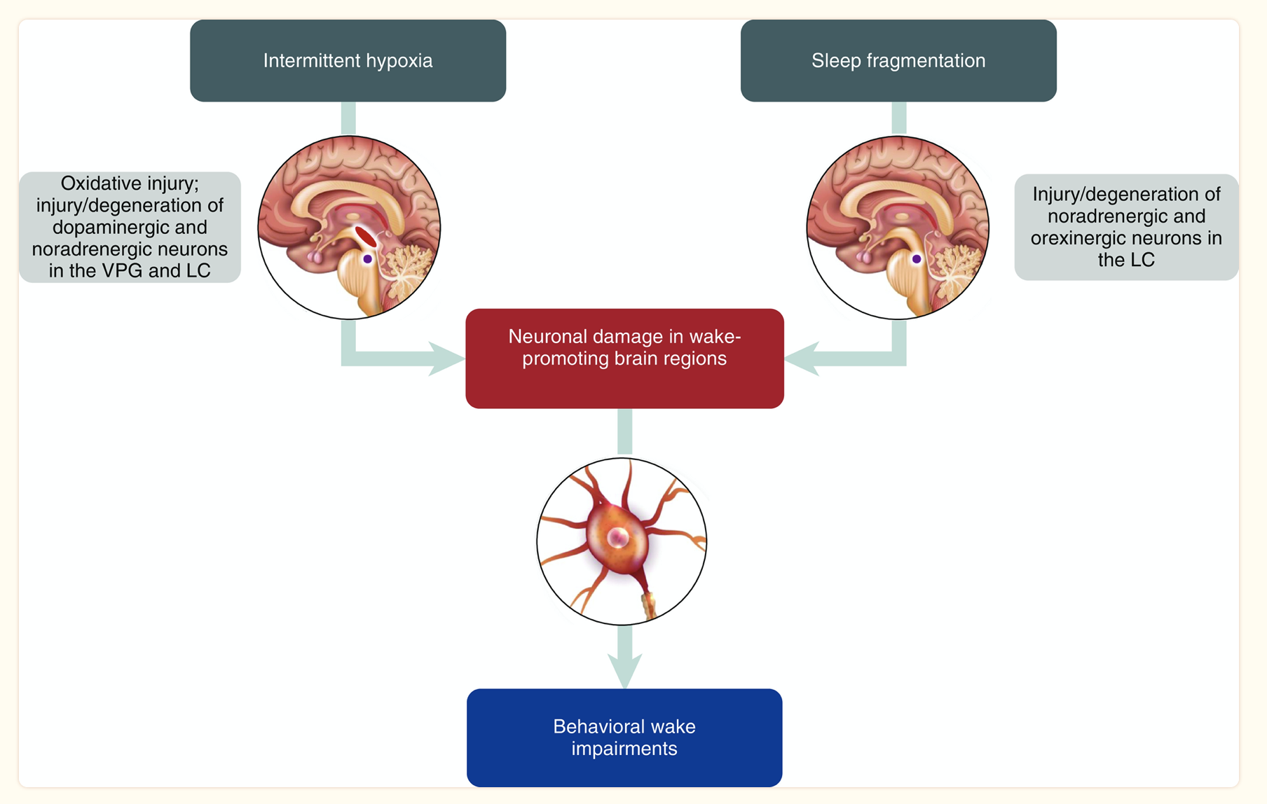
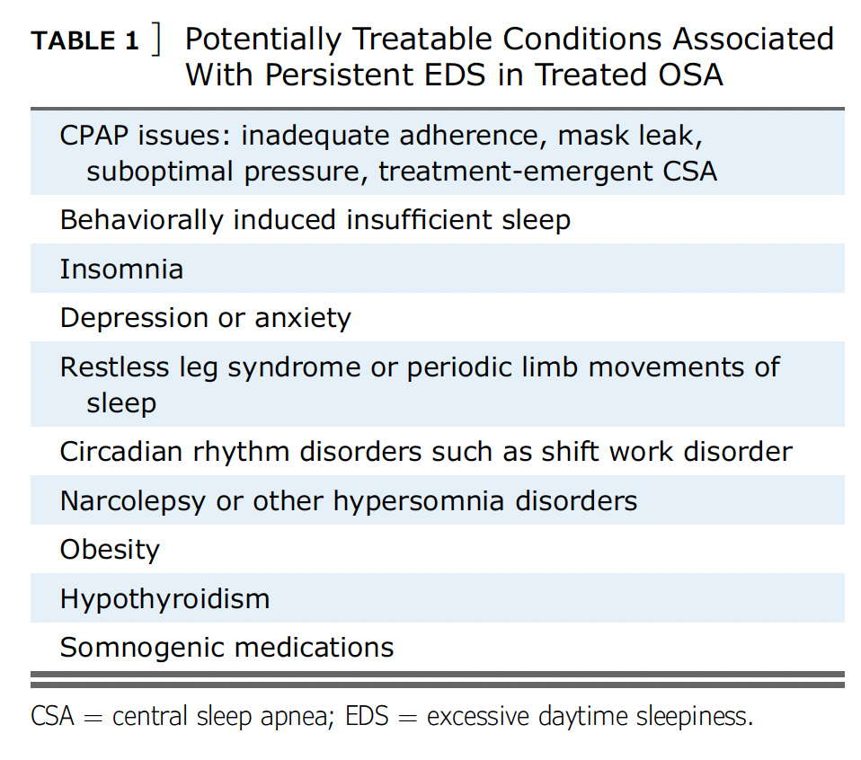
Mechanisms of EDS in OSA

Slide 7
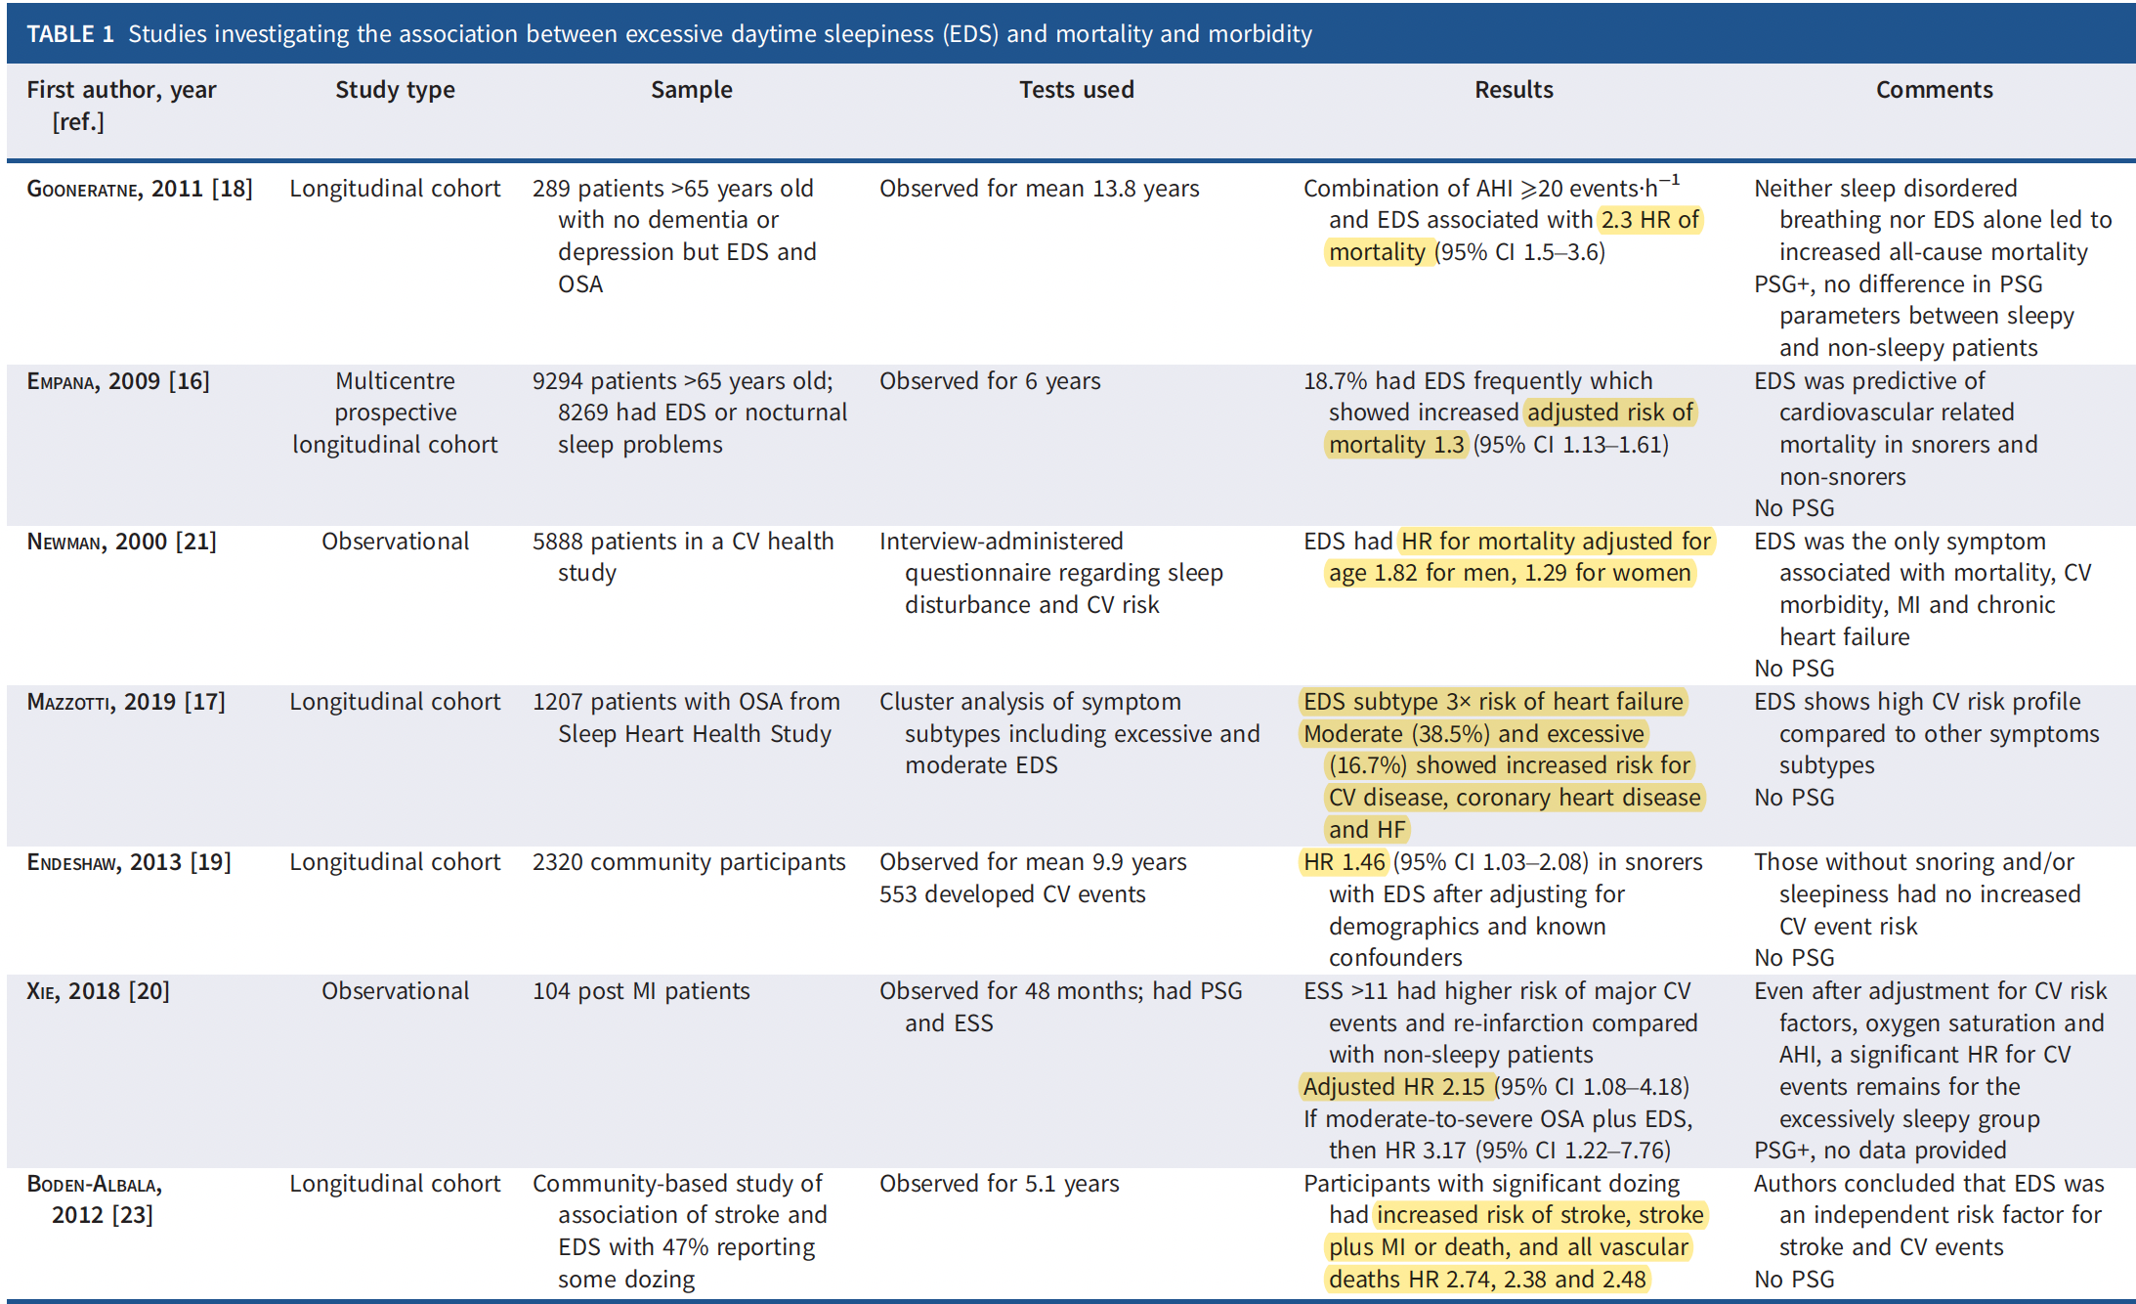
Studies Investigating the Association Between Excessive Daytime Sleepiness (EDS) and Mortality and Morbidity

Slide 8
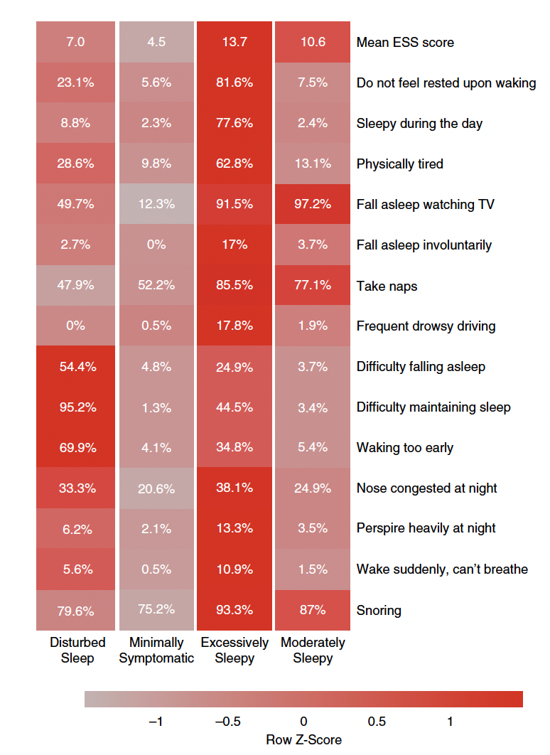
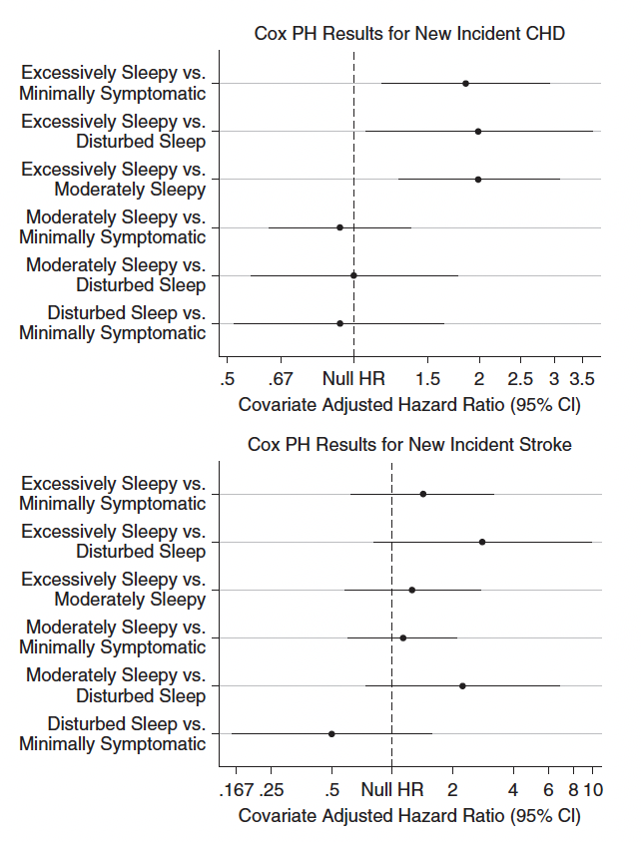
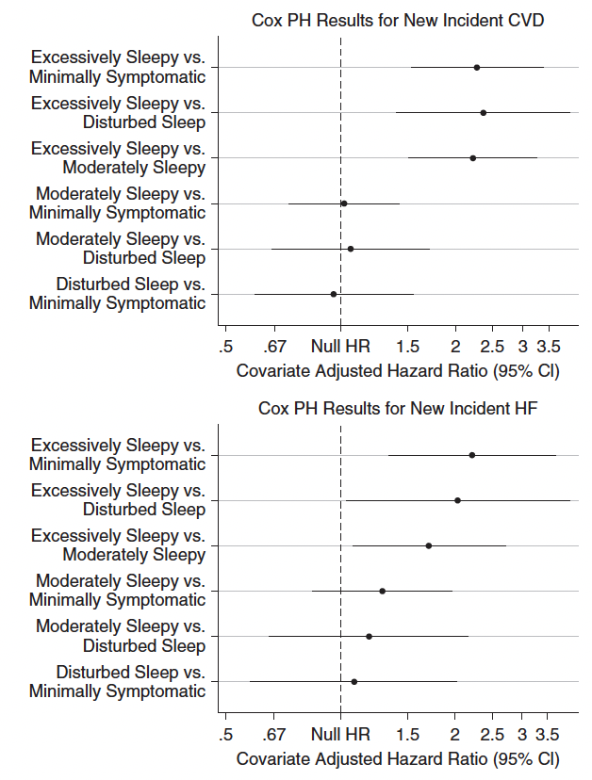
Sleepy Phenotype and Cardiovascular Risk

Slide 9
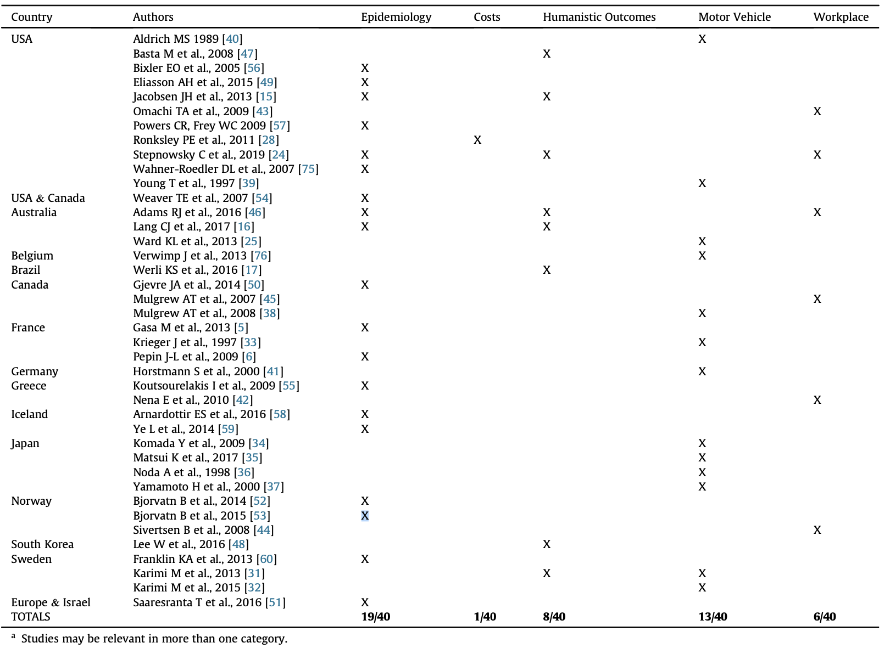
The Economic and Societal Burden of Excessive Daytime Sleepiness in Patients with Obstructive Sleep Apnea

Slide 10
The Adverse Health Effects of Excessive Daytime Sleepiness in Obstructive Sleep Apnea
Increased risk of headaches
Depressed mood
Anxiety
Impaired cognition, including decreased cognitive flexibility, executive function, and working memory
Disturbed attention and impaired vigilance, particularly in monotonous tasks like driving
Decreased quality of life (QOL) compared to patients with OSA but no EDS
Increased societal burden, including higher rates of motor vehicle accidents (MVAs) and workplace accidents, leading to injury and disability
Hypothesized association with excess health care utilization and increased health care costs, such as MVAs, work accidents, and loss of productivity
Economic burden of EDS in OSA, including unrecognized and underappreciated direct and indirect costs

Slide 11
Looking for more resources on this topic?
CME/CE in minutes
Congress highlights
Late-breaking data
Quizzes
Webinars
In-person events
Slides & resources
www.MedEdOTG.com

