Slide 1
Case 6: Implementing Current Guidelines and Best Practices for Monitoring and Mitigating Immune-Related Adverse Events
Joshua E. Reuss, MD
Thoracic Medical Oncologist
Assistant Professor of Medicine
Georgetown University School of Medicine
Washington, DC

Slide 2
Resource Information
About This Resource
These slides are one component of a continuing education program available online at MedEd On The Go titled NSCLC Case by Case: Optimizing 1L Immunotherapy for Advanced & Metastatic Disease
Program Learning Objectives:
Select optimal frontline treatment strategies for patients with advanced non-small cell lung cancer without actionable driver alterations by incorporating treatment-specific and patient-related characteristics
Implement evidence-based strategies to monitor and mitigate immune-related adverse events to optimize treatment adherence and patient outcomes
MedEd On The Go®
www.mededonthego.com
This content or portions thereof may not be published, posted online or used in presentations without permission.
This content can be saved for personal use (non-commercial use only) with credit given to the resource authors.
To contact us regarding inaccuracies, omissions or permissions please email us at support@MedEdOTG.com

Slide 3
Disclaimer
The views and opinions expressed in this educational activity are those of the faculty and do not necessarily represent the views of Total CME, LLC, the CME providers, or the companies providing educational grants. This presentation is not intended to define an exclusive course of patient management; the participant should use their clinical judgment, knowledge, experience, and diagnostic skills in applying or adopting for professional use any of the information provided herein. Any procedures, medications, or other courses of diagnosis or treatment discussed or suggested in this activity should not be used by clinicians without evaluation of their patient's conditions and possible contraindications or dangers in use, review of any applicable manufacturer’s product information, and comparison with recommendations of other authorities. Links to other sites may be provided as additional sources of information.

Slide 4
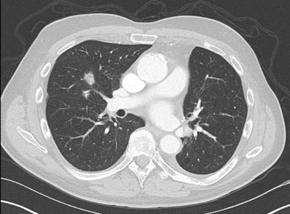
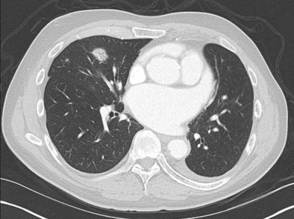
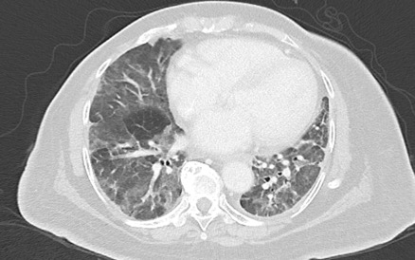
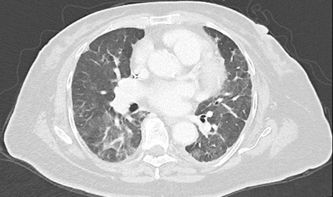
Case Examples
Mr. N
Ms. S
Mr. N is a 74yo male with a history of chronic atrial fibrillation on apixaban who is receiving adjuvant anti-PD-1 immunotherapy in sequence following adjuvant chemotherapy for resected stage IIB NSCLC. He presents for cycle #5 of therapy without complaints, but CT imaging reveals new non-specific ground glass opacities of the right middle lobe. In clinic, his vital signs are stable, but he reports a subtle change in dyspnea on exertion over past few weeks.
What is your recommended approach for Mr. N?
Ms. S is a 77yo female with a history of HTN, HLD and DM2 who is currently receiving maintenance therapy with pemetrexed/pembrolizumab for stage IV NSCLC with excellent response. She presents to clinic for unscheduled visit for dyspnea 9 days after receiving her 8th cycle of maintenance therapy. She reports 1 week of worsening DOE and can only walk ~5ft before needing a break. She also reports worsening dry cough. She denies fevers or substernal chest pain. In clinic, she desaturates from 96% to 91% on RA when ambulating 5 feet, and this is associated with dyspnea.
What is your recommended approach for Ms. S?

Slide 5
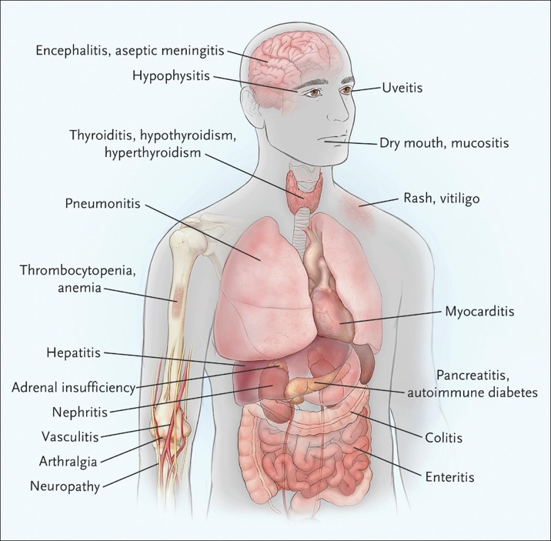
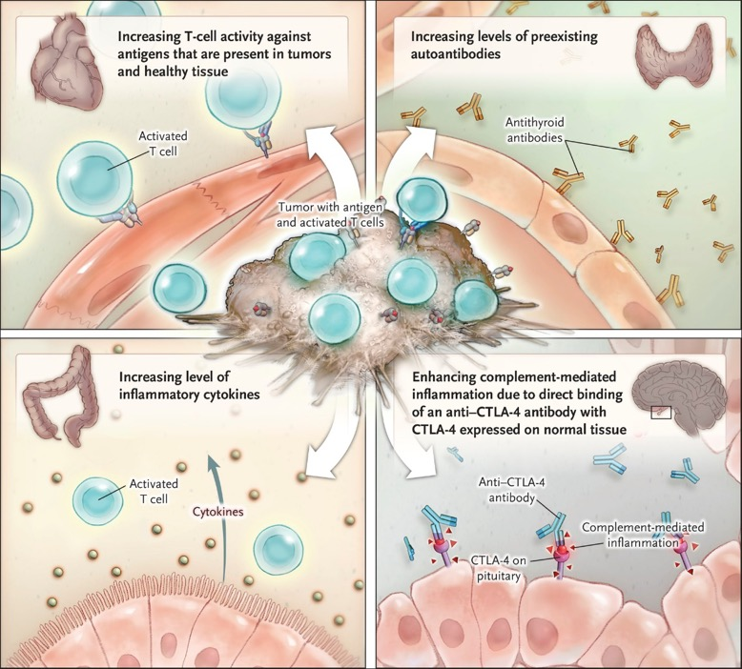
Immune-Related Adverse Events (irAEs) Associated with Immune Checkpoint Blockade

Slide 6
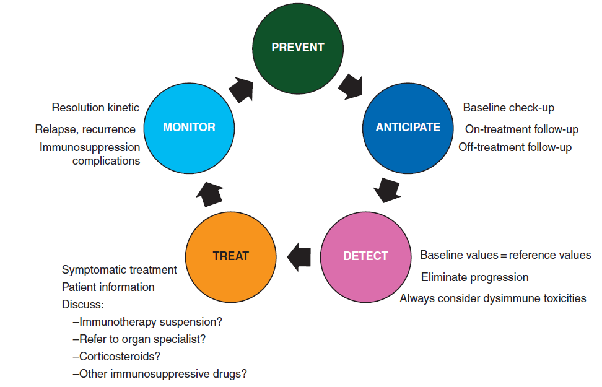
The Pillars of Immunotherapy Toxicity Management
Know the immune toxicity spectrum
Identify Risk factors

Slide 7
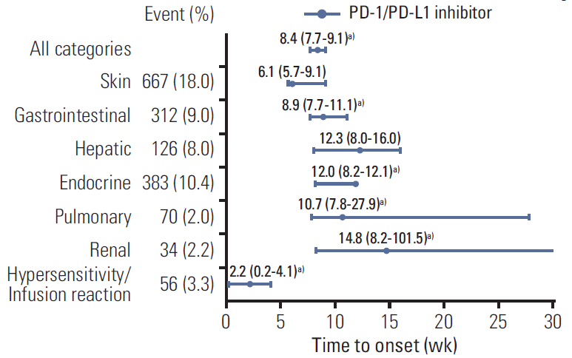
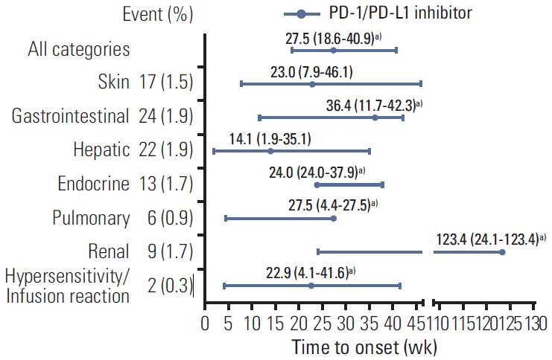
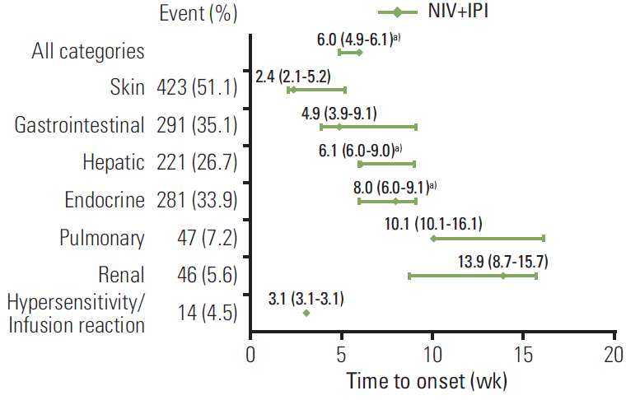
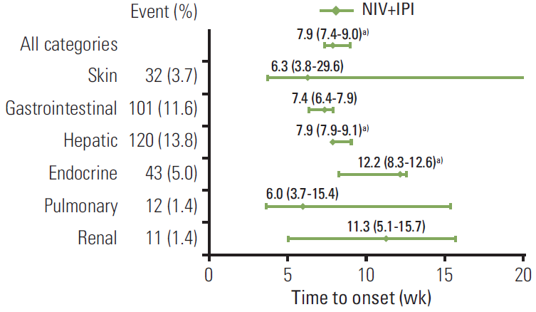
Time to Onset of irAEs is Heterogeneous
All Grade irAEs
Grade ≥ 3 irAEs
PD-1 monotherapy
PD-1 + CTLA-4

Slide 8
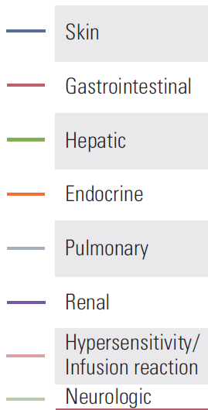
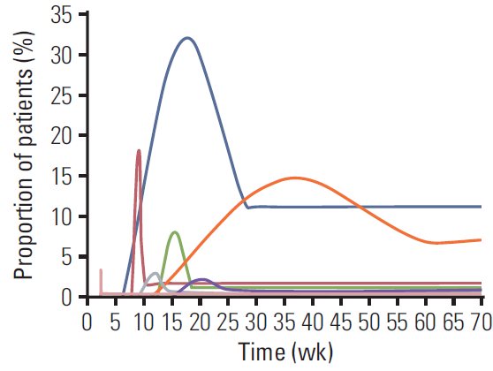
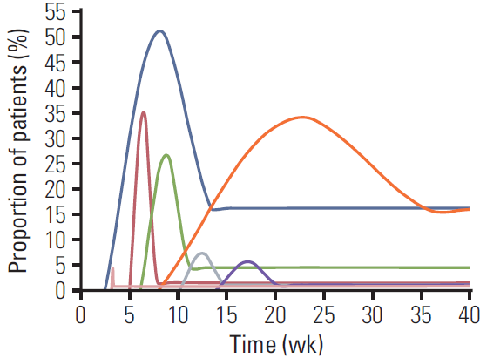
Time to Onset and Resolution of irAE is Heterogeneous
PD-1 monotherapy
PD-1 + CTLA-4
All grades

Slide 9
Frequency of irAEs in Patients Treated with Tremelimumab+Durvalumab+Chemotherapy

Slide 10
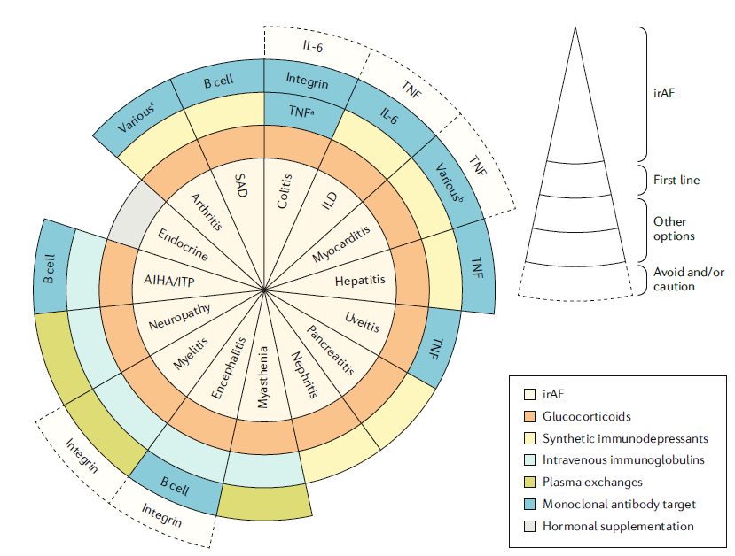
irAE Work-Up and Management Requires Multi-Disciplinary Input
Work-up is organ-dependent and requires assessment of other common etiologies
Can occur days to years after immunotherapy initiation
Fatal toxicities, when they occur, tend to happen early after immunotherapy initiation. Most common:¹
PD-1 monotherapy: pneumonitis (35%), hepatitis (22%), neurotoxic (15%)
PD-1/CTLA-4: colitis (37%), myocarditis (25%)
Initial management similar across irAEs (typically prednisone 1-2 mg/kg), but steroid-refractory irAE treatment varies by organ system
Case-by-case decision to resume immunotherapy
irAE severity, disease status, prognosis, patient/provider preference.

Slide 11
Managing AEs from Immune Checkpoint Inhibitors
Managed in outpatient/community setting
Generally requires hospital admission
Referral to specialist
Strong immune suppressive treatment
Oral steroids Intravenous steroids. ------------>
Steroids (PO/IV): 1-2 mg/kg/d prednisone or equivalent, slow taper over 4-6/52
-----> Intravenous steroids -------->
Increasing intensity of treatment required
Stop treatment * ------------------------------------------------------>
* For some AEs, treatment can be restarted after resolution (eg, rash); CPI generally continued with endocrinopathies once managed
Symptomatic therapy ----------------------------------------------------------------------------->
Grade 1
Grade 2
Grade 3
Grade 4
Mild
Moderate
Severe
Very severe
Increasing grade of AE

Slide 12
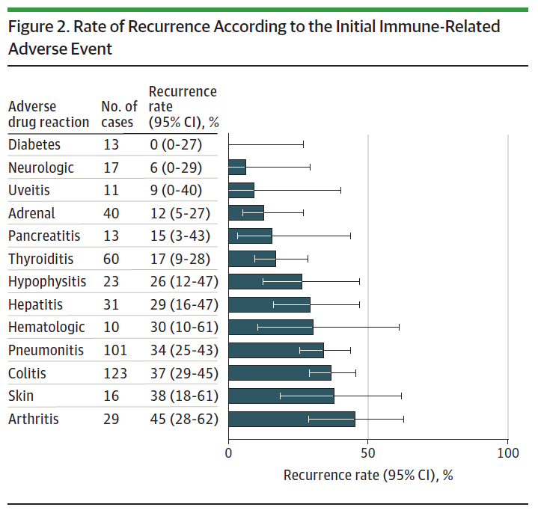
Can I Resume Immunotherapy After Resolution of an irAE?
Important considerations:
Type of irAE
Severity of irAE
Goal/setting of immunotherapy
Neoadjuvant versus adjuvant versus metastatic
Response status to therapy
Patient co-morbidities
Patient goals

Slide 13
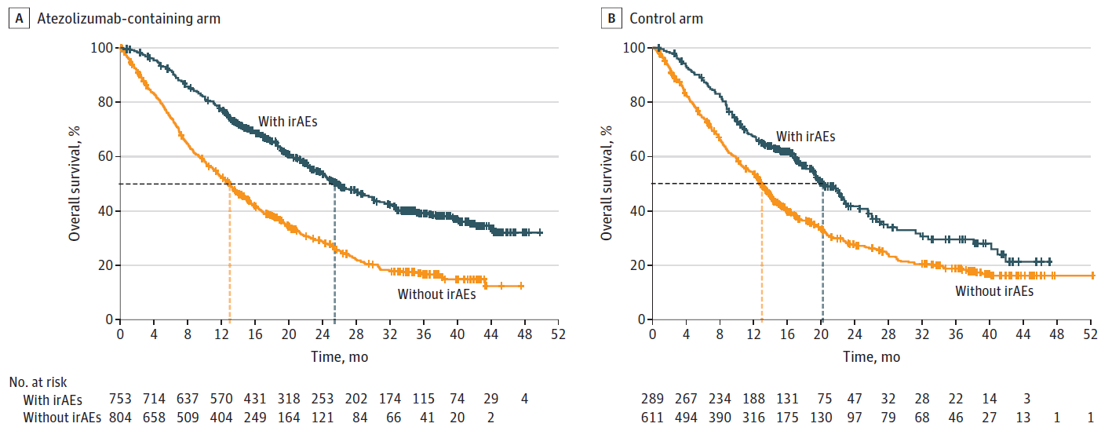
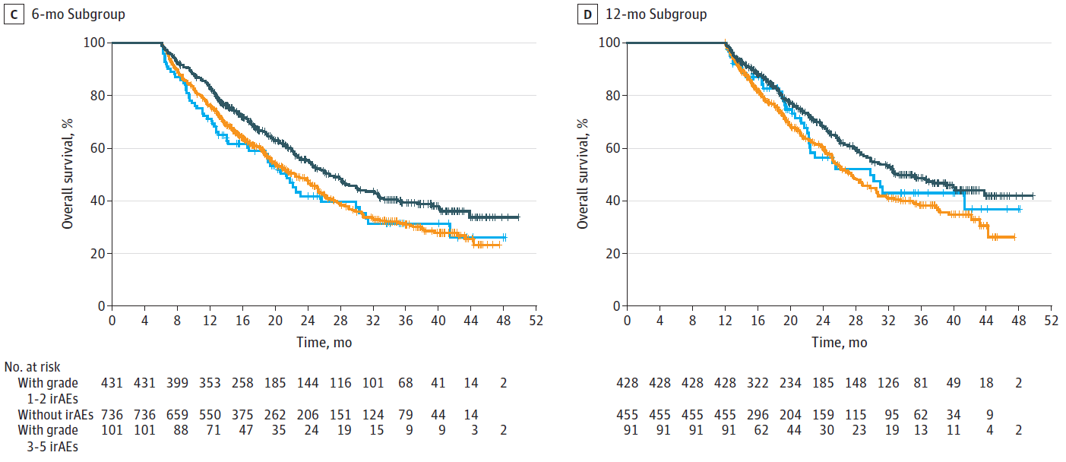
irAEs May Be Associated with Immunotherapy Benefit
Pooled analyses of IMpower130, IMpower132 and IMpower150
mOS 25.7 mo
mOS 20.2 mo
Overall survival according to treatment arm
mOS 13.0 mo
mOS 12.8 mo
Landmark OS by irAE grade in atezolizumab-containing arm

Slide 14
Cases Revisited
Mr. N
Ms. S
Mr. N is a 74yo male with a history of chronic atrial fibrillation on apixaban who is receiving adjuvant anti-PD-1 immunotherapy in sequence following adjuvant chemotherapy for resected stage IIB NSCLC. He presents for cycle #5 of therapy without complaints, but CT imaging reveals new non-specific ground glass opacities of the right middle lobe. In clinic, his vital signs are stable, but he reports a subtle change in dyspnea on exertion over past few weeks.
What is your recommended approach for Mr. N?
Ms. S is a 77yo female with a history of HTN, HLD and DM2 who is currently receiving maintenance therapy with pemetrexed/pembrolizumab for stage IV NSCLC with excellent response. She presents to clinic for unscheduled visit for dyspnea 9 days after receiving her 8th cycle of maintenance therapy. She reports 1 week of worsening DOE and can only walk ~5ft before needing a break. She also reports worsening dry cough. She denies fevers or substernal chest pain. In clinic, she desaturates from 96% to 91% on RA when ambulating 5 feet, and this is associated with dyspnea.
What is your recommended approach for Ms. S?
In the setting of possible worsening dyspnea (Grade 1 vs Grade 2 irAE), immunotherapy was held for pulmonology evaluation. PFTs and 6-min walk test were without significant changes from baseline. His immunotherapy was subsequently resumed without worsening of symptoms.
In the setting of exertional hypoxia (Grade 3 irAE), Ms. S was hospitalized for further work-up. She was CTPA negative for PE but demonstrated worsening diffuse GGOs throughout all 5 lobes of lungs. Cardiac w/u was w/o ECG changes. No BNP or troponin elevation was noted. Infectious work-up was negative. She was started on 1mg/kg methylprednisolone with rapid improvement in symptoms and discharged on prednisone taper.

Slide 15
Additional Case
Mr. L is a 67yo M w/ history of HTN, HLD and DM2 receiving adjuvant atezolizumab after completing 4 cycles of adjuvant cisplatin/pemetrexed chemotherapy for resected stage IIB NSCLC. 2 weeks after receiving his initial cycle of atezolizumab, Mr. L presents to clinic with significant worsening fatigue, DOE and tachycardia. In clinic Mr. L is tachycardic (HR 145). His vital signs are otherwise stable. His labs are significant for new AKI, low-grade anemia, thrombocytopenia and transaminitis. Mr. L is directed to the ER for additional work-up. ECG demonstrates sinus tachycardia incomplete R bundle branch block. CTPA is negative for PE or any new GGOs. Troponin and BNP are WNL. Mr. L. is hospitalized for further work-up.
TTE on admission shows new drop in LVEF to 25-30% with severe global hypokinesis of LV. Cardiac MRI reveals patchy myocardial inflammation diffusely involving the LV myocardium with evidence of pericardial inflammation. Left and right heart catheterization with endomyocardial biopsy reveals stable 3 vessel CAD. Biopsy returns showing lymphohistiocytic infiltration consistent with myocarditis.
What is your recommended treatment approach for Mr. L?

Slide 16
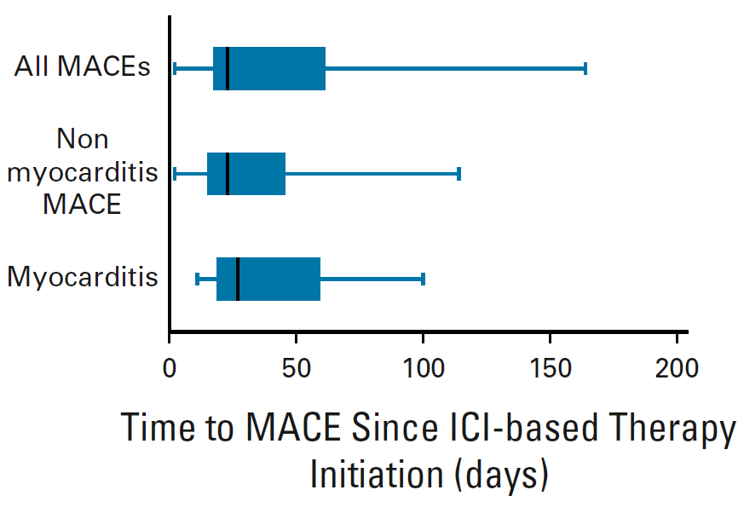
Major Adverse Cardiac Events (MACEs) with Immunotherapy
In pooled clinical trial data, ICI-related MACE occurs in ~0.6% of patients
Majority (78%) high grade
Myocarditis is the most common ICI-related MACE (45%)
Higher incidence with anti-PD(L)1 combination versus single agent anti-PD(L)1, 0.36% vs 0.15%
Can present as triad with myositis and myasthenia gravis

Slide 17
Management of Immune Checkpoint Inhibitor-Related MACE
Myocarditis
Pericarditis/Pericardial Effusion
Discontinue immunotherapy
Management is tailored to response and acuity of presentation
High-dose steroids such as IV methylprednisolone 1 g/day for 3–5 days; if responding and stable, switch to oral prednisone and taper slowly
If no improvement within 24–48 hours on steroids, consider further interventions:
Abatacept
Mycophenolate
Intravenous immunoglobulin (IVIG)
Alemtuzumab
Infliximab (use with extreme caution in patients with reduced left ventricular ejection fraction [LVEF])
Antithymocyte globulin (ATG)
Plasmapheresis
ICU-level monitoring
Temporary or permanent pacing as required
Consider myocarditis as a contributor
If myocarditis is not present, manage as per usual recommendations

Slide 18
Additional Case - Revisited
Mr. L is a 67yo M w/ history of HTN, HLD and DM2 receiving adjuvant atezolizumab after completing 4 cycles of adjuvant cisplatin/pemetrexed chemotherapy for resected stage IIB NSCLC. 2 weeks after receiving his initial cycle of atezolizumab, Mr. L presents to clinic with significant worsening fatigue, DOE and tachycardia. In clinic Mr. L is tachycardic (HR 145). His vital signs are otherwise stable. His labs are significant for new AKI, low-grade anemia, thrombocytopenia and transaminitis. Mr. L is directed to the ER for additional work-up. ECG demonstrates sinus tachycardia incomplete R bundle branch block. CTPA is negative for PE or any new GGOs. Troponin and BNP are WNL. Mr. L. is hospitalized for further work-up.
TTE on admission shows new drop in LVEF to 25-30% with severe global hypokinesis of LV. Cardiac MRI reveals patchy myocardial inflammation diffusely involving the LV myocardium with evidence of pericardial inflammation. Left and right heart catheterization with endomyocardial biopsy reveals stable 3 vessel CAD. Biopsy returns showing lymphohistiocytic infiltration consistent with myocarditis.
What is your recommended treatment approach for Mr. L?
Following TTE and before cardiac MRI or cardiac biopsy, he was started on empiric 1g/day methylprednisolone in close consultation with cardiology. Following cardiac MRI results, given stability, he was transitioned to 1mg/kg BID methylprednisolone and ultimately to 1 mg/kg/d methylprednisolone. He was discharged on prednisone taper, and his cardiac function ultimately returned to baseline. Atezolizumab was permanently discontinued.

Slide 19
Summary
Immune-related adverse events can affect any organ system and any time after administration of immunotherapy
Close surveillance for emergence of irAEs is important in order to institute prompt management
For severe and complicated irAEs, multi-disciplinary input is critical
A decision as to whether or not to resume immunotherapy after an irAE is complex. Factors such as severity of toxicity, clinical benefit of therapy, setting of therapy (metastatic vs (neo)adjuvant), patient co-morbidities and patient/provider preference should be considered

Slide 20
Looking for more resources on this topic?
CME/CE in minutes
Congress highlights
Late-breaking data
Quizzes
Webinars
In-person events
Slides & resources
www.MedEdOTG.com

