Slide 1
Case 5: Is There a Role for Immunotherapy-Based Therapy in KRAS-Mutated NSCLC? What About in Patients with Co-Mutations in STK11 or KEAP1?
Joshua E. Reuss, MD
Thoracic Medical Oncologist
Assistant Professor of Medicine
Georgetown University School of Medicine
Washington, DC

Slide 2



Resource Information
About This Resource
These slides are one component of a continuing education program available online at MedEd On The Go titled NSCLC Case by Case: Optimizing 1L Immunotherapy for Advanced & Metastatic Disease
Program Learning Objectives:
Select optimal frontline treatment strategies for patients with advanced non-small cell lung cancer without actionable driver alterations by incorporating treatment-specific and patient-related characteristics
Implement evidence-based strategies to monitor and mitigate immune-related adverse events to optimize treatment adherence and patient outcomes
MedEd On The Go®
www.mededonthego.com
This content or portions thereof may not be published, posted online or used in presentations without permission.
This content can be saved for personal use (non-commercial use only) with credit given to the resource authors.
To contact us regarding inaccuracies, omissions or permissions please email us at support@MedEdOTG.com

Slide 3
Disclaimer
The views and opinions expressed in this educational activity are those of the faculty and do not necessarily represent the views of Total CME, LLC, the CME providers, or the companies providing educational grants. This presentation is not intended to define an exclusive course of patient management; the participant should use their clinical judgment, knowledge, experience, and diagnostic skills in applying or adopting for professional use any of the information provided herein. Any procedures, medications, or other courses of diagnosis or treatment discussed or suggested in this activity should not be used by clinicians without evaluation of their patient's conditions and possible contraindications or dangers in use, review of any applicable manufacturer’s product information, and comparison with recommendations of other authorities. Links to other sites may be provided as additional sources of information.

Slide 4
Case Example
Mr. M is a 60-year-old male with a history of BPH and prior tobacco abuse who presents to your clinic.
He was originally diagnosed with a stage IIB poorly differentiated NSCLC for which he underwent RLL lobectomy followed by adjuvant cisplatin/pemetrexed chemotherapy in 7/2021.
In 2/2022 imaging showed recurrent enlarged mediastinal lymph nodes and multiple enlarged liver lesions.
Liver biopsy was positive for poorly differentiated NSCLC.
MRI brain was negative for intracranial disease.
NGS reveals mutations in KRAS, KEAP1 and TP53, PD-L1 0%, TMB 7 mut/Mb.
He is asymptomatic from the recurrence and is actively working.
What is your recommended treatment approach for Mr. M?

Slide 5
Systemic Therapy for KRAS-Mutated NSCLC Should Follow the Guidelines for 1L Therapy Without Actionable Driver Mutation
First-Line Therapy
Subsequent Therapy
Systemic Therapy in KRASm (including KRAS G12C) NSCLC
By histology: Immunotherapy Chemoimmunotherapy Dual-immunotherapy
Response or Stable Disease
Maintenance therapy with immunotherapy, chemotherapy, or dual-immunotherapy based upon: Previous therapy Histology PS 0-2 PS 3-4 Best supportive care
KRAS G12C NSCLC
KRAS G12C targeted therapy: Sotorasib Adagrasib
Progressive Disease
Immunotherapy, chemotherapy, or dual-immunotherapy based upon: Previous therapy, histology PS 0-2 PS 3-4 best supportive care

Slide 6
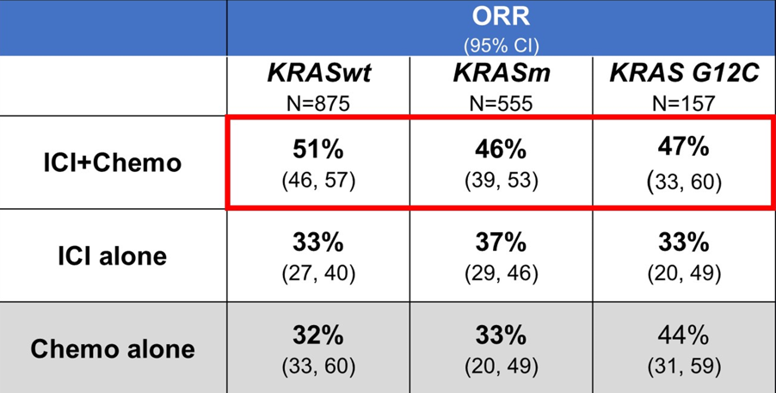
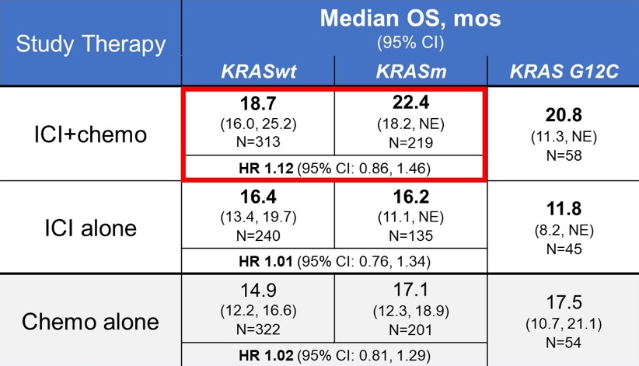
Patients with KRAS-Mutated NSCLC Respond to Frontline IO-Based Therapy
FDA analysis of 1L therapy trial outcomes according to KRAS mutation status

Slide 7
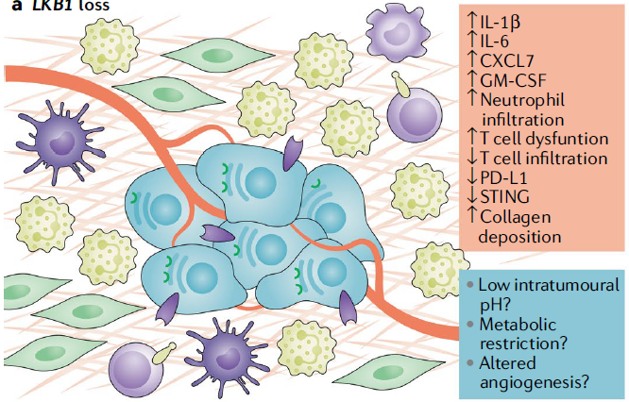
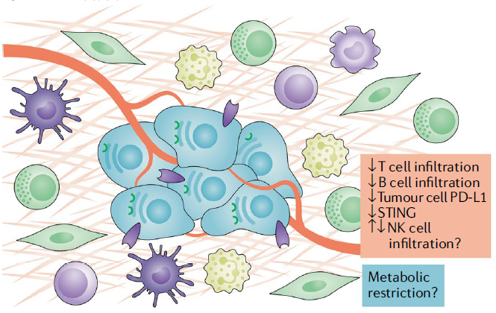
Do Additional Mutations Impact IO Efficacy in Driver Mutation-Negative NSCLC?
STK11/LKB1
KEAP1

Slide 8
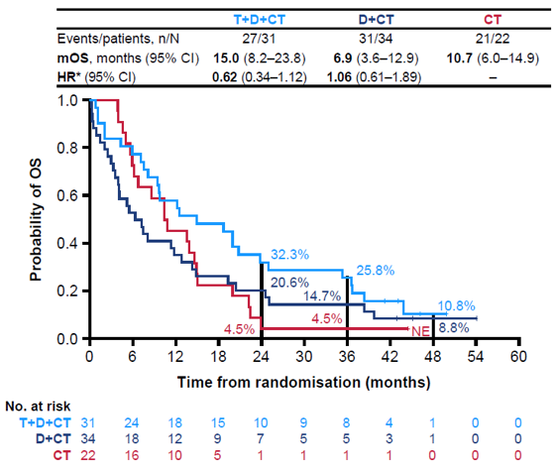
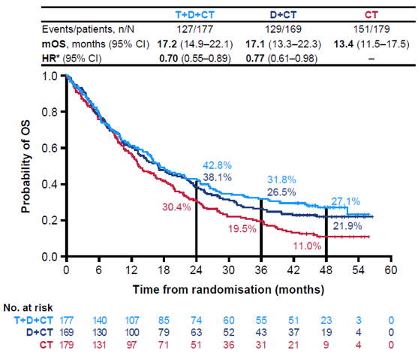
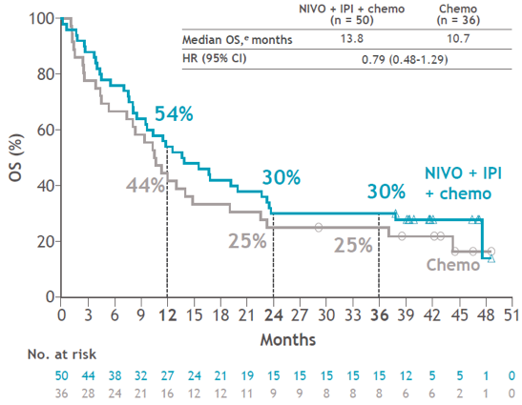
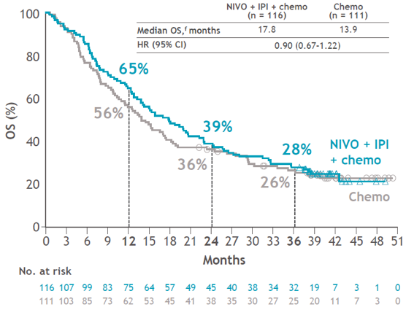
Do Additional Mutations Impact IO Efficacy in Driver Mutation-Negative NSCLC – STK11
STK11-mut
STK11-wt
POSEIDON¹
CheckMate 9LA²

Slide 9
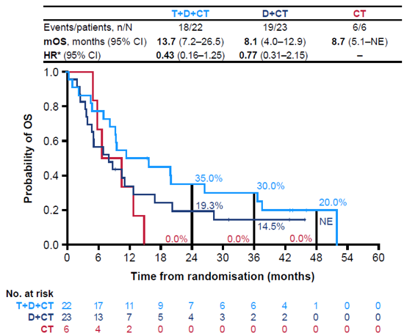
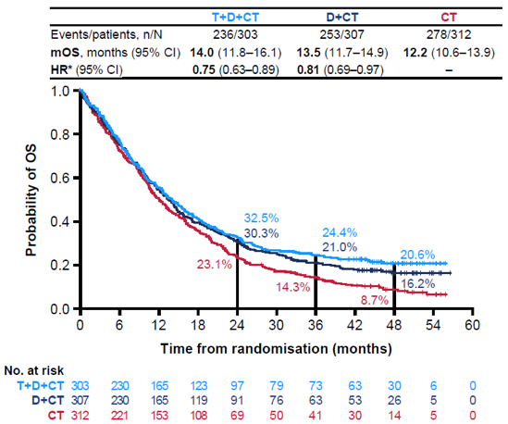
Do Additional Mutations Impact IO Efficacy in Driver Mutation-Negative NSCLC – KEAP1
KEAP1-mut
KEAP1-wt
POSEIDON¹
 | KEAP1-mut |  | KEAP1-wt
Outcomes | Nivo/Ipi + CT (2-cycles) (n=16) | Chemotherapy (CT) (n=16) | Nivo/Ipi + CT (2-cycles) (n=150) | Chemotherapy (CT) (n=131)
Median OS, months (95% CI) | 13.2 (6.6-22.7) | 5.0 (2.8-9.8) | 16.8 (13.2-20.5) | 14.1 (11.4-17.4)
HR (95% CI) | 0.51 (0.24-1.08) |  | 0.94 (0.71-1.23)
CheckMate 9LA²

Slide 10
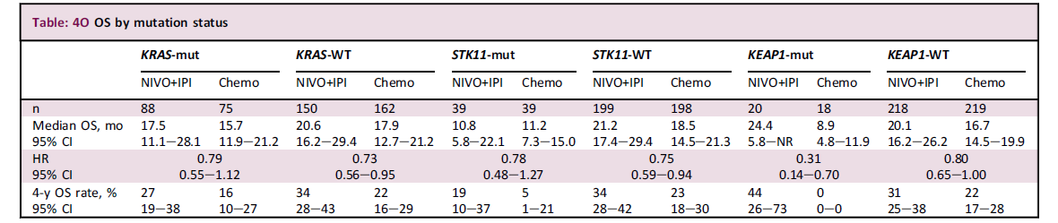
Survival Benefit with First-Line Nivolumab + Ipilimumab in Advanced NSCLC Regardless of KRAS, STK11, and KEAP1 Mutation Status

Slide 11
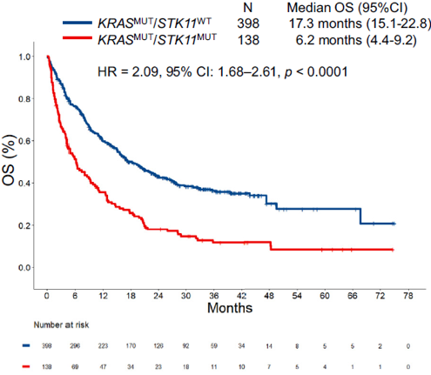
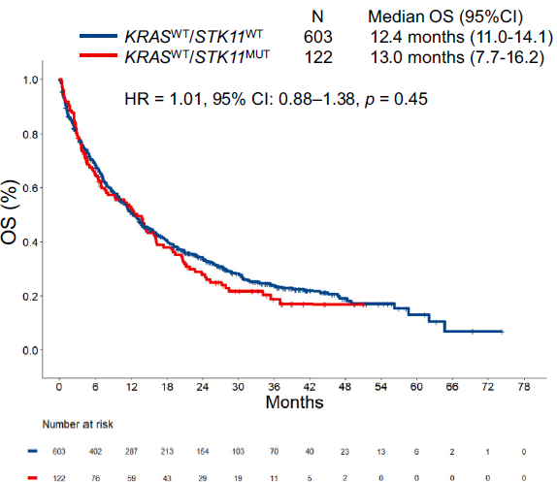
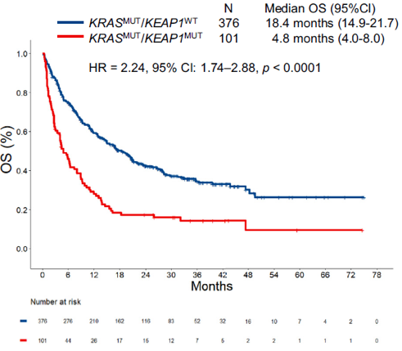
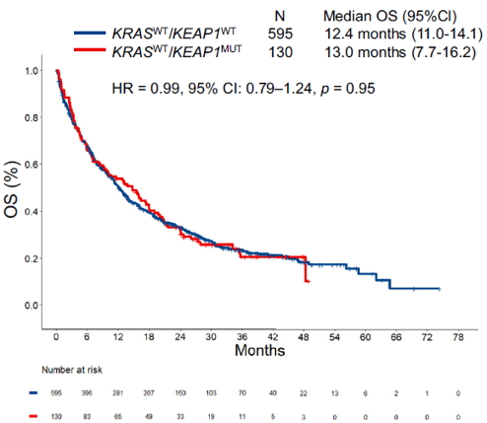
Do Additional Mutations Impact IO Efficacy in Driver Mutation-Negative NSCLC – Does KRAS Status Matter?
KRASmut
KRASwt
STK11
KEAP1

Slide 12
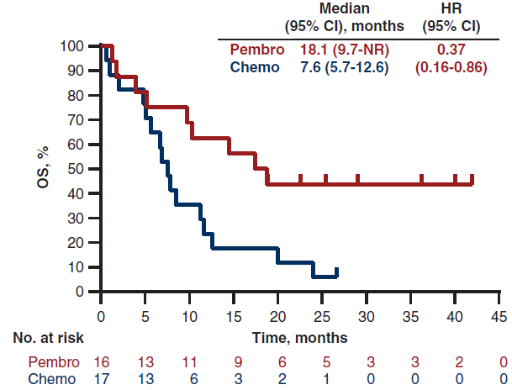
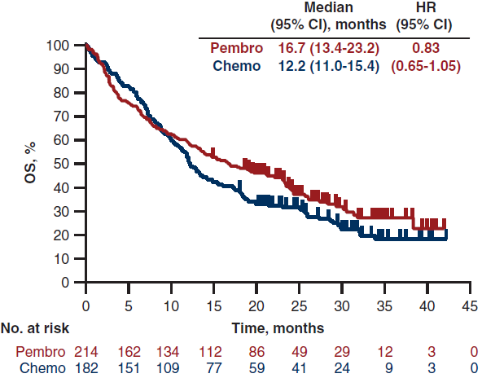
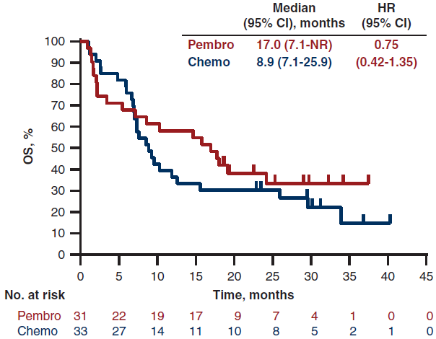
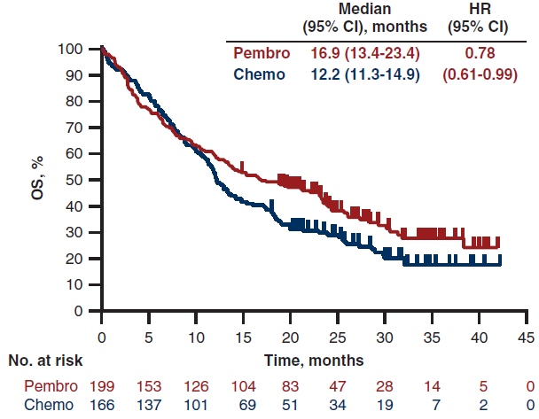
Do Additional Mutations Impact IO Efficacy in Driver Mutation-Negative NSCLC – Data Are Mixed?
Mutated
Wild-Type
STK11
KEAP1

Slide 13
Summary
Patients with NSCLC who have a mutation in KRAS and no other known driver alterations should be treated with a frontline therapy strategy that incorporates immunotherapy +/- chemotherapy
Emerging evidence suggests certain molecular alterations, such as STK11 and KEAP1, may impact the efficacy of anti-PD(L)1-based treatments in advanced NSCLC
Prospective randomized data are needed to determine the best treatment strategy for patients who harbor a mutation in STK11 or KEAP1

Slide 14
Case Example - Revisited
Mr. M is a 60-year-old male with a history of BPH and prior tobacco abuse who presents to your clinic
He was originally diagnosed with a stage IIB poorly differentiated NSCLC for which he underwent RLL lobectomy followed by adjuvant cisplatin/pemetrexed chemotherapy in 7/2021
In 2/2022 imaging showed recurrent enlarged mediastinal lymph nodes and multiple enlarged liver lesions
Liver biopsy was positive for poorly differentiated NSCLC.
MRI brain was negative for intracranial disease
NGS reveals mutations in KRAS, KEAP1 and TP53, PD-L1 0%, TMB 7 mut/Mb
He is asymptomatic from the recurrence and is actively working
What is your recommended treatment approach for Mr. M?

Slide 15
Case Example - Revisited
Mr. M is a 60-year-old male with a history of BPH and prior tobacco abuse who presents to your clinic
He was originally diagnosed with a stage IIB poorly differentiated NSCLC for which he underwent RLL lobectomy followed by adjuvant cisplatin/pemetrexed chemotherapy in 7/2021
In 2/2022 imaging showed recurrent enlarged mediastinal lymph nodes and multiple enlarged liver lesions
Liver biopsy was positive for poorly differentiated NSCLC.
MRI brain was negative for intracranial disease
NGS reveals mutations in KRAS, KEAP1 and TP53, PD-L1 0%, TMB 7 mut/Mb
He is asymptomatic from the recurrence and is actively working
What is your recommended treatment approach for Mr. M?
Mr. M was started on a CM-9LA regimen of nivolumab/ipilimumab + 2 cycles of carboplatin/paclitaxel. He experienced progression after 4 months on therapy and has since received investigational treatment in clinical trials.

Slide 16



Looking for more resources on this topic?
CME/CE in minutes
Congress highlights
Late-breaking data
Quizzes
Webinars
In-person events
Slides & resources
www.MedEdOTG.com

