Slide 1
Case 3: In a PD-L1 Negative Patient, Is There Any Benefit to Using Single Agent IO/Chemotherapy or Dual Agent IO/ Chemotherapy?
Charu Aggarwal, MD, MPH
University of Pennsylvania Perelman School of Medicine
Philadelphia, PA

Slide 2



Resource Information
About This Resource
These slides are one component of a continuing education program available online at MedEd On The Go titled NSCLC Case by Case: Optimizing 1L Immunotherapy for Advanced & Metastatic Disease
Program Learning Objectives:
Select optimal frontline treatment strategies for patients with advanced non-small cell lung cancer without actionable driver alterations by incorporating treatment-specific and patient-related characteristics
Implement evidence-based strategies to monitor and mitigate immune-related adverse events to optimize treatment adherence and patient outcomes
MedEd On The Go®
www.mededonthego.com
This content or portions thereof may not be published, posted online or used in presentations without permission.
This content can be saved for personal use (non-commercial use only) with credit given to the resource authors.
To contact us regarding inaccuracies, omissions or permissions please email us at support@MedEdOTG.com

Slide 3
Disclaimer
The views and opinions expressed in this educational activity are those of the faculty and do not necessarily represent the views of Total CME, LLC, the CME providers, or the companies providing educational grants. This presentation is not intended to define an exclusive course of patient management; the participant should use their clinical judgment, knowledge, experience, and diagnostic skills in applying or adopting for professional use any of the information provided herein. Any procedures, medications, or other courses of diagnosis or treatment discussed or suggested in this activity should not be used by clinicians without evaluation of their patient's conditions and possible contraindications or dangers in use, review of any applicable manufacturer’s product information, and comparison with recommendations of other authorities. Links to other sites may be provided as additional sources of information.

Slide 4
Case 3
Patient is a 65-year-old male with significant smoking history
Underwent screening CT of the chest that revealed a large hilar lung mass, with multiple lung nodules in both lungs
PET CT confirmed presence of uptake in hilar mass, LNs, adrenal
MRI brain NED
Bx reveals squamous cell cancer
PD-L1 0%
What should he receive?

Slide 5
First-Line Therapy Recommendations (Category 1) for Advanced/Metastatic NSCLC with PD-L1 <1% and Negative for Actionable Molecular Markers
ADENOCARCINOMA (PS 0-1)
Pembrolizumab + pemetrexed + (carboplatin or cisplatin)*
Atezolizumab + carboplatin + paclitaxel + bevacizumab
Nivolumab + ipilimumab + pemetrexed + (carboplatin or cisplatin)
Cemiplimab-rwlc + paclitaxel + (carboplatin or cisplatin)
Cemiplimab-rwlc + pemetrexed + (carboplatin or cisplatin)
Useful in Certain Circumstances
Bevacizumab + carboplatin + paclitaxel
Carboplatin + albumin-bound paclitaxel
Carboplatin + (docetaxel or etoposide or paclitaxel or gemcitabine or pemetrexed)
Cisplatin + (docetaxel or etoposide or gemcitabine or paclitaxel or pemetrexed)
Gemcitabine + (docetaxel or vinorelbine)

Slide 6
First-Line Therapy Recommendations (Category 1) for Advanced/Metastatic NSCLC with PD-L1 <1% and Negative for Actionable Molecular Markers
SQUAMOUS CELL CARCINOMA (PS 0-1)
Useful in Certain Circumstances
Pembrolizumab + carboplatin + (paclitaxel or albumin-bound paclitaxel)*
Nivolumab + ipilimumab + paclitaxel + carboplatin
Cemiplimab-rwlc + paclitaxel + (carboplatin or cisplatin)
Carboplatin + albumin-bound paclitaxel
Carboplatin + (docetaxel or gemcitabine or paclitaxel)
Cisplatin + (docetaxel or etoposide or gemcitabine or paclitaxel)
Gemcitabine + (docetaxel or vinorelbine)

Slide 7
Immunotherapy Options for Advanced NSCLC with PD-L1 Expression <1% (NCCN Cat 1)⁷
Regimen Trial NCCN status | IPI/NIVO+CT CHECKMATE 9LA¹ n=204 NCCN Cat 1 | PEM+PC(AD) KEYNOTE 021² N=39 NCCN Cat 1 Preferred | PEM+PC(AD) KEYNOTE - 189ᶟ n=128 NCCN Cat 1 Preferred | PEM+CP(SQ) KEYNOTE 407⁴ n=103 NCCN Cat 1 Preferred | ATEZO+BCP IMpower 150⁵ n=359 NCCN Cat 1 AD only | CEM+CT EMPOWER -Lung 3⁶ n-114 NCCN Cat 1
PD-L1% parameter | TPS < 1 % ‡ | TPS< 1 % ᵠ | TPS < 1% ᵠ | TPS < 1 % ᵠ | TC/IC 0-3†ˠ | TPS < 1 %ˠ
ORR,% | 43% | 33% | 33.10% | 67.40% | 55%* | 33.7%
Median DoR, mo | 17.5 | 33.1 | 10.8 | 6.9 | 10.8* | 16.4*
Median PFS, mo | 5.8 (HR:0.69) | 24 .5 (HR:0.35) | 6.2 (HR:0.67) | 6.3 (HR: 0.70) | 8.5 (HR: 0.71)* | 6.2 (HR:0.73)
Median OS, mo | 17.7 (HR:0.67) | 34.5 (HR:0.54) | 17.2 (HR:0.55) | 15.0 (HR:0.83) | 19.2 (HR:0.78)* 18.6 (HR:0.82) PD-L1 TPS < 1 % | 12.8 (HR: 0.94)
*Value represents all PD-L1 subtypes combined; ᵠBy PD-L1 22C3 assay; †By PD-L1 SP142 IHC assay; ‡By PD-L1 28-8 IHC assay; ˠ By PD-L1 SP263 IHC assay.
AD, adenocarcinoma; Atezo, atezolizumab; BCP, bevacizumab + carboplatin + paclitaxel; cat, category; CEM, cemiplimab; CP, paclitaxel/nab paclitaxel, carboplatin; CT, chemotherapy; DoR, duration of response; DURV, durvalumab; HR, hazard ratio; IC, immune cells; IPI, ipilimumab; mo, month; NCCN, National Comprehensive Cancer Network; NIVO, nivolumab; NR, not reported; OS, overall survival; ORR, objective response rate; PC, pemetrexed/carboplatin; PEM, pembrolizumab; PFS, progression-free survival; SC, squamous cell; TC, tumor cells; TPS, tumor proportion score; TREM, tremelimumab.
1. Paz-Ares LG, et al. J Thorac Oncol. 2023;18:204-22; 2. Awad MM, et al. J Thorac Oncol. 2021;16:162-8; 3. Garassino MC, et al. J Clin Oncol. 2023;41:1992-8; 4. Novello S,
et al. J Clin Oncol. 2023; 41:1999-2006; 5. Socinski MA, et al. J Thorac Oncol. 2021;16:1909-24; 6. Makharadze T, et al. J Thorac Oncol. 2023;18:755-68; 7. National Comprehensive Cancer Network. Non-Small Cell Lung Cancer (Version 3.2023).

Slide 8
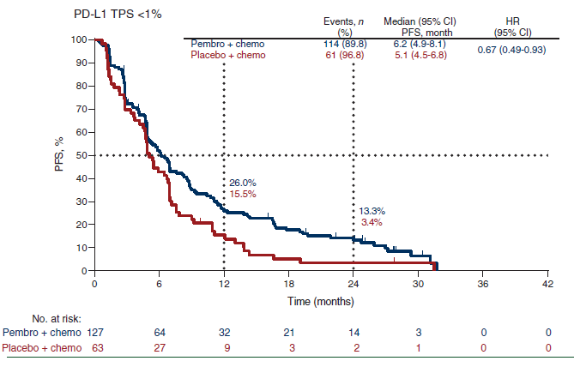
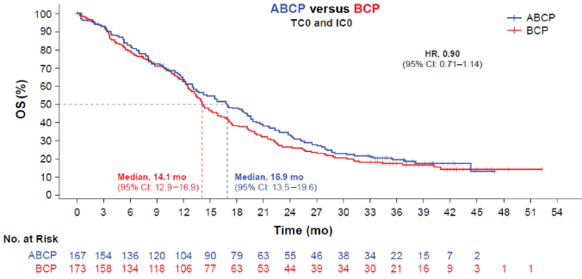
1L Chemo-IO Combinations for Advanced Nonsquamous NSCLC with PD-L1 Negative Expression
KEYNOTE-189¹
IMpower150²
OS: PD-L1 Negative (TC0 and IC0)

Slide 9
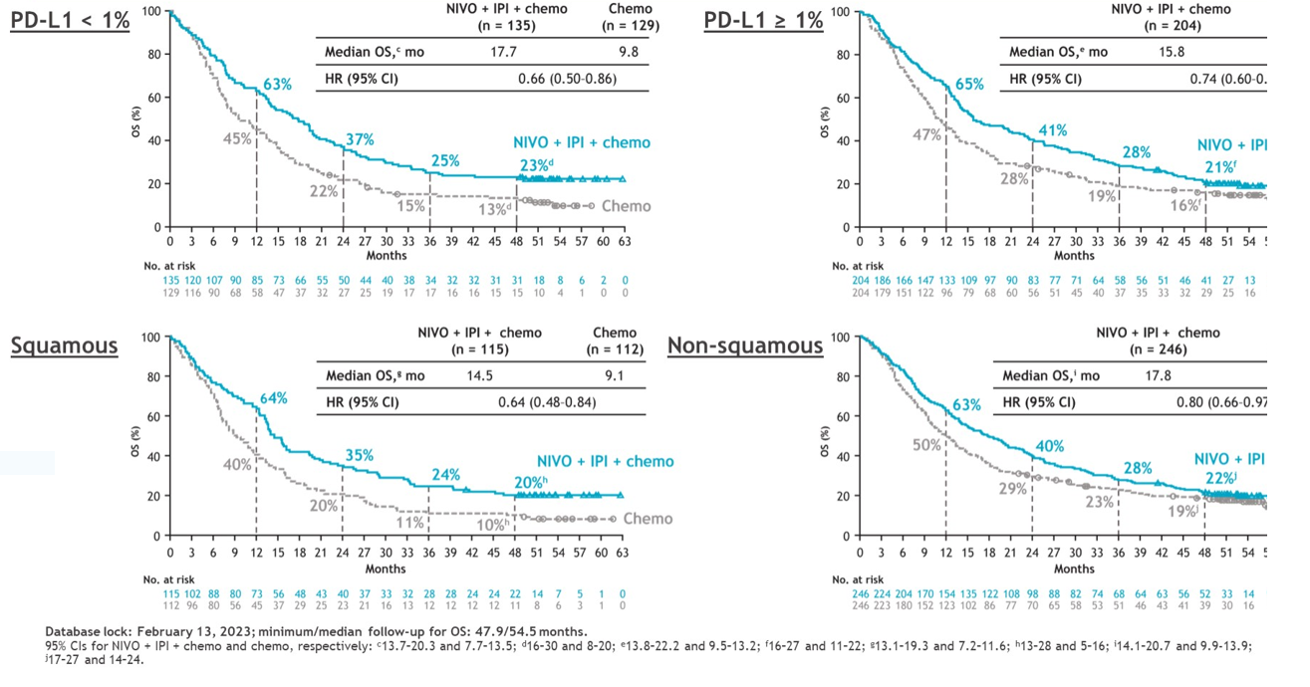
CheckMate 9LA 4-Year Update: OS by Tumor PD-L1 Expression and Histology
Reck M, et al. ASCO 2020. Abstract 9501.

Slide 10
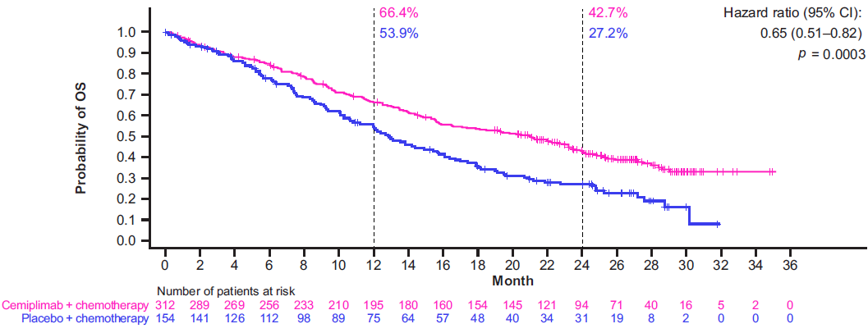
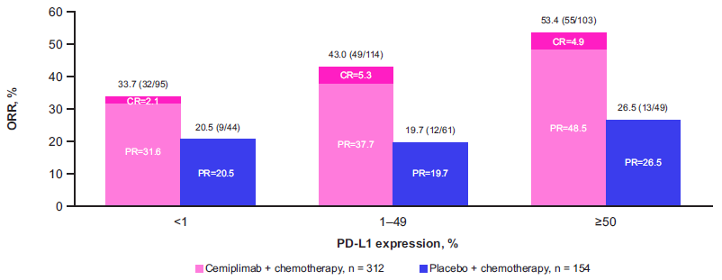
Cemiplimab ± Chemotherapy for NSCLC: EMPOWER-Lung 3
All patients (N=466)

Slide 11
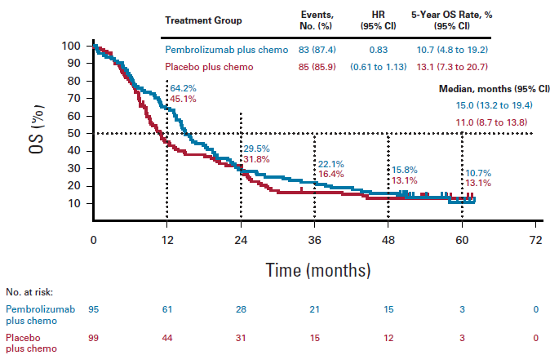
Pembrolizumab + Chemotherapy Results: KEYNOTE 407 5-Year Update (PD-L1 <1%)
Outcomes | Pembrolizumab + CT (n=95) | Chemotherapy (n=99)
ORR, % (95% CI) | 67.4 (57.0-76.6) | 41.4 (31.6-51.8)
mDOR, mo. (range) | 6.9 (1.4+ to 58.9+) | 5.7 (1.4+ to 55.8+)

Slide 12
Summary
Dual immunotherapy therapy is not currently approved
Quadruplet therapy may be considered
No role for single agent immunotherapy

Slide 13
Case 3
Patient is a 65-year-old male with significant smoking history
Underwent screening CT of the chest that revealed a large hilar lung mass, with multiple lung nodules in both lungs
PET CT confirmed presence of uptake in hilar mass, LNs, adrenal
MRI brain NED
Bx reveals Squamous Cell Cancer
PD-L1 0%
What should he receive?

Slide 14



Looking for more resources
on this topic?
CME/CE in minutes
Congress highlights
Late-breaking data
Quizzes
Webinars
In-person events
Slides & resources
www.MedEdOTG.com

