Slide 1
Case 2: In a Patient with PD-L1 1% to 49%, Should I Use Single Agent IO or Combination IO?
Charu Aggarwal, MD, MPH
University of Pennsylvania Perelman School of Medicine
Philadelphia, PA

Slide 2



Resource Information
About This Resource
These slides are one component of a continuing education program available online at MedEd On The Go titled NSCLC Case by Case: Optimizing 1L Immunotherapy for Advanced & Metastatic Disease
Program Learning Objectives:
Select optimal frontline treatment strategies for patients with advanced non-small cell lung cancer without actionable driver alterations by incorporating treatment-specific and patient-related characteristics
Implement evidence-based strategies to monitor and mitigate immune-related adverse events to optimize treatment adherence and patient outcomes
MedEd On The Go®
www.mededonthego.com
This content or portions thereof may not be published, posted online or used in presentations without permission.
This content can be saved for personal use (non-commercial use only) with credit given to the resource authors.
To contact us regarding inaccuracies, omissions or permissions please email us at support@MedEdOTG.com

Slide 3
Disclaimer
The views and opinions expressed in this educational activity are those of the faculty and do not necessarily represent the views of Total CME, LLC, the CME providers, or the companies providing educational grants. This presentation is not intended to define an exclusive course of patient management; the participant should use their clinical judgment, knowledge, experience, and diagnostic skills in applying or adopting for professional use any of the information provided herein. Any procedures, medications, or other courses of diagnosis or treatment discussed or suggested in this activity should not be used by clinicians without evaluation of their patient's conditions and possible contraindications or dangers in use, review of any applicable manufacturer’s product information, and comparison with recommendations of other authorities. Links to other sites may be provided as additional sources of information.

Slide 4
Case 2
Patient is a 70-year-old female who had a fall and went to the ER
Brain MRI revealed multiple brain mets, and CT chest showed a RUL lung mass, mediastinal LAD and liver mets
PET CT confirmed metastatic disease
Biopsy reveals adenocarcinoma, PD-L1 2%
TP53 mutant, no actionable alterations
SRS is performed
What should she receive?

Slide 5
Case 2
How should this patient be managed?
Chemotherapy alone?
Immunotherapy alone?
Chemo + immunotherapy?
Chemo + immunotherapy doublet?

Slide 6
Chemotherapy alone is NOT standard of care

Slide 7
First-Line Therapy Recommendations (Category 1) for Advanced/Metastatic NSCLC with PD-L1 ≥1% to 49%
ADENOCARCINOMA
SQUAMOUS CELL CARCINOMA
Pembrolizumab + pemetrexed + (carboplatin or cisplatin)* - KEYNOTE-189; KEYNOTE-021)
Atezolizumab + bevacizumab + carboplatin + paclitaxel – IMpower150
Nivolumab + ipilimumab + pemetrexed + (carboplatin or cisplatin) - CheckMate 9LA
Nivolumab + ipilimumab - CheckMate 227
Cemiplimab-rwlc + paclitaxel + (carboplatin or cisplatin) - EMPOWER-Lung 3
Cemiplimab-rwlc + pemetrexed + (carboplatin or cisplatin – EMPOWER-Lung 3
Tremelimumab-actl + durvalumab + carboplatin + nab-paclitaxel – POSEIDON
Tremelimumab-actl + durvalumab + (carboplatin or cisplatin) + pemetrexed - POSEIDON
Pembrolizumab + carboplatin + (paclitaxel or nab-paclitaxel) – KEYNOTE-407*
Nivolumab + ipilimumab + paclitaxel + carboplatin (CheckMate 9LA)
Nivolumab + ipilimumab – CheckMate 227
Cemiplimab-rwlc + paclitaxel + (carboplatin or cisplatin) – EMPOWER-Lung 3

Slide 8
Immunotherapy Options for Advanced NSCLC with PD-L1 Expression ≥1% or ≥1% to 49% (NCCN Cat 1)⁹
Regimen Trial NCCN status | IPI/NIVO CHECKMATE 227¹ n=396 NCCN Cat 1 | IPI/NIVO+CT CHECKMATE 9LA² n=204 NCCN Cat 1 | PEM+PC(AD) KEYNOTE-021ᶟ N=39 NCCN Cat 1 Preferred | PEM+PC(AD) KEYNOTE-189⁴ n=128 NCCN Cat 1 Preferred | PEM+CP(SC) KEYNOTE-407⁵ n=103 NCCN Cat 1 Preferred | ATEZO+BCP IMpower 150⁶ n=359 NCCN Cat 1 AD only | CEM+CT EMPOWER-Lung 3⁷ n-114 NCCN Cat 1 | TREM/DURV+CT POSEIDON⁸ n=338 NCCN Cat 1 AD only
PD-L1% parameter | TPS ≥ 1 % ‡ | TPS ≥ 1 % ‡ | TPS ≥ 1 % ᵠ | TPS ≥ 1 % - 49% ᵠ | TPS ≥ 1 % - 49% ᵠ | TC/IC 0-3 †ˠ | TPS ≥ 1 % - 49%ˠ | TC 1-2 ˠ
ORR,% | 36% | 86% | 61% | 50% | 54.40% | 55%* | 43.0% | 38.8%
Median DoR, mo | 24.5 | 11.3 | NR | 13.6 | 11.1 | 10.8* | 16.4* | 9.5
Median PFS, mo | 5.1 (HR: 0.79) | 8.9 (HR: 0.71) | 16.6 (HR:0.7) | 9.40 (HR:0.57) | 8.2 (HR: 0.60) | 8.5 (HR: 0.71)* | 8.2 (HR: 0.48) | 6.2 (HR:0.72)
Median OS, mo | 17.1 (HR: 0.77) | 15.8 (HR:0.74) | 40.9 (HR:0.84) | 21.8 (HR:0.65) | 18.0 (HR 0.61) | 19.2 (HR:0.78)* 18.9 (HR:0.69) PD-L1 TPS ≥ 1 % | 23.2 (HR: 0.50) | 14 (HR:0.77)

Slide 9
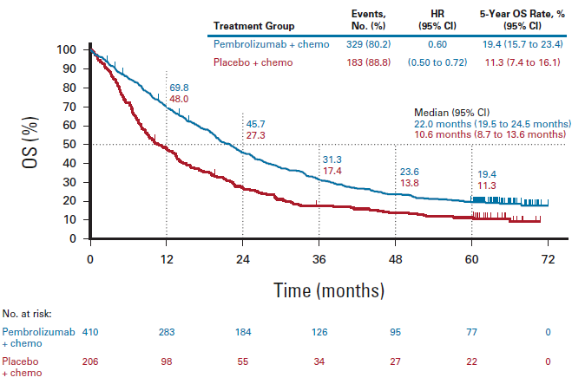
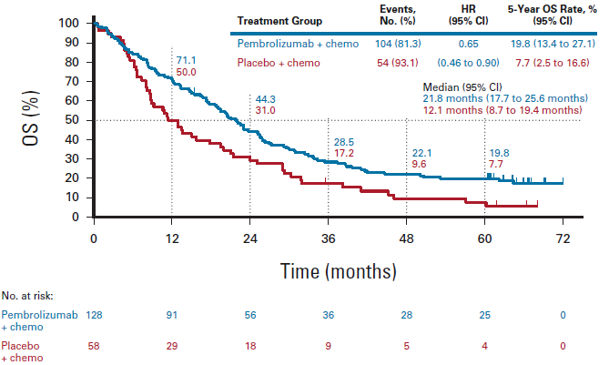
KEYNOTE-189: 5-Year Outcomes
ITT
PD-L1 TPS 1%-49%

Slide 10
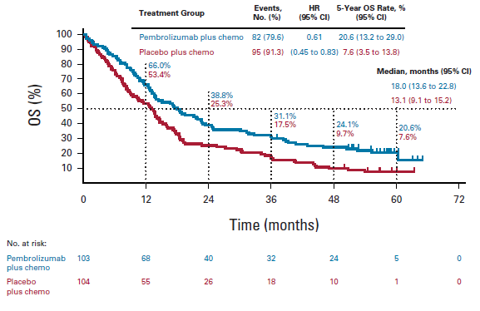
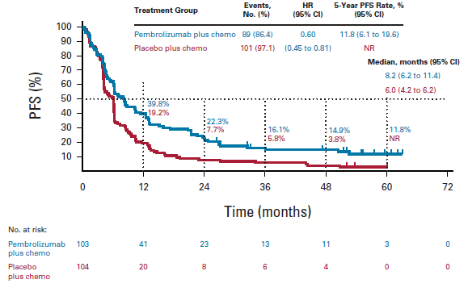
Pembrolizumab + Chemotherapy in Squamous NSCLC: KEYNOTE-407: 5-Year Update
PD-L1 TPS 1%-49%

Slide 11
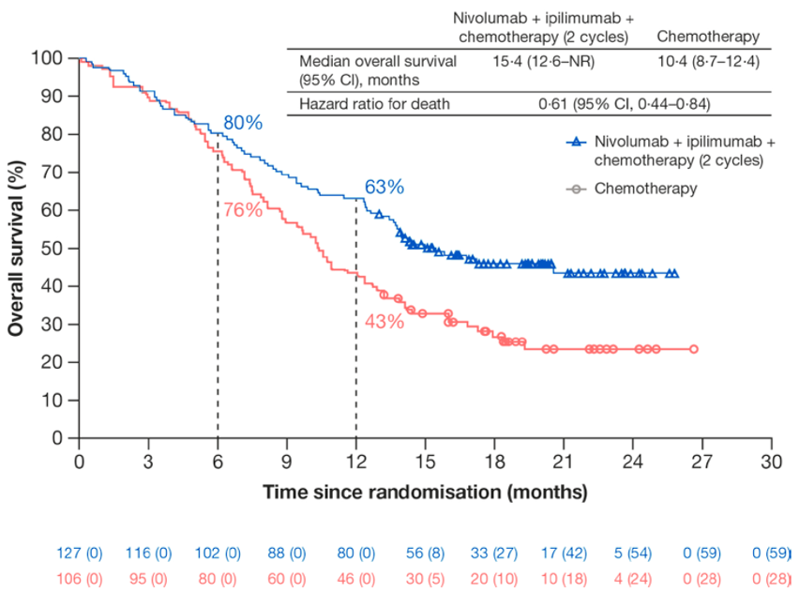
First-Line Nivolumab/Ipilimumab + 2 Cycles of CT for Advanced NSCLC with PD-L1 1% to 49% (CheckMate 9LA)
Outcomes: PD-L1≥1%-49% | Nivo/Ipi + CT (n=127) | CT (n=106)
ORR, % (n) | 39.4 | 24.5
mDOR, mo (95% CI) | 10.0 (6.5-13.2) | 5.6 (3.9-15.2)

Slide 12
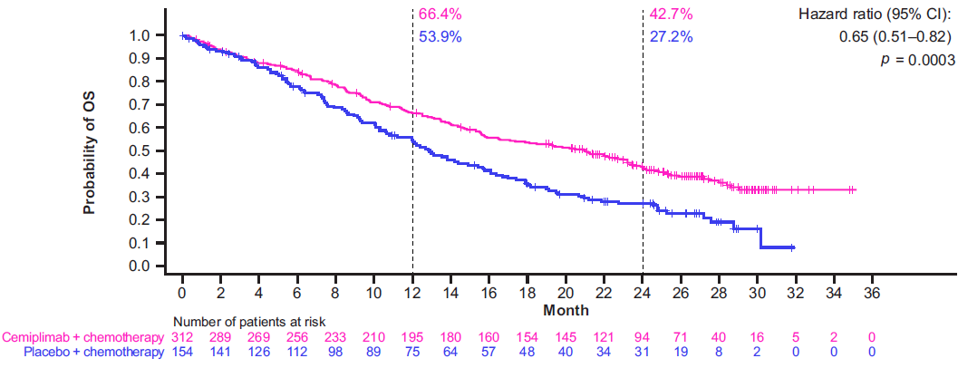
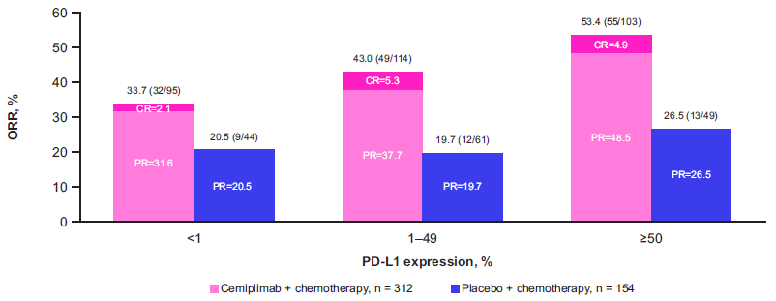
Cemiplimab ± Chemotherapy for NSCLC: EMPOWER-Lung 3
All patients (N=466)

Slide 13
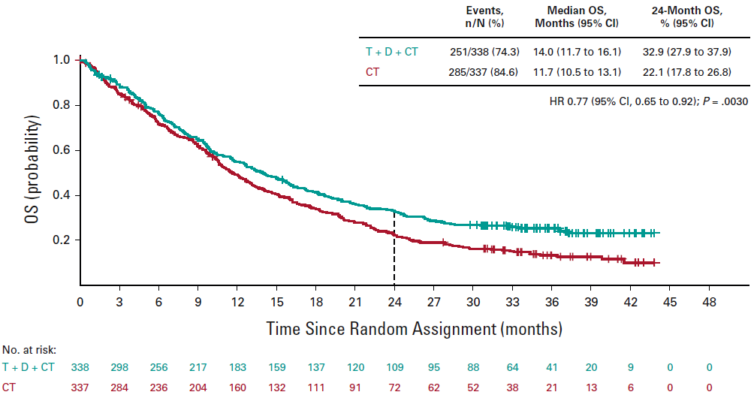
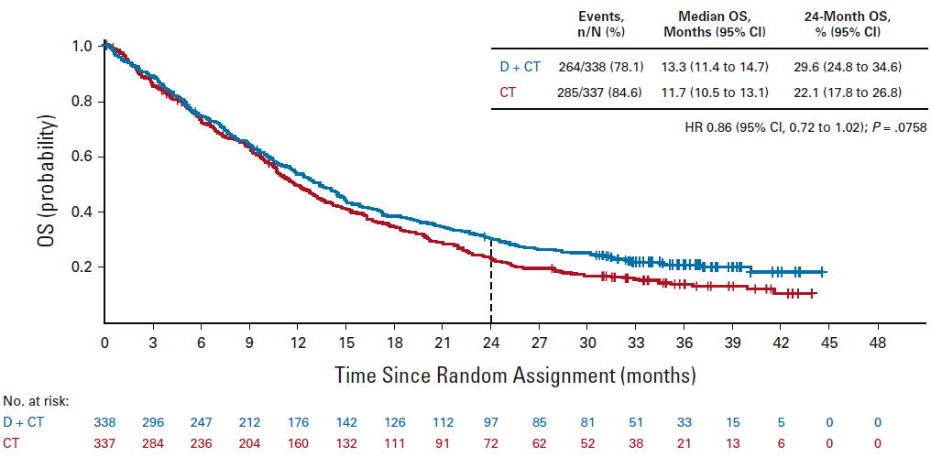
Durvalumab ± Tremelimumab in Combination with Chemotherapy (POSEIDON)
POSEIDON
FDA approved November 10, 2022
FDA approved November 10, 2022

Slide 14
Dual immunotherapy is an option

Slide 15
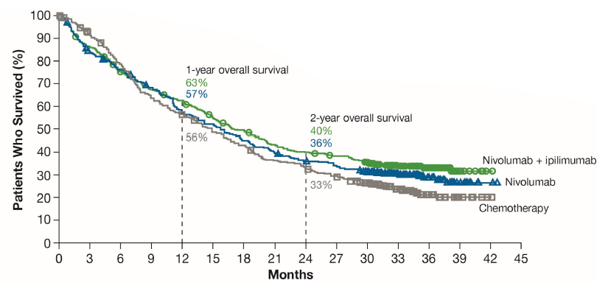
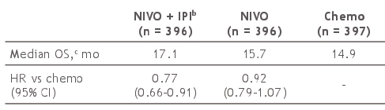

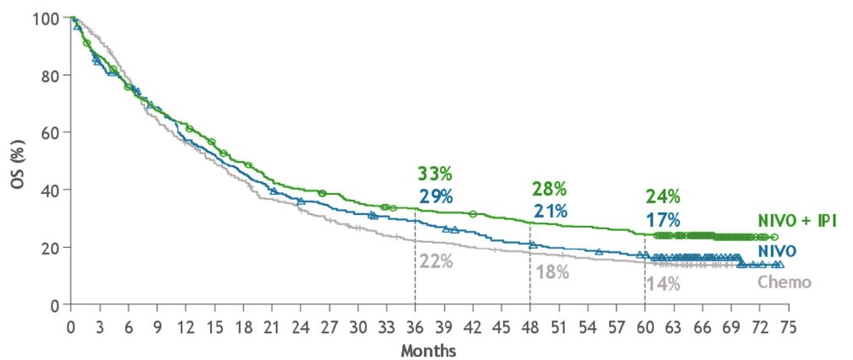
First-Line Nivolumab+Ipilimumab Versus CT for Advanced or Metastatic NSCLC and PD-L1≥1% (CheckMate 227)
b. NIVO + IPI vs NIVO HR 0.84 (95% CI, 0.72-0.99)
Outcomes | Nivolumab/Ipilimumab (n=396) | Nivolumab (n=396) | Chemotherapy (CT) (n=397)
ORR, % (95% CI) | 35.9 (31.1-40.8) | 27.5 (23.2-32.2) | 30.0 (25.5-34.7)
mDOR, mo (95% CI) | 23.2 (15.2-32.2) | 15.5 (12.7-23.5) | 6.2 (5.6-7.4)
Outcomes | Nivolumab/ Ipilimumab (n=396) | Nivolumab (n=396) | Chemotherapy (CT) (n=397)
ORR, % (n) | 36 (144) | 28 (109) | 30 (118)
mDOR, mo (95% CI) | 24.5 (15.5-33.9) | 15.5 (12.5-20.8) | 6.7 (5.6-7.6)
No data available for PD-L1 1%-49% group

Slide 16
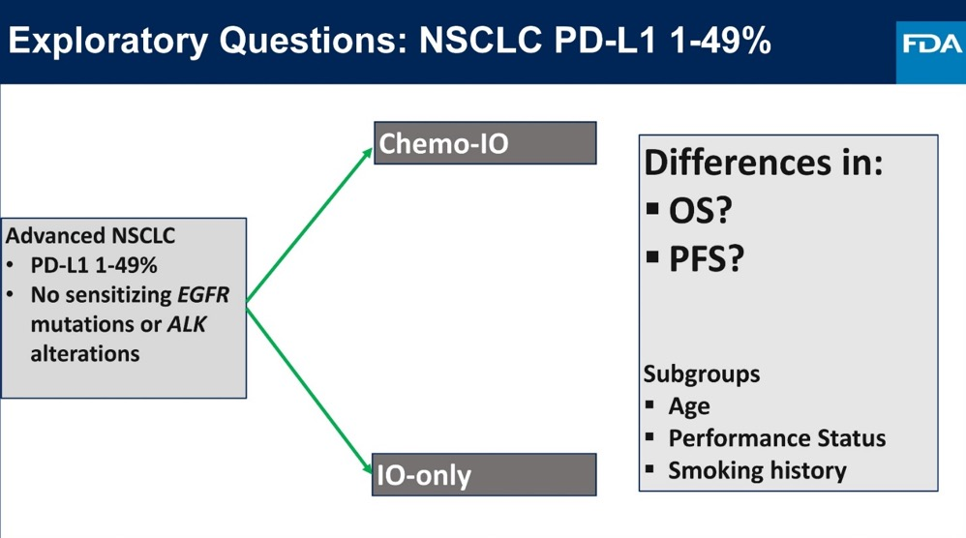
FDA Pooled Analysis
RCT Leading to Approval | Experimental Arm*†
IO alone KEYNOTE-042 CheckMate 227 | Pembro Nivo + ipi
Chemo-IO KEYNOTE-189 KEYNOTE-407 KEYNOTE-021 (Cohort G) IMpower150 IMpower130 CheckMate 9LA | Pembro + chemo Pembro + chemo Pembro + chemo Atezo + bev + chemo Atezo + chemo Nivo + ipi + chemo

Slide 17
FDA Pooled Analysis of First-Line Chemo-IO Versus IO in Advanced NSCLC with PD-L1 1% to 49%: Patient Characteristics
Characteristic, % | Chemo-IO (n = 639) | IO Alone (n = 529) | Chemo (n = 940) | Total (N = 2108)
Age <65 yr 65-74 yr ≥75 yr | 48 40 11 | 53 36 11 | 53 36 12 | 51 37 12
Female | 35 | 31 | 32 | 33
Race White Asian Black/African American | 88 9 2 | 69 23 2 | 78 19 2 | 79 17 2
Current/prior smoker | 91 | 81 | 84 | 85
ECOG PS ≥1 | 62 | 67 | 67 | 65
Nonsquamous histology | 77 | 63 | 64 | 68
Stage IV | 89 | 91 | 92 | 91

Slide 18
FDA Pooled Analysis of First-Line Chemo-IO Versus IO in Advanced NSCLC with PD-L1 1% to 49%: Exploratory OS
 | Chemo-IO (n = 639) | IO Alone (n = 529)
Median OS, mo | 21.4 | 14.5
(95% CI) | (19.4-25.2) | (12.2-16.9)
HR (95% CI) | 0.68 (0.52-0.90)
1.00
0.75
OS Probability
0.50
0.25
0.00
Patients at Risk, n
(number of events)
0
6
12
18
24
30
36
Mos
Chemo-IO
639 (0)
529 (0)
502 (108)
378 (147)
332 (203)
283 (239)
151 (246)
183 (286)
45 (261)
77 (323)
2 (270)
14 (334)
0 (270)
0 (336)
IO alone

Slide 19
FDA Pooled Analysis of First-Line Chemo-IO Versus IO in Advanced NSCLC with PD-L1 1% to 49%: OS Across Subgroups
Subgroup | N | HR (95% CI) | Median OS (95% CI)
 |  |  | Chemo-IO | IO Alone
Overall | 1168 |  | 21.4 (19.4-25.2) | 14.5 (12.2-16.9)
Age <65 yr 65-74 yr ≥75 yr | 580 443 132 |  | 23.7 (18.1-25.6) 22.5 (20.5-NE) 13.9 (10.2-NE) | 16.1 (11.1-19.6) 14.8 (12.3-18.2) 10.3 (8.0-15.7)
ECOG PS 0 ≥1 | 415 751 |  | 25.2 (23.7-NE) 16.8 (13.8-22.3) | 20.0 (18.2-23.9) 11.0 (9.1-13.9)
Smoking status Current/former smoker Never smoker | 1005 160 |  | 20.8 (17.4-25.1) 28.2 (20.3-NE) | 13.5 (11.7-16.6) 18.0 (10.8-23.8)
0.25
0.50
1.0
2.0
Chemo-IO better
IO alone better

Slide 20
Summary
No clear role for single agent immunotherapy
Immunotherapy + chemotherapy or quadruplet regimens may be used

Slide 21
Case 2
Patient is a 70-year-old female who had a fall and went to the ER
Brain MRI revealed multiple brain mets, and CT chest showed a RUL lung mass, mediastinal LAD and liver mets
PET CT confirmed metastatic disease
Biopsy reveals adenocarcinoma, PD-L1 2%
TP53 mutant, no actionable alterations
SRS is performed
What should she receive?

Slide 22



Looking for more resources on this topic?
CME/CE in minutes
Congress highlights
Late-breaking data
Quizzes
Webinars
In-person events
Slides & resources
www.MedEdOTG.com

