Slide 1
Case 1: How Should I Choose Between Single-Agent IO or IO/Chemotherapy in Patients with PD-L1≥50% and No Driver Mutations?
Charu Aggarwal, MD, MPH
University of Pennsylvania Perelman School of Medicine
Philadelphia, PA

Slide 2



Resource Information
About This Resource
These slides are one component of a continuing education program available online at MedEd On The Go titled NSCLC Case by Case: Optimizing 1L Immunotherapy for Advanced & Metastatic Disease
Program Learning Objectives:
Select optimal frontline treatment strategies for patients with advanced non-small cell lung cancer without actionable driver alterations by incorporating treatment-specific and patient-related characteristics
Implement evidence-based strategies to monitor and mitigate immune-related adverse events to optimize treatment adherence and patient outcomes
MedEd On The Go®
www.mededonthego.com
This content or portions thereof may not be published, posted online or used in presentations without permission.
This content can be saved for personal use (non-commercial use only) with credit given to the resource authors.
To contact us regarding inaccuracies, omissions or permissions please email us at support@MedEdOTG.com

Slide 3
Disclaimer
The views and opinions expressed in this educational activity are those of the faculty and do not necessarily represent the views of Total CME, LLC, the CME providers, or the companies providing educational grants. This presentation is not intended to define an exclusive course of patient management; the participant should use their clinical judgment, knowledge, experience, and diagnostic skills in applying or adopting for professional use any of the information provided herein. Any procedures, medications, or other courses of diagnosis or treatment discussed or suggested in this activity should not be used by clinicians without evaluation of their patient's conditions and possible contraindications or dangers in use, review of any applicable manufacturer’s product information, and comparison with recommendations of other authorities. Links to other sites may be provided as additional sources of information.

Slide 4
Case 1
Patient is a 67-year-old male who presented with cough, and shortness of breath. PCP started antibiotics
When cough did not improve, imaging was performed, revealing a large left lower lobe mass measuring 5.2 x 6 cm, with mediastinal and hilar lymphadenopathy
PET CT was performed that confirmed uptake in LLL mass, mediastinal, hilar lymph nodes. PET also showed the presence of adrenal and bone metastases
MRI brain NED

Slide 5
Case 1
CT guided biopsy of the LLL Mass was performed, revealing poorly differentiated carcinoma, TTF-1+, CK5/6 negative, c/w adenocarcinoma
PMH: DM, CAD, HTN, hypercholesterolemia
No relevant PSH, familial hx
Former smoker, 10 pack year, quit 2018
ECOG PS 1
PD-L1 60%
KRAS G12V mutation present

Slide 6
Case 1
How should this patient be managed?
  Immunotherapy alone?
  Immunotherapy doublet?
  Immunotherapy-chemotherapy?

Slide 7
First-line Therapy Recommendations (Category 1‡) for Advanced/Metastatic NSCLC with PD-L1 ≥50% and Negative for Actionable Molecular Markers
Chemo-IO Trials
Trial | Investigation Regimen
KEYNOTE-021* | Pembrolizumab + chemo**‡
KEYNOTE-189 | Pembrolizumab + chemo**‡
KEYNOTE-407 | Pembrolizumab + chemo**‡
IMpower150 | Atezolizumab + Bevacizumab + chemo***‡
EMPOWER-Lung 3 | Cemiplimab + chemo**‡
CheckMate-9LA | Nivolumab + Ipilimumab + chemo**‡
IO-only Trials
Trial | Investigation Regimen
KEYNOTE-024 | Pembrolizumab**‡
KEYNOTE-042 | Pembrolizumab**‡
IMpower110 | Atezolizumab**‡
CheckMate 227 | Nivolumab + Ipilimumab**‡
EMPOWER-Lung 1 | Cemiplimab**‡

Slide 8
Immunotherapy Options§ for Advanced NSCLC with
High PD-L1 Expression Across Histologies
Parameter | KEYNOTE-024: Pembrolizumab (n = 154)¹ | KEYNOTE-042: Pembrolizumab (n=299)² | IMpower110: Atezolizumab (n = 107)³ | EMpower-Lung 1: Cemiplimab (n = 283)⁴ | CheckMate 227: Nivo/Ipi (n = 205)⁵
PD-L1+ definition | TPS ≥50%* | TPS ≥50%* | TC3 or IC3† | TPS ≥50%* | TPS ≥50%‡
ORR, % | 46.1 | 39.1 | 40.2 | 39.0 | 45
Median DoR, mo | 29.1 | 28.1 | 38.9 | 16.7 | 31.8
Median PFS, mo | 7.7 (HR: 0.50) | 6.5 (HR: 0.86) | 8.2 (HR: 0.59) | 8.2 (HR: 0.54) | 6.7 (HR: 0.60)
Median OS, mo | 26.3 (HR: 0.62) | 20 (HR: 0.68) | 20.2 (HR: 0.76) | NR (HR: 0.57) | 21.2 (HR: 0.66)
§ NCCN Category 16; *By PD-L1 22C3 IHC assay; †Staining of ≥50% tumor cells (TC3) or ≥10% tumor-infiltrating immune cells (IC3) by PD-L1 SP142 IHC assay; ‡PD-L1 28-8 IHC assay. Caution needs to be taken when comparing data across trials.
CI, confidence interval; DoR, duration of response; HR, hazard ratio; Ipi, ipilimumab; mo, month; Nivo, nivolumab; ORR, objective response rate; OS, overall survival; PFS, progression-free survival; TPS, tumor proportion score.
1. Reck M, et al. J Clin Oncol. 2021;39:2339-49; 2. de Castro G, et al. J Clin Oncol. 2022;41:1986-91; 3. Jassem J, et al. J Thorac Oncol. 2021;16:1872-82; 4. Sezer A, et al. Lancet. 2021;397:592-604; 5. Paz-Arez L, et al. J Thorac Oncol. 2022;17:289-308; 6. National Comprehensive Cancer Network. Non-Small Cell Lung Cancer (Version 3.2023).

Slide 9
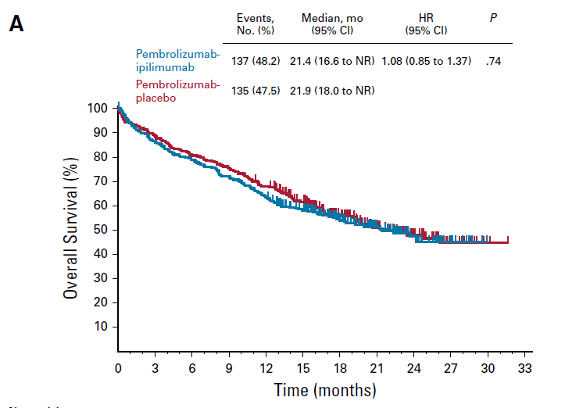
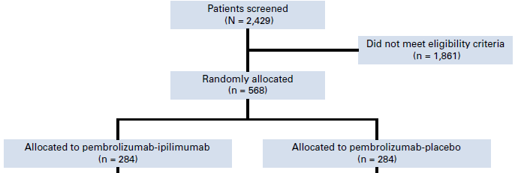
Should We Use Combination IO in PD-L1 TPS ≥50% (KEYNOTE-598)
Pembro + Ipi is NOT better than pembro alone for PD-L1 TPS >50%

Slide 10
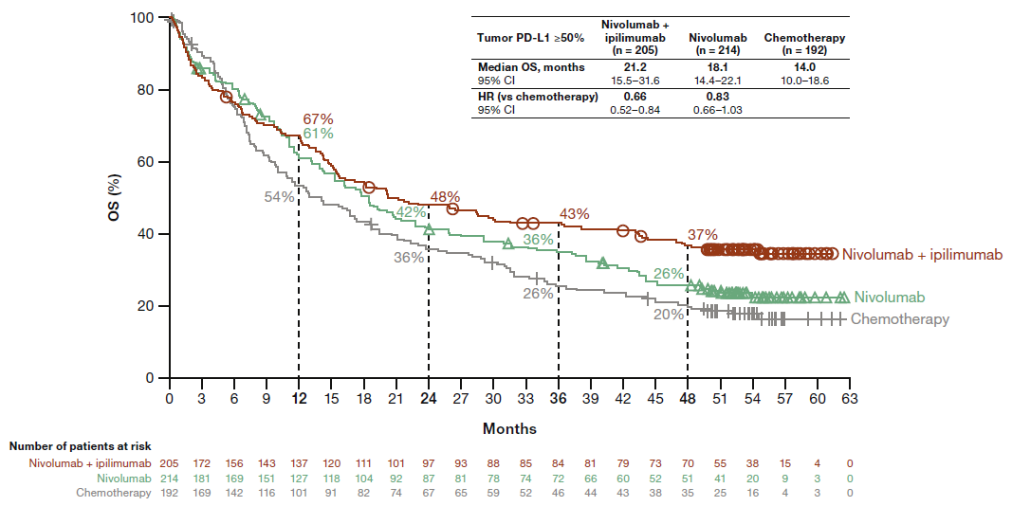
Should We Use Combination IO in PD-L1 TPS ≥50%?
CheckMate 227
Response Outcomes: PD-L1 ≥50% | Nivo/lpi (n = 205) | Nivo (n = 214) | CT (n = 192)
ORR, % (n) | 45.4 (93) | 36.9 (79) | 35.4 (68)
mDoR, mo (95% CI) | 31.8 (20.7-51.2) | 16.8 (13.5-29.6) | 5.8 (4.5-6.9)
Primary endpoint: OS in PD-L1 ≥1% for Nivo/Ipi versus CT
FDA approval for advanced NSCLC with PD-L1 ≥1% granted in May 2020

Slide 11
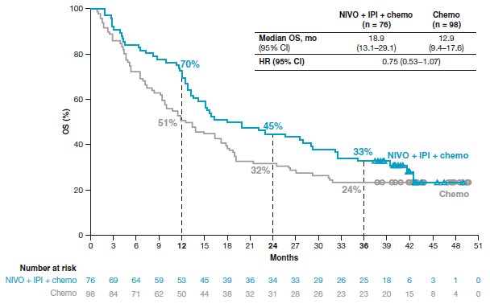
Nivolumab + Ipilimumab + 2 Cycles of Chemotherapy: CheckMate 9LA 3-Year Update
PD-L1≥ 50%
Long-term, durable benefit was observed across histologies and PD-L1 expression levels

Slide 12
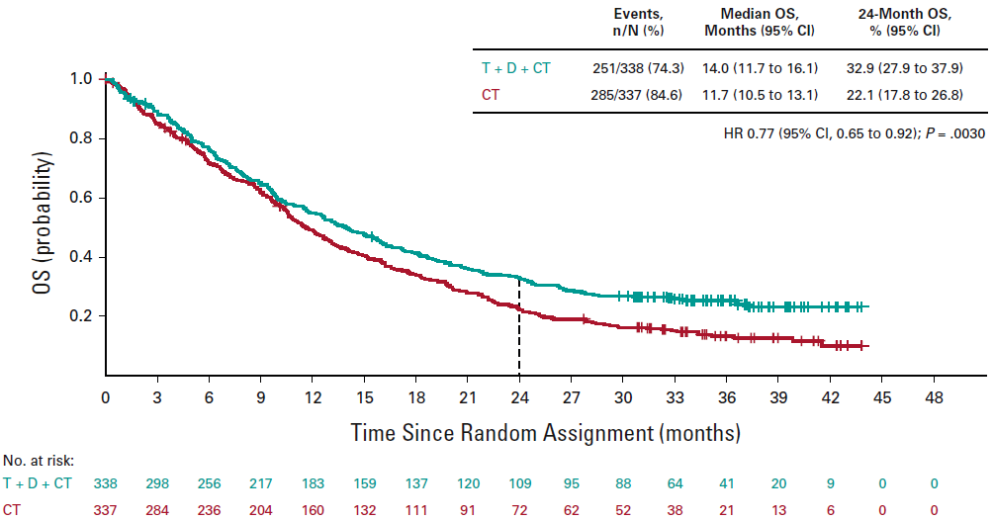







Durvalumab ± Tremelimumab in Combination with Chemotherapy
POSEIDON
POSEIDON
FDA approved November 10, 2022

Slide 13
Immunotherapy + Chemotherapy Options§ for Advanced NSCLC with High PD-L1 Expression Across Histologies
Parameter | IMpower150: Atezolizumab + Bevacizumab/CT (n = 154)¹ | CheckMate 9LA: Nivolumab + Ipilimumab + CT (n=76)² | EMPOWER-Lung3: Cemiplimab + CT (n = 103)³ | KEYNOTE-189: Pembrolizumab + CT (n = 132)⁴ | KEYNOTE-407ª: Pembrolizumab + CT (n = 73)⁵
PD-L1+ definition | TC3 or ICS⁺ | TPS≥50%‡ | TPS ≥50%* | TPS ≥50%* | TPS ≥50%*
ORR, % |  | 38 | 53.4 | 62.1 | 64.4
Median DoR, mo |  | NR |  | 15.3 | 10.4
Median PFS, mo | 15.2 (HR: 0.34) | 7.5 (HR: 0.61) | 10.8 (HR: 0.48) | 11.3 (HR: 0.35) | 8.3 (HR: 0.48)
Median OS, mo | 30.0 (HR: 0.70) | 18.0 (HR: 0.66) | 23.5 (HR: 0.56) | 27.7 (HR: 0.68) | 19.9 (HR: 0.68)

Slide 14
Summary
Patients with PD-L1 ≥50% benefit from immune checkpoint therapy
No clear role of dual ICI therapy
Chemotherapy + immunotherapy should be used in patients needing fast disease control

Slide 15
Case 1
Patient is a 67-year-old male
CT guided biopsy of the LLL mass is performed, revealing poorly differentiated carcinoma, TTF-1+, CK5/6 negative, c/w adenocarcinoma
ECOG PS 1
PD-L1 60%
KRAS G12V mutation present
How do you treat this patient?

Slide 16



Looking for more resources
on this topic?
CME/CE in minutes
Congress highlights
Late-breaking data
Quizzes
Webinars
In-person events
Slides & resources
www.MedEdOTG.com

