Slide 1
Caregiver Testimonial:
A Day in the Life of the Bronchiectasis Patient
Ashwin Basavaraj, MD, FCCP, ATSF
Section Chief, Pulmonary Critical Care and Sleep Medicine
Bellevue Hospital Center
Associate Director, Bronchiectasis and NTM Program
New York University Grossman School of Medicine
New York, NY
Jungae Kole, RN, BSN
Caregiver

Slide 2



Resource Information
About This Resource
These slides are one component of a continuing education program available online at MedEd On The Go titled Non-CF Bronchiectasis: Navigating the Chronic Cough Vortex
Program Learning Objectives:
Discuss epidemiological data supporting NCFBE as a clinically relevant disease that is more common than previously described
Identify common etiologies and the clinical presentation of this disease, emphasizing overlap with comorbid medical conditions routinely seen in clinical practice
Review the complex pathophysiology of how NCFBE leads to progressive decline in lung function
Review the current recommended diagnostic algorithm, with emphasis on the importance of early diagnosis and pulmonary referral
Review the current treatment options and potential future pharmaceutical options for the management of NCFBE
MedEd On The Go®
www.mededonthego.com
This content or portions thereof may not be published, posted online or used in presentations without permission.
This content can be saved for personal use (non-commercial use only) with credit given to the resource authors.
To contact us regarding inaccuracies, omissions or permissions please email us at support@MedEdOTG.com

Slide 3
Disclaimer
The views and opinions expressed in this educational activity are those of the faculty and do not necessarily represent the views of Total CME, LLC, the CME providers, or the companies providing educational grants. This presentation is not intended to define an exclusive course of patient management; the participant should use their clinical judgment, knowledge, experience, and diagnostic skills in applying or adopting for professional use any of the information provided herein. Any procedures, medications, or other courses of diagnosis or treatment discussed or suggested in this activity should not be used by clinicians without evaluation of their patient's conditions and possible contraindications or dangers in use, review of any applicable manufacturer’s product information, and comparison with recommendations of other authorities. Links to other sites may be provided as additional sources of information.

Slide 4

Diagnostic Summary
Common Chronic Symptoms of NCFBE:
  Chronic cough
  Phlegm production
  Difficulty expectorating mucus
  Challenges with airway clearance

Slide 5
Devices to Help with Expectoration and Challenges
Devices
Challenges
Nebulizer and Bronchodilator (BD) Therapy
High Frequency Chest Wall Oscillation (HFCWO)
  Brand names of HFCWO include: The Vest® System, inCourage®, Smart Vest®, AffloVest®
Oxygen Use
  High O₂ requirements preclude use of oxygen concentrator
Nebulizer/BD therapy may require 30 minutes multiple times a day
Spinal surgery and chronic pain posed challenges to adherence
Frequent PICC lines led to loss of venous access and placement of Portacath, which caused discomfort with HFCWO use, limiting adherence
Need for larger tanks
Need for extra tanks
Travel limited to short distances & visits

Slide 6
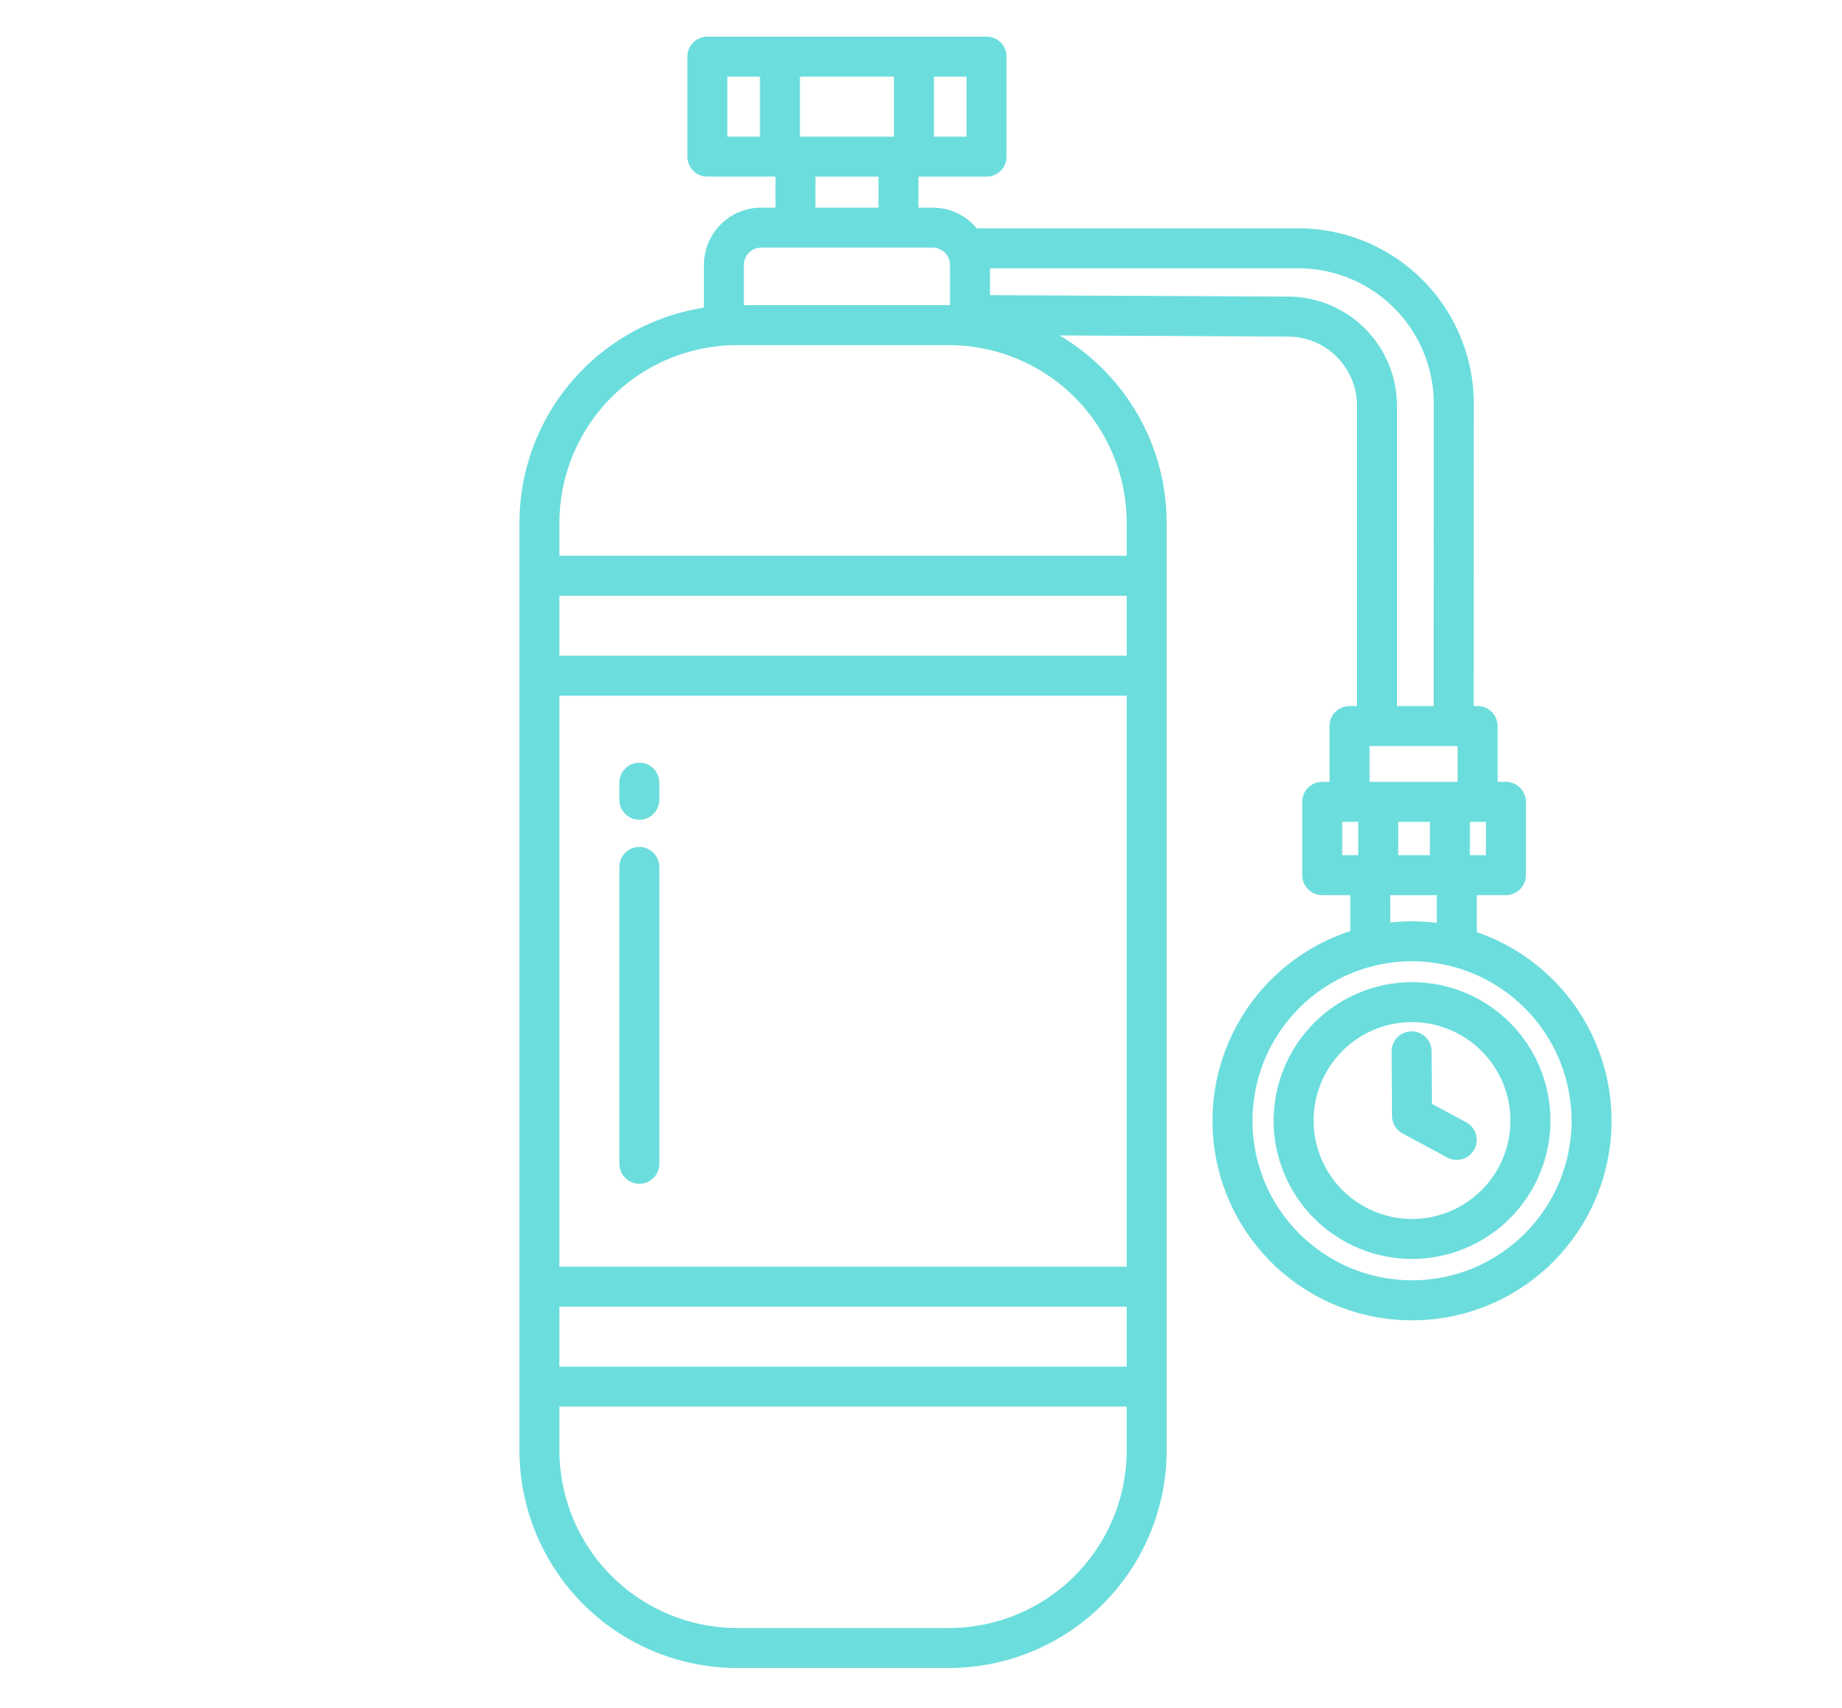

Additional Devices and Supports
Wheelchair
Walker
Grab bars in the bathroom
Shower chair
Oxygen tubing
Urinal
Private care duty
  Help with care to reduce overall stress

Slide 7


Resources for Caregivers and Patients
COPD Foundation
https://www.copdfoundation.org/
Patient Advocacy Groups: NTM IR
https://ntminfo.org/

Slide 8



Looking for more resources
on this topic?
CME/CE in minutes
Congress highlights
Late-breaking data
Quizzes
Webinars
In-person events
Slides & resources
www.MedEdOTG.com

