Slide 1
The Neutrophil and Neutrophil Serine Proteases (NSPs) in Non-CF Bronchiectasis (NCFBE)
Ashwin Basavaraj, MD, FCCP, ATSF
Section Chief, Pulmonary Critical Care and Sleep Medicine
Bellevue Hospital Center
Associate Director, Bronchiectasis and NTM Program
New York University Grossman School of Medicine
New York, NY

Slide 2
Disclaimer
The views and opinions expressed in this educational activity are those of the faculty and do not necessarily represent the views of Total CME, LLC, the CME providers, or the companies providing educational grants. This presentation is not intended to define an exclusive course of patient management; the participant should use their clinical judgment, knowledge, experience, and diagnostic skills in applying or adopting for professional use any of the information provided herein. Any procedures, medications, or other courses of diagnosis or treatment discussed or suggested in this activity should not be used by clinicians without evaluation of their patient's conditions and possible contraindications or dangers in use, review of any applicable manufacturer’s product information, and comparison with recommendations of other authorities. Links to other sites may be provided as additional sources of information.

Slide 3



Resource Information
About This Resource
These slides are one component of a continuing education program available online at MedEd On The Go titled Non-CF Bronchiectasis: Navigating the Chronic Cough Vortex
Program Learning Objectives:
Discuss epidemiological data supporting NCFBE as a clinically relevant disease that is more common than previously described
Identify common etiologies and the clinical presentation of this disease, emphasizing overlap with comorbid medical conditions routinely seen in clinical practice
Review the complex pathophysiology of how NCFBE leads to progressive decline in lung function
Review the current recommended diagnostic algorithm, with emphasis on the importance of early diagnosis and pulmonary referral
Review the current treatment options and potential future pharmaceutical options for the management of NCFBE
MedEd On The Go®
www.mededonthego.com
This content or portions thereof may not be published, posted online or used in presentations without permission.
This content can be saved for personal use (non-commercial use only) with credit given to the resource authors.
To contact us regarding inaccuracies, omissions or permissions please email us at support@MedEdOTG.com

Slide 4
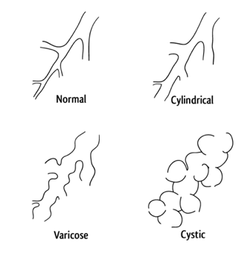
What Is Bronchiectasis?
Inflammation, dilatation, and irreversible damage to the bronchial tubes
Loss of ability to clear mucous and bacteria
Repeated infections and further damage

Slide 5
Non-CF Bronchiectasis Exacerbation: Significance and Definition
Bronchiectasis is characterized by:
Nonspecific symptoms
Can be characterized by frequent exacerbations
A bronchiectasis exacerbation is defined as a deterioration in 3 or more of the following key symptoms for at least 48 hours:
Cough
Sputum volume and/or consistency
Sputum purulence
Breathlessness and/or exercise tolerance
Fatigue and/or malaise
Hemoptysis
AND a clinician determines that a change in bronchiectasis treatment is required

Slide 6
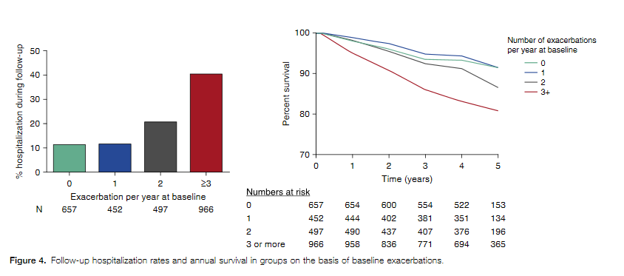
Characterization of the “Frequent Exacerbator Phenotype” in Bronchiectasis
Exacerbations can have effect on lung function decline, symptoms, quality of life, mortality, and may lead to future exacerbations

Slide 7
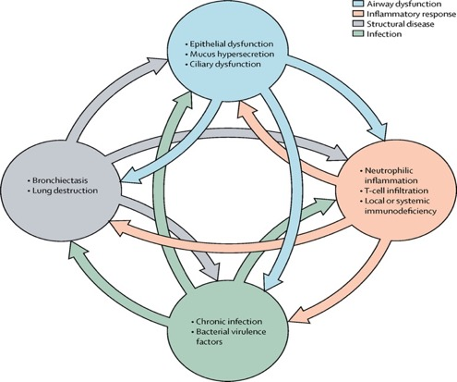
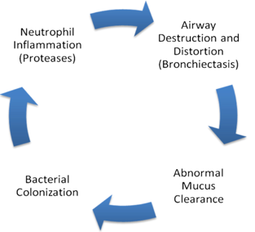
The Vicious Cycle and Vortex
Airway dysfunction
Inflammatory response
Structural disease
Infection
Epithelial dysfunction
Mucus Hypersecretion
Cillary dysfunction
Neutrophilic inflammation
T-cell infiltration
Local or systemic immunodeficiency
Bronchiectasis
Lung destruction
Chronic infection
Bacterial virulence factors

Slide 8
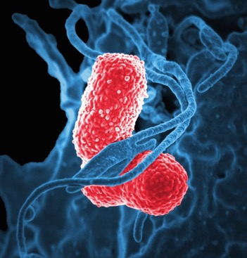
Neutrophilic Inflammation
Neutrophils are reprogrammed in bronchiectasis
Prolonged survival/delayed apoptosis
Impaired phagocytosis
Deficient killing of Pseudomonas
Formation of neutrophilic extracellular traps
Colorized SEM of a human neutrophil white blood cell (blue) interacting with two rod-shaped, multidrug-resistant (MDR) Klebsiella pneumoniae bacteria (blue)

Slide 9
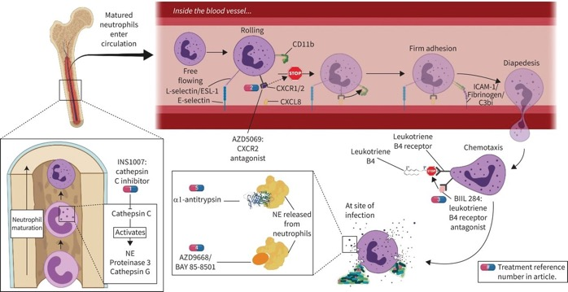
Mechanisms of Current Anti-inflammatory Therapies in Bronchiectasis in Trials
Notes:
Mechanisms of current anti-inflammatory therapies in bronchiectasis in trials. NE: neutrophil elastase; ESL-1: E-selectin ligand-1; ICAM-1: intercellular adhesion molecule-1; CXCR1/2: C-X-C chemokine receptor type 1/2; CXCL8: C-X-C chemokine ligand 8.

Slide 10
Emerging Therapies Inhibiting Neutrophils
Neutrophil Elastase Inhibitors
Phase 1
Phase 2
Phase 3
Registration
BI 1323495¹
DPP-1 Inhibitors
BI 1291583²
Brensocatib³⁻⁵
1. ClinicalTrials.gov. Safety, tolerability, pharmacokinetics, and pharmacodynamics of different oral doses of BI 1323495 bid versus placebo in patients with non-cystic fibrosis bronchiectasis. https://clinicaltrials.gov/ct2/show/study/NCT04656275;
2. ClinicalTrials.gov. A randomised, double-blind, placebo-controlled, parallel group, dose-finding study evaluating efficacy, safety and tolerability of BI 1291583 qd over at least 24 weeks in patients with bronchiectasis (AirleafTM). https://clinicaltrials.gov/ct2/show/NCT05238675;
3. Chalmers JD, et al. N Engl J Med. 2020;383(22):2127-2137;
4. ClinicalTrials.gov. A phase 3, randomized, double-blind, placebo-controlled study to assess the efficacy, safety, and tolerability of brensocatib administered once daily for 52 weeks in subjects with non-cystic fibrosis bronchiectasis-The ASPEN Study. https://clinicaltrials.gov/ct2/show/NCT04594369;
5. ClinicalTrials.gov. An expanded access study to assess brensocatib for participants with non-cystic fibrosis bronchiectasis. https://clinicaltrials.gov/ct2/show/study/NCT05344508.

Slide 11
Summary
Bronchiectasis can present with nonspecific symptoms and is often heterogeneous
Bronchiectasis exacerbations are common, lead to diminished quality of life, and should be recognized early and treated appropriately
Inflammation is a key component of the vicious vortex, and emerging therapies may significantly reduce the frequency of bronchiectasis exacerbations, thereby changing the landscape of our current treatment model of this condition

Slide 12



Looking for more resources on this topic?
CME/CE in minutes
Congress highlights
Late-breaking data
Quizzes
Webinars
In-person events
Slides & resources
www.MedEdOTG.com

