Slide 1
Non-CF Bronchiectasis (NCFBE): Identifying
At-Risk Patients
Colin Swenson, MD
Assistant Professor and Senior Physician
Division of Pulmonary, Allergy, and Critical Care Medicine
Emory University
Atlanta, GA

Slide 2
Disclaimer
The views and opinions expressed in this educational activity are those of the faculty and do not necessarily represent the views of Total CME, LLC, the CME providers, or the companies providing educational grants. This presentation is not intended to define an exclusive course of patient management; the participant should use their clinical judgment, knowledge, experience, and diagnostic skills in applying or adopting for professional use any of the information provided herein. Any procedures, medications, or other courses of diagnosis or treatment discussed or suggested in this activity should not be used by clinicians without evaluation of their patient's conditions and possible contraindications or dangers in use, review of any applicable manufacturer’s product information, and comparison with recommendations of other authorities. Links to other sites may be provided as additional sources of information.

Slide 3



Resource Information
About This Resource
These slides are one component of a continuing education program available online at MedEd On The Go titled Non-CF Bronchiectasis: Navigating the Chronic Cough Vortex
Program Learning Objectives:
Discuss epidemiological data supporting NCFBE as a clinically relevant disease that is more common than previously described
Identify common etiologies and the clinical presentation of this disease, emphasizing overlap with comorbid medical conditions routinely seen in clinical practice
Review the complex pathophysiology of how NCFBE leads to progressive decline in lung function
Review the current recommended diagnostic algorithm, with emphasis on the importance of early diagnosis and pulmonary referral
Review the current treatment options and potential future pharmaceutical options for the management of NCFBE
MedEd On The Go®
www.mededonthego.com
This content or portions thereof may not be published, posted online or used in presentations without permission.
This content can be saved for personal use (non-commercial use only) with credit given to the resource authors.
To contact us regarding inaccuracies, omissions or permissions please email us at support@MedEdOTG.com

Slide 4
Patient Case
68-year-old white female patient presents with chronic cough that started over 1 year ago. The cough is productive of 5 to 10 mL off-white sputum per day. She also complains of breathlessness when walking up more than 1 flight of stairs. She reports a gradual increase in fatigue over the last 2 years.
Medical history: Gastroesophageal reflux (GERD), osteoporosis,
mild asthma
Social history: Lifelong nonsmoker, married, 2 grown children, retired
Physical exam notable for body mass index (BMI) of 18.1 kg/m². Vital signs unremarkable
Spirometry: Mild obstructive ventilatory defect

Slide 5
When to Suspect Bronchiectasis
Chronic daily cough in patient older than 65
Regular, chronic sputum production
Chronic obstructive pulmonary disease diagnosis in lifelong nonsmoker
History of frequent lower respiratory infections
Isolation of bacterial pathogens
or nontuberculous mycobacteria from sputum
History of hemoptysis
Cough with fatigue and weight loss
History of pediatric lung infections and tuberculosis

Slide 6
Non-CF Bronchiectasis: Symptom Burden
#1 complaint in non-CF bronchiectasis: Chronic cough
  Almost 75% have daily bouts of coughing
  Only half of patients with non-CF bronchiectasis have daily sputum production
  Around 25% have history of hemoptysis
64% with dyspnea with activity
50% will complain of daily fatigue
50% will have obstruction on pulmonary function testing

Slide 7
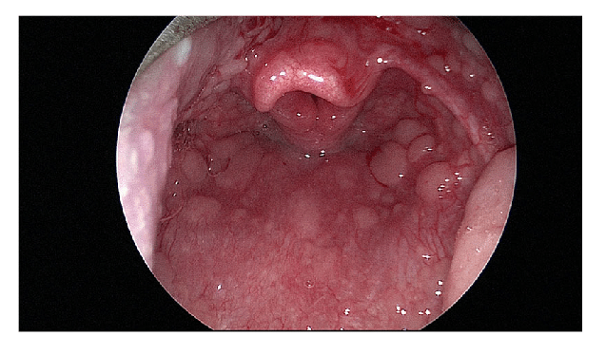
Chronic Cough Workup
Auscultation
  Coarse breath sounds/rhonchi (may clear with cough)
  Inspiratory squeaks and wheezing
Nasopharyngeal exam
  Turbinate hypertrophy, erythema, polyposis
  Postnasal drip, cobblestone throat
Bacterial culture of sputum/phlegm
Chest imaging
  High-resolution computed tomography is gold standard

Slide 8
Patient Case, Revisited
Older than 65 years, female
Chronic daily cough with mucopurulent sputum
Dyspnea with activity
Fatigue
Low BMI
History of GERD and asthma
  GERD in almost half of patients with non-CF bronchiectasis

Slide 9



Looking for more resources
on this topic?
CME/CE in minutes
Congress highlights
Late-breaking data
Quizzes
Webinars
In-person events
Slides & resources
www.MedEdOTG.com

