Slide 1
Non-CF Bronchiectasis (NCFBE): Redefined
Colin Swenson, MD Assistant Professor and Senior Physician Division of Pulmonary, Allergy, and Critical Care Medicine Emory University Atlanta, GA

Slide 2
Disclaimer
The views and opinions expressed in this educational activity are those of the faculty and do not necessarily represent the views of Total CME, LLC, the CME providers, or the companies providing educational grants. This presentation is not intended to define an exclusive course of patient management; the participant should use their clinical judgment, knowledge, experience, and diagnostic skills in applying or adopting for professional use any of the information provided herein. Any procedures, medications, or other courses of diagnosis or treatment discussed or suggested in this activity should not be used by clinicians without evaluation of their patient's conditions and possible contraindications or dangers in use, review of any applicable manufacturer’s product information, and comparison with recommendations of other authorities. Links to other sites may be provided as additional sources of information.

Slide 3
Resource Information
About This Resource
These slides are one component of a continuing education program available online at MedEd On The Go titled Non-CF Bronchiectasis: Navigating the Chronic Cough Vortex
Program Learning Objectives:
Discuss epidemiological data supporting NCFBE as a clinically relevant disease that is more common than previously described
Identify common etiologies and the clinical presentation of this disease, emphasizing overlap with comorbid medical conditions routinely seen in clinical practice
Review the complex pathophysiology of how NCFBE leads to progressive decline in lung function
Review the current recommended diagnostic algorithm, with emphasis on the importance of early diagnosis and pulmonary referral
Review the current treatment options and potential future pharmaceutical options for the management of NCFBE
MedEd On The Go®
www.mededonthego.com
This content or portions thereof may not be published, posted online or used in presentations without permission.
This content can be saved for personal use (non-commercial use only) with credit given to the resource authors.
To contact us regarding inaccuracies, omissions or permissions please email us at support@MedEdOTG.com

Slide 4
Non-CF Bronchiectasis: Then
Rare, orphan disease
U.S. rare disease definition: Fewer than 200,000 people (1 in 2,000)
Post-infectious etiology
Almost exclusively elderly women
Not associated with increased mortality

Slide 5
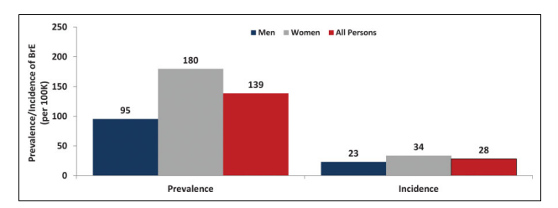
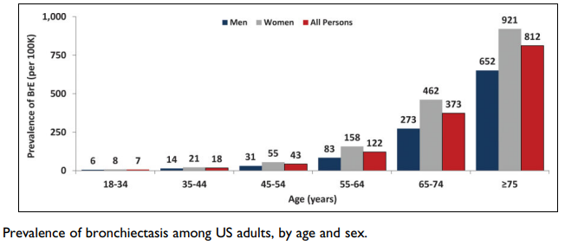
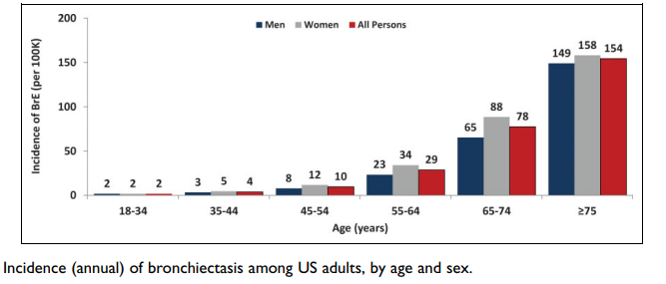
Non-CF Bronchiectasis: Now
Not a rare or orphan disease
Non-CF bronchiectasis in the United States: Up to 500,000 adults
Increasing prevalence: ~40% increase in 10 years
Prevalence increases with age
10-fold difference over 60 years versus under 50
Older than 60: 300 to 500 per 100,000 (~0.5%)
Older than 65: 700 per 100,000 (8.7% per year)

Slide 6
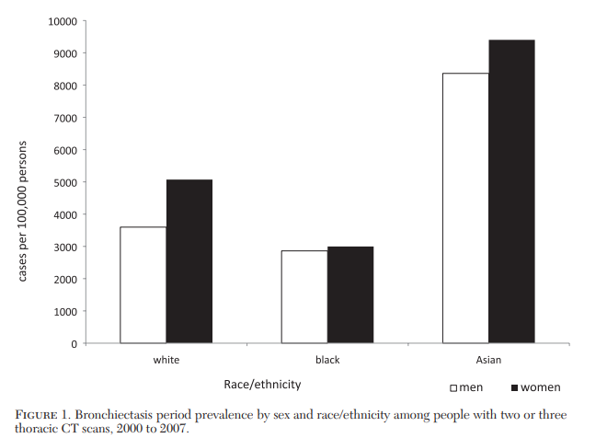
Non-CF Bronchiectasis: Now
Women more than men (~2:1)
Higher in certain ethnic groups
Asian > White/European > Black/African
Higher health care utilization
Frequent hospitalizations and office visits
Increased expenditures ($630M in 2001)
Increased mortality: 10 to 16% over 4 years
Heterogenous etiologies: Most are idiopathic

Slide 7
Non-CF Bronchiectasis: Implications
500,000 adults in the United States alone, likely many more
8.7% increase in prevalence per year (65 and older)
High healthcare utilization
Increased morbidity and mortality
Current treatments lacking: One size fits most
Therapeutics in pipeline: Pathway targeting

Slide 8
Looking for more resources on this topic?
CME/CE in minutes
Congress highlights
Late-breaking data
Quizzes
Webinars
In-person events
Slides & resources
www.MedEdOTG.com

