Slide 1
Assessing Response to Targeted Therapy in Non-Advanced Systemic Mastocytosis: How to Distinguish AEs From Disease Symptoms?
Deepti H. Radia, MD
Hematology Consultant
Guy’s and St Thomas’ Hospitals NHS Foundation Trust
London, UK

Slide 2



Resource Information
About This Resource
These slides are one component of a continuing education program available online at MedEd On The Go titled Non-Advanced Systemic Mastocytosis - When the Best Supportive Care is Not Enough
Program Learning Objectives:
Describe the most recent updates to the World Health Organization (WHO) and NCCN guidelines on classifying non-advanced SM
Explain the advantages and limitations of each criterion and test that are relevant to nonAdvSM
Discuss how to use information from validated assessments for patient symptom reporting and risk stratification to enhance clinical assessment and inform treatment decisions
Explain which specialists are best suited to dealing with each type of symptom common to patients with nonAdvSM
Formulate approaches to provide optimal management of patients with nonAdvSM
MedEd On The Go®
www.mededonthego.com
This content or portions thereof may not be published, posted online or used in presentations without permission.
This content can be saved for personal use (non-commercial use only) with credit given to the resource authors.
To contact us regarding inaccuracies, omissions or permissions please email us at support@MedEdOTG.com

Slide 3
Disclaimer
The views and opinions expressed in this educational activity are those of the faculty and do not necessarily represent the views of Total CME, LLC, the CME providers, or the companies providing educational grants. This presentation is not intended to define an exclusive course of patient management; the participant should use their clinical judgment, knowledge, experience, and diagnostic skills in applying or adopting for professional use any of the information provided herein. Any procedures, medications, or other courses of diagnosis or treatment discussed or suggested in this activity should not be used by clinicians without evaluation of their patient's conditions and possible contraindications or dangers in use, review of any applicable manufacturer’s product information, and comparison with recommendations of other authorities. Links to other sites may be provided as additional sources of information.

Slide 4

Which Patient with Non-Advanced Systemic Mastocytosis Would I Consider for Targeted Therapy?
Multiple antimediator treatments, more than 3 or 4 regular medications
Multiple organs affected, affecting the ability to function
High symptom burden despite increasing treatment doses, reflected by tryptase level and symptom assessment
Inadequate symptom control
Consider targeted therapy
Tyrosine kinase inhibitors (TKI) trial
How well is it tolerated?
What side effects do patients report?
Persistent Symptoms
GI symptoms
“Allergy” symptoms
Multiple triggers for episodes or “attacks”
Recurrent anaphylaxis, ITT not option
Intractable pruritis

Slide 5
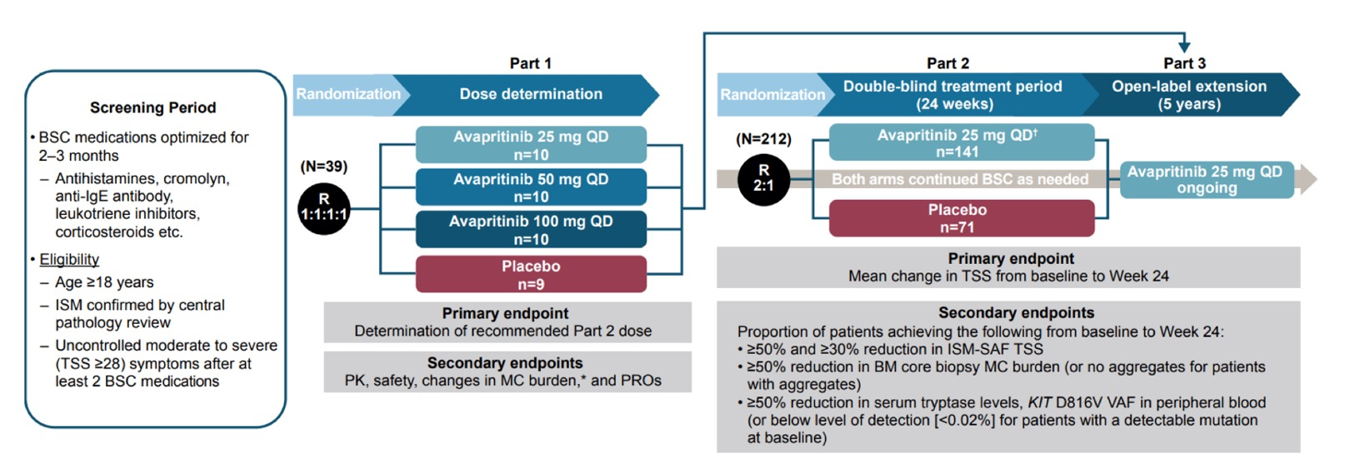
Registrational PIONEER Study: Randomized, Double-Blind, Placebo-Controlled Study in Patients with ISM
PIONEER is the first randomized, placebo-controlled trial of a highly selective KIT D816V-targeting agent in patients with ISM
Avapritinib-treated patients showed rapid, durable, and clinically meaningful improvements in biomarkers of mast cell burden, symptoms, and quality of life versus placebo patients at 24 weeks of treatment
Avapritinib was well tolerated with a similar safety profile to placebo
Open-label extension assessing long-term safety and efficacy of 25 mg avapritinib ongoing

Slide 6
Baseline Patient and Disease Characteristics Balanced Between Arms
Patient demographic | Avapritinib 25 mg QD (n=141) | Placebo (n=71)
Age (years), median (range) | 50.0 (18-77) | 54.0 (26-79)
Female, n (%) | 100 (70.9) | 54 (76.1)
ISM symptom burden
TSS score, mean (SD) | 50.2 (19.1) | 52.4 (19.8)
Most severe symptom score, mean (SD) | 7.7 (1.7) | 7.9 (1.7)
Mast cell burden
Median tryptase (central), ng/mL (range) | 38.4 (3.6-256.0) | 43.7 (5.7-501.6)
Median bone marrow biopsy mast cells (central), % (range) | 7.0 (1.0-50.0) | 7.0 (1.0-70.0)
Mast cell aggregates present, n (%) | 106 (75.2) | 57 (80.3)
Median KIT D816V VAF in peripheral blood, % (range) | 0.4 (0.02-41.3) | 0.3 (0.02-36.7)
KIT D816V positivity, n (%) | 131 (92.9) | 69 (97.2)
SM therapy | Avapritinib 25 mg QD (n=141) | Placebo (n=71)
Prior cytoreductive therapy, n (%)ª | 19 (13.5) | 7 (9.9)
Prior TKI therapy, n (%) | 10 (7.1) | 4 (5.6)
BSC use
Number of BSC treatments, median (range) | 3 (0-11) | 4 (1-8)
BSC use at baseline, n (%)^{b} | 140 (99.3) | 71 (100)
H1 antihistamines | 137 (97.2) | 71 (100)
H2 antihistamines | 93 (66.0) | 47 (66.2)
Leukotriene receptor inhibitors | 49 (34.8) | 25 (35.2)
Cromolyn sodium | 43 (30.5) | 25 (35.2)
Proton pump inhibitors | 22 (15.6) | 20 (28.2)
Corticosteroids | 17 (12.1) | 7 (9.9)
Anti-IgE antibody (omalizumab) | 14 (9.9) | 7 (9.9)
Other | 33 (23.4) | 19 (26.8)

Slide 7
Avapritinib Demonstrated Improvement in all Individual ISM Symptoms Versus Placebo Including the Most Severe Symptom at Baseline
Mean change in most severe symptom score (SD)
Avapritinib 25 mg
(n=128)
Placebo
(n=65)
P-Value
0.015
Regardless of which symptom was rated most severe at baseline, avapritinib patients had a significant reduction in this symptom versus placebo
-2.22 (2.302)
-1.42 (1.875)

Slide 8
Avapritinib 25 mg Once Daily Was Well Tolerated, with Similar Safety Profile to Placebo
Majority of AEs were Grade 1 or 2 with a low rate of discontinuation
SAEs were reported more frequently in the placebo arm (no treatment-related SAEs in either arm)
Edema AEs were slightly higher in the avapritinib group (majority Grade 1 and did not result in discontinuation)
 | Avapritinib 25 mg QD (N=141) | Placebo (N=71)
Any AEs^{a,b}, n (%) | 128 (90.8) | 66 (93.0)
Grade 1-2 AEs | 98 (69.5) | 51 (71.8)
Grade 1-2 related AEs | 74 (52.5) | 30 (42.3)
Grade ≥3 AEs | 30 (21.3) | 15 (21.1)
Grade ≥3 related AEs | 3 (2.1) | 2 (2.8)
SAEs, n (%) | 7 (5.0) | 8 (11.3)
Any grade TRAEs | 77 (54.6) | 32 (45.1)
Most frequently reported TRAEs (≥5% of patients)
Headache | 1 (7.8) | 7 (9.9)
Nausea | 9 (6.4) | 6 (8.5)
Peripheral edema | 9 (6.4) | 1 (1.4)
Periorbital edema | 9 (6.4) | 2 (2.8)
Dizziness | 4 (2.8) | 5 (7.0)
TRAEs leading to discontinuation | 2 (1.4) | 1 (1.4)

Slide 9
Summary of Managing Common Side Effects of Avapritinib
Generally well tolerated
Most frequently reported adverse events
Often can overlap with SM mediator symptoms
Important to have baseline clinical history of SM related symptoms and comorbidities to evaluate changes
Note: Triggers for patient symptoms
Headache
Nausea
Peripheral edema
Periorbital edema
Dizziness
Periorbital Edema: Known side effect of TKIs
Less severe on lower doses 25 mg versus 50 mg/100 mg avapritinib doses
Management:
  Inform patients when consenting:
  Worse in morning and better in evening
  If severe, low dose of diuretic may be used
Peripheral Edema: Known side effect of TKIs
Check baseline status and comorbidities
Dependent Edema: Worse in evenings, so elevate legs
If significant, low dose of diuretic may be used
Nausea: Can use antiemetics
To be taken on an empty stomach 2 hours pre-dose and not eat for 1 hour post-dose
‘Whitening’ of hair color

Slide 10



Looking for more resources
on this topic?
CME/CE in minutes
Congress highlights
Late-breaking data
Quizzes
Webinars
In-person events
Slides & resources
www.MedEdOTG.com

